Slide 1

Pre Placement Project
Diwali Sales Analysis
Name : Siddharth Raj Saxena
Mentor : Jaya Pandey
Batch : DA22S2

Slide 2
Project Introduction:
This dataset contains sales data for a retail store during the Diwali festival period in India.
The data includes information on the products sold, their categories, the sales channels, the dates and times of sale, the sale prices, and the quantities sold.

Slide 3
Description of the Dataset:
This Dataset have total rows = 11251 & total columns = 15.
Description of Important Columns :
Sale Price : The price at which the product was sold
Quantity : The number of units sold of each product
Gender : M | F
Marital_Status : 0(Unmarried) | 1(Married)
State : State which the belong
Occupation : Profession (e.g. IT Sector, Banking, Govt.)
Orders : Number of orders
Product ID : The unique identifier for each product sold
Product Category : The category of each product (e.g. electronics, clothing, home decor)
Perform Data Pre-Processing before loading the dataset into Tableau.
Display summary statistics
Identify the Total missing values
Treated the missing or null values

Slide 4
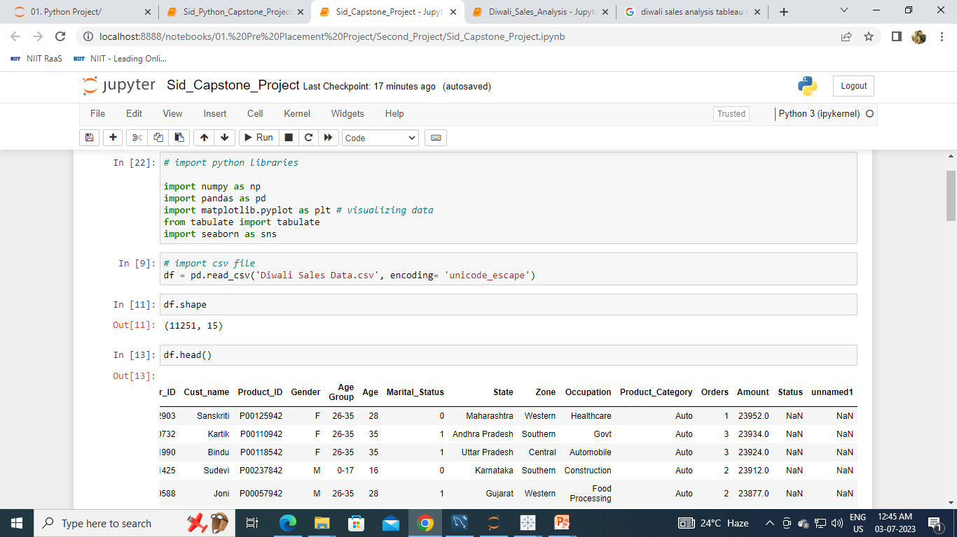
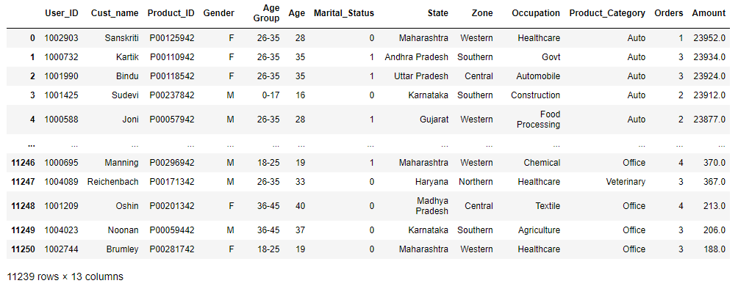
Task 1 : Load the necessary libraries and read the CSV file.
Technique :
Output :

Slide 5
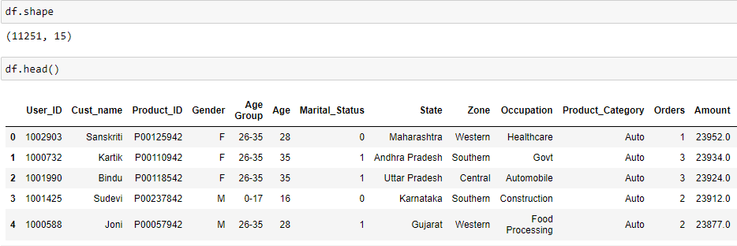
Task 2 : Display total number of rows & column of the dataset top five rows of the dataset.
Technique : df.shape, df.head
Output :

Slide 6
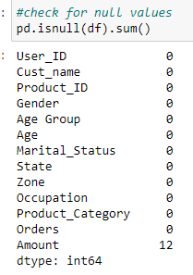
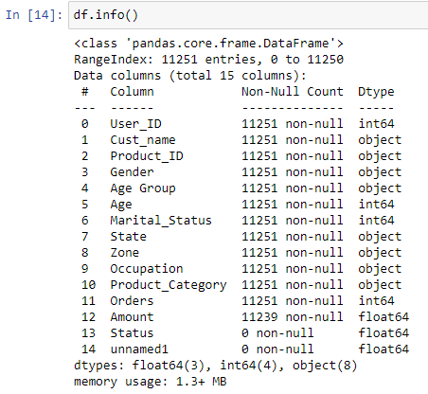
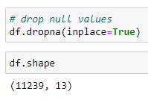
Task 3: Display the details of the database & check for null values, if there is any null
value then impute them with suitable method.
Technique :
pd.isnull(df).sum()
df.info()
Output :

Slide 7
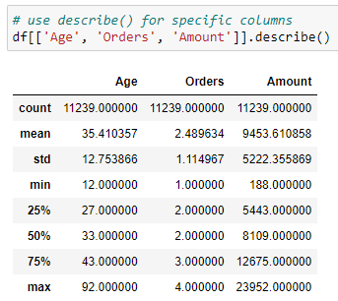
Task 4 : Display the sum of statistics for important Numerical columns.
Output :
Technique :
df.describe()

Slide 8
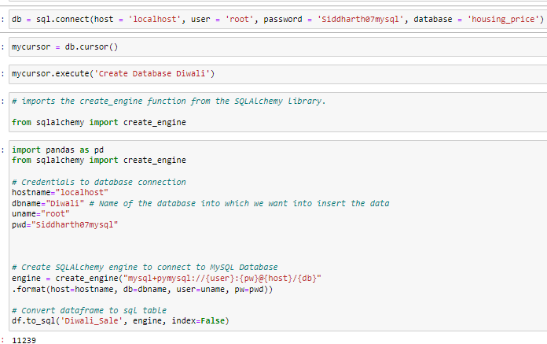
Task 5 : Convert the database frame into MySQL table & push it into the SQL database.

Slide 9
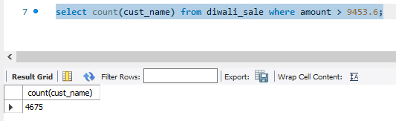
Task 6 : Display the total count of customers whose amount is greater than the average amount.
Output :
Technique :
Select
Count
where
Interpretation :
There are total 4675 customer whose sale/amount is greater than the average of amount.

Slide 10
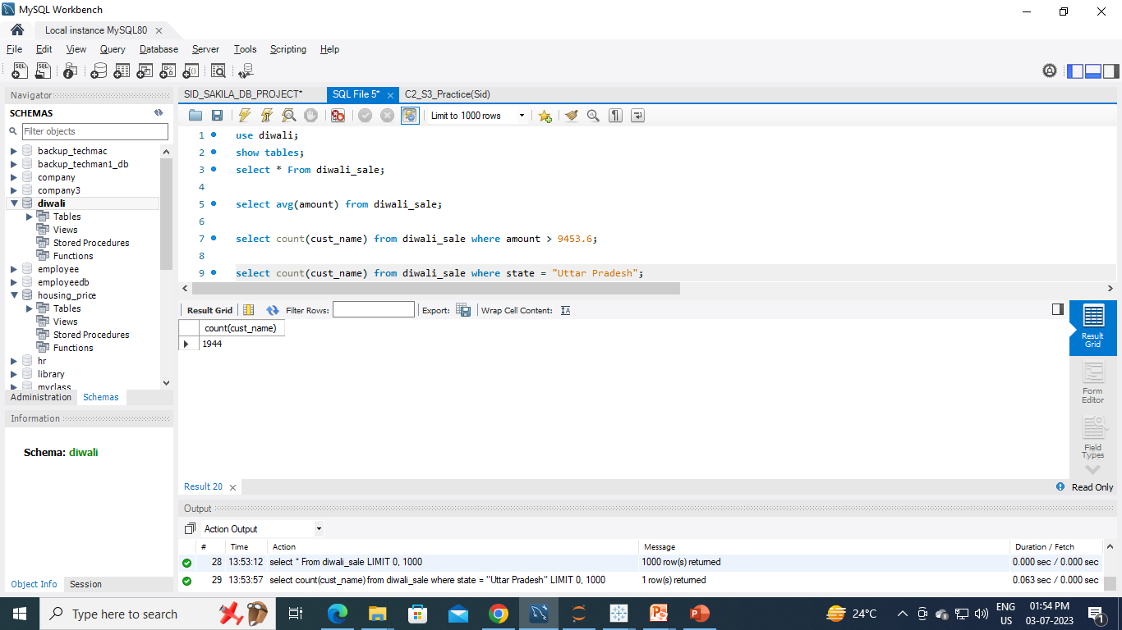
Task 7 : Display the total count of customers who belongs to Uttar Pradesh.
Technique :
Select
Count
where
Interpretation :
There are total 1944 customer whose belongs to Uttar Pradesh.

Slide 11
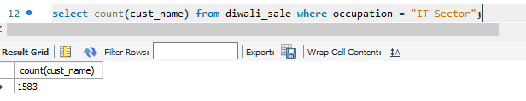
Task 7 : Display the total count of customers who belongs to IT Sector.
Technique :
Select
Count
where
Interpretation :
There are total 1583 customer who are working in IT Sector.

Slide 12

Task 7 : Display the total count of customers who product_category is food.
Technique :
Select
Count
where
Interpretation :
There are total 2490 customer whose product_category is food.

Slide 13
Conclusion:
Married women age group 26-35 yrs from UP, Maharastra and Karnataka working in IT, Healthcare and Aviation are more likely to buy products from Food, Clothing and Electronics category.

Slide 14
Thank You !

