Slide 1
SQL Capstone Project
Movie Rental Data Analysis
Mentor : Jaya Pandey
Student : Siddharth Raj Saxena
Batch : DA22S2

Slide 2
Objective
The aim of the project is to provide the management of Movie on Rent with actionable insights and data-driven recommendation for stocking their inventory.
By understanding the most frequent rented movies, popular genres, and actors in demand, the management can make informed decisions about which movies to stock in their stores.
This, in turn, aims to improve customer satisfaction by offering a wide selection of movies that align with customer preference.
Also, enhance business profitability by offering inventory management and increasing movie rentals.

Slide 3
Description of Dataset
Database schema – Sakila Database
The sakila database is a normalized schema of DVD rental store, featuring thing like actor, film- actor relationship and the table that connect film, stores, rental, actor and many more.
Sakila database had total 18 tables.
In my analysis I have considered the table film, film category, actor, category and rental.
Film table contains the columns like film_id, rental_rate, title, replacement_cost, length, rental duration etc.
Actor table contains actor_id and name of the actor columns.
Category table contains category_id, the category name in which the movie belongs and last update columns.

Slide 4
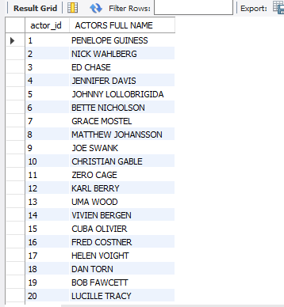
Task 1 :
Display the full names of actors available in the database.
Output :
Technique :
Use Sakila
Select
Concat Function
Conclusion :
There are around 200 actors, and there are actor_id and full_name has displayed using concat function.

Slide 5
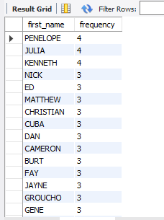
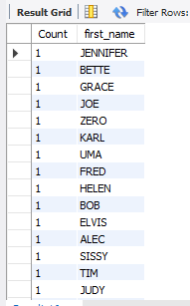
Task 2 :
Display the full names of actors available in the database.
What is the count of actors that have unique first names in the database? Display the first names of all these actors.
Technique :
Output :
Select, count(*), group by, order by, desc
Conclusion :
The name PENELOPE and JULIA appears around 4 times.
There are total 76 actors who are having unique first_name and it has displayed.

Slide 6
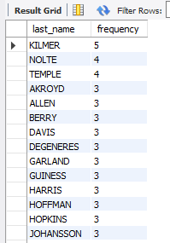

Task 3 :
Display the full names of actors available in the database.
Display all unique last names in the database.
Technique :
Output :
Select, count(*), group by, order by, having
Interpretation :
The last name Kilmer appears around 5 times.
There are total 66 actors who are having unique last_name and it has displayed.

Slide 7
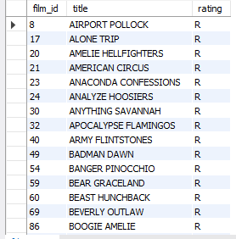
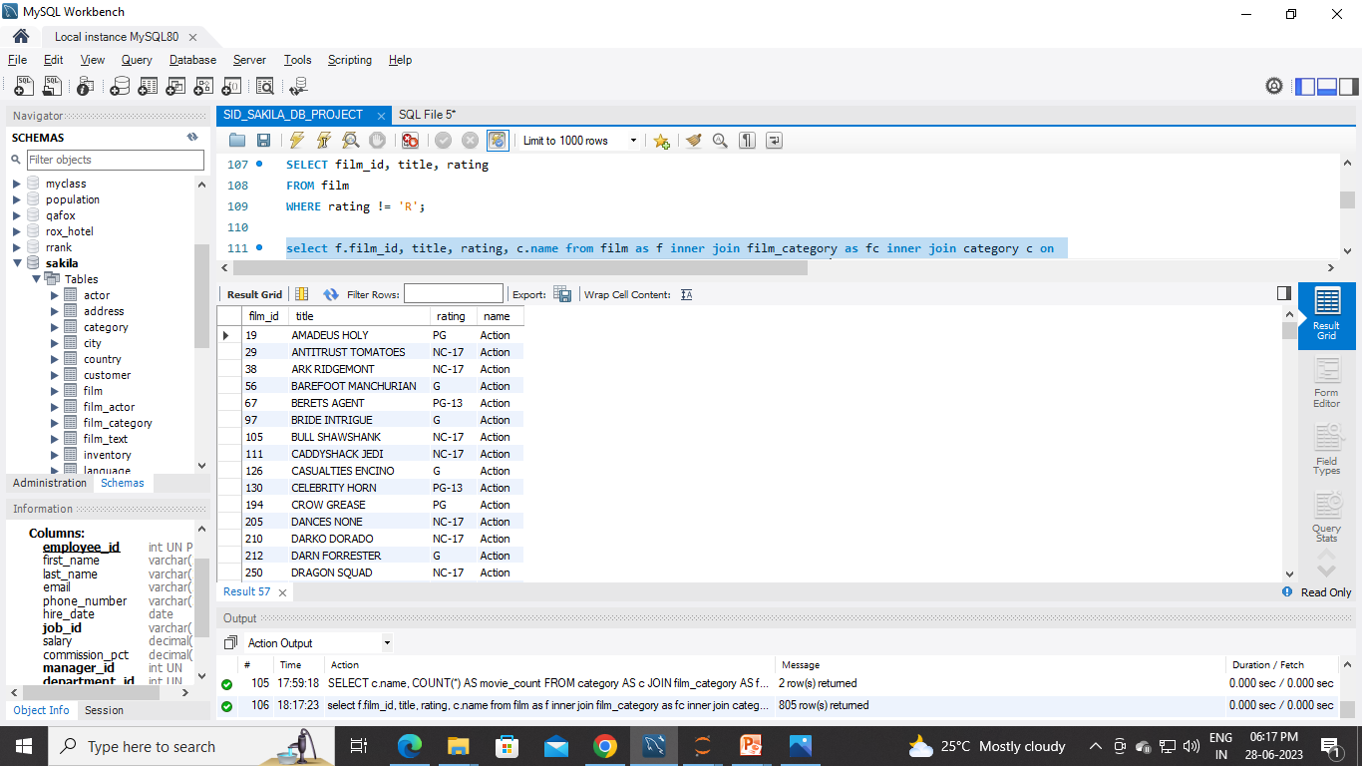
Task 4 :
Display the list of records for the movies with the rating "R"(The movies with the rating "R" are not suitable for the audience under 17 years of age).Display all unique last names in the database.
Display the list of records for the movies that are not rated "R"
Technique :
Output :
Select,
Inner Join
Where
Tables for Join :
Film
Film Category
Category
Interpretation :
There are total 195 movies having rating “R”.
There are total 805 movies that are not rated “R”.

Slide 8
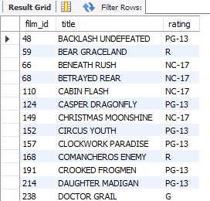
Task 4 :
iii. Display the list of records for the movies that are suitable for audience below 13 years of age.
Output :
Technique :
Select,
Inner Join
Where
Tables for Join :
Film
Film Category
Category
Interpretation :
Audience below 13 years of age means they are belong to the children category and there are 60 movies for children category.

Slide 9
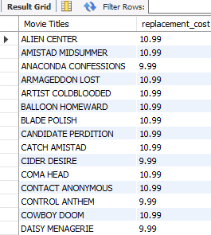
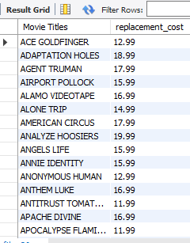
Task 5 :
Display the list of records for the movies where the replacement cost is up to $11.
Display the list of records for the movies where the replacement cost is between $11 and $20.
Technique :
Output :
Select,
Where
Between
Interpretation :
In task 5.i there are 90 movie having replacement_cost less than $11.
In task 5.ii there are total 424 movies having there replacement cost between 11 and 20.

Slide 10
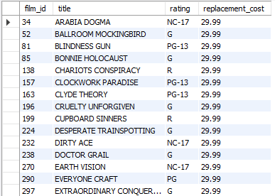
Task 5 :
iii. Display the list of records for the all movies in descending order
of their replacement costs.
Technique :
Output :
Select,
Order By
Interpretation :
The list of records of all the movies along with rating and replacement_cost has displayed, highest replacement cost is 29.99

Slide 11
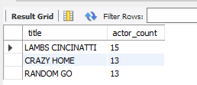
Task 6 :
Display the names of the top 3 movies with the greatest number of actors.
Technique :
Tables for Join :
Select,
Inner Join
Group by, Order by
Desc, limit
Film
Film Actor
Actor
Output :
Interpretation :
The movie LAMBS CINCINATTI has 15 number of actors, CHITTY LOCK and BOONDOCK BALLROOM has 13 number of actors each.

Slide 12
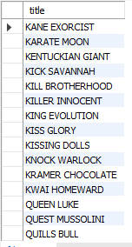
Task 7 :
'Music of Queen' & 'Kris Kristofferson' have seen an unlikely resurgence. As an unintended consequence, films starting with the letters 'K' & 'Q' have also soared in popularity. Display the titles of the movies starting with the letters 'K' & 'Q'.
Output :
Technique :
Select,
Where
Like
Interpretation :
There are 12 movies having a first letter ‘K’ and 3 movies having the first letter ‘Q’.

Slide 13
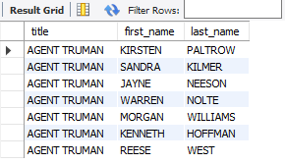
Task 8 :
The film 'Agent Truman' has been a great success. Display the names of all actors who appeared in this film.
Output :
Technique :
Select,
Inner Join
Where
Tables for Join :
Film
Film Actor
Actor
Interpretation :
There are total 7 actors in the movie ‘AGENT TRUMAN’ and there full names has displayed.

Slide 14
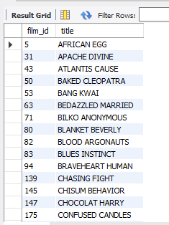
Task 9:
Sales have been lagging among young families, so the management wants to promote family movies. Identify all the movies categorized as family films.
Output :
Technique :
Select,
Inner Join
Where
Tables for Join :
Film
Film_Category
Category
Interpretation :
There are total 69 movies belongs to the family genre.

Slide 15
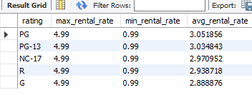
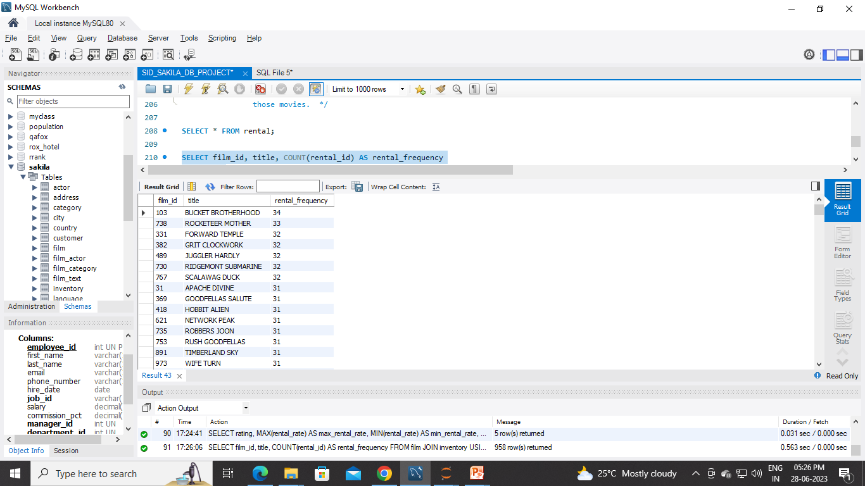
Task 10 :
Display the maximum, minimum, and average rental rates of movies based on their ratings. The output must be stored in descending order of the average rental rates.
Display the movies in descending order of their rental frequencies, so the management can maintain more copies of those movies.
Technique :
Select, count
Inner Join
Group By
Order By
Output :
Tables for Join :
Film
Inventory
Rental
Interpretation :
The avg rental rate is highest for PG-rating, it has maximum rental rate 4.99 and minimum rental rate has 0.99.
The most frequently rented movie is ‘BUCKET BROTHERHOOD’ has rented around 34 times.

Slide 16
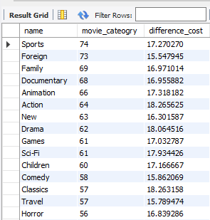
Task 11:
In how many film categories, the difference between the average film replacement cost (disc - DVD/Blue Ray) and the average film rental rate is greater than $15.
Display the list of all film categories identified above, along with the corresponding average film replacement cost and average film rental rate.
Output :
Technique :
Select,
Inner Join
Group by, Order by
Tables for Join :
Film
Film_Category
Category
Interpretation :
Sports category has maximum number of movies around 74 movies having avg difference between the movie replacement cost and the rental rate is 17.27.

Slide 17
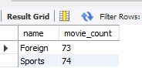
Task 12:
Display the film categories in which the number of movies is greater than 70.
Output :
Technique :
Select,
Inner Join
Group by, Having
Tables for Join :
Film
Film_Category
Category
Interpretation :
The film category foreign and sports are having the number of movies greater than 70.

Slide 18
Conclusion :
In this database there are 16 category, 1000 movies and 200 actors.
Most of the movies (30%) got “PG-13” rating and average rental rate for the movies having PG-13 rating are 3.03.
73% of the movies are having the replacement cost between $11 and $25.
The average number of actors for the movies is between 8-10 and the film_id ‘508’ has maximum number of actors.
The movie “AGENT TRUMAN” got a great success, it has 7 actors and belongs to foreign genre has rental rate = 2.99, replacement cost = 17.99 and rating = “PG-13”.
The movie “BUCKET BROTHERHOOD” has frequently rented movie, it has rented around 34 times belongs to the Travel genre and having the “PG” rating.
“Sports” genre has maximum number of movies around 74 movies, foreign genre has 73 movies, family genre has 64 movies and children genre has 60 movies.

Slide 19
Thank You!

