Slide 1
Python Capstone Project
TMDB Movie Data Analysis
Mentor : Jaya Pandey
Student : Siddharth Raj Saxena
Batch : DA22S2

Slide 2
Introduction
Objective
Analyze movies that cost over $100 million can still fail.
A production company wants to analyze the movie data to identify what kind of movies well perform in the cinemas and which genre they belongs to.
It will help the company predict if a movie will be in commercial success, if the movie will be highly rated.
Analyze a movie data to perform exploratory data analysis.
Retrieve and explore a movie dataset containing relevant information such as movie title, genres, production companies, budget, revenue and runtime.
Determine the key factors that contribute to a movie’s success.

Slide 3
Description of TMDB Dataset
The TMDB (Movie Dataset) is provides information and data related to movies, TV shows and entertainment shows.
This Dataset contain 4803 rows and 20 columns.
There are total 13 categorical & 7 numerical columns present in data.
For my analysis, I am considering columns like genres, budget, title, production_company, revenue, runtime.
Columns Description:
Genres : Category of movies and TMDB id (JSON Format)
Budget : The Budget of movie in dollars. (A budget value 0 means the budget value in unknown)
Title : The title of the movies in English language.
Production_Company : All production companies names & TMDB id of a movie (JSON Format)
Revenue : The total revenue earned by a movie (in dollars)
Runtime : The total runtime of a movie in minutes (integer)
Using Python Libraries like Pandas, Numpy, Matplotlib, Seaborn.

Slide 4
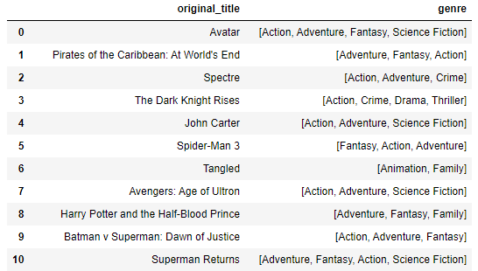
Task 1 :
Load the movie dataset in the python notebook. Display the numbers of row and columns in the dataset. Display the titles and the genres of the first 50 movies from the dataset.
Technique :
Output :
pd.read_csv()
df.shape
json.loads
Lambda
Head(50)
Conclusion :
This dataset contains 4803 rows and 20 columns.
Output shows the title and genres of first 50 movies of the dataset.

Slide 5
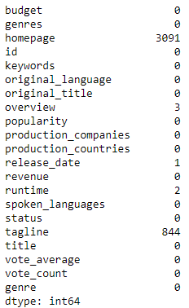
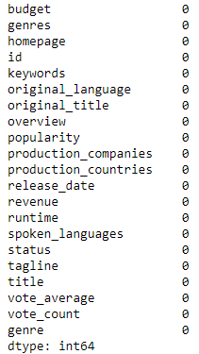
Task 2 :
Identify the columns that have null values and perform the null value treatment. (choose the imputation method based on the type of data in the columns of interest)
Technique :
Output :
Before:
After:
df.isnull().sum()
Imputation Using fillna()
Conclusion :
The dataset contains null values in homepage , overview, release_date, runtime and tagline columns.
Imputing mean value for runtime column because it is numerical column and mode value for rest of the columns.
Notes:
Numerical Columns = 7 & Categorical Columns = 13

Slide 6
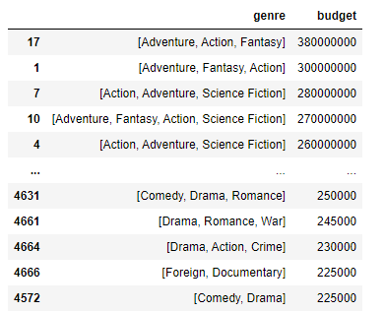
Task 3 :
Display the movie categories that have a budget greater than $220,000
Technique :
Output :
Filter Condition
df.sort_values
(ascending=False)
Conclusion :
There are total 3682 movie categories that have budget > $220,000.
[Adventure, Action, Fantasy] movie categories have highest budget which is $380000000.
Notes:
Drama : 1694, Comedy : 1282, TV Movies : 3

Slide 7
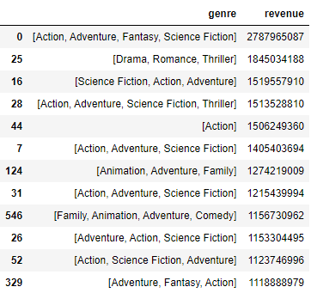
Task 4 :
Display the movie categories where the revenue is greater than $961,000,000.
Technique :
Output :
Filter Condition
df.sort_values
(ascending=False)
Conclusion :
There are total 24 movie categories that have revenue > $961,000,000.
[Adventure, Action, Fantasy, Science Fiction] movie categories have highest revenue which is $2787965087.
Notes:
Adventure : 18, Action: 16 , Romance: 1

Slide 8
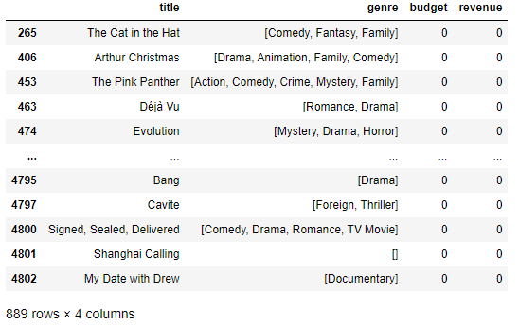
Task 5:
In the dataset, there are some movies for which the budget and revenue columns have the value 0, which mean unknown values. Remove the row with value 0 from both the budget and revenue columns.
Technique :
Output :
Filter Condition
df.[(df.budget !=0)
& (df.revenue !=0)
Conclusion :
There are total 890 movies having budget and revenue value 0.
For further analysis, we considering only 3229 rows.

Slide 9
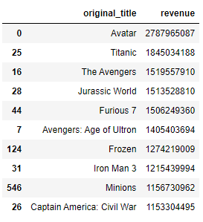
Task 6.1 :
List the top 10 movies with the highest revenues and the top 10 movies with the least budget.
Technique :
Output :
df.sort_values
(ascending = False)
df.head(10)
Conclusion :
‘Avatar’ movie has the highest revenue 2787965087 and ‘Captain America : Civil War’ has the least revenue 1153304495 among top 10.

Slide 10
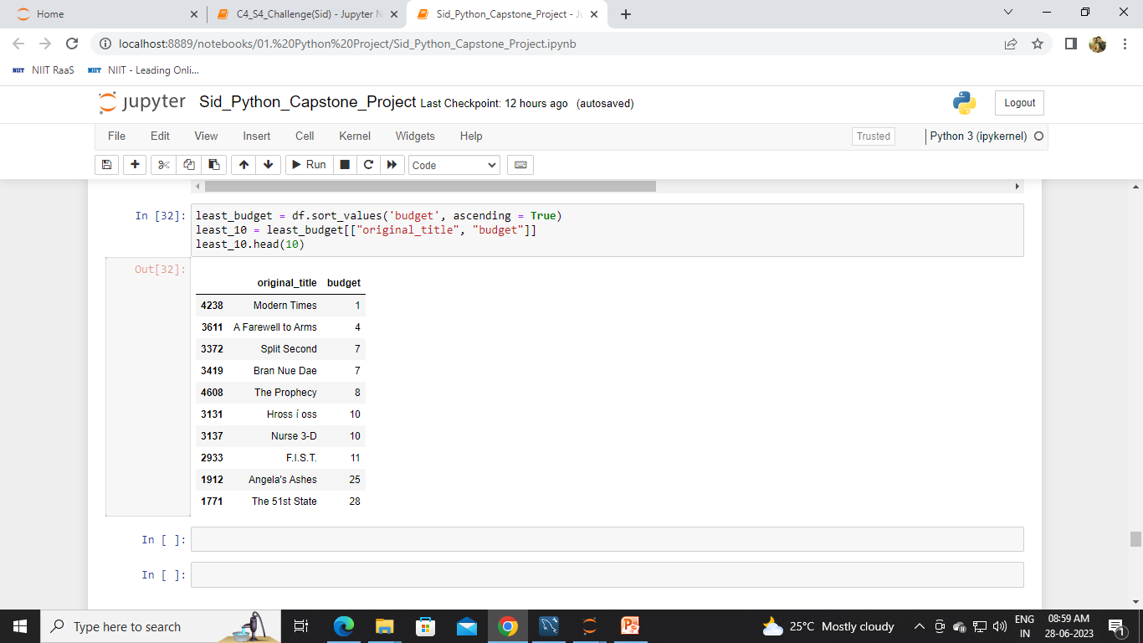
Task 6.2 :
List the top 10 movies with the least budget.
Technique :
Output :
df.sort_values
(ascending = True)
df.head(10)
Conclusion :
‘Modern Times’ movie has the least budget which is $1 and ‘The 51st State’ has the highest budget which is $28.

Slide 11
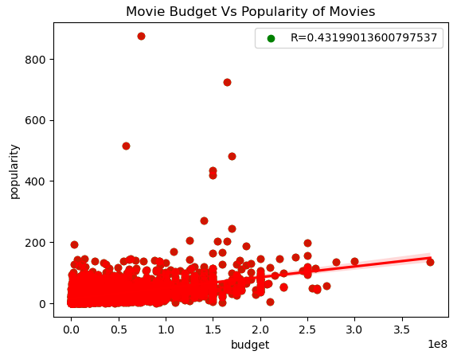
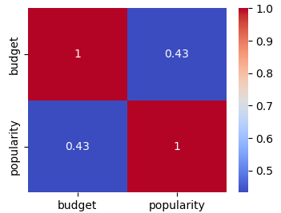
Task 7 :
How are popularities of movies related with the movie budgets? Are they correlated or totally uncorrelated with each other?
Technique :
Output :
Filter Condition
sns.heatmap()
df.[‘budget’].corr(df[‘popularity’])
plt.scatter()
Plt.show()
Conclusion :
Popularity and budget having positive correlation with correlation value 0.43.

Slide 12
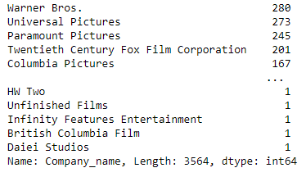
Task 8 :
Identify and display the names of all production companies along with the number of times they appear in the dataset.
Technique :
Output :
Json.loads
Lambda
.explode()
.value_counts
(sort=True)
Conclusion :
The production company ‘Warner Bros’ has appeared 280 times which is maximum times appeared to other production company.
Universal Pictures appeared 273 times.
Notes:
Explode Method converts each element of the specified column into a row.

Slide 13
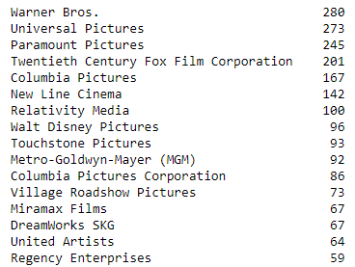
Task 9 :
Display the name of the top 25 production companies based on the number of movies they have produced in descending order of the number of movies produced.
Technique :
Output :
df.head(25)
Conclusion :
The production company ‘Warner Bros’ produced 280 movies which are highest number.
‘Universal Pictures’ produced second highest movies which are 273.

Slide 14
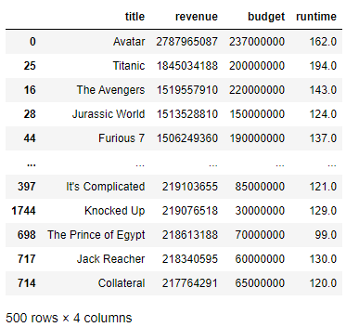
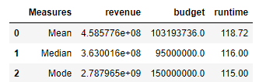
Task 10.1 :
Sort the data in descending order based on the revenue and filter the top 500 movies.
Task 10.2 :
Find the measures of central tendency for the following columns using the filtered data
1. budget 2. revenue 3. runtime
Technique :
Output :
df.sort_values
(‘revenue’,ascending = False)
df.head(500)
Mean, Median, Mode
sns.boxplot
Conclusion :
Avatar movie generates highest revenue but the budget is low than revenue.
Runtime of Avatar movie is 162 times.

Slide 15
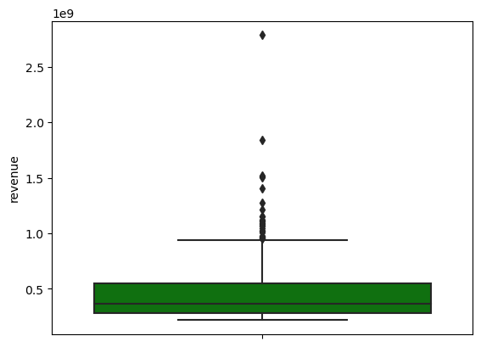
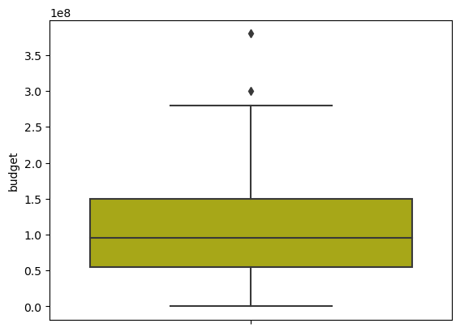
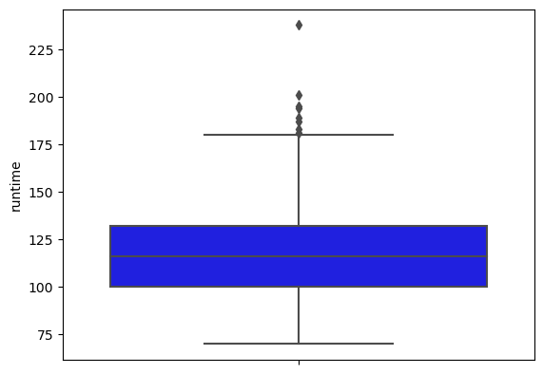
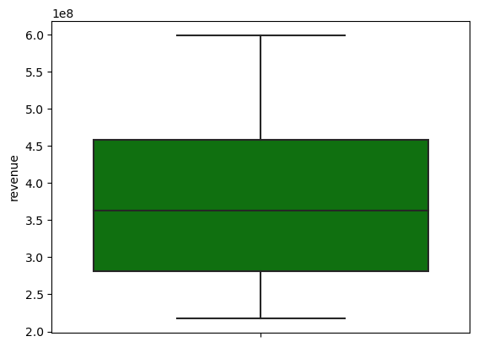
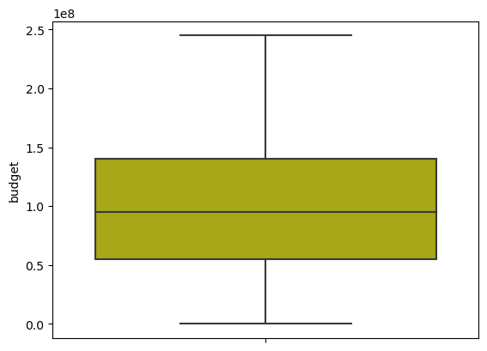
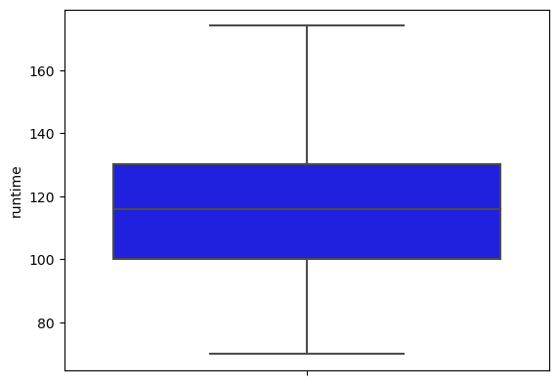
Find outlier analysis for the given three columns using boxplot.
1. budget 2. revenue 3. runtime
Conclusion : Outlier analysis has performed for revenue, budget and runtime column using boxplot.

Slide 16
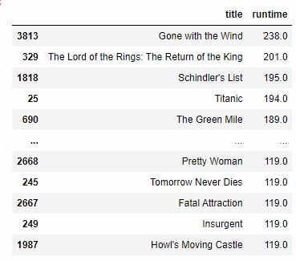
Task 11:
Identify and display the names of the movies along with their run times for those movies that have average runtime, using the data from the previous task.
Technique :
Output :
.mean()
runtime> avg(runtime)
Conclusion :
There are total 234 movies which has runtime greater than avg runtime.
‘Gone with the Wind’ has highest runtime which is 238 times.

Slide 17
Conclusion :
‘Action, Adventure, Fantasy and Science Fiction’ are the most profitable genres.
‘Drama’ and ‘Comedy’ are the most popular genres.
‘Avatar’ and ‘Titanic’ movies generated highest revenue and they have less budget than revenue.
‘Modern Times’ and ‘A Farewell to Arms’ are the very least budget movies.
There is positive correlation between ‘budget’ and ‘popularity’ of movies (0.43).
Also vote_count is positively correlated with ‘popularity’ (0.75) and ‘revenue’ (0.76).
‘Budget’ and ‘revenue’ are strongly correlated (0.71).
‘Warner Bros’ (280) and ‘Universal Pictures’ (273) are the very famous companies. This production companies have high number of movies.
The average runtime of movies is 118 minutes. There are total 234 movies have runtime greater than average runtime.
‘Gone with the Wind’ has highest runtime with 238 minutes and budget of movie is $4 million and generated $400 million.
Most of movies are made in ‘United Stated of America’ because film industry is highly active in this country.

Slide 18
Thank You !

