Slide 1
EXL EQ 2019
Team:Samrat_Kilwish
Vaibhav Kumar (vaibhav_bt2k16@dtu.ac.in)
Siddharth Singh (siddharths_bt2k16@dtu.ac.in)

Slide 2
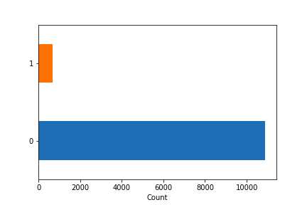
Understanding the Problem
The company wishes to reduce amount of loss occurring due to fraudulent transactions.
Checking of each claim costs the company a certain amount based on the type of representatives used for checking.
Trends seen in case of fraud claims to better understand the data.
Analytic models can reduce this cost by a significant amount.
Lack of fraudulent claims makes classification challenging as fraudulent claims may be classified as genuine
Fraud
Genuine
Distribution of data available with Frauds represented by 1 and Genuine Claims by 0

Slide 3
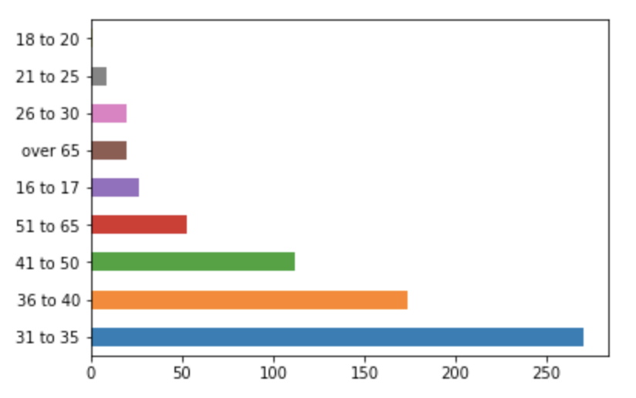
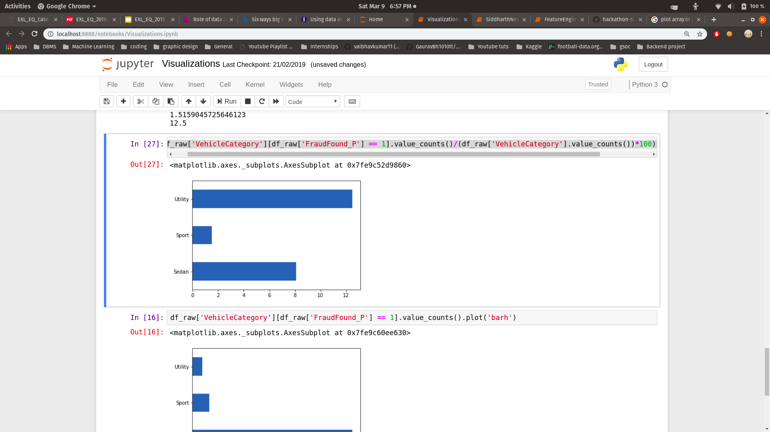
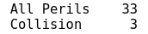
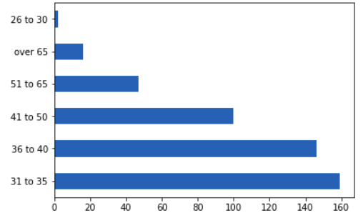
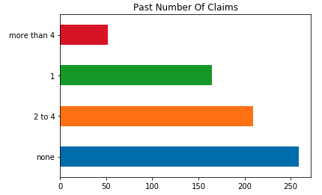
Important Trends in Fraudulent Claims
Middle age people are more likely to be involved in fraud claims
12% of all utility vehicles are involved in fraud claims causing higher suspicion towards this vehicle category with Utility-All perils policy type having a high proportion
Single middle aged people with cars older than 5 years make a large proportion of fraudulent claims
Person with 0 past claims is more likely to do fraudulent claims as they have a smaller proportion in the dataset.

Slide 4
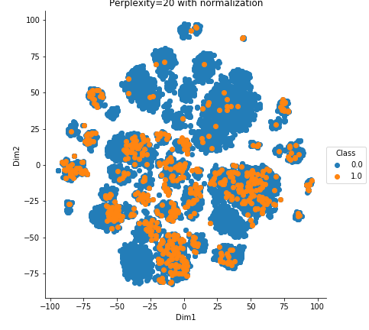
Challenges in Building Model
Lack of data made model building tricky. Neural Networks based approach caused overfitting and tree-based algos(XGBoost, Random forest) also overfit to certain extent
The fraud data as seen in above image isn’t outlier to genuine claims making Outlier detection algorithms inadequate.
Oversampling fraud claims wouldn’t work due to their very small number and oversampling would lead to more overfitting.

Slide 5
Our Solution - The Model
Undersampled genuine claims using clustered centroid method to create fabricated data to getter a better variation of data using less amount of data in turn balancing the dataset
Preprocess the data removing nan values and assign numerical values to categorical features
Gives a probability score for each prediction (Threshold = 0.45)
Data Preprocessing
Feature Engineering
Data Resampling
ML Model
Predictions
Extra features were created which are explained:
Claim Gap: Days between accident and claim
Claim Amount Percent: The percent of claim amount and price of vehicles.
Used LGBoost, a decision tree based framework as it gave better performance wrt competing algorithms with least false positive

Slide 6
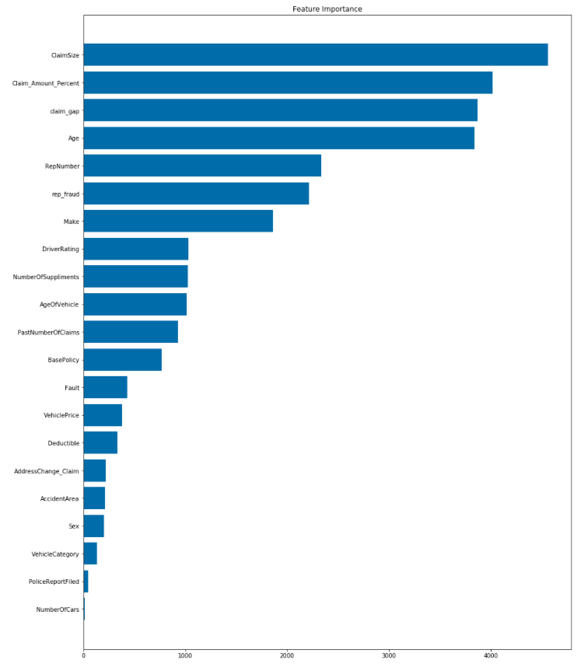
Feature Importance for Model
The size of claims affects the model with claim_amount_percent showing that difference between vehicle price and claim amount being important.
Days between when the accident happened and when it was reported is of vital importance to our model.
Age of insurance holder is important as seen before due to the high fraud claims involved in case of middle aged people.
Sedans are more likely to be involved in frauds than any other category.
Old vehicle(>6yrs) have higher chances of fraud

Slide 7
Methodology
Recommendations
After preprocessing data we introduce some new relevant features:
Claim_gap:The gap between the day of accident and day of claim.
Claim_Amount_Percent:The percent of claim amount and price of vehicles.
The majority class was resampled into 7500 data points based on the Clustered Centroid undersampling algorithm.
Among tree-based techniques, gradient boosted trees performed much better with the best performance being achieved by LightGBM, a high performance decision tree framework.
A LightGBM model with 32 leaves and learning rate 0.05 was used to give the max aug score.
We get a probability score for each prediction which allows us to understand a fraud claim with 1 being a false claim and 0 as genuine claim
Using the model we can first check each claim for fraud. A probability score would be generated for each claim
If probability is below 0.4 we can tell it is a genuine claim
If score is above 0.6 then it is a fraud claim
If score between 0.4-0.6, the company can check the claim as claims may or may not be fraud’s.
The company would have to keep only a single team for checking claims rather than 3
Recheck the utility-all perils policy as it had was involved in high number of frauds
Check background for people especially middle aged single people as high they have involvement in frauds
Focus more on sport category vehicles as they have low fraud claims

