Slide 1

MSC GROUP PROJECT PROPOSAL • GROUP 3
ClauseGuard
An AI-Powered Illegal & Unfair Lease Clause Checker for Irish Renters
TU Dublin MSc Project

Slide 2
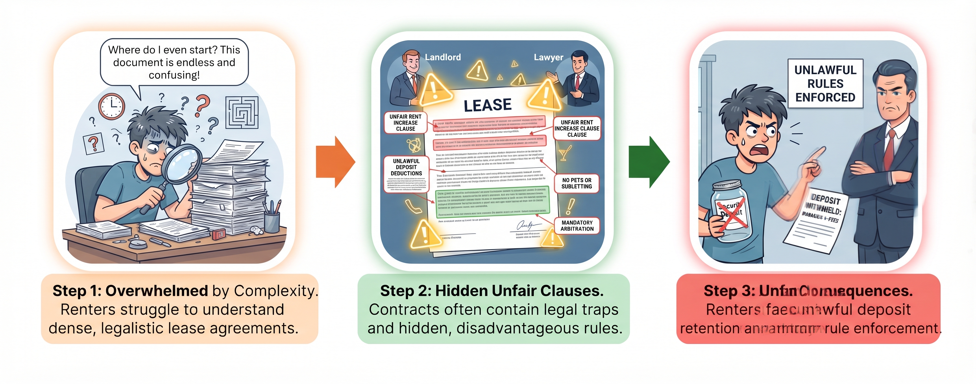
Problem Statement
Renters face severe information asymmetry when signing residential leases
Dense Legal Language
Inaccessible Legal Aid
Generic AI Limitations
Complex jargon prevents tenants from spotting unenforceable repair burdens or waived statutory notice periods.
Independent solicitor review is expensive and slow, leaving vulnerable renters without pre-signing support.
Standard AI summaries lack grounding in Irish tenancy acts and hallucinate legal advice.
Notes:
Currently there are no applications which support scanning of lease agreements and checking out the matter for vulnerabilities due to which in most situation it takes a lot of time and money to resolve such issues.

Slide 3
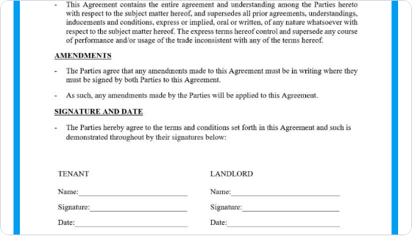



Why This Matters
Protecting rights under the Residential Tenancies Acts 2004–2026
Unenforceable Clauses
Landlords frequently insert illegal caps on deposit returns, illegal access rights, or shifting repair duties.
Evolving Legislation
Frequent RTB amendments require point-in-time legal reasoning based on the exact lease start date.
Tenant Empowerment
Provides instant clarity and citations to statutory authorities (RTB, Threshold, Citizens Information).
Notes:
The main need of this application is for the ease and convenience for the purchase of the real estate between the buyer and seller, and also making sure that the buyers can understand in simple language.

Slide 4



Target Users
Serving primary renters and secondary legal advocacy services
Primary User
Primary User
Secondary User
Students & First-Timers
Expats & Non-Native Speakers
Tenant Advisory Services
First-time renters with minimal legal knowledge needing immediate plain-English lease verification before signing.
Relocating professionals unfamiliar with local statutory regulations and specific Irish RTB tenancy protections.
Housing charities (e.g. Threshold) using ClauseGuard as a preliminary triage tool to accelerate manual case reviews.
Notes:
We’re focusing on non-native English speakers and people who are not proficient in housing laws.

Slide 5
End-to-End Workflow Use Case
From document upload to document-anchored compliance insights in under 60s
STEP 01
STEP 02
STEP 03
STEP 04
Document Upload
Privacy & Anonymization
Hybrid Legal Analysis
Anchored Traffic Report
Tenant uploads PDF, DOCX, or scan. Untrusted input screening deters prompt injection & hidden text.
PII Redaction pipeline cleans names, PPSNs, bank details before external AI model processing.
Rule engine checks numbers; RAG LLM evaluates qualitative wording with point-in-time statutory lookup.
Interactive view highlights clauses (Red/Amber/Green) with statutory citations & grounded Q&A chat.
Notes:
This workflow use-case shows the ease with which the user can use & understand the application.

Slide 6
System Architecture & Pipeline
Five-layer modular architecture for privacy, retrieval, and analysis
1. Document Ingestion Layer
Ingestion
2. Privacy & Security Layer
Security
3. Versioned Legal Knowledge Base
Knowledge
4. Hybrid Analysis Engine
AI Reasoning
5. Presentation Layer
Frontend
Notes:
o Front-end: a React app with drag-and-drop upload, a colour-coded clause report, a document-anchored PDF viewer that highlights the exact clause text, and a grounded Q&A chat panel.
o Back-end: a FastAPI service with async Celery workers, a deterministic rule engine for quantifiable clauses, a hybrid BM25-plus-dense retrieval and reranking layer for grounded classification, a citation verifier, and a conformal-prediction abstention layer so the system flags “needs review” rather than guessing.
o Data sources: the Residential Tenancies Acts 2004-2026, RTB plain-language guidance and determination orders, and the Housing (Standards for Rented Houses) Regulations 2019 – which were compiled into a version-dated knowledge base, and for which a labelled dataset of real and synthetic lease clauses was developed by the team during two rounds of annotation and checked by a second annotator.
o The technology stack put across in this documentation is yet to be finalized among the team members and will be finalized till Sprint 1.

Slide 7
EXECUTION TIMELINE
Development Plan (12-Week Roadmap)
6 Two-Week Sprints from 21 September to 13 December 2026
SPRINT 1 (W1-2)
SPRINT 2 (W3-4)
SPRINT 3 (W5-6)
SPRINT 4 (W7-8)
SPRINT 5 (W9-10)
SPRINT 6 (W11-12)
Requirements & Legal Review
Architecture & PII Setup
Ingestion & Baselines
RAG & Test Set Freeze
Evaluation & UI Study
Freeze & Submission
Proposal finalization, legal taxonomy definition, dataset schema.
KB schema, PII redaction pipeline, repo CI setup, GPU confirmation.
PDF/OCR parser, labeling round 1 (~250 clauses), rule engine v1.
Fine-tuning, end-to-end slice, kappa score, Freeze Test Set (15 Nov).
Frozen test set runs, injection testing, user study (SUS metric).
Final code freeze (30 Nov), report submission & live demo (13 Dec).
Notes:
GitHub is the system of record for issues, branches, pull requests and CI;
Zenhub is used as the visual sprint board, populated directly from the GitHub issue set.

Slide 8
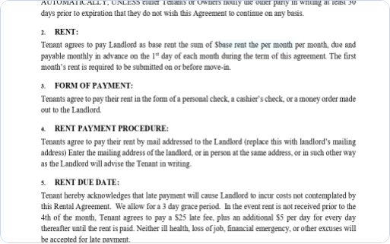
Future Enhancements & Extensions
Scaling ClauseGuard beyond the 30-credit MSc project scope
Multilingual Explanations
Landlord Email Generator
Translating plain-English reports into Ukrainian, Polish, Portuguese, and Mandarin.
Constructing polite, constructive negotiation drafts citing exact RTB laws.
Mobile Document Scanner
Whole-Lease Risk Rating
Real-time camera deskewing and perspective adjustment for physical lease scans.
Aggregated compliance score highlighting omitted mandatory statutory terms.
Notes:
After the MVP, we plan to expand to add more languages and also thinking of adding Adobe PDF type mobile scanner which can scan written documents and convert them to PDF for ease of parsing without any discrepencies.

Slide 9
Q & A
Thank You
PM & Legal Lead
NLP / AI Engineer
Backend & KB Engineer
Siddharth Varma Raja
Shubham Patil
Prasad Nitin Pansare
Frontend / UX Dev
QA & Data Lead
Security Engineer
A K Karthik
Jude Fernandes
Swapnil Prachande
TU Dublin • School of Computer Science

