Slide 1






Clause
Guard
LEASE
Week 6 Progress Presentation
A00047237 – Siddharth Varma Raja
A00047190 – Prasad Nitin Pansare
A00047193 – Shubham Tatyasaheb Patil
A00046404 – Kameshwara Karthik Ayyalasomayajula
A00046791 – Jude Fernandes

Slide 2

Issues With Previous Version
Container Inflation and Build Failures
Memory Exhaustion
Monolithic Scaling Issues
LEASE
Heavy OCR libraries inflate Docker image sizes, causing frequent Render deployment failures.
Loading massive local NLP models for PII redaction caused RAM spikes and fatal OOM crashes.
Tightly coupled API and AI logic meant scaling up required expensive server tiers instead of targeted microservices.

Slide 3

UPDATES MADE FOR THE ISSUES
GCP Cloud Offloading
Secure Credentials
Replaced local extraction with Document AI and Cloud DLP, eliminating OOM crashes on Render.
Migrated GCP service accounts to Render's secure secret management.
Lease Checker
CORS Middleware
DiffEngine rejects invalid license agreement docs early, saving processing costs.
Configured the FastAPI middleware to securely accept traffic from the new custom domain.

Slide 4
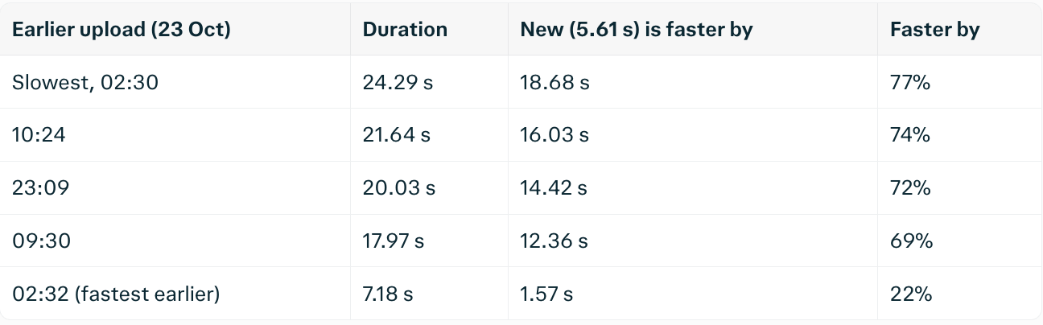
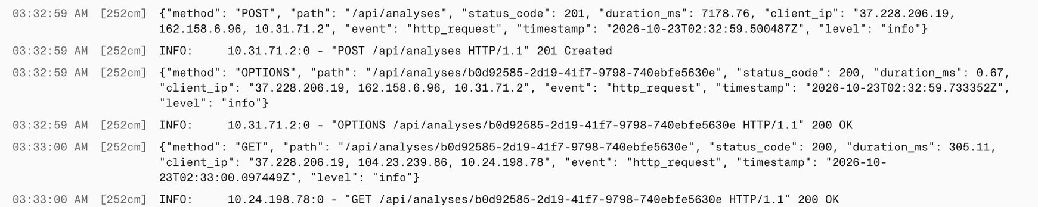
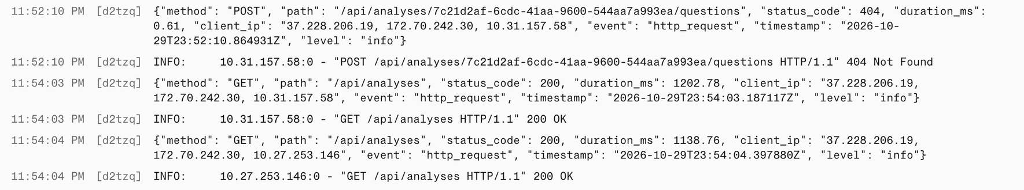
SUCCESS IN REDUCING TIME (COMPARISON FROM 23-10-2026 VS 30-10-2026)

Slide 5

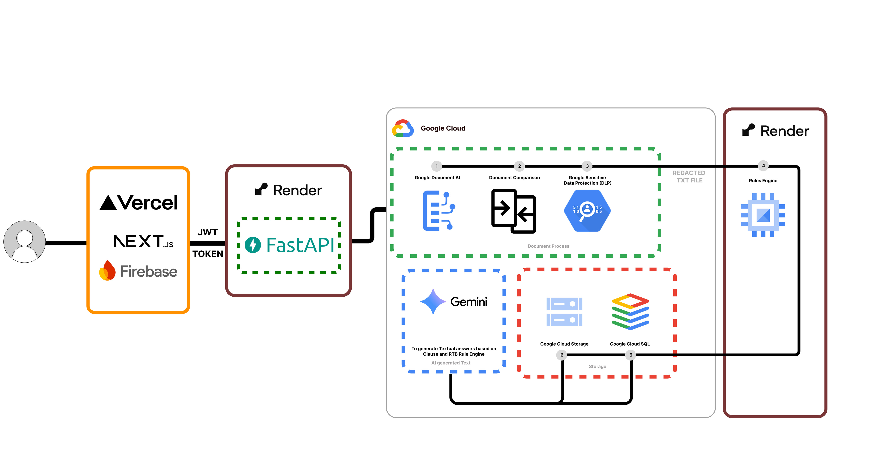
Current Architecture

Slide 6

Rule Engine Updates
Rule engine: fewer false alarms, clearer reasons, one new rule
1 False alarm fixed
2 Shows its evidence
3 New rent review rule
"...the Landlord may re-enter the property if rent is in arrears..."
Entry without notice
A lease that allows a review every 6 months is flagged amber
RED
Amber: against guidance
Fine
Landlord may enter at any time with no notice period stated.
BEFORE
AFTER
RED
Entry without notice
Not flagged
Matched: "enter at any time"
0
6
12
18
24
months between rent reviews
Forfeiture and re-entry for unpaid rent is no longer mistaken for entering without notice.
Every flag quotes the phrase that triggered it, so the tenant can see why.
Minimum 12 months. Guidance, so never red. Draft until the source is confirmed.
3 improvements
4 rules in engine
36 tests passing
ClauseGuard | Group 3 | TU Dublin
1

Slide 7
Ask about your lease
New: a tenant can ask what is wrong in their lease
Upload lease
Rules check
Results saved
Tenant asks
Gemini explains
Plain answer
Ask ClauseGuard about this lease
example
Why not train a new model?
What is wrong in this lease?
Model from Irish LegalBERT
Gemini + saved results
2 clauses are worth checking:
Encoder: it labels clauses but cannot write answers.
Explains what the rule engine found, nothing else.
AMBER
Rent review every 6 months, which is more often than the 12-month guidance.
RED
Entry at any time, with no notice period stated.
Status
GREEN
Deposit clause looks fine.
Backend: built and tested
Chat box: next
Answers come only from the checks above.
ClauseGuard | Group 3 | TU Dublin
2

Slide 8
My next tasks
Connect, label, extend, evaluate
1
Connect the chat
2
Grow the dataset
Chat box
Backend
Real Gemini
289
500+
labelled clauses
Test real questions on a sample lease. So far only tested with a stand-in.
2nd annotator
3
Extend the rules
4
Evaluate
Deposit
Entry
Rent review
Notice
table
Fees
new
Keyword baseline
(now)
TF-IDF + logistic
regression (new)
Green: in engine. Amber: termination notice table needs statute figures. Blue: to add.
Then update the report's evaluation section to the latest numbers.
ClauseGuard | Group 3 | TU Dublin
3

Slide 9

UPCOMING TASKS
1)
1)
HAVE TO WORK ON TESTING THE SERVICES OF THE APPLICATION WITH A 10K USER COUNT
2)
POST THE UI CHANGES PUSHED TO MAIN, NEED TO START WITH THE NEXT ROUND OF USER EVALUATIONS
3)
ADD THE NEW FEATURES OF THE APPLICATION; LEASE VERSIONING AND EMAIL GENERATOR

Slide 10



THANK
YOU
LEASE

