Slide 1
Real-Time Fraud Investigation Orchestration
A human-in-the-loop system combining live transaction streaming, agentic investigation with LangGraph, and ML-powered risk scoring for real-time fraud detection.

Slide 2
Architecture Overview
Backend Stack
FastAPI for REST endpoints
LangGraph + LangChain (Gemini 2.5 Flash)
Pandas for data manipulation
psycopg2 for Postgres access
ML Components
Isolation Forest model (if_model.joblib)
Heuristic rules engine
Feature scaler and transformer
Frontend
React-based interface with live polling and investigation views

Slide 3
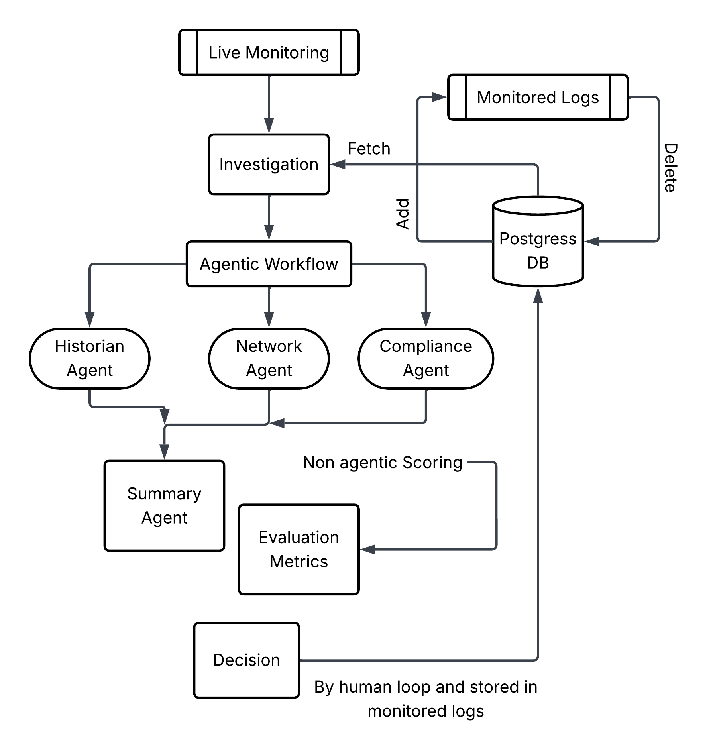
Architecture

Slide 4
System Components
Postgres Data Store
ML Scoring Engine
Four core tables: live_transaction, transaction_history, watchlist, and monitoring_logs
Isolation Forest with heuristic rules for real-time risk assessment
LangGraph Agents
React Frontend
Parallel agentic investigation with Historian, Network, Compliance, and Synthesizer nodes
Live monitoring dashboard with investigation workflows and decision logging

Slide 5






Data Flow Architecture
Live Transaction Pull
Frontend polls GET /stream_transactions every 2 seconds, receiving 1–3 rows from live_transaction table with wrap-around logic
Investigate Trigger
User clicks "Investigate" button, initiating POST /investigate/{Transaction_ID} request to backend pipeline
Feature Enrichment
Transaction lookup, velocity calculations, geo anomaly detection, and spend deviation analysis
ML + Rules Scoring
Fraud scorer combines Isolation Forest predictions with heuristic rules to generate risk metrics
Agentic Fan-Out
Three LLM agents execute in parallel, each assessing different risk dimensions
Decision Logging
Human decisions POST to /monitor_log, storing complete investigation payload for audit and analysis

Slide 6

Agentic Investigation Pipeline
01
02
Historian Agent
Network Agent
Compares transaction against user's historical behavior, identifying spending pattern deviations and unusual activity sequences
Detects shared IP addresses or destination accounts across multiple users, flagging potential mule account networks
03
04
Compliance Agent
Synthesizer Agent
Assesses watchlist and sanctions list hits, identifying known bad actors or restricted entities
Merges all agent statements into unified recommendation: Block, Escalate, or Clear transaction

Slide 7
ML Scoring Model Features
Core Features
Transaction amount and velocity (60-minute window)
Geographic anomaly detection
Time since last transaction
Spend deviation from mean
Hour and day-of-week patterns
Model Architecture
Isolation Forest from if_model.joblib with fitted scaler transforms raw features into normalized inputs. Rules engine applies business logic thresholds in parallel.
Output Metrics
Triggered Rules
Composite risk_score (0–100)
Risk label categorization
Individual scores A/B/C
Isolation Forest anomaly flag
Watchlist IP/account matches
Banned country flags
Velocity spike detection
Structured amount patterns

Slide 8
Frontend User Experience
1
Live Monitoring View
Streaming table of live transactions with "Investigate" buttons. Auto-refresh every 2 seconds via GET /stream_transactions endpoint
2
Investigation Panel
Transaction details, three agent statements, final summary, risk score charts, triggered rules list, and latency metrics display
3
Decision Actions
Four action buttons: Block, Escalate, No Risk, Monitor. Each logs complete investigation state to monitoring_logs table
4
Monitored Logs
Read-only view of past decisions with "Open" to inspect stored payload and "Delete" to remove log from database

Slide 9
Key Features & Capabilities
Real-Time Streaming
Explainable Scoring
Continuous polling of live transaction feed with wrap-around logic ensures no transactions are missed during high-volume periods
Transparent risk metrics show exactly which rules triggered and how ML model arrived at score, building investigator trust
Audit Logging
Agentic Fan-Out
Complete investigation payloads stored with human decisions, enabling full replay of investigation context and reasoning
Parallel LLM agent execution reduces investigation latency while maintaining independence of assessment perspectives
CORS Enabled
JSON API
Open CORS headers allow consumption by React or Streamlit frontends without proxy configuration
Standardized JSON responses across all endpoints enable easy integration with monitoring tools and downstream systems

