Slide 1
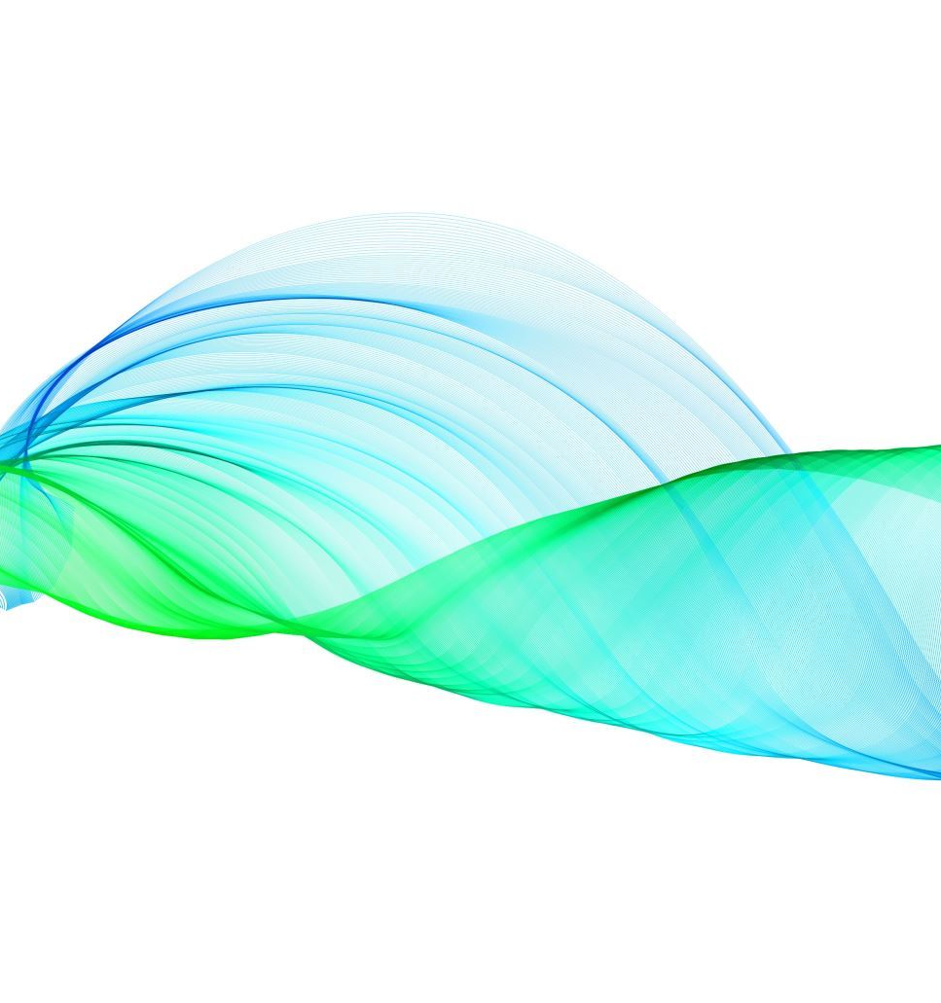
Integrated Adaptive Sub-band Active Noise Cancellation with Real-Time Inverse Filtering and Online Secondary Path Modeling
Project Course-EE 299

Slide 2
Why Active Noise Cancellation?

Slide 3
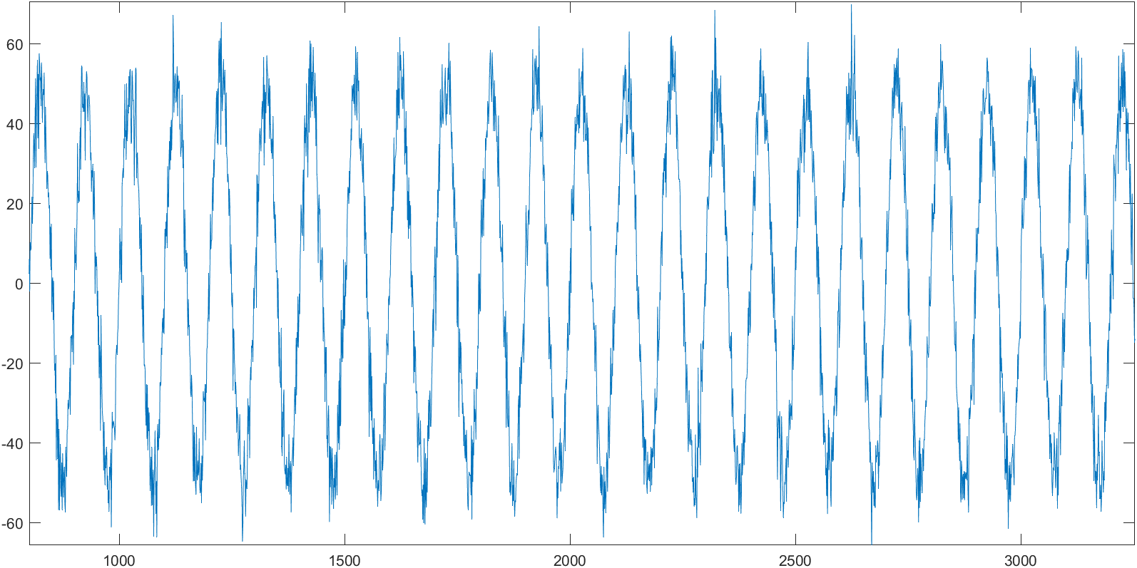
INPUT= NOISE+AUDIO

Slide 4
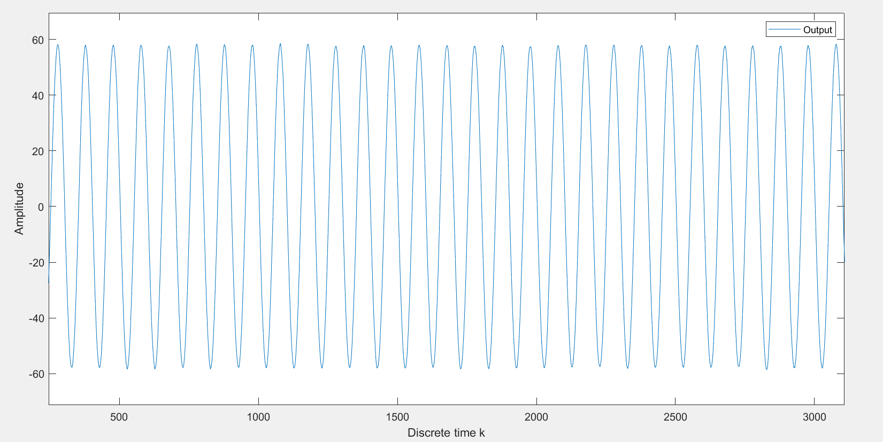
OUTPUT

Slide 5
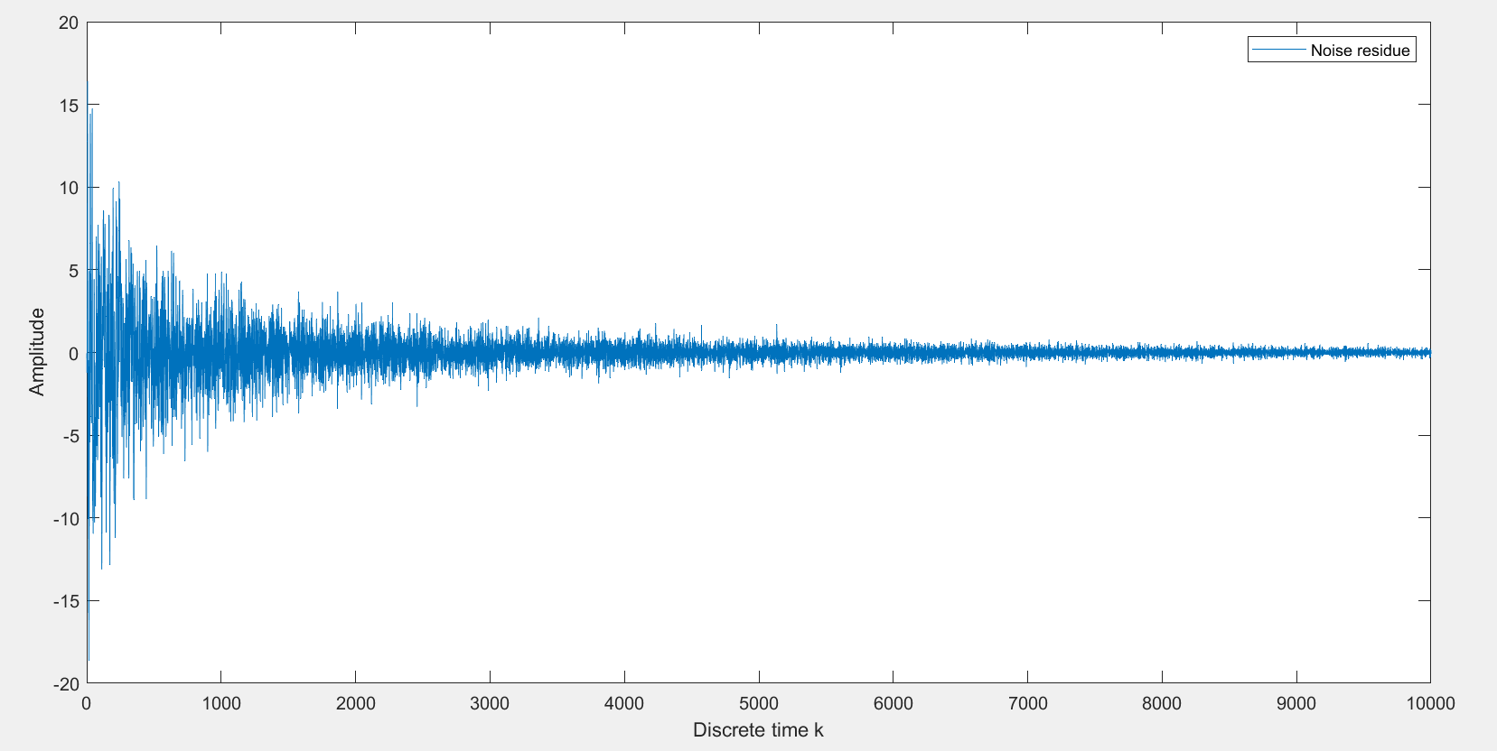
NOISE RESIDUE

Slide 6
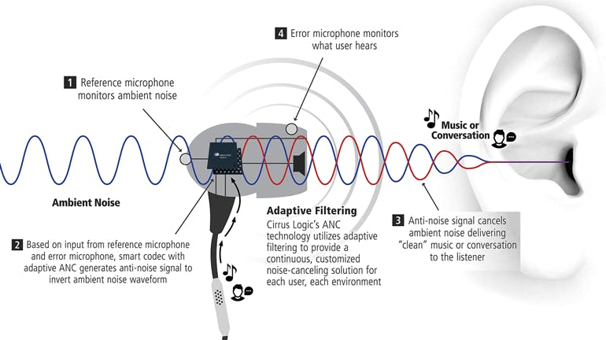
Structure of an ANC headphone:

Slide 7
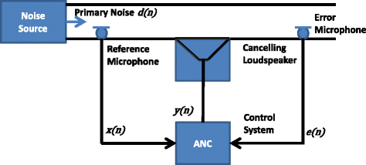
Adaptive Active Noise Control:

Slide 8
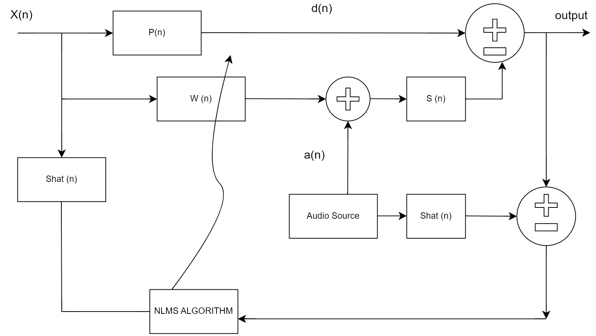
ANC with integrated audio source:

Slide 9
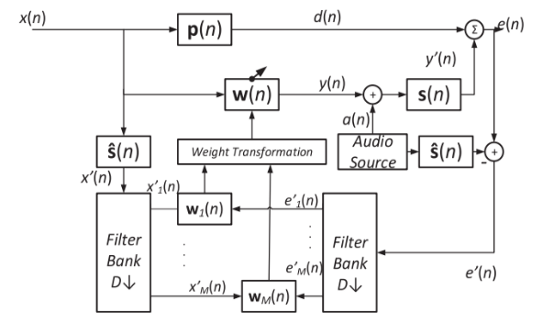
Integrated Sub-band ANC:

Slide 10
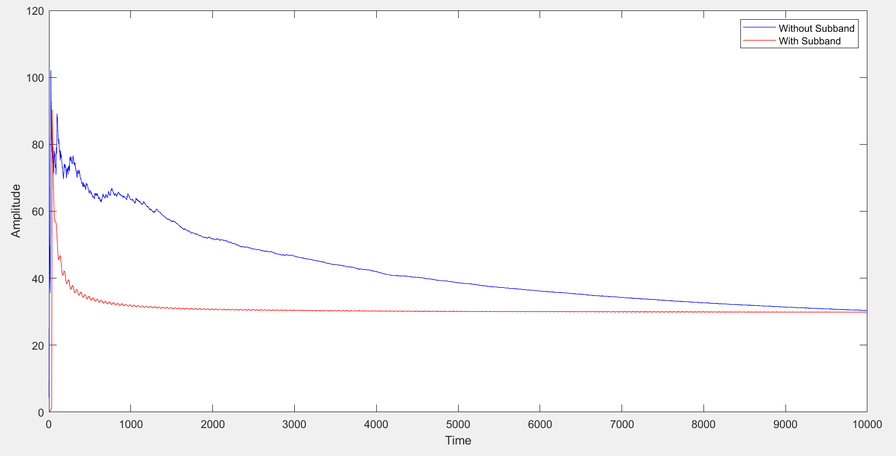
Advantage:
Faster convergence and computationally cheaper.

Slide 11
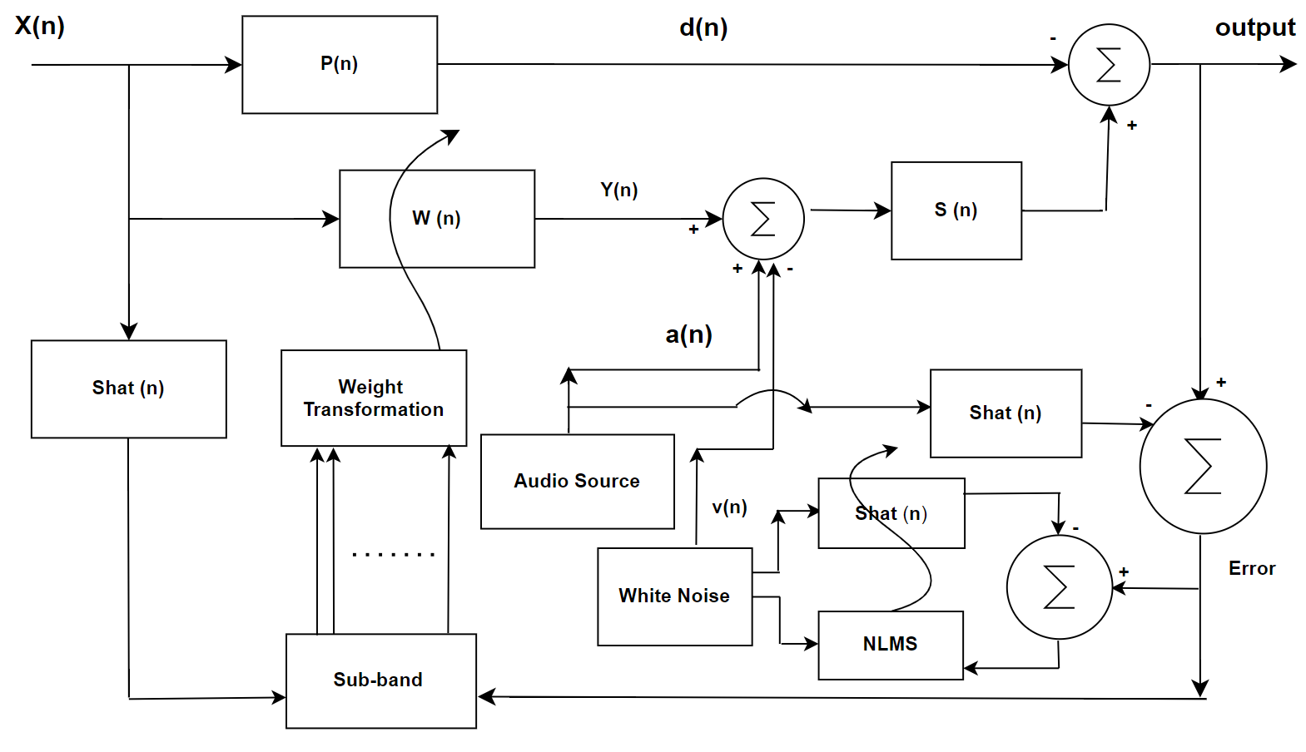
ANC with online modelling of secondary path:

Slide 12
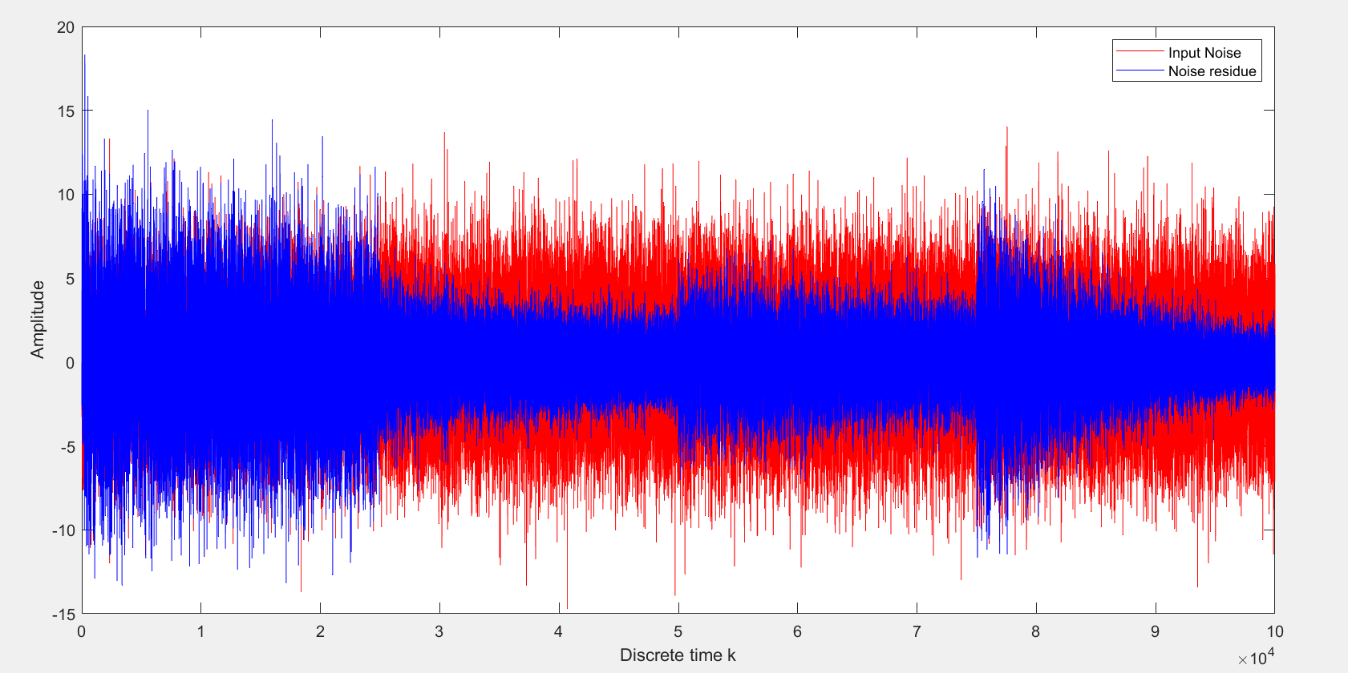
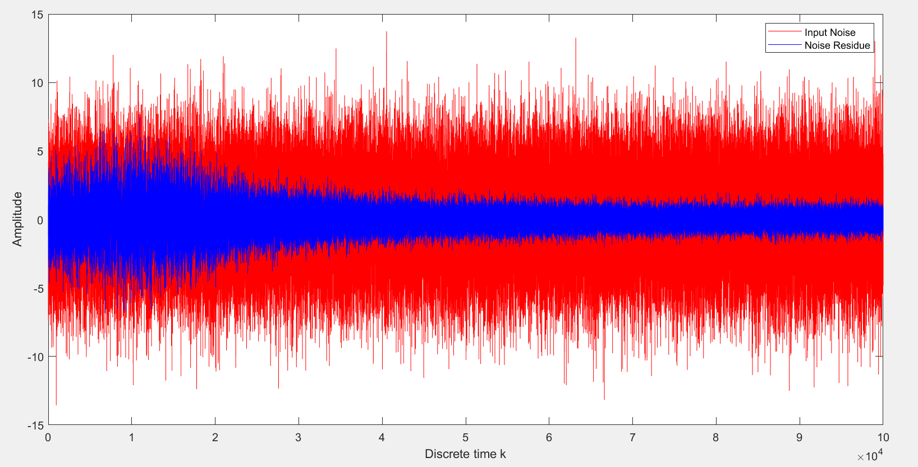
Advantage:
In conventional ANC, if the secondary path changes, then the noise cancellation no longer works.
In the below plots for noise residue, secondary path is changed every 25000 samples.
Without online secondary path modelling With online secondary path modelling

Slide 13
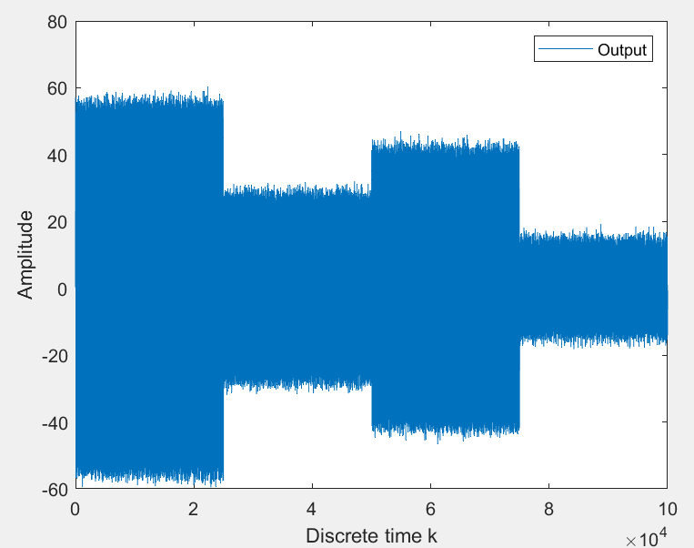
Limitations:
Here, because of the presence of secondary path the audio output gets affected, resulting in poor PESQ (Perceptual Evaluation of Speech Quality) score. PESQ is rated on a scale from 1(bad) to 4.5(excellent).
In the plot, secondary path is changed every 25000 samples.
PESQ score for this signal is 2.214

Slide 14
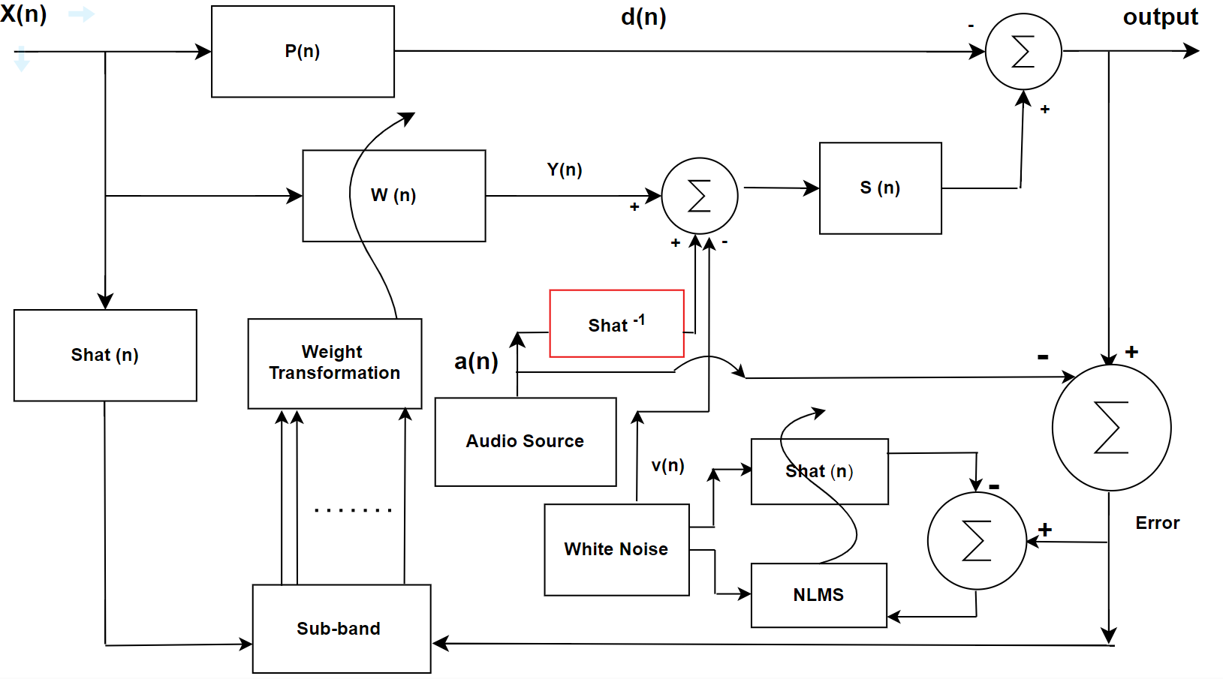
Integrated Sub-band with Inverse Filtering of Secondary Path Filter

Slide 15
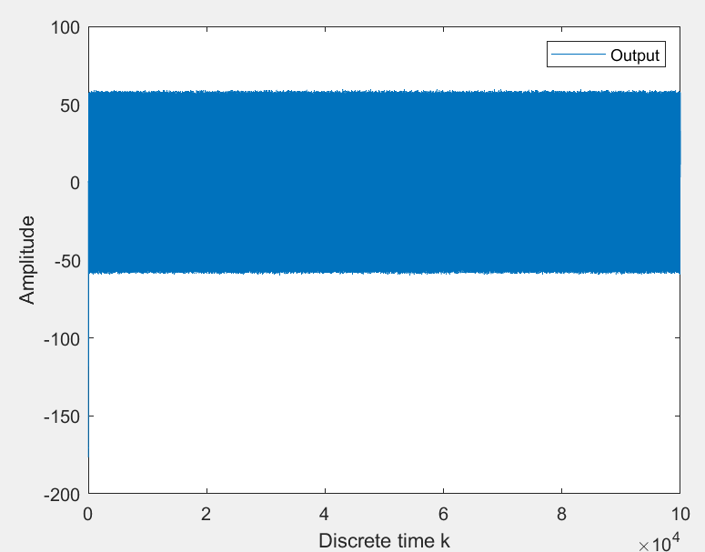
Simulation results:
In the plot, secondary path is changed every 25000 samples.
PESQ score for this signal is 3.083

Slide 16
Comparision:
PESQ score: 2.214 PESQ Score: 3.083

Slide 17
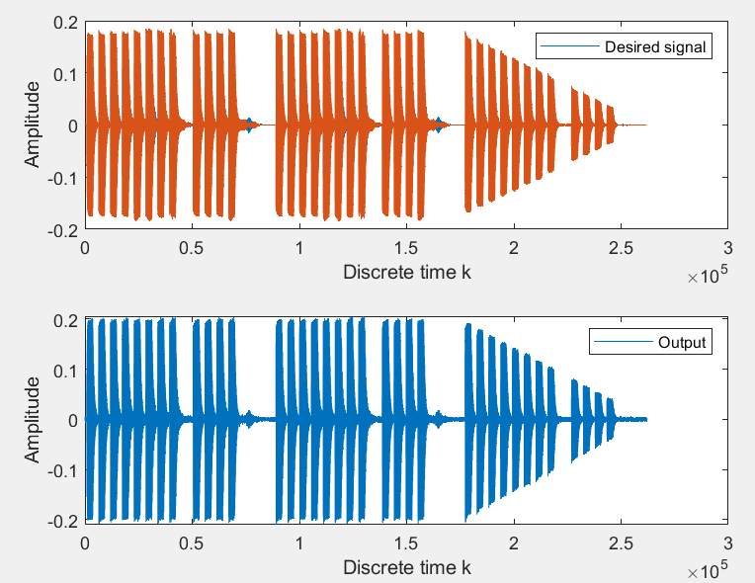
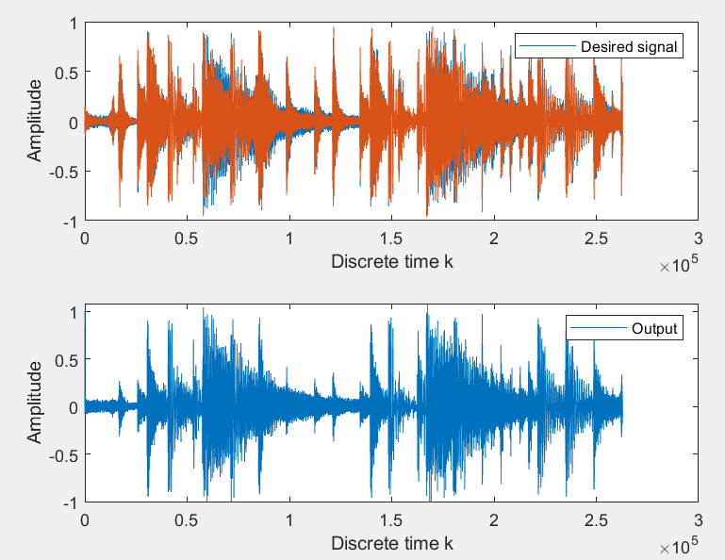
Simulation result for non-sinusoidal wave

Slide 18
Report:
In this project course, conventional ANC algorithm was first implemented.
After this, an attempt was made to implement the integrated audio ANC as suggested by Gan WS, Kuo SM in their paper 'An integrated audio and active noise control headset.'
For faster computation, sub-band adaptive ANC was used as given in the book 'Subband adaptive Filtering' by Lee, Gan and Kuo.
For making the algorithm more robust, the online secondary path modelling as given by L.J. Eriksson, M.C. Allie in their paper 'Use of random noise for on-line transducer modeling in an adaptive active attenuation system' was used.
Moreover, to make the audio quality better and less distorted because of the presence of secondary path, implementation of real time inverse of the estimated secondary path. The perceptual quality of the audio was considerably better than previous algoritms.

Slide 19
Summary:
Conventional ANC disadvantages | Proposed Solutions
High computational cost from high order finite-impulse-response filter, leading to slower convergence. | Sub-band adaptive noise cancellation algorithms
Estimated secondary path is static. | Usage of online secondary path modelling
Audio output gets attenuated because of the secondary path. | Implementation of inverse of online secondary path before audio output.

Slide 20
Prospective Research Enhancements
Stability of the inverse filter can be enhanced by checking if the zeros of the FIR filter are outside the unit circle and then only calculating the inverse of the filter.
Use of auditory masking, for better perceptual quality as suggested by Valiantsin B and Woon-Seng G. In their paper 'Integrated psychoacoustic active noise control and masking'.
Use of Feedforward Selective Fixed-filter Active Noise Control as given by Shi, Dongyuan; Gan, Woon‐Seng and Shulin for better efficiency.

Slide 21
References:
[1] Guicking D. On the invitation of active noise control by Paul Lueg. J. Acoust. Soc. Am. 1990;87(5).
[2] Haykin S, Widrow B. Least-mean-Square Adaptive filters. John Wiley and Son Ltd; 2002.
[3] Milani AA, Panahi MS, Loizou PC. A new delayless subband adaptive filtering algorithm for active noise control systems. IEEE Trans. Audio, Speech Lang. Process. 2009;17(5).
[4] Kuo SM, Morgan DR. Active noise control systems: algorithms and DSP implementations. John Wiley and Sons Ltd; 1996.
[5] Gan WS, Kuo SM. An integrated audio and active noise control headset. IEEE Trans. On Cons. Electronics 2002;48(2)
[6] Gan WS, Kuo SM, Mitra S. Active noise control system for headphone applications. IEEE Trans. Control Sys. Technol. 2006;14(2):331–5.

Slide 22
References:
[7] Valiantsin B, Woon-Seng G. Integrated psychoacoustic active noise control and masking. Applied Acoustics, Vol 145, 2019, 339-9.
[8] B. Widrow, S.D. Stearns Adaptive Signal Processing Prentice-Hall, NJ (1985)
[9] L.J. Eriksson, M.C. Allie Use of random noise for on-line transducer modeling in an adaptive active attenuation system J. Acoust. Soc. Am., 85 (2) (February 1989), pp. 797-802

Slide 23
THANK YOU

