Slide 1
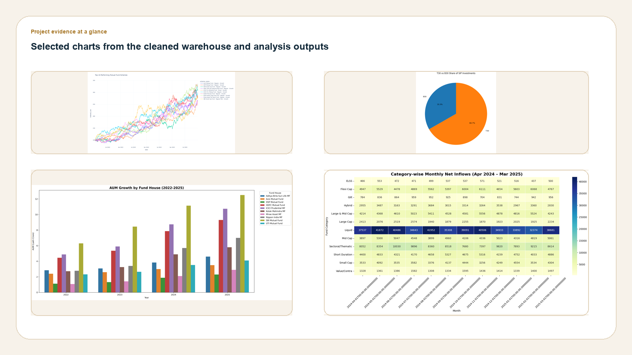
PROJECT SNAPSHOT
Bluestock MF Capstone
A cleaned mutual-fund analytics stack covering 40 schemes, 10 public datasets, and a verified SQLite warehouse.
40
10
schemes tracked
source datasets
from the fund master
raw CSVs and public APIs
64,320
32,778
cleaned NAV rows
transaction rows
after forward-fill
retail behavior sample
project evidence collage
Sources: AMFI India, mfapi.in, NSE/BSE public data. Composite visuals assembled from project outputs.
1

Slide 2
PROBLEM & OBJECTIVE
The capstone turns fragmented public fund data into a repeatable analytics pipeline.
Goal: explain who invests, what drives flows, and which funds win on both return and risk.
Problem statement
Project objectives
• Public mutual-fund data is spread across many files and refresh cadences.
• Build a cleaned warehouse with enforced quality checks.
• Retail participation, performance, and benchmark context are rarely analyzed together.
• Surface EDA patterns in investor mix, flows, and geography.
• A practical capstone needs both an ETL layer and a decision layer.
• Rank funds using return, Sharpe, alpha, drawdown, and benchmark context.
Source: project analysis built from the MFA data folder.
2

Slide 3
DATA SOURCES
The warehouse starts with 10 public inputs and ends with a fully joined star schema.
Each source has a clear business role, from NAV history through to holdings and benchmark series.
01_fund_master.csv
02_nav_history.csv
40 rows
64,320 rows
scheme master and categories
daily NAV fact
fee / plan / benchmark metadata
forward-filled calendar coverage
03_aum_by_fund_house.csv
04_monthly_sip_inflows.csv
90 rows
48 rows
fund-house AUM trend
SIP inflow and account trend
scale and growth lens
retail momentum
05_category_inflows.csv
06_industry_folio_count.csv
144 rows
21 rows
category net inflows
foliowide asset mix
allocation rotation
industry adoption
07_scheme_performance.csv
08_investor_transactions.csv
40 rows
32,778 rows
returns / risk / alpha
retail transaction behavior
fund ranking input
city, age, gender, KYC
09_portfolio_holdings.csv
10_benchmark_indices.csv
322 rows
8,050 rows
sector allocation
benchmark close series
stock concentration
comparison context
Source: raw CSV inventory and the cleaned warehouse generated by the ETL script.
3

Slide 4
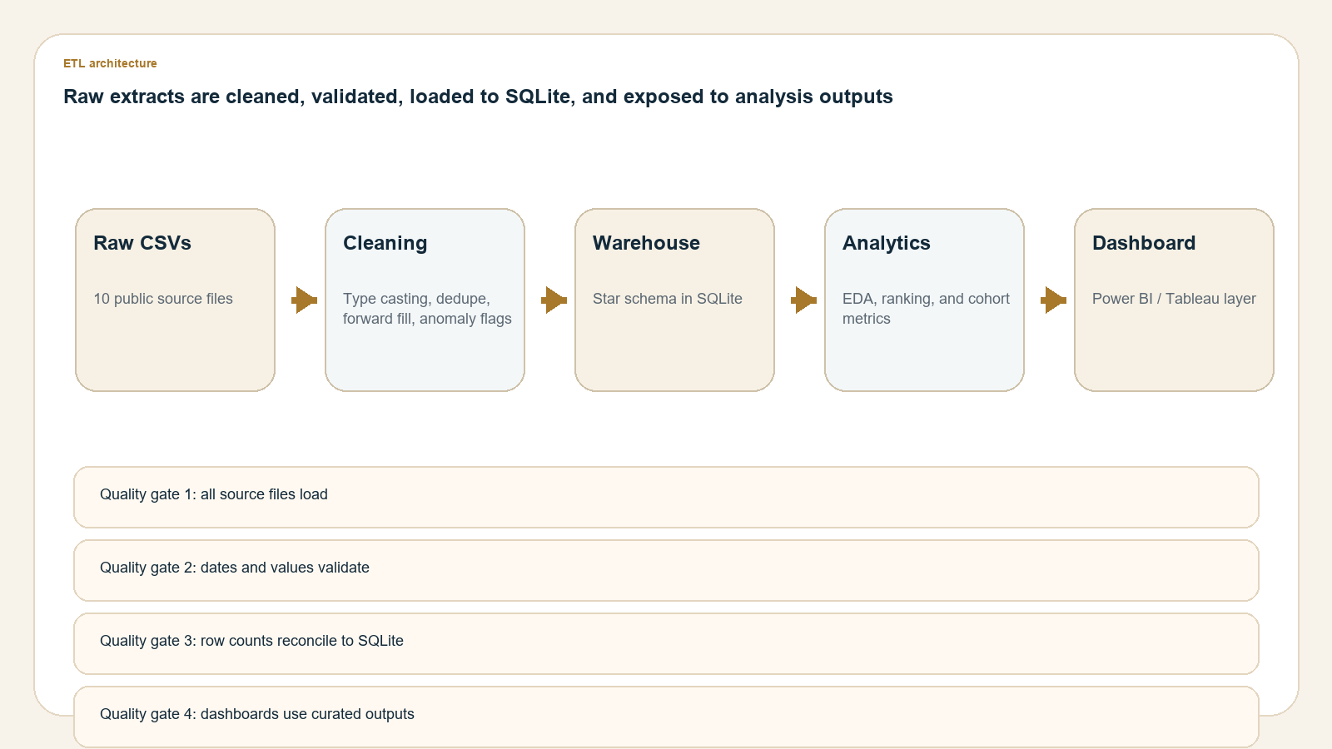
ARCHITECTURE
The pipeline is linear by design: clean the inputs, load SQLite, then publish analysis-ready outputs.
The same warehouse feeds the report, the deck, and the dashboard layer.
Quality gates
• All source files load and reconcile to cleaned counts.
• NAV, transaction, and fee rules are enforced before load.
• schema.sql and queries.sql are regenerated by the pipeline.
etl architecture
Source: ETL design in day2_pipeline.py and the generated warehouse artifacts.
4

Slide 5
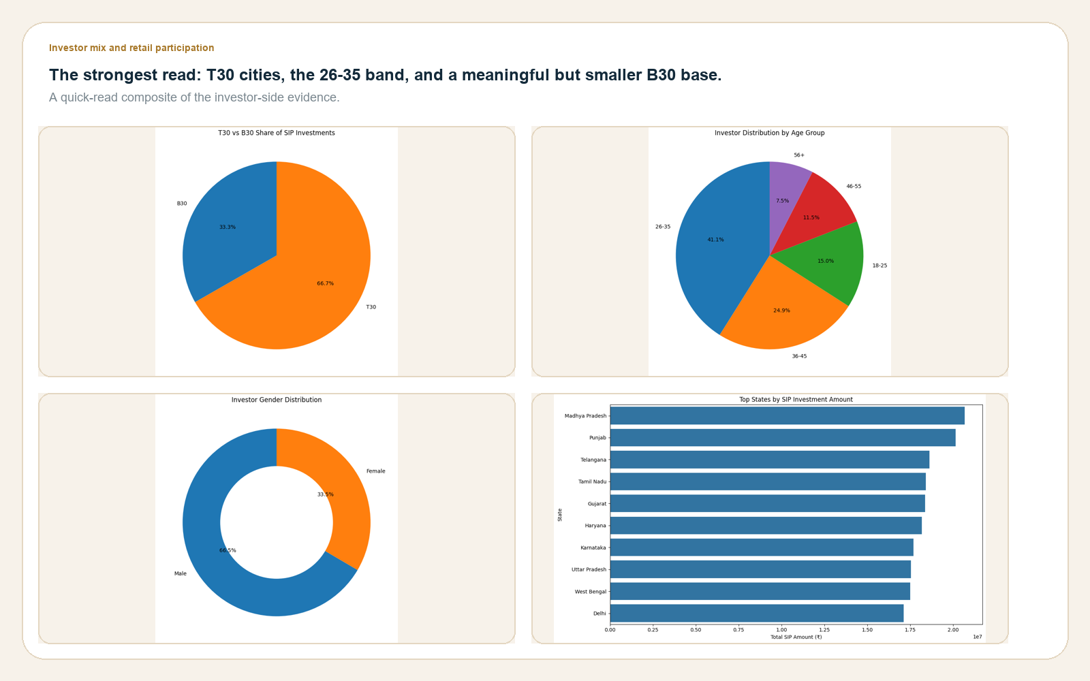
EDA HIGHLIGHTS
Retail participation is concentrated in T30 cities and the 26-35 age band.
The participation profile is broad, but the transaction mix is visibly urban and youthful.
Readout
• T30 cities account for about 66 percent of transactions.
• The 26-35 cohort is the largest age band at 41 percent.
• Male investors make up roughly two-thirds of the sample.
investor mix
Source: investor transaction and attribution data.
5

Slide 6
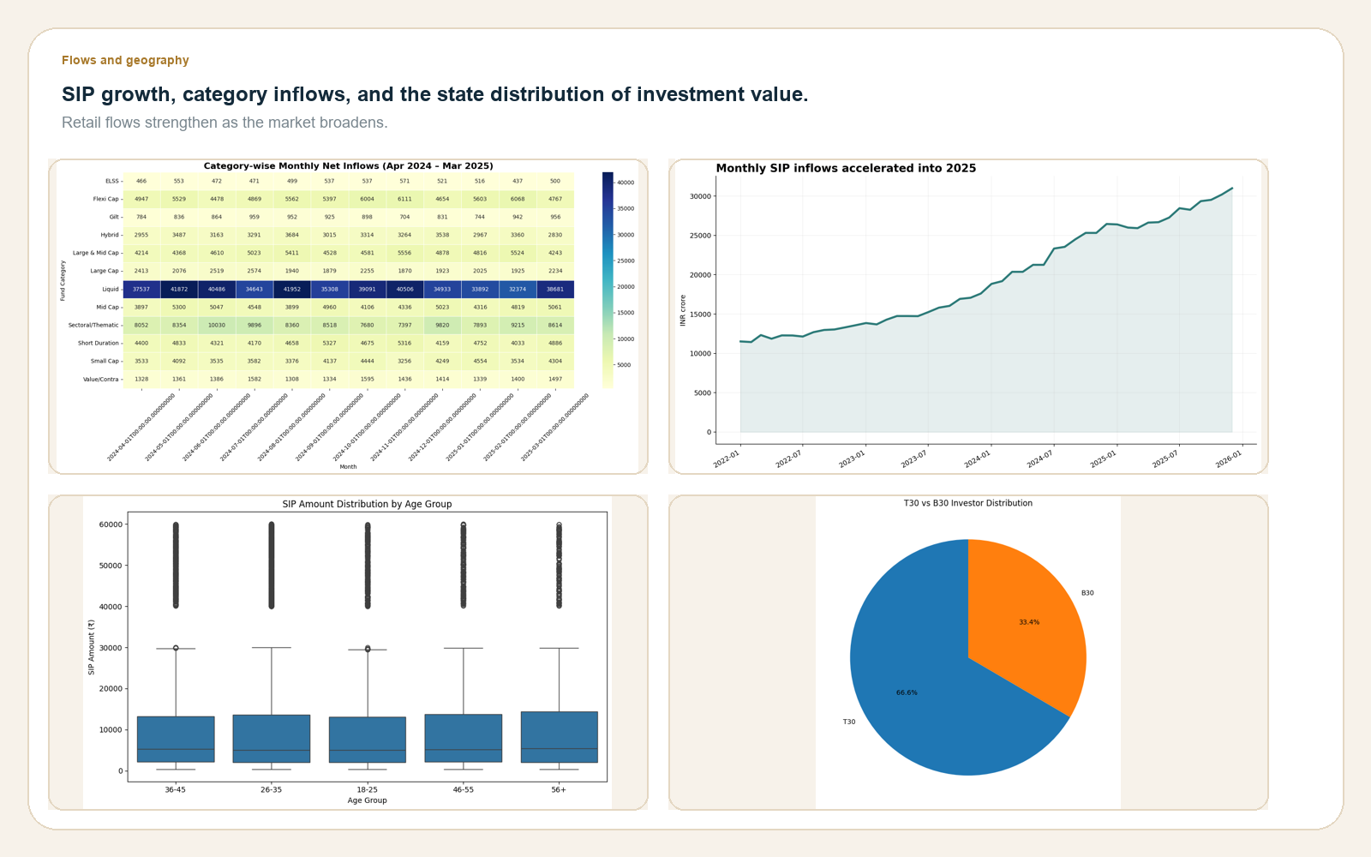
EDA HIGHLIGHTS
Flows accelerated into 2025, with Liquid and Mid Cap leading the latest category snapshot.
SIP growth, category rotation, and geography tell the demand-side story.
Readout
• SIP inflows rose from INR 11,438 crore to INR 31,002 crore.
• Liquid funds led the latest category snapshot at INR 38,681 crore.
• Punjab, Tamil Nadu, and Madhya Pradesh were among the strongest SIP states.
flows and geography
Source: SIP inflow, category inflow, and transaction geography files.
6

Slide 7
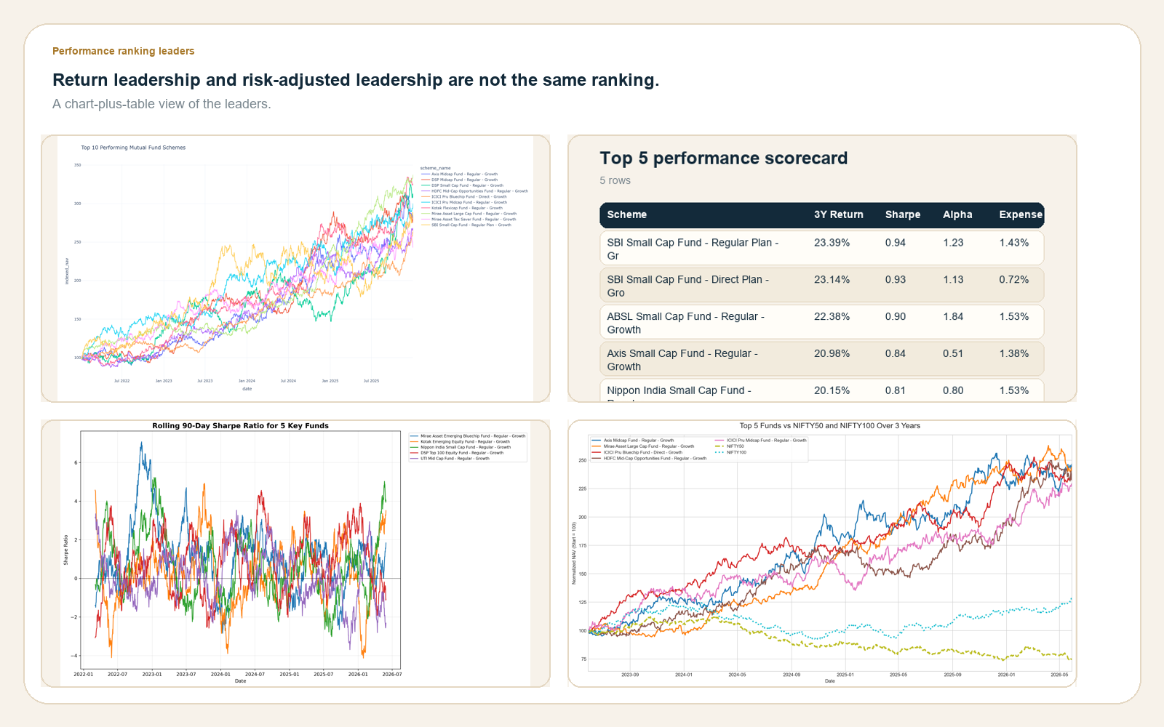
PERFORMANCE METRICS
The return leaderboard is equity-heavy, but the top Sharpe ratios belong to lower-volatility debt funds.
That split matters: return strength and risk efficiency are not the same ranking problem.
Readout
• Top 3-year return: SBI Small Cap Fund - Regular Plan - Growth.
• Top Sharpe ratio: ICICI Pru Liquid Fund - Regular - Growth.
• Alpha and drawdown help separate the active winners from the crowded middle.
performance rankings
Source: scheme performance CSV and derived scorecard outputs.
7

Slide 8
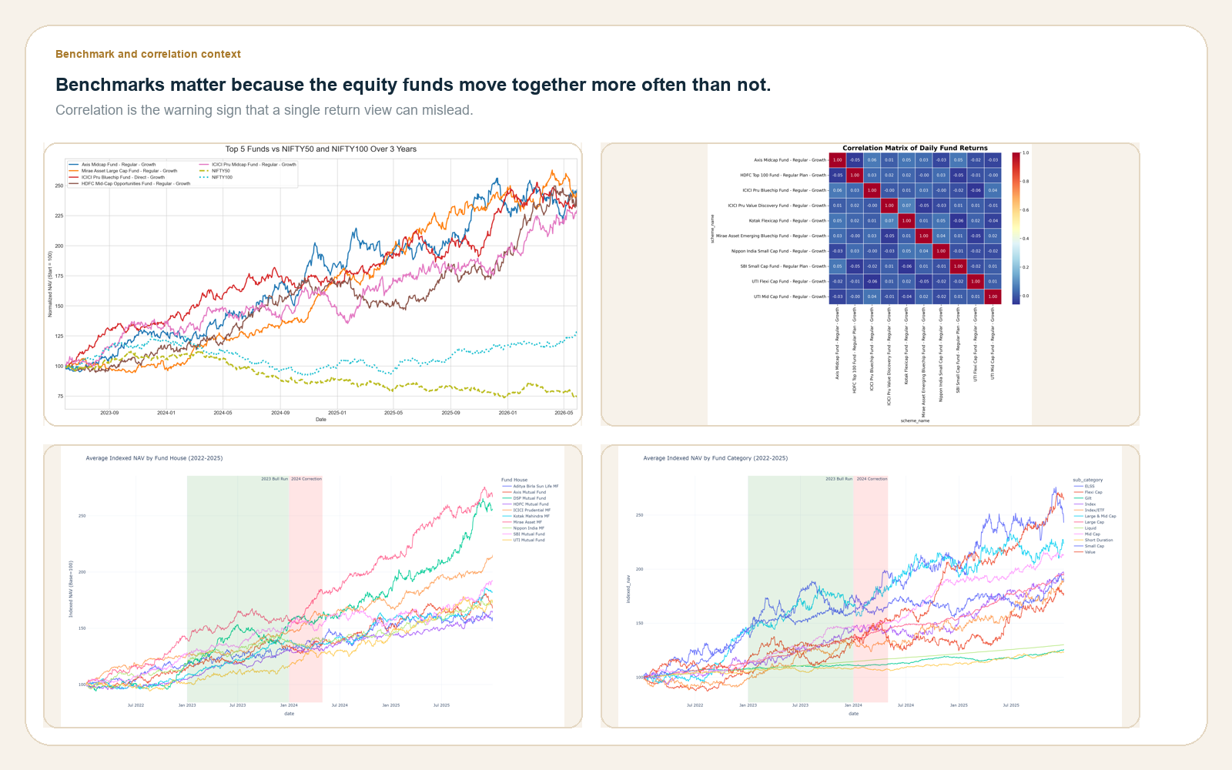
PERFORMANCE METRICS
Benchmark spreads remain meaningful, but correlation and drawdown explain most of the visible clustering.
The matrix view keeps the story honest: strong funds are often still strongly related to the same factor set.
Readout
• Active equity funds cluster tightly versus their benchmarks.
• The correlation matrix shows why a single broad-market view is not enough.
• Risk-adjusted performance is best judged with benchmark context attached.
benchmark and correlation
Source: benchmark index series and fund return correlations.
8

Slide 9
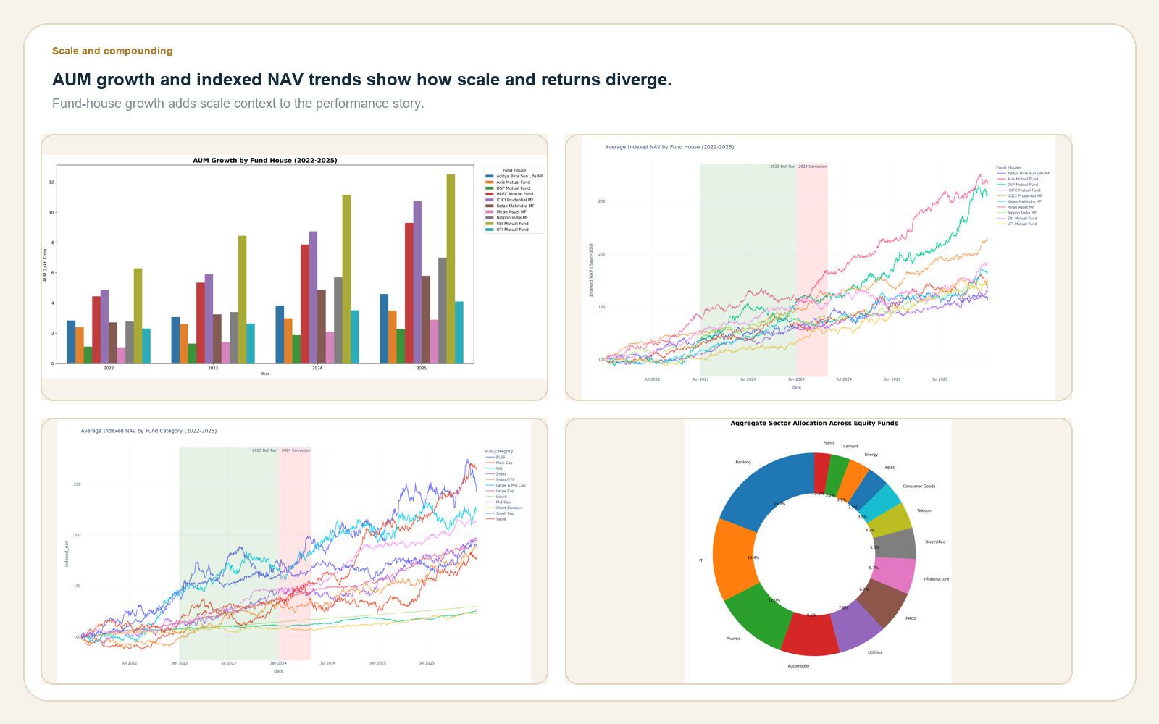
PERFORMANCE METRICS
AUM growth and indexed NAV trends show that scale, compounding, and category mix do not move in lockstep.
The fund-house view is useful because it exposes growth, leadership, and concentration at once.
Readout
• Mirae Asset MF shows the strongest AUM growth across the window.
• NAV behavior differs materially by fund-house and category.
• The growth picture needs both scale and time-series context.
aum and indexed nav
Source: AUM trend and indexed NAV outputs.
9

Slide 10
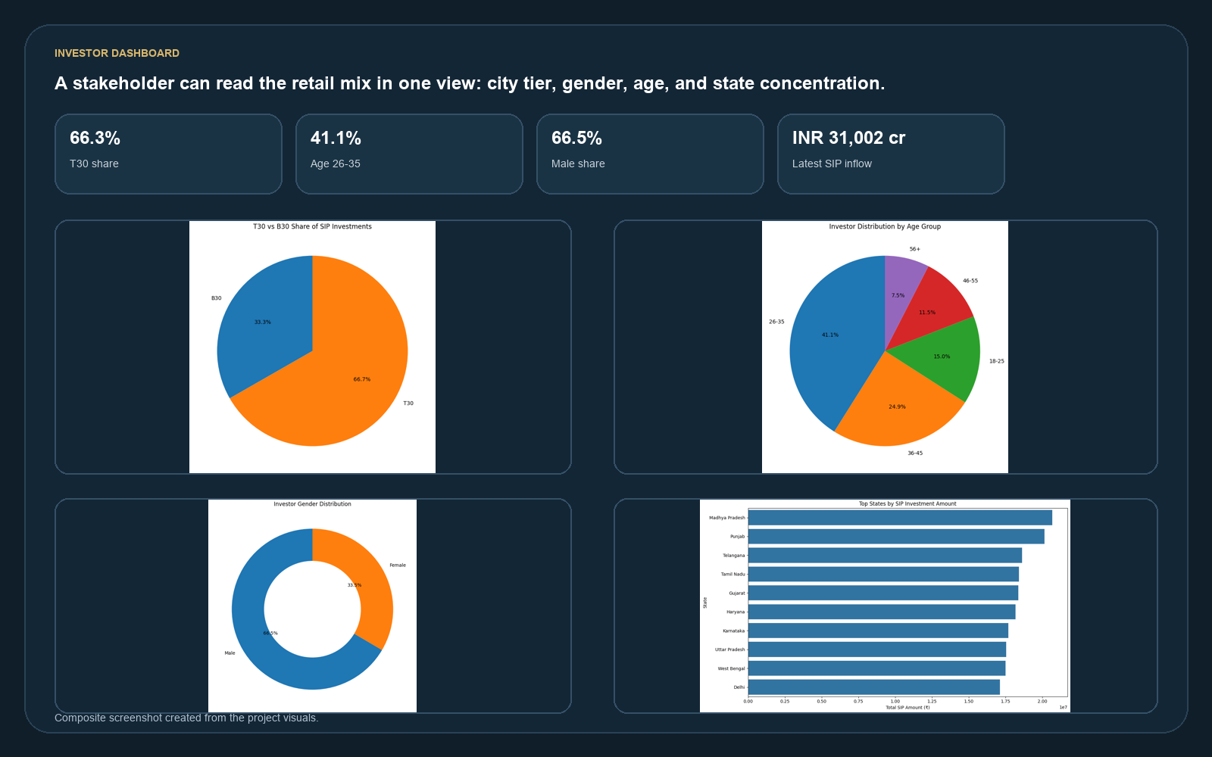
DASHBOARD SCREENSHOTS
Investor dashboard view: participation mix, demographic spread, and geographic concentration.
This is the user-facing view that a stakeholder would read first.
dashboard investor
Composite dashboard screenshot assembled from project visuals.
10

Slide 11
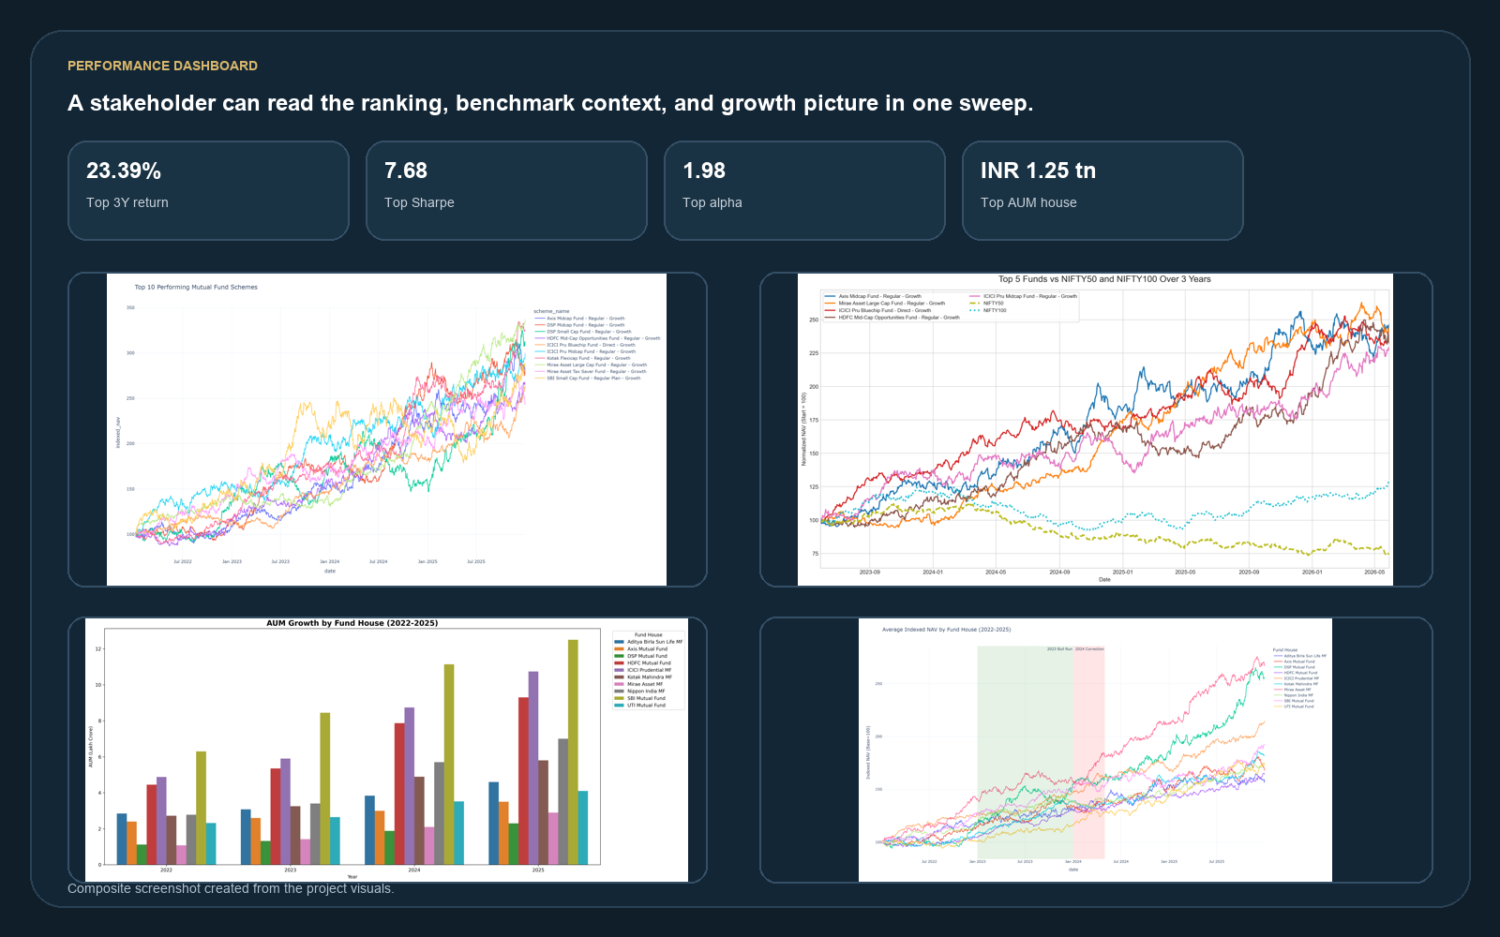
DASHBOARD SCREENSHOTS
Performance dashboard view: leaders, benchmark context, and scale trends.
This second view anchors the investment story in risk-adjusted performance.
dashboard performance
Composite dashboard screenshot assembled from project visuals.
11

Slide 12
KEY FINDINGS
The capstone succeeds because the ETL, EDA, and performance layers now tell one coherent story.
A clean warehouse, visible retail mix, and a disciplined scorecard are the real deliverables.
What the project proves
Thank you
• The pipeline is reproducible and the warehouse is validated.
• The repository is ready for the v1.0 tag.
• Retail demand is urban, young, and SIP-led.
• The remaining optional step is BI hosting.
• Performance leadership splits between active equity and low-volatility debt funds.
• Questions and iteration are welcome.
• Dashboard visuals can be refreshed from the curated outputs.
Source: consolidated project summary.
12

