Slide 1
MANUAL TESTING
Manual Testing
Manual testing is a software-testing process in which a person executes test cases without using an automated tool.
The tester follows a user scenario, provides inputs, observes the actual result, and compares it with the expected result.
Example: searching for a Netflix science-fiction movie checks usability and user acceptance from a real user’s point of view.
Notes:
Introduce manual testing as a person-led process. Emphasize the sequence: follow a user scenario, provide inputs, observe the actual result, and compare it with the expected result.

Slide 2
SOFTWARE DEVELOPMENT ROADMAP
SDLC: the complete software development roadmap
A structured process used to plan, design, develop, test, deploy, and maintain software.
Planning & Feasibility Analysis
System Design
Testing
Maintenance
Plan the architecture, modules, and data structures for the solution.
Find and fix defects to confirm the software meets its requirements.
Update, fix, and improve the software after it goes live.
Define the project goals and check whether the product is practical and worthwhile.
1
2
3
4
5
6
7
Requirement Specification (SRS)
Development (Coding)
Deployment
Developers write the code and build the working software.
Release the tested software to users in the production environment.
Document what users need in a clear Software Requirement Specification.
SDLC connects user needs and business goals to a product that can be released and supported.
Notes:
Read the roadmap from left to right. Testing is one phase in a larger product journey, connected to both the initial needs and the later release and support work.

Slide 3
TESTING PROCESS INSIDE SDLC
STLC: the testing process inside SDLC
A structured set of testing activities used to check whether a software product meets quality expectations.
STLC · TESTING PHASES
1. Requirement Analysis
2. Test Planning
3. Test Case Development
Testers study the requirements to find what must be tested and whether each one can be tested.
The team sets the scope, goals, effort, resources, schedule, and risks for testing.
Testers write and review test cases and test data based on the requirements.
4. Test Environment Setup
5. Test Execution
6. Test Closure
The hardware, software, and data needed to run the tests are prepared and checked.
Testers run the test cases, record the results, and log any defects found.
The team reviews results against exit criteria and archives the testing evidence.
STLC gives testing its own scope, responsibilities, evidence, defect tracking, and release-readiness decision.
Notes:
Show that STLC is not separate from product development. It is the testing process that runs inside the wider SDLC, with its own activities and evidence.

Slide 4



THREE LEVELS OF SYSTEM KNOWLEDGE
Core Manual Testing Techniques
The difference is how much the tester knows about the internal code and architecture.
White box
Black box
Gray box
Internal code and architecture are visible to the tester.
Testing focuses on inputs, outputs, requirements, and user-visible behavior.
Testing combines external behavior with partial internal knowledge.
Inspect the inside.
Check the outside.
Use both views.
All three approaches can support functional checks, defect discovery, and better release confidence.
Notes:
Use the three boxes as a visual vocabulary for the next three cards. The tester is always working manually; what changes is the level of system knowledge.

Slide 5
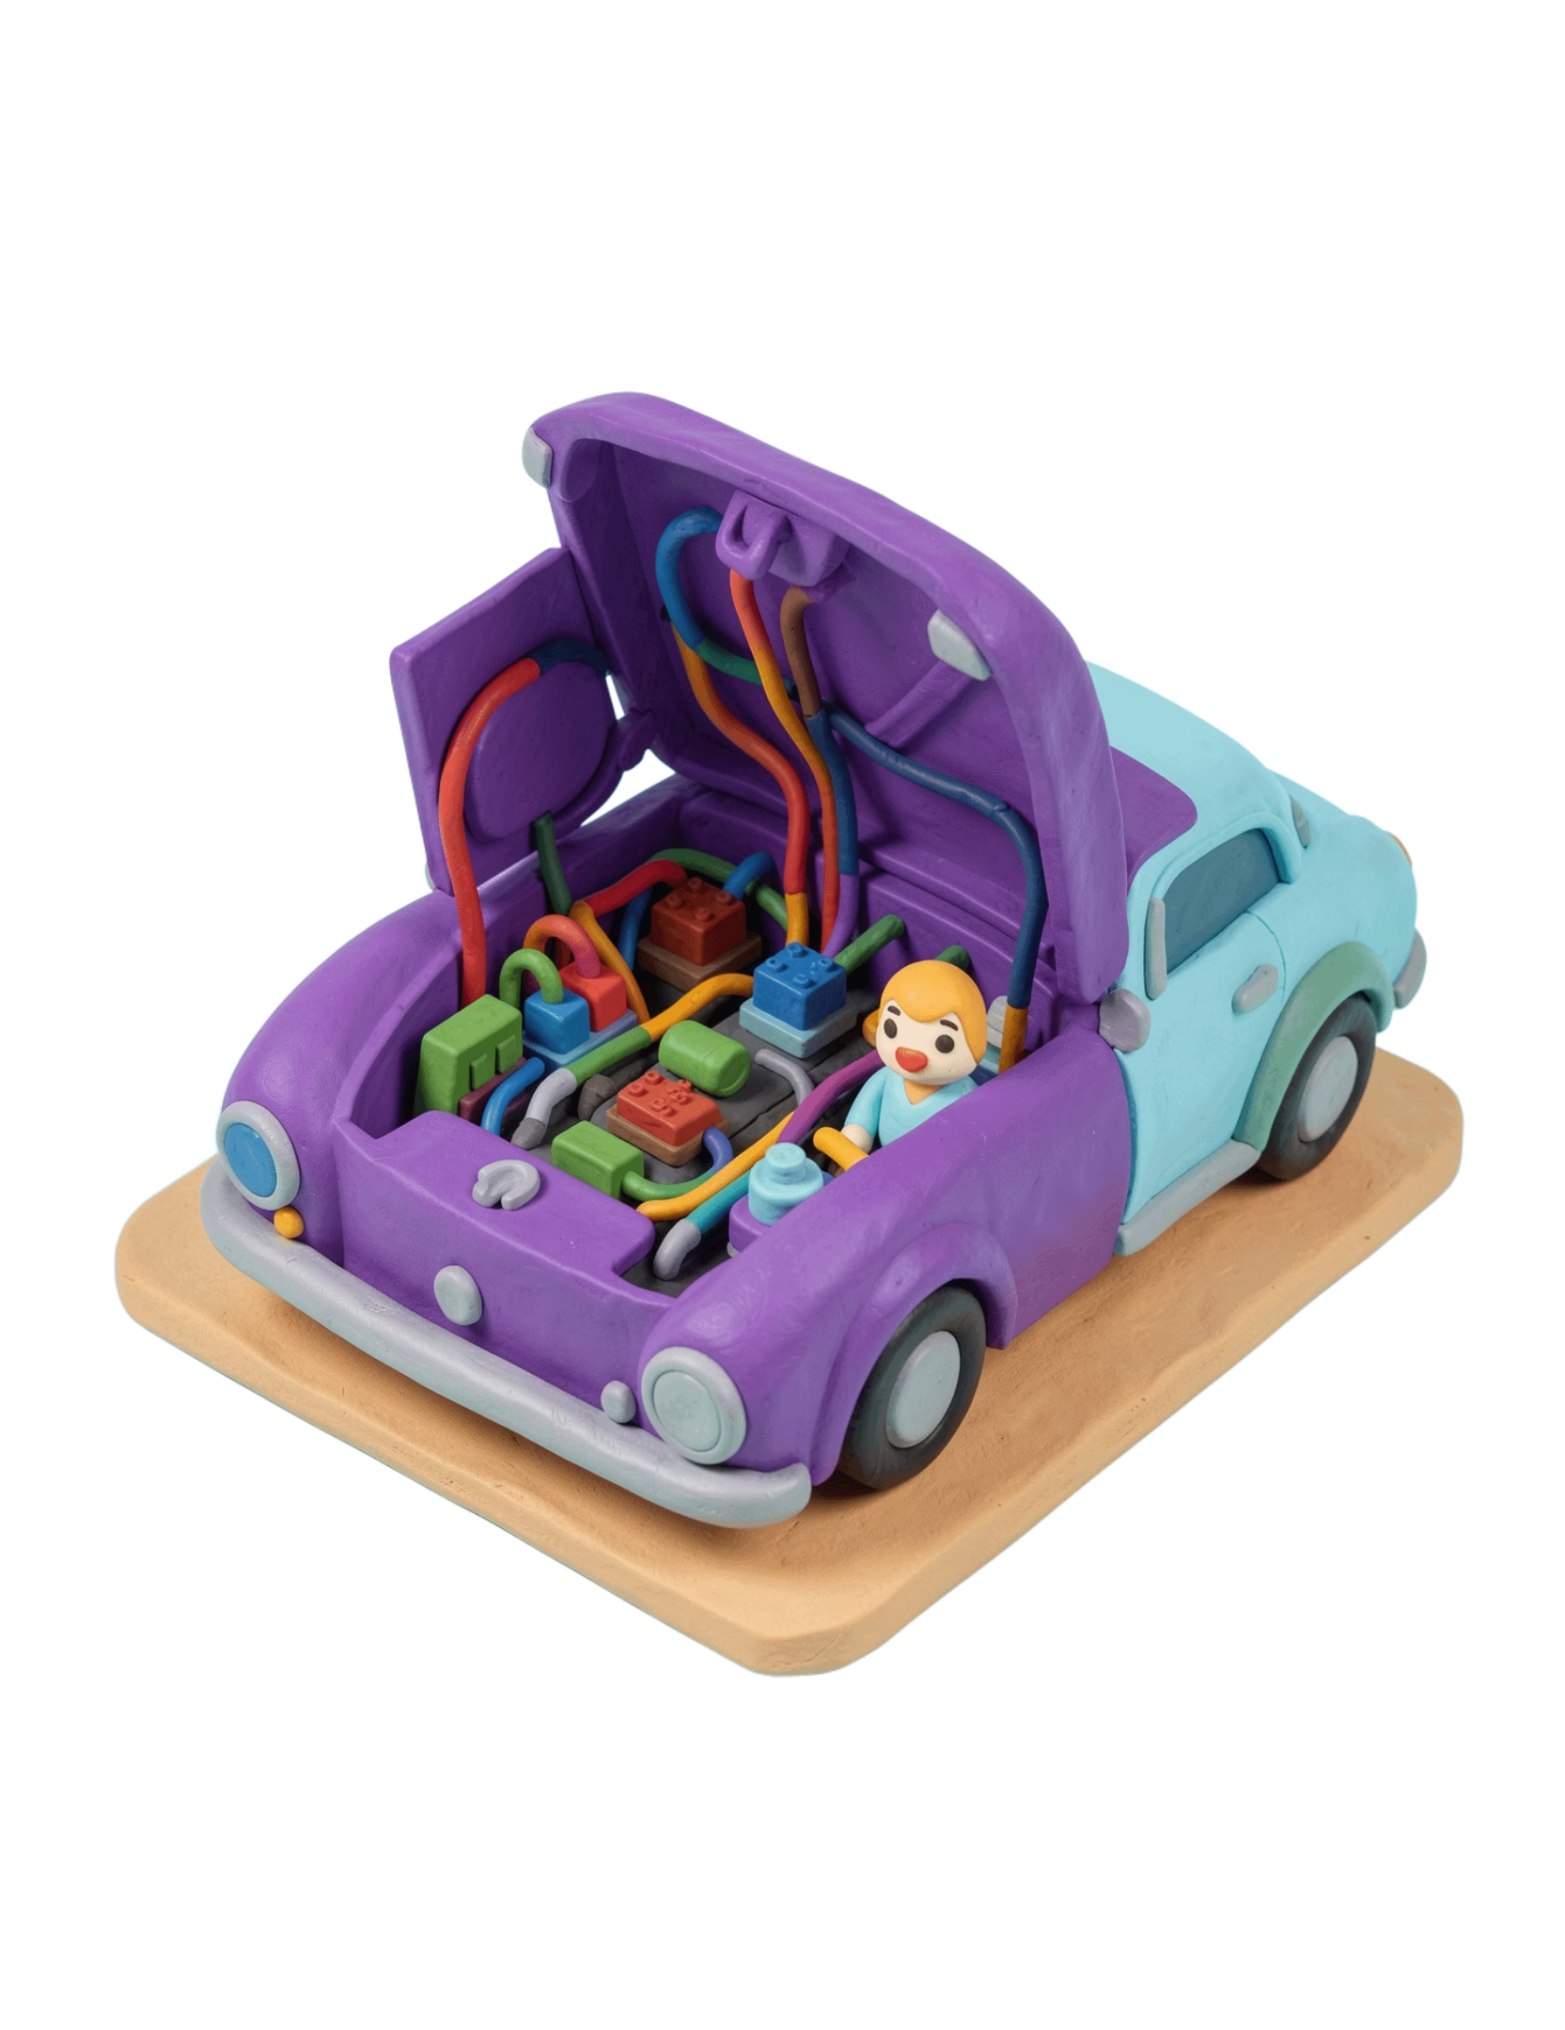
INSIDE THE IMPLEMENTATION
White-box testing
White-box testing examines the internal structure, code logic, branches, data flow, and implementation of an application.
The tester uses programming or design knowledge to verify that the code behaves correctly along important paths.
Opening a car hood to inspect wiring and relays instead of only checking whether the car starts.
Notes:
Use the car analogy to make the inside-versus-outside distinction concrete. White-box testing follows implementation paths, not only the behavior visible to a user.

Slide 6
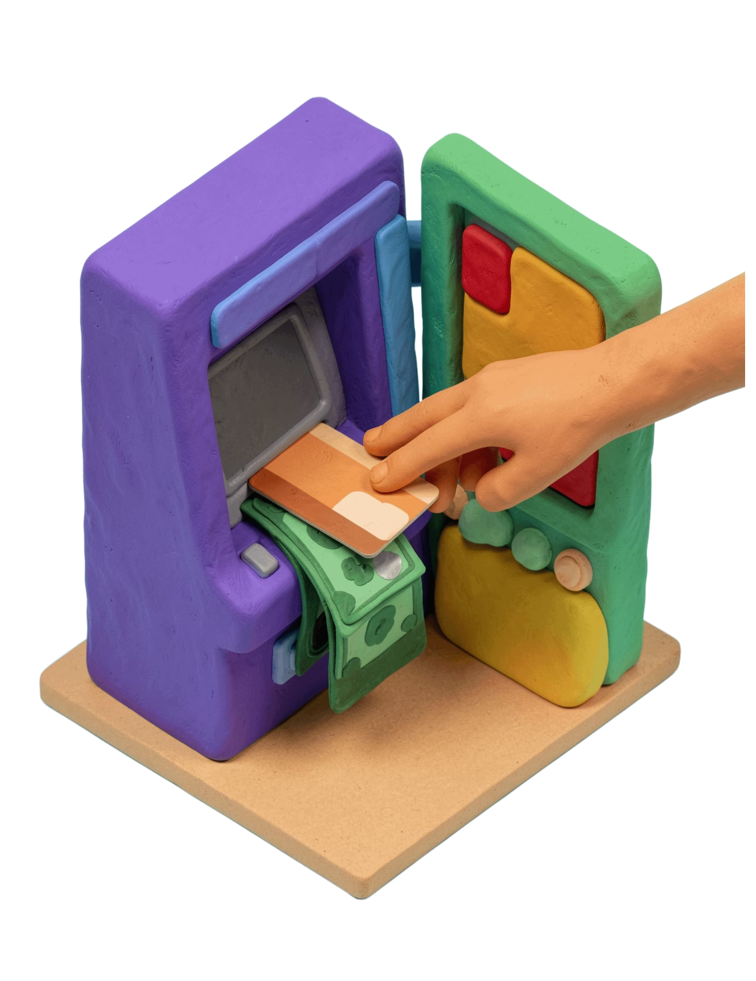
OUTSIDE-IN BEHAVIOR
Black-box testing
Black-box testing validates software behavior without requiring knowledge of the internal code or structure.
The tester concentrates on inputs, outputs, requirements, and user-visible behavior.
ATM withdrawal
Insert a card, request a withdrawal, and verify the cash and balance update without knowing the internal banking flow.
Notes:
Stress that black-box testing does not require the tester to know how the system works internally. The expected behavior is judged from the user-facing inputs and outputs.

Slide 7
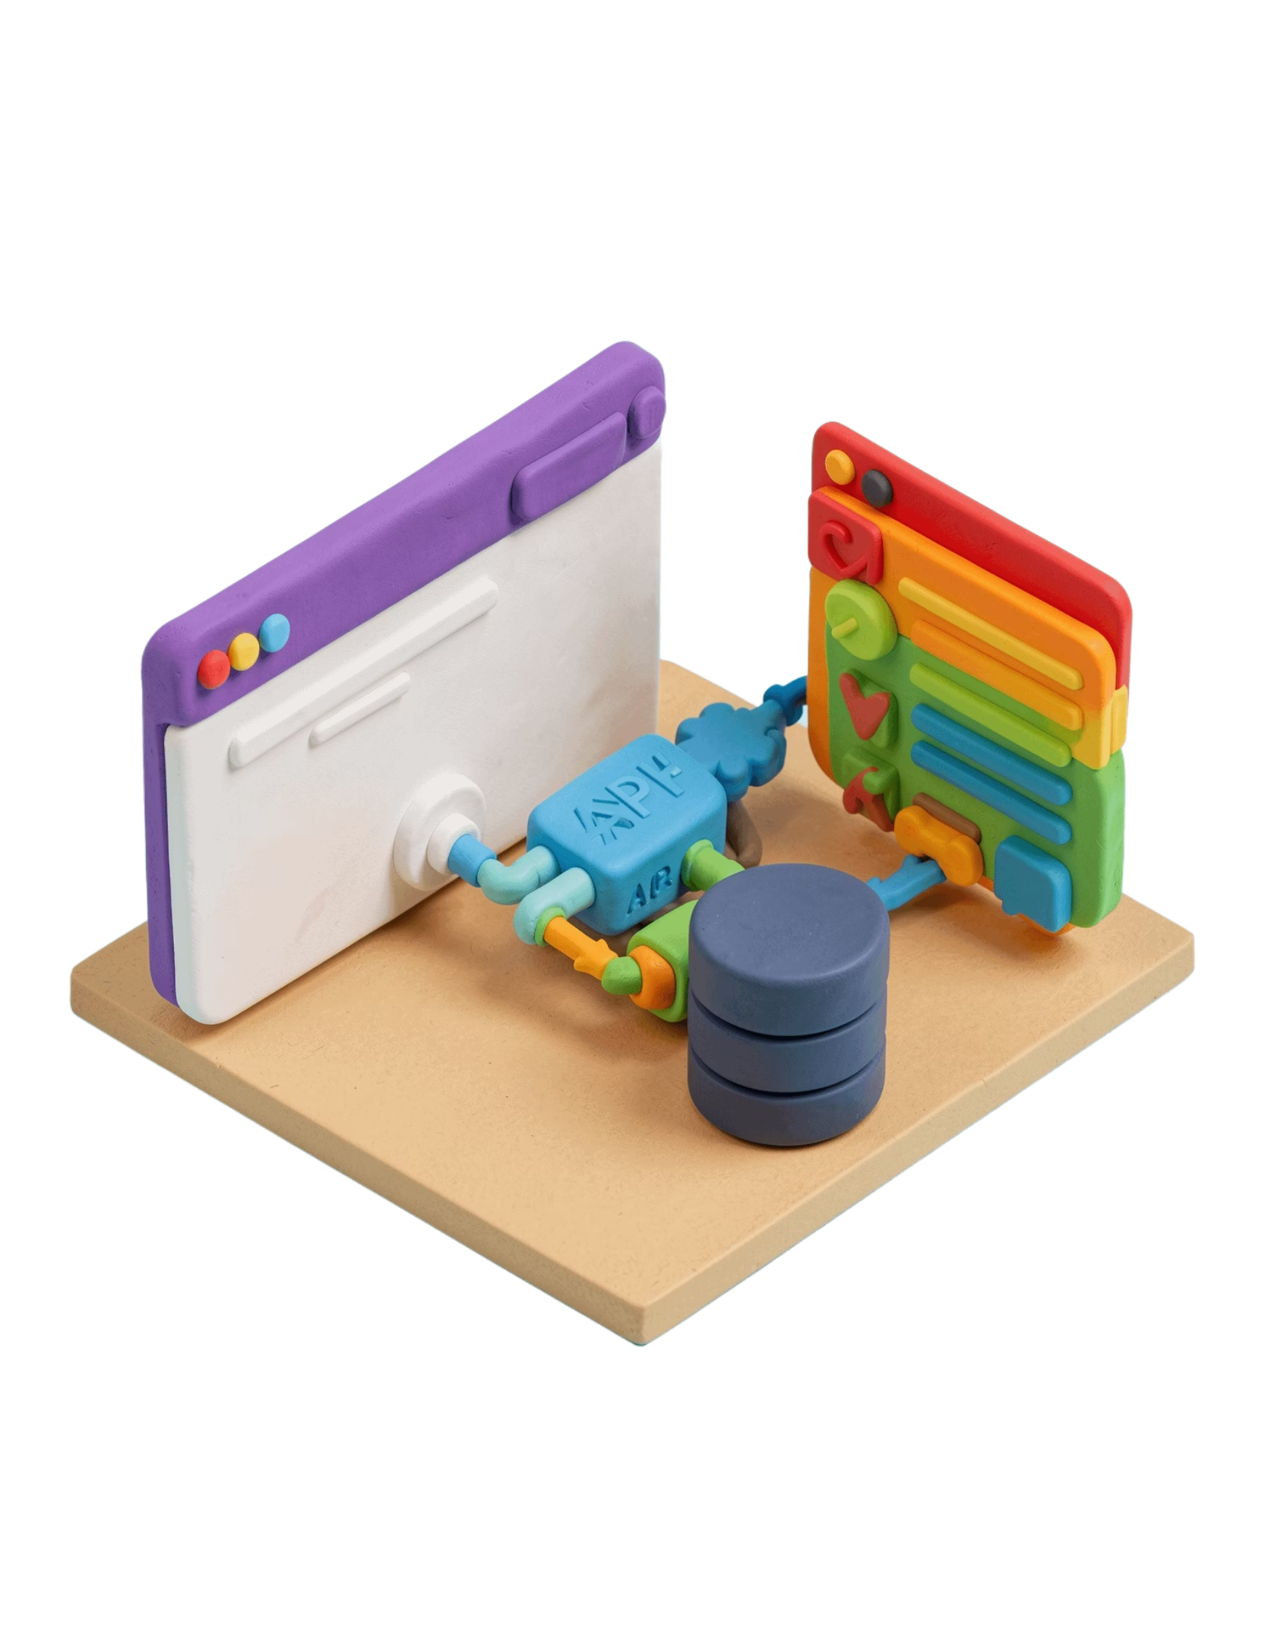
PARTIAL INTERNAL KNOWLEDGE
Gray-box testing
Gray-box testing combines external user-behavior testing with partial knowledge of the internal system.
The tester may know API structures, database schemas, or system architecture, but does not inspect every line of code.
Why use it?
It helps target realistic integration and data-flow risks while keeping the test close to user behavior.
Notes:
Gray-box testing sits between the two extremes. The tester uses selected knowledge of APIs, databases, or architecture to aim tests at integration and data-flow risks.

Slide 8








FROM APPROACH TO TEST CASE
White-box and black-box techniques in practice
WHITE BOX
BLACK BOX
How code executes
What the system produces
Statement coverage
Equivalence partitioning
Branch coverage
Boundary-value analysis
Path coverage
Decision-table testing
Condition testing
State-transition testing
White box asks “which internal paths ran?” while black box asks “did the system produce the correct result?”
Notes:
Contrast the questions, not just the technique names. White-box techniques derive evidence from code execution; black-box techniques derive cases from requirements and behavior.

Slide 9

FROM MISTAKE TO VISIBLE BEHAVIOR
Errors, Bugs/Defects, and Failures
Plan
Design
Implement
Review
Error
Bug / defect
Failure
A human mistake made during requirements, design, coding, or decision-making.
A problem in the software caused by an error and identified during review or testing; a confirmed defect is reported and tracked for correction.
The visible incorrect behavior that occurs when the software runs—for example, an application crashes or a login button does not respond.
Notes:
Walk through the chain in order. An error is made by a person, a defect is identified in the software, and a failure is what a user or tester can observe when the software runs.

Slide 10
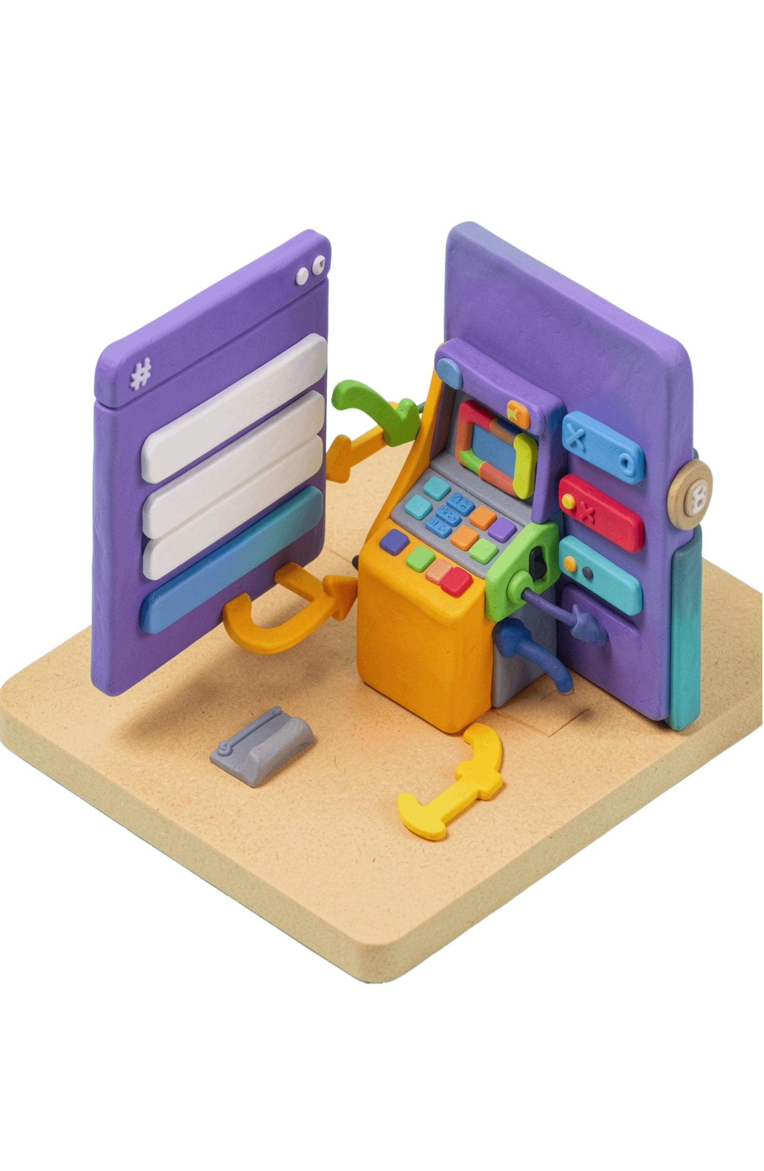
TESTING TYPES
Functional Testing
Functional testing verifies that the application performs defined functions according to requirements, using inputs and expected outputs.
Smoke
Sanity
Integration
System
Regression
User acceptance
Examples: verify login, validate an ATM withdrawal, confirm frontend-to-backend data flow, and check that a new release has not broken an existing feature.
Notes:
Functional testing is about whether defined functions work as required. Use the examples to connect the categories to recognizable checks: login, withdrawal, data flow, and protection against regression.

