Slide 1
ORANGEHRM
Test Case Test Data - OrangeHRM
QA execution deck

Slide 2
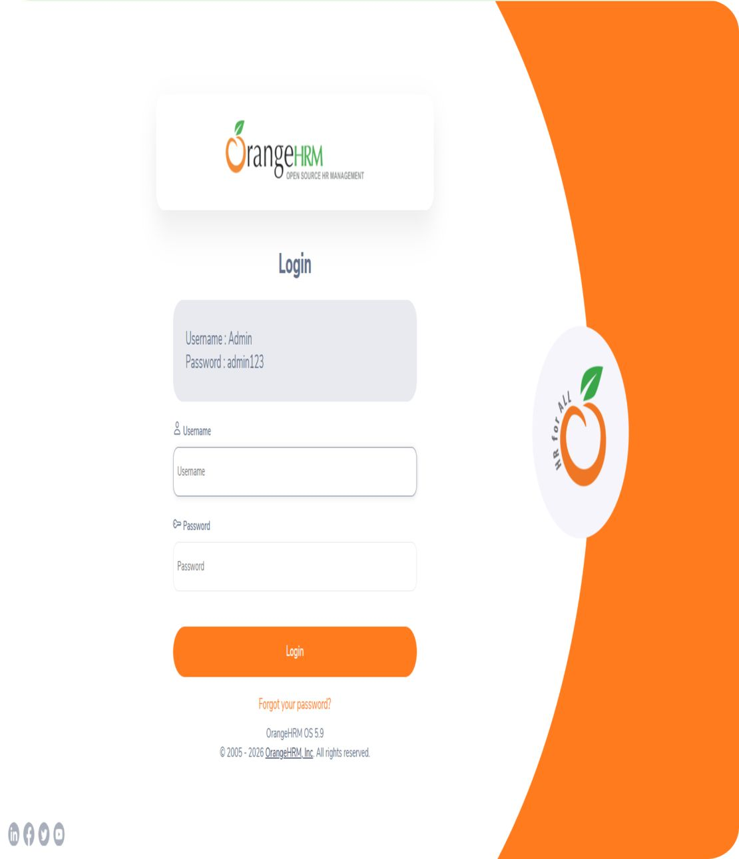
LOGIN PAGE
TEST CASES
TEST CASES- LOGIN PAGE :
1
TC_LOGIN_01
Verify that the login page loads successfully and displays all the main controls, including the username field, password field, Login button, and Forgot Password link.
2
TC_LOGIN_02
Verify that a user can log in successfully using the valid credentials, username Admin and password admin123, and is redirected to the Dashboard page.
3
TC_LOGIN_03
Verify that submitting the login form with both the username and password fields empty displays the appropriate required-field validation messages.
4
TC_LOGIN_04
Verify that submitting the login form with an empty username and a valid password displays username validation and prevents login.
5
TC_LOGIN_05
Verify that submitting the login form with a valid username and an empty password displays password validation and prevents login.

Slide 3

6
TC_LOGIN_06
Verify that attempting to log in with an invalid username (InvalidUser) and a valid password (admin123) is rejected and displays an appropriate error message.
7
TC_LOGIN_07
Verify that attempting to log in with a valid username (Admin) and an invalid password (WrongPass123) is rejected and displays an appropriate error message.
8
TC_LOGIN_08
Verify that the password field masks the entered characters instead of displaying the password in plain text.
9
TC_LOGIN_09
Verify that clicking the Forgot your password? link navigates the user to the password-reset page.
10
TC_LOGIN_10
Verify that clicking the Login button after entering valid credentials submits the form successfully and redirects the user to the Dashboard page.

Slide 4

LOGIN PAGE
TEST DATA
TEST DATA – LOGIN PAGE
 | Use the username Admin and password admin123 to verify successful login with valid credentials.
 | Leave both the username and password fields blank to verify required-field validation.
 | Leave the username field blank and enter admin123 as the password to verify username validation.
 | Enter Admin as the username and leave the password field blank to verify password validation.
 | Enter InvalidUser as the username and admin123 as the password to verify that login is rejected for an invalid username.
 | Enter Admin as the username and WrongPass123 as the password to verify that login is rejected for an invalid password.
 | Enter Admin as the username and Incorrect password as the password to verify that the password is masked and the login attempt is rejected.
TD_LOGIN_01
TD_LOGIN_02
TD_LOGIN_03
TD_LOGIN_04
TD_LOGIN_05
TD_LOGIN_06

Slide 5
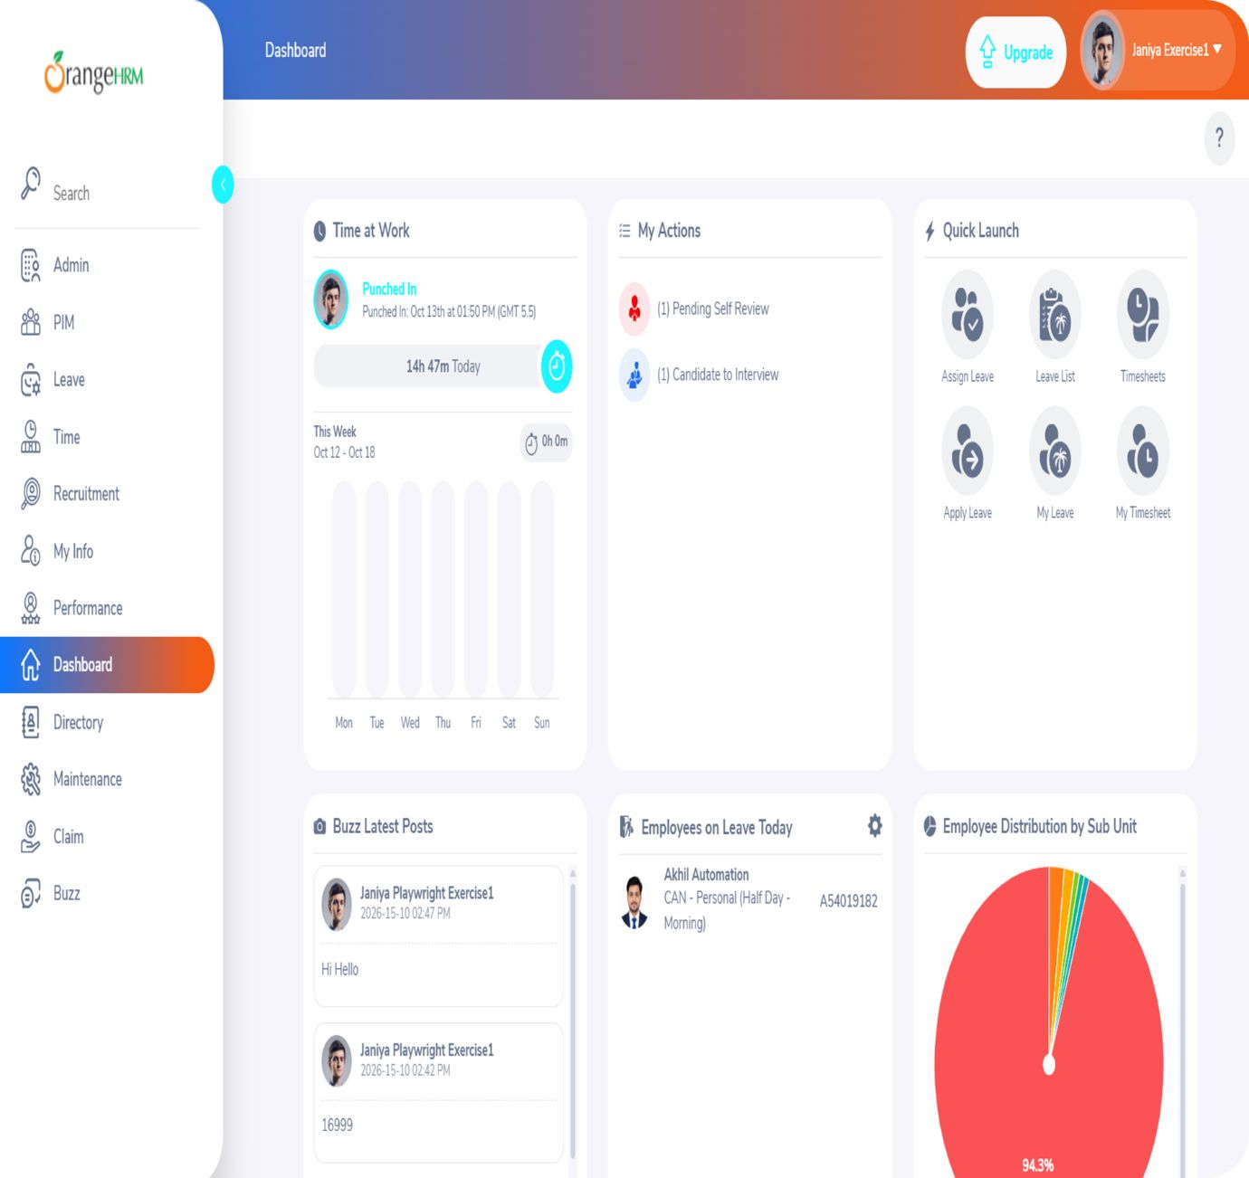
DASHBOARD
TEST CASES
TEST CASES- DASHBOARD
1
TC_DASH_01
Verify that the Dashboard page loads successfully after logging in with valid credentials.
2
TC_DASH_02
Verify that the page header displays the title Dashboard correctly.
3
TC_DASH_03
Verify that the left-side navigation menu is displayed with the expected menu items.
4
TC_DASH_04
Verify that entering PIM in the sidebar search displays the matching navigation item and behaves as expected.
5
TC_DASH_05
Verify that the Time at Work widget displays attendance information appropriately for the demo account.
6
TC_DASH_06
Verify that the My Actions widget displays available action items and their corresponding counts, where applicable.

Slide 6
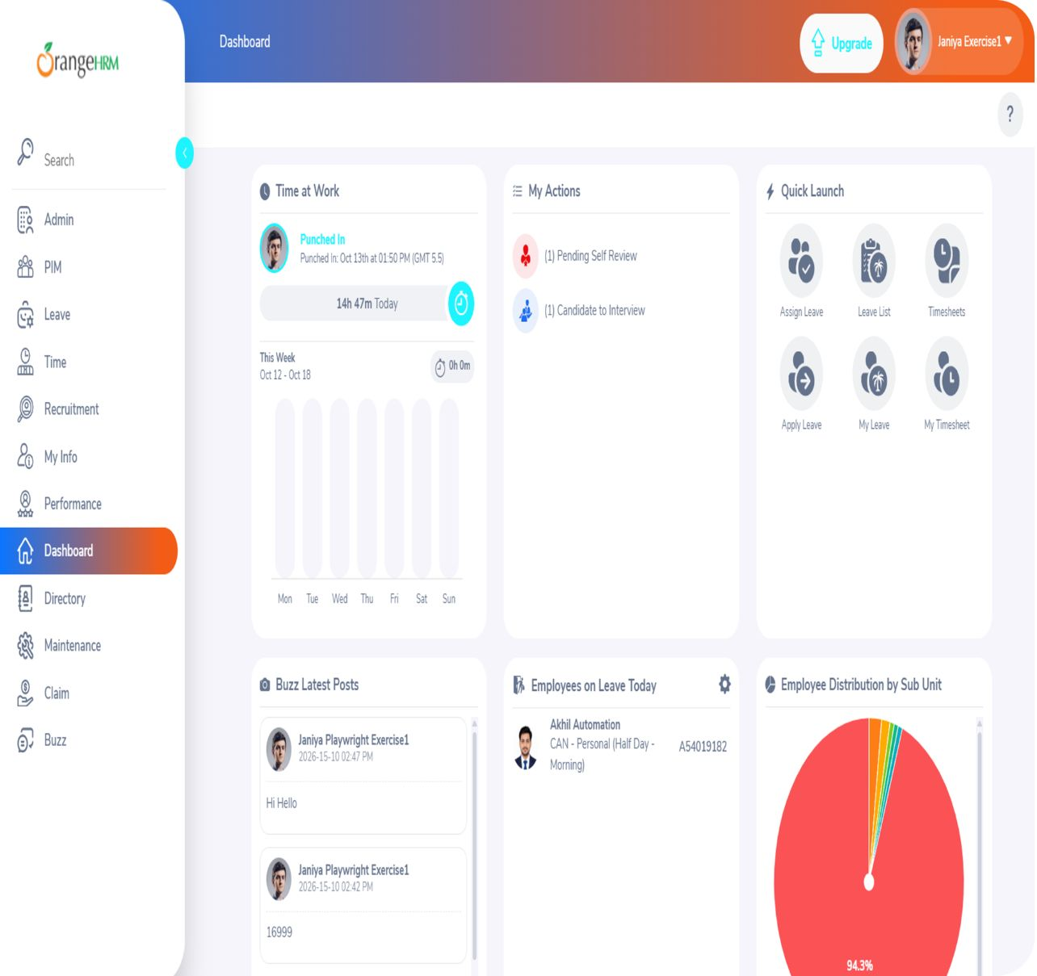
7
TC_DASH_07
Verify that clicking an available Quick Launch shortcut navigates to the relevant page or functionality.
8
TC_DASH_08
Verify that the Buzz Latest Posts section displays posts or an appropriate empty state when no posts are available.
9
TC_DASH_09
Verify that clicking the user profile dropdown displays the available account options.
10
TC_DASH_10
Verify that selecting Logout from the user profile dropdown ends the session and redirects the user to the login page.
11
TC_DASH_11
Verify that accessing the Dashboard URL directly after logout redirects the unauthenticated user to the login page.
12
TC_DASH_12
Verify that clicking the sidebar collapse/expand control switches the sidebar between expanded and collapsed layouts.

Slide 7

DASHBOARD
TEST DATA
TEST DATA – DASHBOARD
 | Use the Dashboard URL /web/index.php/dashboard/index to verify dashboard access after successful login.
 | Use the valid credentials Admin / admin123 to log in before testing the dashboard features.
 | Enter PIM in the sidebar search field to verify search functionality for a valid navigation item.
 | Enter Leave in the sidebar search field to verify search functionality for another valid navigation item.
 | Enter InvalidModule123 in the sidebar search field to verify how the application behaves when no matching navigation item exists.
 | Inspect and interact with the Time at Work widget, where controls are available.
TD_DASH_01
TD_DASH_02
TD_DASH_03
TD_DASH_04
TD_DASH_05
TD_DASH_06

Slide 8

DASHBOARD
TEST DATA
TEST DATA – DASHBOARD
 | Click Pending Self Review under My Actions, if available, to verify navigation to the relevant action page.
 | Click Assign Leave or Leave List under Quick Launch, if available, to verify that the selected shortcut opens the relevant page.
 | Inspect the Buzz Latest Posts section to verify that posts or an appropriate empty state are displayed.
 | Click the user profile dropdown to verify that the account menu and its available options are displayed.
 | Select Logout from the user profile dropdown to verify that the session ends and the login page appears.
 | Open the Dashboard URL after logging out to verify that unauthenticated access is redirected to the login page.
TD_DASH_07
TD_DASH_08
TD_DASH_09
TD_DASH_10
TD_DASH_11
TD_DASH_12

