Slide 1
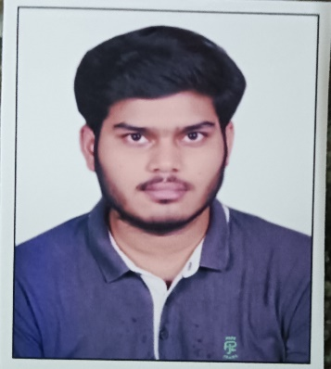
Full Name: Siddharth Arvind Singh
Photo Here
(Face to cover 50% of the box)
No Facebook Pics
Trainee Software Engineer
Mobile : 8070216971
Email:Siddharth.Singh2@mastek.com
LinkedIn: https://www.linkedin.com/in/siddharth-singh-223a001a5/
Educational Qualification: BSc IT
CGPA/Overall Score: 9.1/10
University: Mumbai University
Technical Skills: C ,C++, Python, Java, Dot Net, Php, Html,CSS,JavaScript
Domain Knowledge: Dot Net, Java
Behavioural Trainings Completed: Angular 13, ASP.NET MVC, ASP.Net API, SQL server, HTML, CSS, JavaScript, Bootstrap, Public Cloud (Aws, Azure, GCP).
TechnicalTrainings/Certifications:NA
Academic Project Details
Problem Statement: Project Name: Results Design Systems, In this project we are making result for students. We are collect the student marks and store the in database. Based on criteria we show the marks in result with passed or fails
Solution Summary: Before this system we are using excel sheets to store the marks and also design the format of result
My project is simply and straightforward store the data and retrieve the data based on Roll no.
Technology used: Dot net framework, SQL server, AJAX controls, HTML, CSS, and JavaScript
Outcome: Design the format of result and save the marks in databases. Based on roll no all the student data present in result and we are also print the results.

