Slide 1
AGILE VALUES and PRINCIPLES
Agile is the ability to create and respond to change.
AGILE Website

Slide 2
Agile Values
Individuals & Interactions
Working Software
Customer Collaboration
Responding to Change

Slide 3
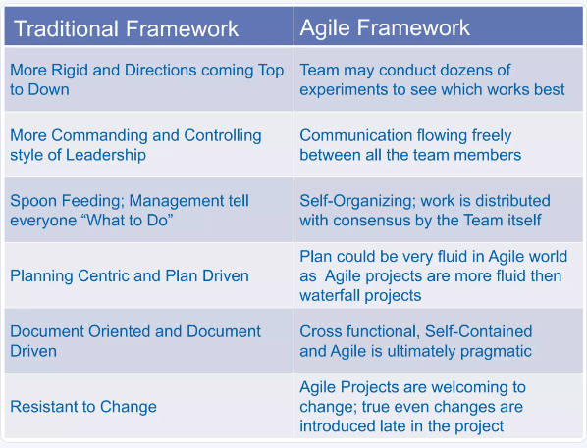

Slide 4
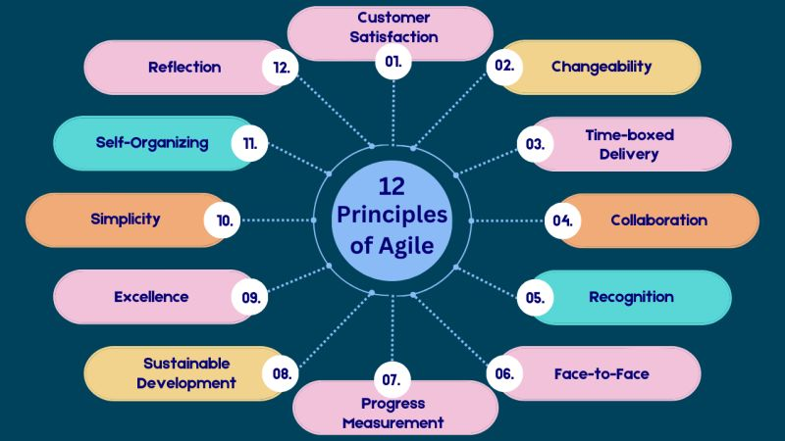
12 Agile Principles

Slide 5
THANK YOU
Siddharth Govardhane

