Slide 1

Trees
Rupesh Nasre.
rupesh@iitm.ac.in
Web: ~rupesh/teaching/pds/spw2019
Summer Projects and Workshop
June 2019

Slide 2
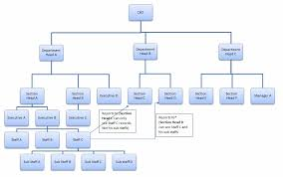

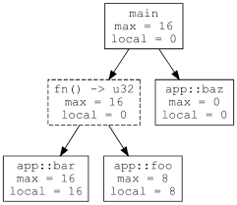

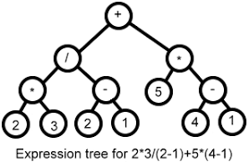
Manager-Employee Relation
Google Maps
Trees
Planetary Hierarchy
Modeling Computation
Expression Evaluation

Slide 3
Nomenclature
Root
Stem
Branches
Leaves
Fruits
Flowers
Edges

Slide 4
Definition
A tree is a collection of nodes.
It could be empty. // base case
Otherwise, it contains a root node,
connected to zero or more (child) nodes,
each of which is a tree in itself! // recursive
Alternatively, a tree is a collection of nodes and directed edges, such that each node except one has a single parent. The node without a parent node is the root.

Slide 5
Nomenclature
Empty Tree
Root has no parent.
Leaves have no children.
Non-leaves are internal nodes.
Each node is reachable
from the root.
The whole tree can be
accessed via root.
Each node can be viewed as
the root of its unique subtree.
Tree with one node
Tree with two nodes
Trees with three nodes

Slide 6
Properties
A tree has six nodes.
  What is the minimum number of edges in the tree?
  What is the maximum?
  Generalization for N nodes?
How many (undirected) paths exist between two nodes?

Slide 7
More Nomenclature
Sibling
  What is the maximum number of siblings a node may have in an N node tree?
Grandparent, grandchild
Ancestor, descendant
Path, length
Height, depth

Slide 8
Exercises
Given (a pointer to) a node in an employee tree, list all its direct and indirect subordinates.
Same as above with the name of the employee given.
Find distance between two nodes.
Find tree diameter (max. distance).
Convert infix to postfix.
Mirror a tree.
Find if there is a directed path from p to q.

Slide 9
Learning Outcomes
Apply tree data structure in relevant applications.
Construct trees in C++ and perform operations such as insert.
Perform traversals on trees.
Analyze complexity of various operations.

Slide 10
Implementation
A challenge is that the maximum number of children is unknown, and may vary dynamically.
typedef struct TreeNode *PtrToNode;
struct TreeNode {
int data;
PtrToNode firstChild;
PtrToNode nextSibling;
};
#include <vector>
typedef struct TreeNode *PtrToNode;
struct TreeNode {
int data;
std::vector<PtrToNode> children;
};
C
C++
A
A
B
C
D
E
F
G
B
C
D
E
F
G
H
I
J
K
L
H
I
J
K
L
M
N
M
N

Slide 11
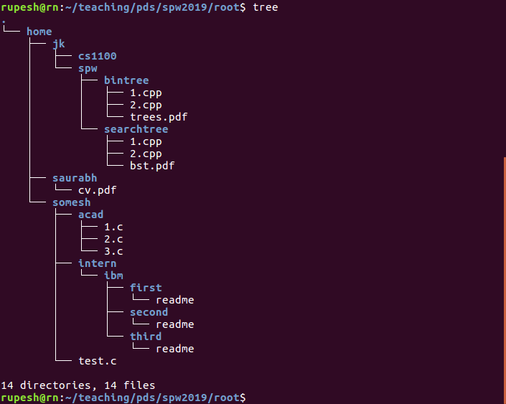
Directory Listing
There is a Linux command to list a directory like this. Any guesses for the command?
/
home
somesh
saurabh
jk
acad
intern
test.c
cv.pdf
cs1100
spw
1.c
bintree
searchtree
2.c
3.c
ibm
first
second
third
1.cpp
2.cpp
trees.pdf
1.cpp
2.cpp
bst.pdf
readme
readme
readme

Slide 12
Switch to code.
2.cpp and 3.cpp
Slides and code at http://www.cse.iitm.ac.in/~rupesh/teaching/pds/spw2019/
C++ basics at http://www.cse.iitm.ac.in/~rupesh/teaching/ooaia/jan18/

Slide 13
Traversals
Preorder
  Process each node before processing its children.
  Children can be processed in any order.
Postorder
  Process each node after processing its children.
  Children can be processed in any order.
Preorder and postorder are examples of Depth-First Traversal.
  Children of a node are processed before processing its siblings.
  The other way is called Breadth-First or Level-Order Traversal.

Slide 14
Preorder
Iterative
Recursive
void Tree::preorder() {
std::stack<PtrToNode> stack;
stack.push(root);
while (!stack.empty()) {
PtrToNode rr = stack.top();
stack.pop();
if (rr) {
rr->print();
for (auto child: rr->children)
stack.push(child);
}
}
}
void Tree::preorder(PtrToNode rr) {
if (rr) {
rr->print();
for (auto child:rr->children)
preorder(child);
}
}
void Tree::preorder() {
preorder(root);
}
Switch to code: 4.cpp, 6.cpp
Labwork: Indent files as per their depth.

Slide 15
Find full size of each directory
/ 29
home 28
somesh 14
saurabh
jk
acad
intern
test.c
cv.pdf 1
cs1100
spw
1.c
bintree
searchtree
2.c
3.c
ibm 7
first
second
third 2
1.cpp
2.cpp
trees.pdf
1.cpp
2.cpp
bst.pdf
readme
1
readme
readme

Slide 16
Postorder
Iterative
Recursive
Try it out in the lab.
void Tree::postorder(PtrToNode rr) {
if (rr) {
for (auto child:rr->children)
postorder(child);
rr→print();
}
}
void Tree::postorder() {
postorder(root);
}
Switch to code: 5.cpp

Slide 17
Story so far...
General trees
  arbitrary number of children
  Resembles several situations such as employees, files, ...
Special trees
  Fixed / bounded number of children
  Resembles situations such as expressions, boolean flows, …
  All the children may not be present.

Slide 18
K-ary Trees
typedef struct TreeNode *PtrToNode;
struct TreeNode {
int data;
PtrToNode firstChild;
PtrToNode nextSibling;
};
#include <vector>
typedef struct TreeNode *PtrToNode;
struct TreeNode {
int data;
std::vector<PtrToNode> children;
};
For a fixed K
When K == 2
typedef struct TreeNode *PtrToNode;
struct TreeNode {
int data;
PtrToNode children[K];
};
typedef struct TreeNode *PtrToNode;
struct TreeNode {
int data;
PtrToNode left;
PtrToNode right;
};

Slide 19
K-ary Trees
Binary
Ternary
For a fixed K
When K == 2
typedef struct TreeNode *PtrToNode;
struct TreeNode {
int data;
PtrToNode children[K];
};
typedef struct TreeNode *PtrToNode;
struct TreeNode {
int data;
PtrToNode left;
PtrToNode right;
};

Slide 20
Properties of Binary Trees
For an N node binary tree (N > 0):
  What is the maximum height?
  What is the minimum height?
  How many NULL pointers?
  How many min/max leaves?
What is the maximum number of nodes a binary tree of height H may have?
Full nodes (nodes with two children):
  how many minimum, maximum?
Show that #full nodes + 1 == #leaves in a non-empty binary tree.
N
log₂(N)
N + 1
1, N - 1
2^{H} - 1
0, N / 2 - 1

Slide 21
Expression Trees
(a + b * c) + ((d * e + f) * g)
+
+
*
a
*
+
g
b
c
*
f
d
e
Where did the parentheses go?
Can we write the expression itself in a way that no parentheses are required?

Slide 22
Traversals
void Tree::inorder(PtrToNode rr) {
if (rr) {
inorder(rr->left);
rr->print();
inorder(rr->right);
}
}
void Tree::inorder() {
inorder(root);
std::cout << std::endl;
}
preorder (NLR)
postorder (LRN)
inorder (LNR)
+
Find output of this code on this example tree.
a+b*c+d*e+f*g
Actual expression:
(a + b * c) + ((d * e + f) * g)
+
*
a
*
+
g
b
c
*
f
d
e

Slide 23
Traversals
void Tree::postorder(PtrToNode rr) {
if (rr) {
postorder(rr->left);
postorder(rr->right);
rr->print();
}
}
void Tree::postorder() {
postorder(root);
std::cout << std::endl;
}
preorder
Postorder (7.cpp)
inorder
Find output of this code on this example tree.
abc*+de*f+g*+
Operator precedence encoded.
+
+
*
a
*
+
g
b
c
*
f
d
e

Slide 24
Infix, Prefix, Postfix
Infix | Prefix | Postfix
A + B * C + D
(A + B) * (C + D)
A * B + C * D
A + B + C + D
A * B * C + D

Slide 25
Infix, Prefix, Postfix
Infix | Prefix | Postfix
A + B * C + D | + + A * B C D | A B C * + D +
(A + B) * (C + D) | * + A B + C D | A B + C D + *
A * B + C * D | + * A B * C D | A B * C D * +
A + B + C + D | + + + A B C D | A B + C + D +
A * B * C + D | + * * A B C D | A B * C * D +
The order of operands (A, B, C, D) remain the same in all the expressions.
Operators in prefix are in the opposite order compared to their postfix versions.

Slide 26
Evaluating postfix
Find the value of 5 1 2 3 * – 4 + 6 * –.
Write a program to evaluate a postfix expression.
  Assume digits, +, –, *, /.
For each symbol in the expression
If the symbol is an operand
Push its value to a stack
Else if the symbol is an operator
Pop two nodes from the stack
Apply the operator on them
Push result to the stack
Switch to postfixeval.cpp

Slide 27
Postfix to Expression Tree
+
+
*
a b c * + d e * f + g * +
a
*
+
g
b
c
*
f
For each symbol in the expression
If the symbol is an operand
Push its node to stack
Else if the symbol is an operator
Pop two nodes from the stack
Connect those to the operator
Push root of the tree to stack
d
e
Switch to postfix2tree.cpp

Slide 28
Operations on Trees
Insert: our addChild would take care of this.
Remove: Update parent’s pointer to NULL (and free memory).
  What if the node getting removed has children?
Search: Our tree traversals can help.
  Can a tree contain duplicate values?

Slide 29
Some Questions?
What if a child node is common to two parents?
  Ancestry
Can the edge be undirected?
Can the edges have weights?
Can there be multiple roots?
Can there be multiple edges between two nodes?
Is it okay to draw a tree with root at the bottom?

Slide 30
Exercises
Given (a pointer to) a node in an employee tree, list all its direct and indirect subordinates.
Same as above with the name of the employee given.
Find distance between two nodes.
Find tree diameter (max. distance).
Convert infix to postfix.
Mirror a tree.
Find if there is a directed path from p to q.

Slide 31
Learning Outcomes
Apply tree data structure in relevant applications.
Construct trees in C++ and perform operations such as insert.
Perform traversals on trees.
Analyze complexity of various operations.

