Slide 1

134th Rank in Engineering Category in NIRF
Ananthasagar, Hasanparthy Mandal, Hanamkonda District. www.sru.edu.in
Developed by
2103A51044 NIKESH REDDY
2103A51223 SATHVIK REDDY
2103A51322 MANOJ KUMAR
2103A51462 SIDDHARTH
Under the Guidance of
Madhira Srinivas, Assistant Professor
School of
Computer Science & Artificial Intelligence (CS&AI)

Slide 2
DSA Course Project Presentation
Objectives:
Introduction to Project
Software / Hardware specifications
System Design
Modules - Functions
Sample Code
Screen Shots / Outputs
Conclusion
References
Department of Computer Science & Artificial Intelligence (DoCS&AI)

Slide 3
DSA Course Project Presentation
I. Introduction to Project
Department of Computer Science & Artificial Intelligence (DoCS&AI)

Slide 4
DSA Course Project Presentation
I. Introduction to Project:
Mobile Store Management System Project using data structures and algorithms in C with Source Code – This C Mobile Store Management System Project is a console-based application written in C. This system is a simple little project that was created in the Code::Blocks IDE and compiled with the GCC compiler. The Mobile Store Management System is a simple console program that does not include any images.
The act of keeping, organizing, and managing information about mobiles and their accessories to customers and owners. It contains a menu where customers and owners can see what are the items are available in the store. And also, owners can check how many sales are done and also, they can add or delete any items in menu.
To place the order the customers, need to add the items to their cart. For this, customers need to check the items in menu and their
Department of Computer Science & Artificial Intelligence (DoCS&AI)

Slide 5
DSA Course Project Presentation
I. Introduction to Project:
specifications. If they want to remove any items from cart, they can use delete item option, so that item will get removed in user cart. After shopping, customers need to select the “Final Bill” option and check the total amount to be paid.
In Admin Section, the admin can check the how many sales are done in a day and admin can edit the menu using Adding or Deleting options. 8 Our project aims at Business process automation, i.e., we have tried to computerize various processes of Mobile Store Management System.
In computer system the customer must check the menu first and then add the required items to their cart or also they can delete the items from their cart.
In computer system the admin can also check the menu and if any new launches arrived in market, then he can add it to the menu.
Department of Computer Science & Artificial Intelligence (DoCS&AI)

Slide 6
DSA Course Project Presentation
I. Introduction to Project:
The system generates types of items are available in their store using menu option.
It satisfies the user requirement.
Be easy to understand by the user and operator.
Be easy to operate.
Have a good user interface.
Be expandable .
Department of Computer Science & Artificial Intelligence (DoCS&AI)

Slide 7
DSA Course Project Presentation
II. Software / Hardware Specifications
Department of Computer Science & Artificial Intelligence (DoCS&AI)

Slide 8
DSA Course Project Presentation
II. Software / Hardware Specifications:
Software Specifications:
  Operating System : Windows 11, Home edition, 64 bit
  Application Software : Dev C++ Editor, Version 5.16
  Hardware Specifications:
  Processor : Intel Core i5, 5rd Generation, 2.6 GHz
  RAM Size : 6 GB DDR-III
  HDD Size : 320 GB, 7200 RPM
Department of Computer Science & Artificial Intelligence (DoCS&AI)

Slide 9
DSA Course Project Presentation
III. System Design
Department of Computer Science & Artificial Intelligence (DoCS&AI)

Slide 10
DSA Course Project Presentation
III. System Design:
In this phase, a logical system is built which fulfils the given requirements. Design phase of software development deals with transforming the clients’s requirements into logically working system. Normally, design is performed in the following in the following two step :
Primary Design Phase :
In this phase, the system is designed at block level. The blocks are created on the basis of analysis done in the problem identification phase. Different blocks are created for different functions emphasis is put on minimising the information flow between blocks. Thus, all activities which require more interaction are kept in one block.
Department of Computer Science & Artificial Intelligence (DoCS&AI)

Slide 11
DSA Course Project Presentation
2. Secondary Design Phase: In the secondary phase the detailed design of every block is performed. The general tasks involved in the design process are the following:
1. Design various blocks for overall system processes.
2. Design smaller, compact and workable modules in each block.
3. Design various database structures.
4. Specify details of programs to achieve desired functionality.
5. Design the form of inputs, and outputs of the system.
6. Perform documentation of the design.
7. System reviews .
Department of Computer Science & Artificial Intelligence (DoCS&AI)

Slide 12
DSA Course Project Presentation
User Interface Design User Interface Design is concerned with the dialogue between a user and the computer. It is concerned with everything from starting the system or logging into the system to the eventually presentation of desired inputs and outputs. The overall flow of screens and messages is called a dialogue.
The following steps are various guidelines for User Interface Design:
1. The system user should always be aware of what to do next.
2. The screen should be formatted so that various types of information, instructions and messages always appear in the same general display area.
Department of Computer Science & Artificial Intelligence (DoCS&AI)

Slide 13
DSA Course Project Presentation
3. Message, instructions or information should be displayed long enough to allow the system user to read them.
4. Use display attributes sparingly.
5. Default values for fields and answers to be entered by the user should be 13 specified.
6. A user should not be allowed to proceed without correcting an error.
7. The system user should never get an operating system message or fatal error.
Department of Computer Science & Artificial Intelligence (DoCS&AI)

Slide 14
DSA Course Project Presentation
IV. Functions of Modules
Department of Computer Science & Artificial Intelligence (DoCS&AI)

Slide 15
DSA Course Project Presentation
IV. Functions of Modules / Functions:
1. ADD ITEMS BY CUSTOMER
If customer need to buy an item, first customer need to select the PLACE ORDER option and enter the serial no. of item and add to their cart.
2. DELETE ITEMS BY CUSTOMER:
If customer need to cancel the product which is in their cart then they need to use to DELETE ORDER option. Here customer need to enter the serial no. of item which they want to delete.
3. MENU FOR CUSTOMER:
If customer need to place the order, first they need to check the menu what items are available in menu by clicking MENU option.
4. VIEW ORDERED ITEMS:
Before going to Final bill option first customer need to check what are the items are selected in their cart. For that they need to click VIEW ORDERED ITEMS option.

Slide 16
DSA Course Project Presentation
IV. Functions of Modules / Functions:
4. FINAL BILL
If customer need Final bill for their cart, they need to select FINAL BILL option.
5. ADD ITEMS BY ADMIN:
If Admin want to add the new launches to their menu, then admin must use this option.
6. DELETE ITEMS BY ADMIN:
If Admin want to delete the old stock items in their menu, then admin must use this option.
7. MENU:
After the edit done by the admin to the menu of items , admin can check the final menu by using this option.
8. CALCULATE SALES:
If admin want know the no. of sales done in a day and wants to calculate the total amount then admin can use this option.

Slide 17
DSA Course Project Presentation
VI. Outputs
Department of Computer Science & Artificial Intelligence (DoCS&AI)

Slide 18
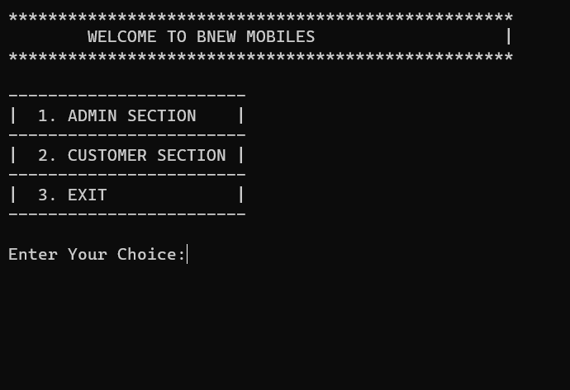
DSA Course Project Presentation
VI. Outputs
Department of Computer Science & Artificial Intelligence (DoCS&AI)

Slide 19
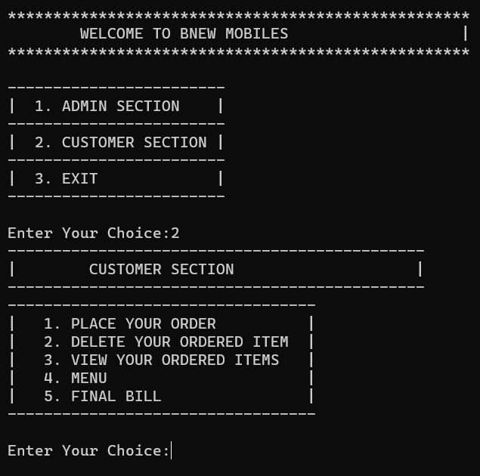
DSA Course Project Presentation
VI. Outputs
Department of Computer Science & Artificial Intelligence (DoCS&AI)

Slide 20
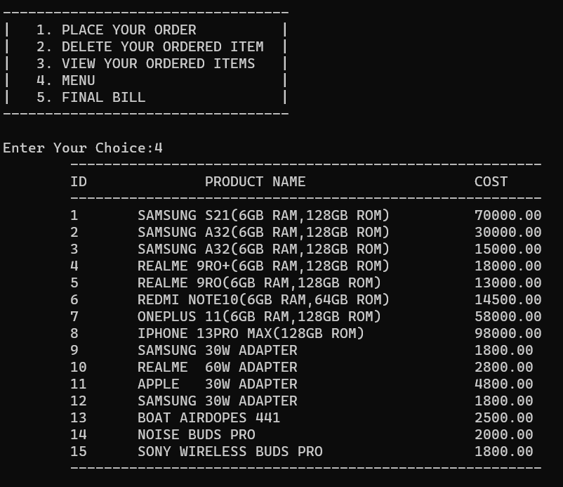
DSA Course Project Presentation
VI. Outputs
Department of Computer Science & Artificial Intelligence (DoCS&AI)

Slide 21
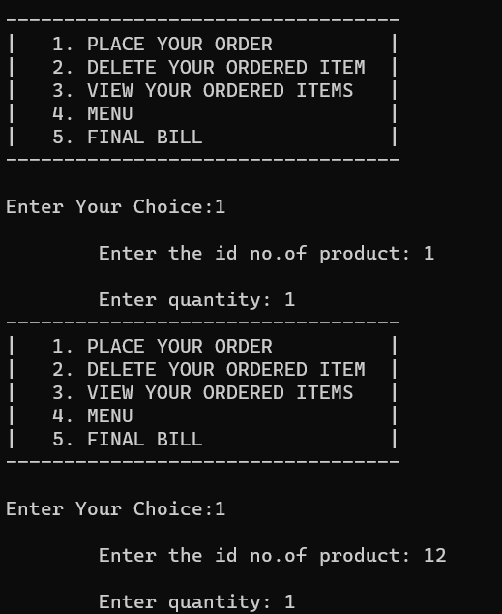
DSA Course Project Presentation
VI. Outputs
Department of Computer Science & Artificial Intelligence (DoCS&AI)

Slide 22
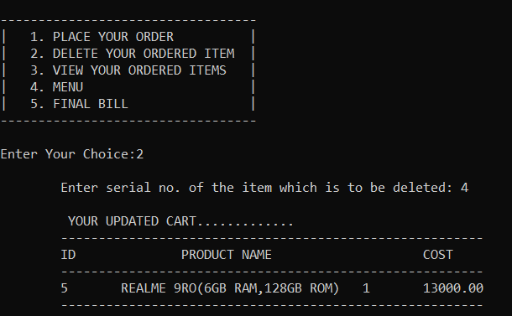
PSP Course Project Presentation
VI. Outputs
Department of Computer Science & Artificial Intelligence (DoCS&AI)

Slide 23
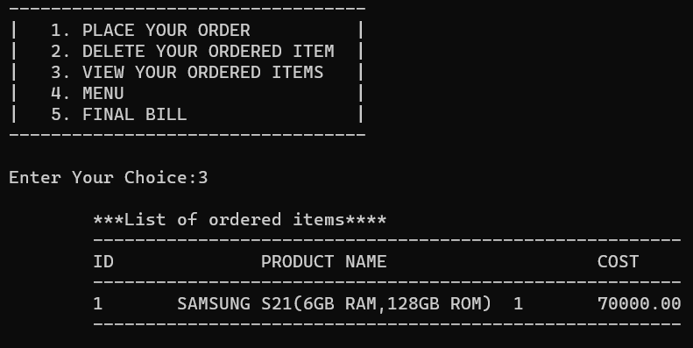
DSA Course Project Presentation
VI. Outputs
Department of Computer Science & Artificial Intelligence (DoCS&AI)

Slide 24
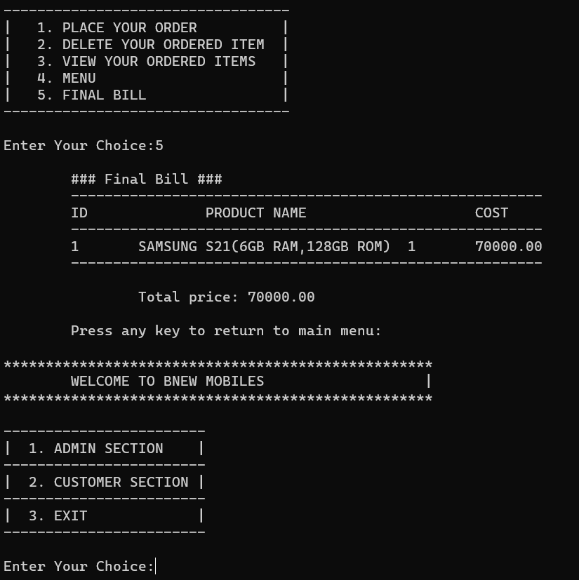
DSA Course Project Presentation
VI. Outputs
Department of Computer Science & Artificial Intelligence (DoCS&AI)

Slide 25
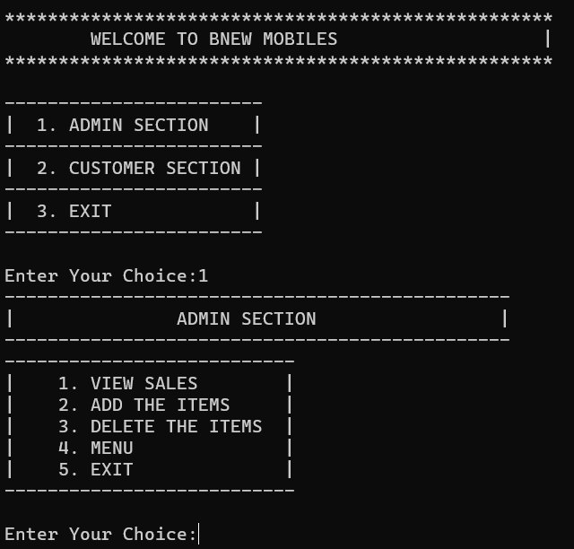
DSA Course Project Presentation
VI. Outputs
Department of Computer Science & Artificial Intelligence (DoCS&AI)

Slide 26
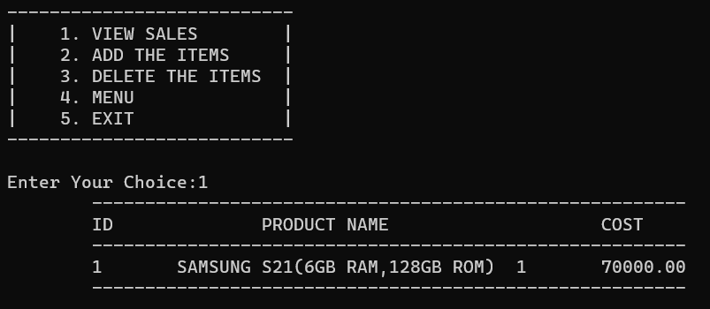
DSA Course Project Presentation
VI. Outputs
Department of Computer Science & Artificial Intelligence (DoCS&AI)

Slide 27
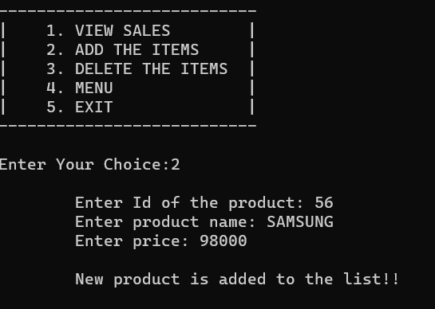
DSA Course Project Presentation
VI. Outputs
Department of Computer Science & Artificial Intelligence (DoCS&AI)

Slide 28
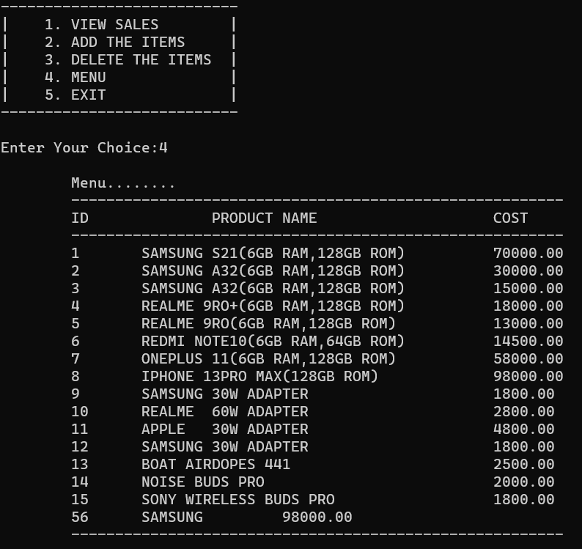
DSA Course Project Presentation
VI. Outputs
Department of Computer Science & Artificial Intelligence (DoCS&AI)

Slide 29
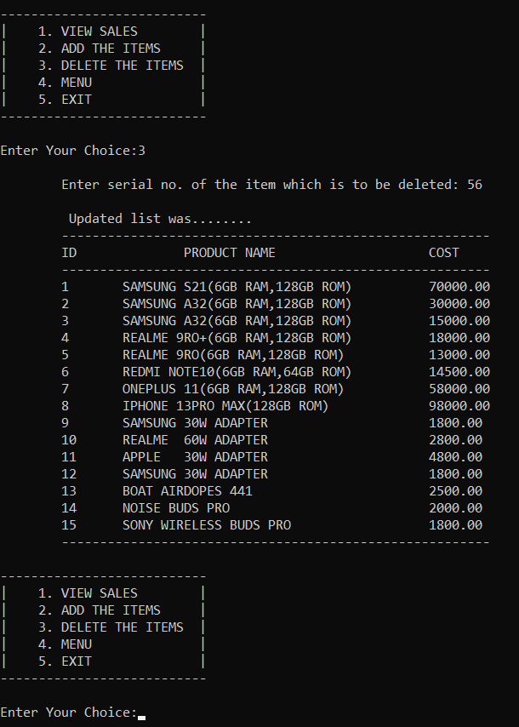
DSA Course Project Presentation
VI. Outputs
Department of Computer Science & Artificial Intelligence (DoCS&AI)

Slide 30
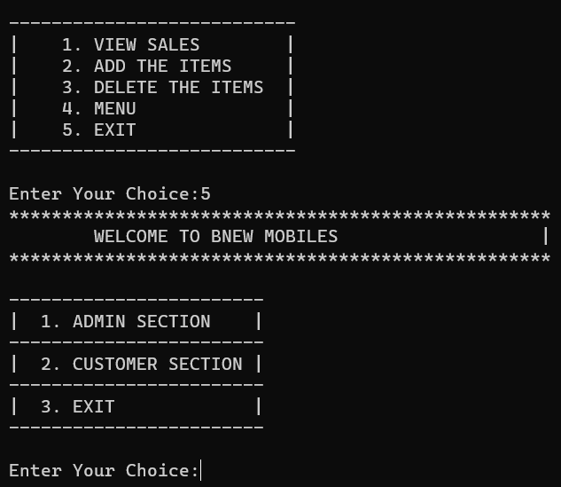
DSA Course Project Presentation
VI. Outputs
Department of Computer Science & Artificial Intelligence (DoCS&AI)

Slide 31
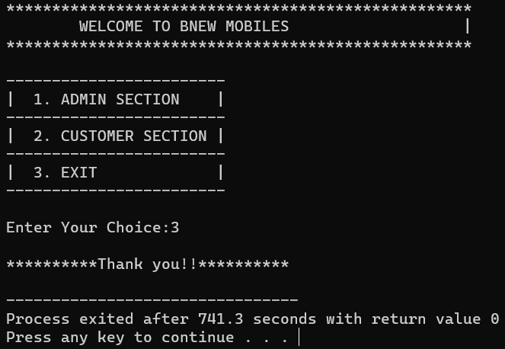
DSA Course Project Presentation
VI. Outputs
Department of Computer Science & Artificial Intelligence (DoCS&AI)

Slide 32
DSA Course Project Presentation
VII. Conclusion
Department of Computer Science & Artificial Intelligence (DoCS&AI)

Slide 33
DSA Course Project Presentation
VII. Conclusions:
By this project we can conclude that, the admin can easily find the sales that were purchased by the customers and the admin can also add any new products, through which they can update their menu. If the admin want to delete any old product they can. The user who want to buy a product they can check the menu and they can add, delete and view their ordered items easily according their bill is generated. Through which user and admin can interact mobile or any other stores with ease.
Department of Computer Science & Artificial Intelligence (DoCS&AI)

Slide 34
DSA Course Project Presentation
VIII. Refrences
Department of Computer Science & Artificial Intelligence (DoCS&AI)

Slide 35
DSA Course Project Presentation
VIII. References:
Websites :
www.codewithharry.com
www.cprogramming.com
http://www.tutorialspoint.com/mysql
httpd.apache.org/docs/2.0/misc/tutorials.html
Text Books :
Data Structures and Algorithm Analysis in C second edition – Mark Allen Wesis
Data Structures Using C – Reema Thareja
Department of Computer Science & Artificial Intelligence (DoCS&AI)

Slide 36

DSA Course Project Presentation
Department of Computer Science & Artificial Intelligence (DoCS&AI)

Slide 37

DSA Course Project Presentation
Department of Computer Science & Artificial Intelligence (DoCS&AI)

