Slide 1
Exploring the Wisdom of Crowds
Week 2
Sharad Goel
Stanford University
February 13, 2015

Slide 2
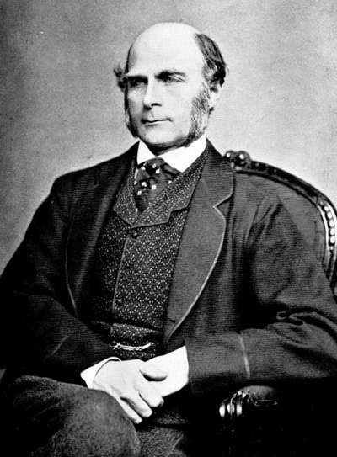
Francis Galton

Slide 3
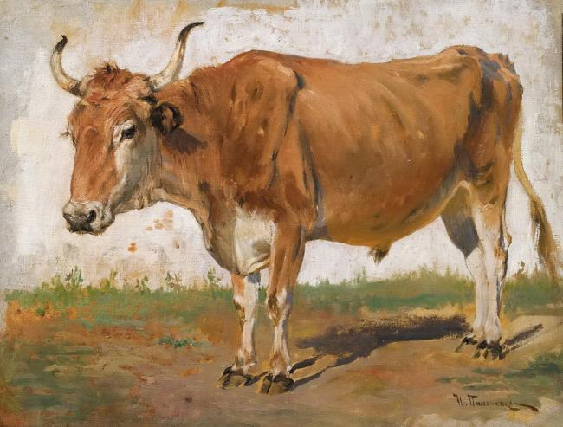
1906 Plymouth County Fair
What is the weight of the ox?

Slide 4
1906 Plymouth County Fair
What is the weight of the ox?
800 guesses
median guess was 1207 lbs.

Slide 5
1906 Plymouth County Fair
What is the weight of the ox?
800 guesses
median guess was 1207 lbs.
actual weight was 1198 lbs.

Slide 6
Francis Galton
Nature, 1907
“The result is, I think, more creditable to the
trustworthiness of a democratic judgment
than might have been expected.”

Slide 7


Slide 8
Wisdom of the crowd
The collective opinion of a crowd
can outperform the judgments
of any one individual

Slide 9
Madness of crowds
Charles Mackay
riots
economic bubbles
mass hysteria
herding

Slide 10
Research question
When are crowds “wise”?

Slide 11
Research question
How best to aggregate opinions?
How big a crowd do you need?
What is the effect of social influence?

Slide 12
Research question
What is the underlying mechanism?

Slide 13
Experimental design
1. Systematically construct thousands of tasks
2. Recruit a crowd to complete the tasks
3. Analyze the responses

Slide 14
Studying crowds, with crowds

Slide 15
A mini-experiment
in “collective intelligence”
http://goo.gl/forms/WG1kWgYjke
Give your best guess
Do not look up the answer
Do not talk to anyone
Don’t worry if you don’t know the answers!

Slide 16
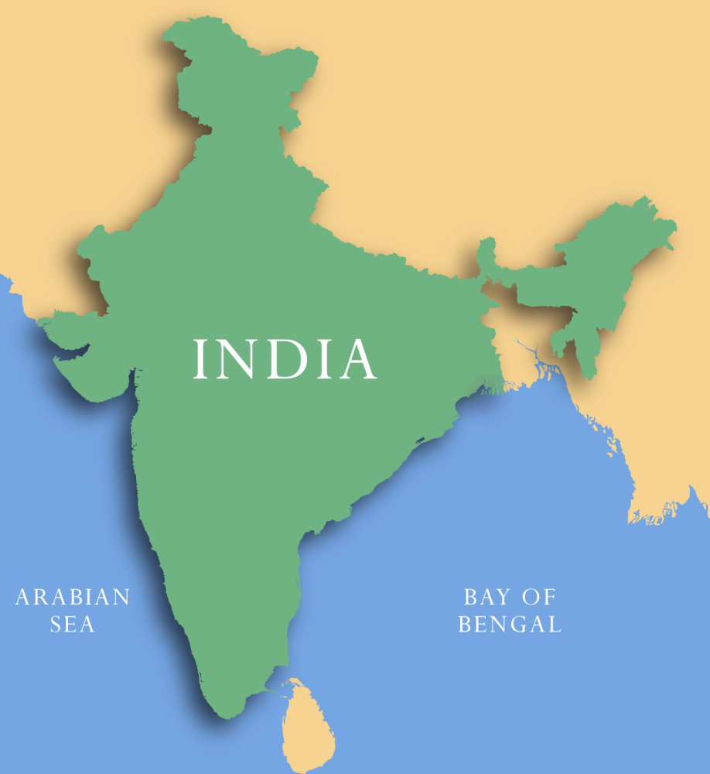
What is the total area of India? (km²)

Slide 17
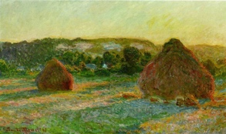
In what year was this painting made?
Notes:
Answer: 1890

Slide 18
How many dots are in the figure?

Slide 19
India vs. Pakistan
Cricket World Cup, Game 4
How many runs do you think
each team will score?

Slide 20
Assignment
literature review
Document past studies
on the wisdom of crowds

Slide 21
Assignment
brainstorm tasks
be creative, but realistic

Slide 22
Assignment [ optional ]
apply to design experiment platform
teams should have experience with
HTML, CSS, PHP, JavaScript, and MySQL

Slide 23
Course materials
Piazza, GitHub

Slide 24
Course Staff
Sharad Goel
Imanol Arrieta Ibarra
Camelia Simoiu
Rajan Vaish
Notes:
3,287,590; 1890; 1149

