Slide 1
Exploring the Wisdom of Crowds
Week 2
Sharad Goel
Stanford University
February 20, 2015

Slide 2
Results of our mini
wisdom of crowds experiment

Slide 3
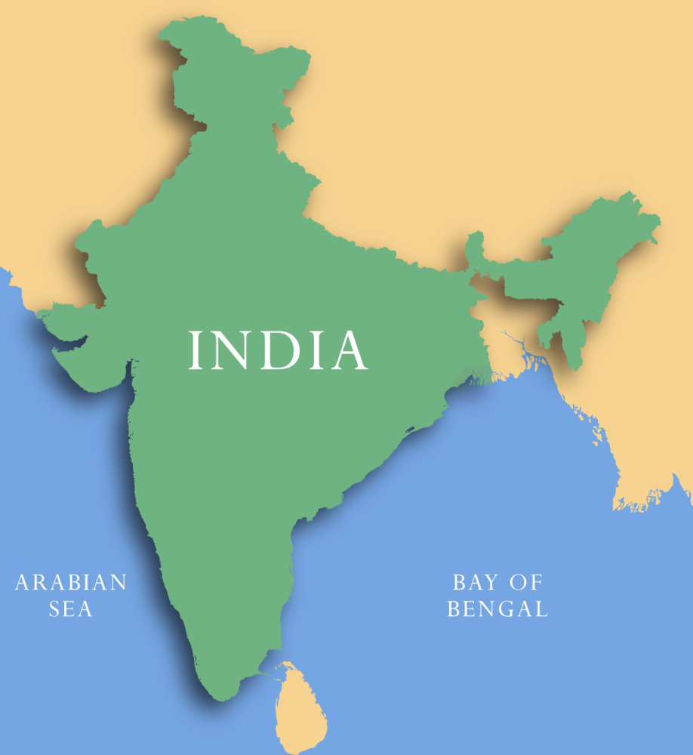
What is the total area of India? (km²)

Slide 4
Correct answer
3,287,590 km²
Mean guess
8,245,802 (18th percentile)

Slide 5
Correct answer
3,287,590 km²
Mean guess
8,245,802 (18th percentile)
Max guess
100,000,000

Slide 6
Correct answer
3,287,590 km²
Median
1,500,000 (72st percentile)

Slide 7
Truncated mean
First remove largest and smallest 5% of values,
and then take the mean of the remaining values

Slide 8
Correct answer
3,287,590 km²
Truncated mean
4,135,343 (81st percentile)

Slide 10
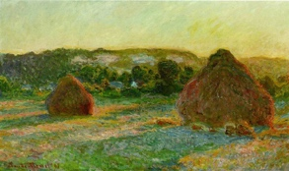
In what year was this painting made?
Notes:
Answer: 1890

Slide 11
Correct answer
1890

Slide 13
Correct answer
1890
Mean answer
1847
Median answer
1820

Slide 14
How many dots are in the figure?

Slide 15
Correct answer
1149
Mean guess
73,623 (2nd percentile)
Max guess
5,000,000

Slide 16
Correct answer
1149
Median
700 (73rd percentile)
Truncated mean
995 (88th percentile)

Slide 18
India vs. Pakistan
Cricket World Cup, Game 4
How many runs do you think
each team will score?

Slide 19
Correct answer
300 (India) - 224 (Pakistan)
Median (India)
280 (72nd percentile)
Median (Pakistan)
250 (66th percentile)

Slide 22
The aggregation method matters
need to account for extreme values
Crowd estimate reasonably good
better than 70 – 80% of participants
[ in these examples ]
[ doc/inClass_exp/survey_results.pdf ]

Slide 23
And the platform
design winners are…

Slide 24
Team Traceback
Alok Shankar, Arvind Srikantan, Chiraag Sumanth,
Bhargav HS, Ramesh Arvind
Team Visionastra
Tushar Dobhal, Atif Ahmed, Mayank Pahadia,
Vikas Yaligar, Mani Shankar
Team Visionaries
Sudheer Vazrapu, Sukanya Venkataraman,
Venkat Nirmal, Kasyap Varma, Anusha Singh

Slide 25
Literature review
Analysis of WoC in a specific domain
(e.g., weather forecasts, combinatorial optimization)
Development of novel aggregation methods
General study of WoC
(e.g., effects of social influence, crowd size)

Slide 26
GitHub
submit usernames by noon PST today
[ for pushing changes / tracking progress ]
do not create extraneous branches;
push directly to the repository

Slide 27
Assignment
[ all teams ]
continue literature review
rate tasks
Assignment
[ platform design teams ]
continue prototyping

