Slide 1
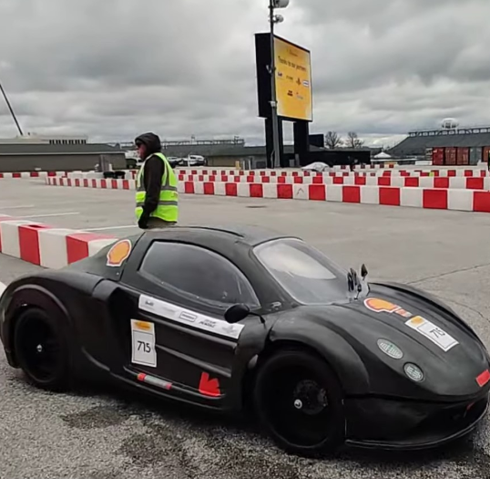
SIDDHARTH GUMMADAPU
Engineering
Project Portfolio
Mechanical Engineering + Computer Engineering
UIUC
sg97@illinois.edu | linkedin.com/in/siddharth-gummadapu

Slide 2
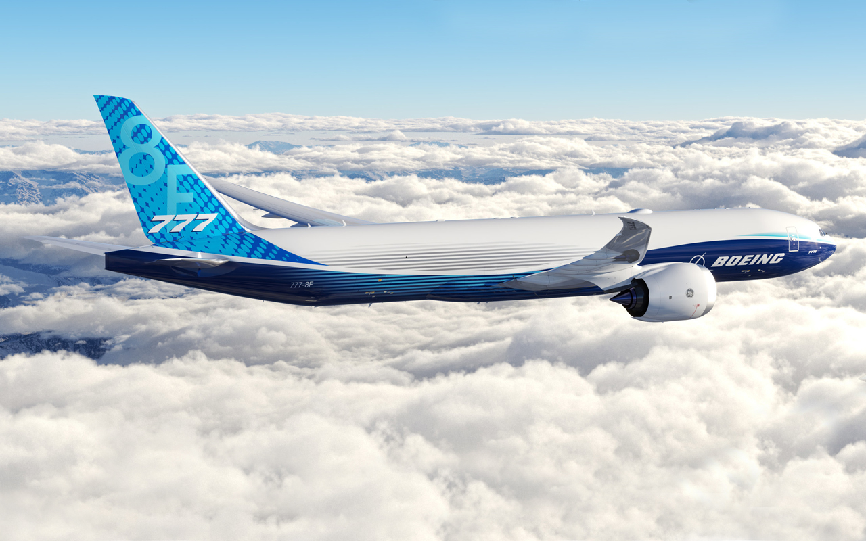
BOEING — 777X STRUCTURES
Closed a 777-8F assembly gap by 50%
OBJECTIVE
Mitigate a factory build hazard without disrupting the surrounding primary-structure architecture.
ENGINEERING WORK
•
Traced the local structure and assembly sequence to define the redesign envelope.
•
Redesigned airframe components in CATIA while preserving interfaces and build intent.
•
Created ASME Y14.5 drawings, rework instructions, and alignment pilot holes for production use.
IMPACT
Reduced the hazardous assembly opening by approximately 50% and enabled a producible rework path.
PROGRAM CONTEXT — public 777-8F rendering; no proprietary geometry shown
02

Slide 3
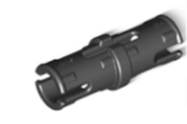
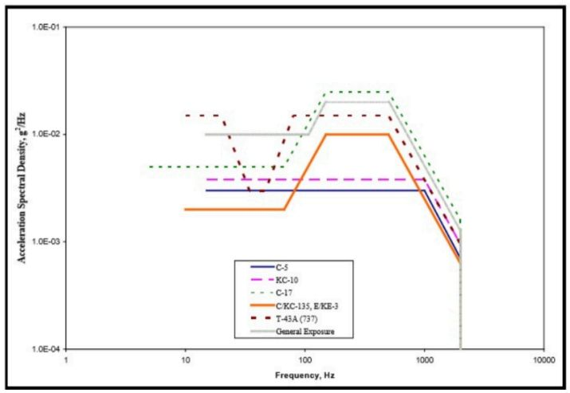
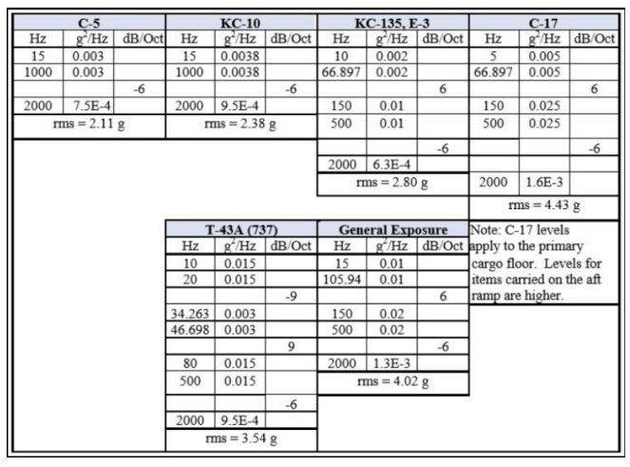
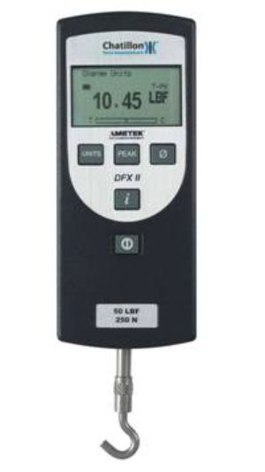
BAE SYSTEMS — AVIONICS MECHANICAL
Validated an ESD-safe fixture at 3× margin
OBJECTIVE
Replace slow screw-mounted flight-test hardware with a fast, manufacturable retention concept.
DESIGN → ANALYSIS → TEST
•
Owned requirements, CAD/prototyping, PETG material trade study, ANSYS modeling, and physical validation.
•
Ran modal and random-vibration analyses; extracted the pin-cap interface 3σ load demand.
•
Repeated force-gauge pull tests and used a conservative lower-bound retention value.
3×
ESD-safe
measured retention margin over predicted 3σ vibration demand
material system for sensitive avionics hardware
Representative visuals only; no proprietary imagery or designs shown.
03

Slide 4
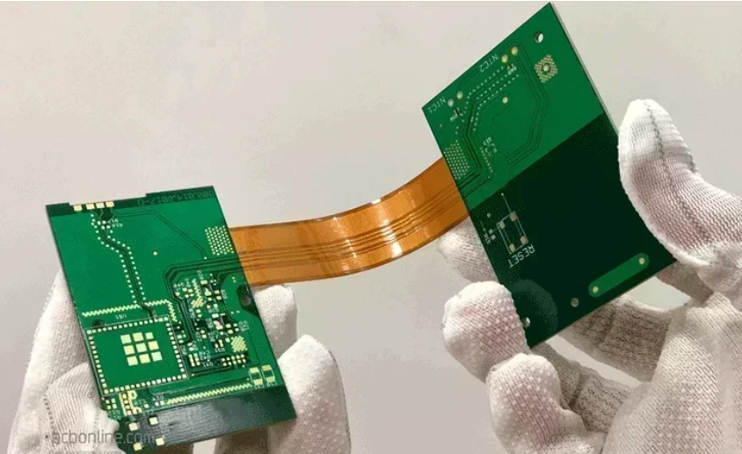
BAE SYSTEMS — RAPID PROTOTYPING
Cut rigid-flex fit-check cost by $5K per unit
OBJECTIVE
Verify rigid-flex-rigid backplane fit for an LRU at a low cost and with low lead time
$5,000
WHAT I DID
•
Converted packaging-critical geometry into a 3D-printable fit-check surrogate.
estimated savings per prototype unit
•
Preserved the features that controlled enclosure compatibility while removing unnecessary fabrication cost.
IMPACT
•
Used the prototype to check physical integration before committing expensive rigid-flex hardware.
Moved fit verification earlier and cheaper in the hardware-development cycle and made it in-house.
Representative visuals only; no proprietary imagery or designs shown.
04

Slide 5
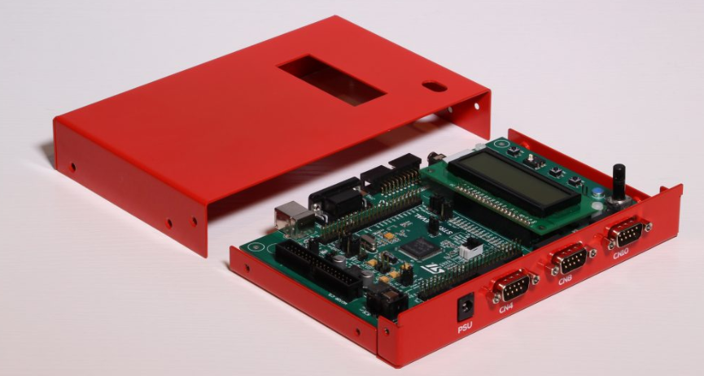
BAE SYSTEMS — ELECTRONICS PACKAGING
PCB Packaging
OBJECTIVE
Package a PCB, considering environmental effects and mechanical constraint tradeoffs
ANALYSIS
•
Analyzed tolerance stack-ups across seven top-cooled SMT component interfaces.
•
Defined material finishes to prevent galvanic corrosion and other unwanted interactions (ENIG, Nickel, Chemfilm, etc.)
•
Defined thermal interface material selection for effective cooling for SMT components (including an FPGA chip)
•
Defined EMI-gasket compression ranges that remained manufacturable across tolerances.
Representative visuals only; no proprietary imagery or designs shown.
IMPACT
Designed a mechanical enclosure that allowed for PCB to be protected while working as intended.
05

Slide 6
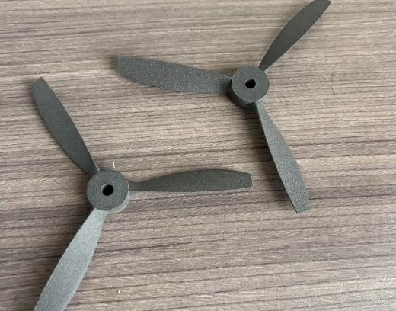
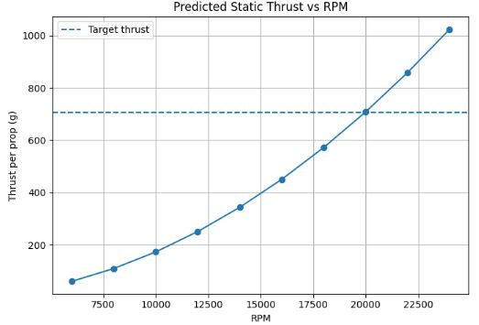
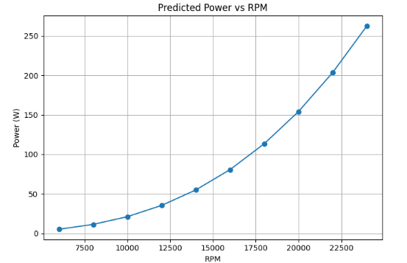
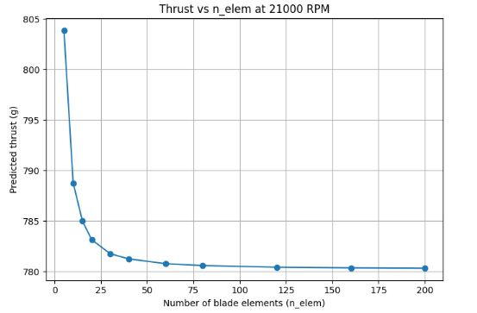
DRONE — PROPELLER AERODYNAMICS
Predicted 7.4 N from a custom 5-inch propeller
OBJECTIVE
Design a three-blade SLS PA12 propeller that supports a 2:1 vehicle thrust-to-weight target.
7.4 N
3
predicted thrust at 21,000 RPM
blades using NACA 8424 / 4415 / 3412 sections
METHOD & FINDINGS
•
Built a Python BEMT solver with induced-velocity iteration and Prandtl tip-loss correction.
•
Ran a blade-element convergence study and checked torque, power, and current against motor/ESC capability.
•
Compared the predicted operating point with manufacturer propeller data as a feasibility check.
IMPACT
Set a defensible thrust-test operating point.
06

Slide 7
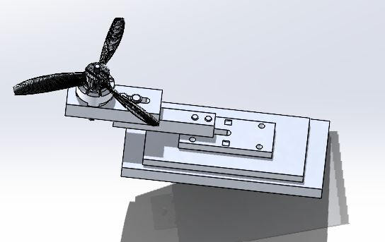
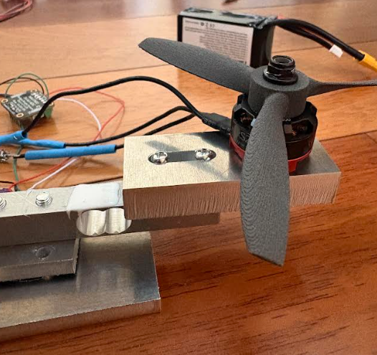
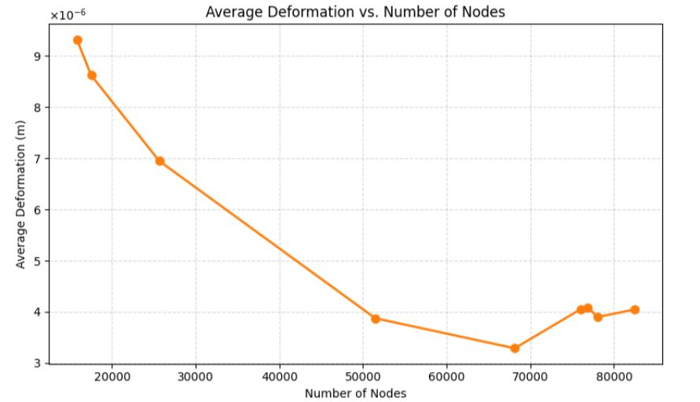
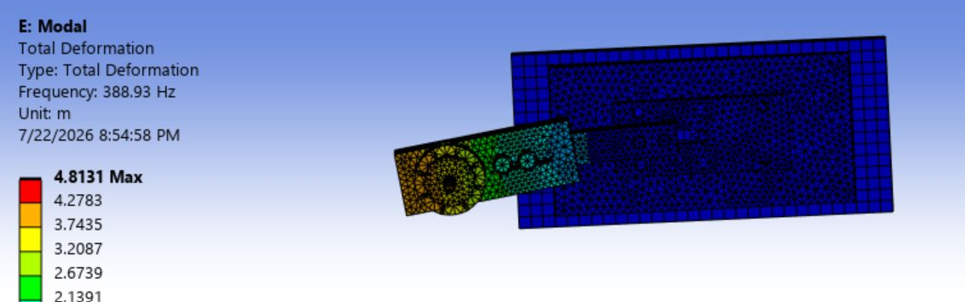
DRONE — STRUCTURAL VALIDATION
Screened a thrust stand against static and modal risk
OBJECTIVE
Design a load-cell fixture that measures ~7.4 N without structural compliance or resonance corrupting the result.
MODEL FIDELITY
•
Modeled bolt pretension, frictional contacts, clamps, gravity, and propeller force in Ansys.
•
Verified static response using mesh-quality checks and deformation convergence.
•
Used free-free, mesh-refinement, and preload-sensitivity checks to validate modal behavior.
•
Built physical thrust stand to validate previously predicted propeller thrust
>7.4 N
of thrust generated through propeller physical testing, validating design
IMPACT
Physically validated propeller thrust
07

Slide 8
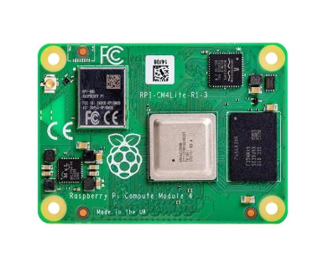
DRONE — INTEGRATED PLATFORM
Integrated structure, compute, and vision on one drone
OBJECTIVE
Develop a consumer-oriented quadrotor platform with protected electronics, custom compute I/O, and onboard perception.
COMPUTE + I/O
Designed a KiCad carrier PCB for Raspberry Pi CM4 power, camera, and I/O interfaces.
PERCEPTION
Trained YOLOv8n for low-resolution Raspberry Pi inputs; achieved mAP50 = 0.289.
IMPACT
Connected airframe design, electronics integration, and edge perception into one extensible platform.
08

Slide 9
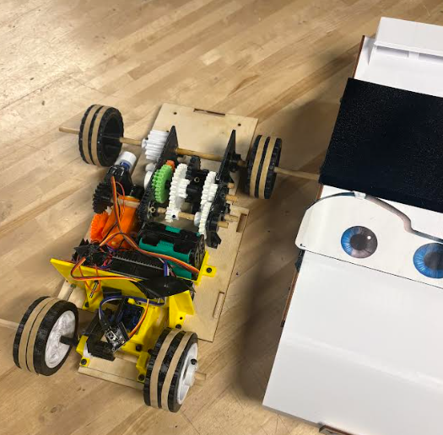
ROBOTICS — MECHANISM DESIGN
Balanced speed, strength, and braking in one robot
OBJECTIVE
Build a miniature vehicle that could shift its performance envelope while surviving impacts and stopping predictably.
ENGINEERING APPROACH
SYSTEM ARCHITECTURE
•
Designed a shifting drivetrain to trade speed against traction and agility.
SHIFTING DRIVETRAIN
•
Added spring elements to absorb frame impacts; checked the load path by hand calculations and FEA.
speed ↔ strength ↔ agility
↓
•
Prototyped a fully 3D-printed, servo-actuated drum brake and verified its operation through analysis and testing.
SPRING-SUPPORTED FRAME
impact energy routed through compliant members
↓
SERVO DRUM BRAKE
3D-printed prototype validated in test
09

Slide 10
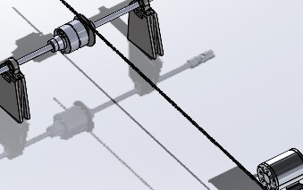
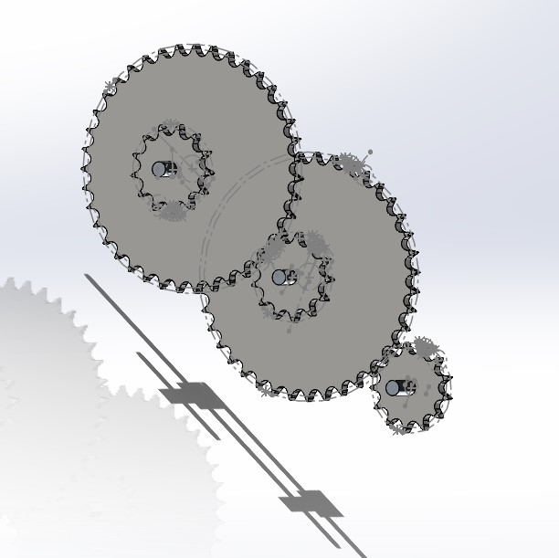
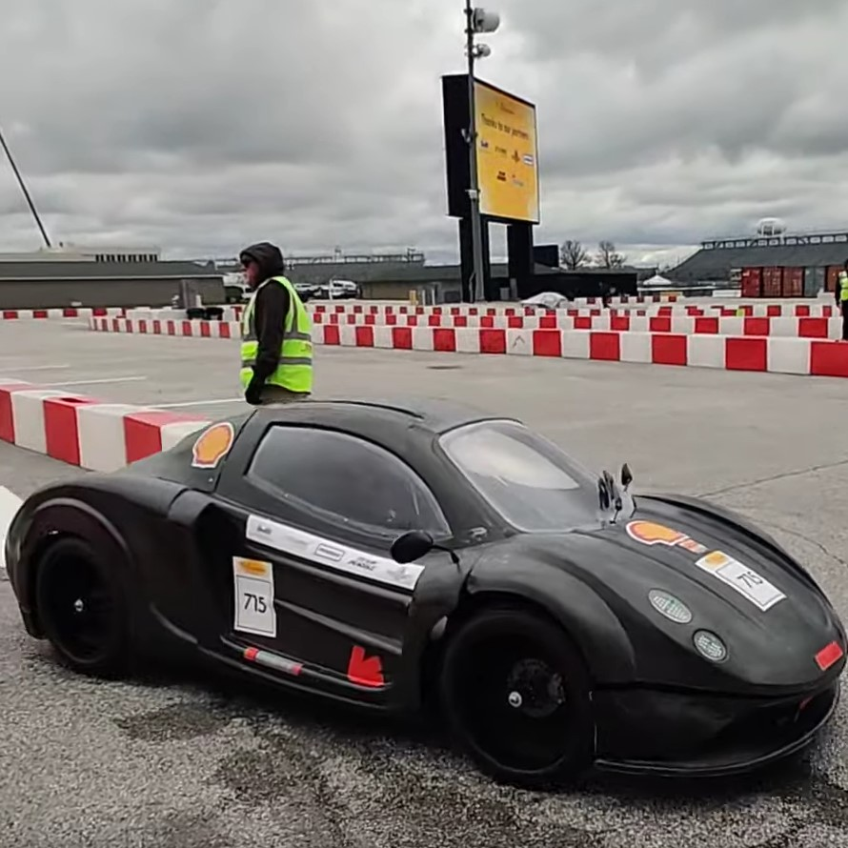
EV CONCEPT — DRIVETRAIN LEAD
Led a 16:1 drivetrain design for maximum efficiency
OBJECTIVE
Align motor and wheel operating points for a lightweight Shell Eco-marathon concept vehicle.
16:1
5
chain-and-sprocket reduction target
team members directed
TECHNICAL OWNERSHIP
•
Selected drivetrain architecture and sprocket sizing to place the motor near its efficient RPM range.
•
Designed an aluminum motor mount, assessed failure modes, and coordinated interfaces with the monocoque and electrical teams.
•
Developed modular jig concepts to test power delivery before the complete vehicle was available.
IMPACT
Led the team from component selection toward a testable, manufacturable drivetrain.
10

Slide 11
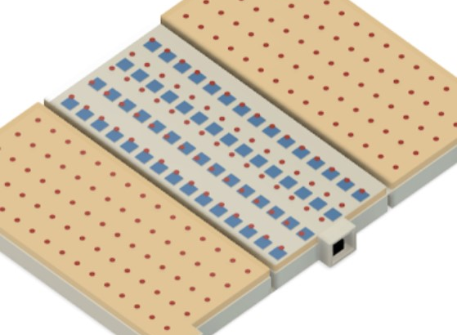
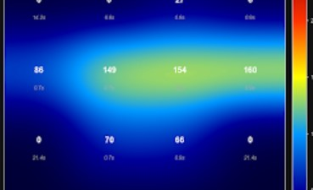
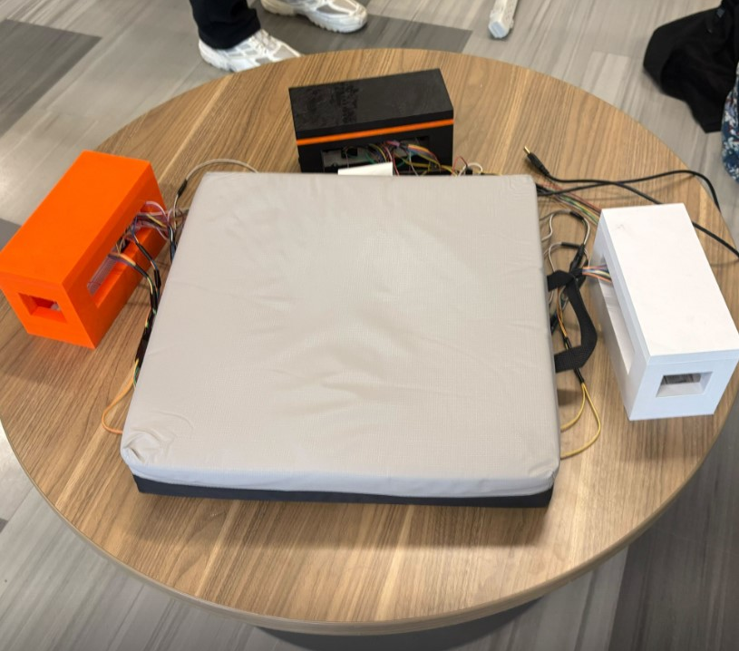
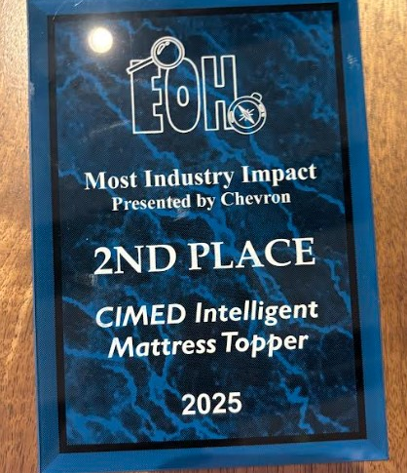
ASME PRODUCT DEVELOPMENT — MEDICAL DEVICE
Mapped pressure in real time to flag injury risk
OBJECTIVE
Create a comfortable topper that reads and prevents pressure ulcers, reducing nursing workload and patient injuries
SYSTEM
SIGNAL PATH
OUTCOME
Pressure + temperature sensors embedded in medical-grade foam with a hydraulic system to inflate pads for pressure relief
Multiplexer + ADC + Arduino → color-coded pressure map
Continuous distribution monitoring and a foundation for automated pressure relief
IMPACT
Co-led the team to 2nd place for Most Industry Impact at UIUC EOH 2025 and 1st place in EOH 2026.
11

Slide 12
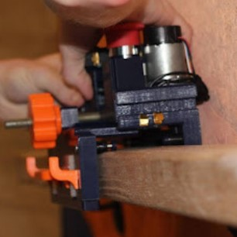
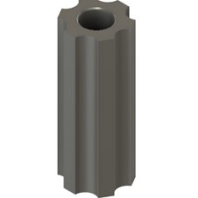
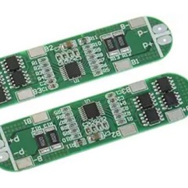
ASME PRODUCT DEVELOPMENT — ASSISTIVE ROBOTICS
Solved charging and traction failures on a stair robot
OBJECTIVE
Help an elderly user move bags upstairs with a rail-mounted robot that is simple to operate and reliable.
CONTRIBUTIONS
•
Selected, soldered, and tested rechargeable-battery circuitry; traced a failure to insufficient startup voltage.
•
Contributed C logic for smooth acceleration and deceleration near rail endpoints.
•
Designed a Fusion 360 mold for silicone wheels after low friction caused the robot to slip.
FAILURE → ROOT CAUSE → FIX
IMPACT
charging did not start → startup-voltage requirement → revised power approach
The silicone-wheel change nearly eliminated rail slipping while the control updates improved motion quality.
12

Slide 13
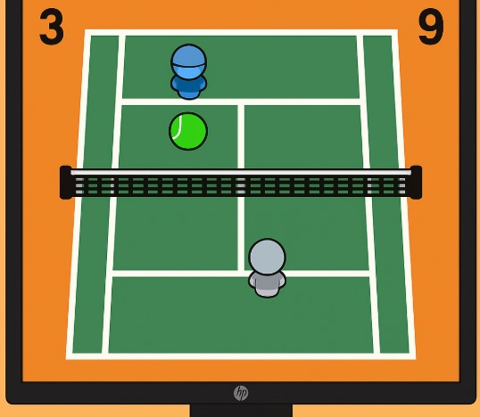
DIGITAL HARDWARE — FPGA
Delivered real-time tennis on a Spartan-7 SoC
OBJECTIVE
Build a two-player keyboard-controlled game with hardware-rendered graphics and responsive ball physics.
ARCHITECTURE
USB keyboard
MAX3421E
SPI driver
MicroBlaze
+ AXI
HDMI
output
→
→
→
•
Implemented player motion, collision/scoring logic, XYZ ball dynamics, sprite animation, and restart flow in SystemVerilog.
•
Used BRAM-backed graphics, UART debug messages, Vivado testbenches, and waveform analysis to close hardware issues.
77.9 MHz
0.479 W
4,197
implemented frequency
estimated total power
LUTs used
13

Slide 14

COMPUTER SYSTEMS — OPERATING SYSTEM
Built a RISC-V kernel from drivers to user space
OBJECTIVE
Implement a working operating system on QEMU with virtual memory, storage, processes, and a usable shell.
EDITABLE SOFTWARE STACK
SHELL + USER PROGRAMS
pipelines • redirection • concurrent execution
IMPLEMENTED
•
UART, RTC, PLIC, VirtIO block, and RNG drivers with a 64-entry block cache.
PROCESS + SYSCALL LAYER
preemption • context switching • pipes
•
Sv39 virtual memory, memory management, and a Unix-style filesystem.
VM + FILESYSTEM
•
System calls, preemptive multitasking, context switches, pipes, I/O redirection, and concurrent pipelines.
Sv39 paging • allocators • Unix-style FS
DEVICE DRIVERS
IMPACT
UART • RTC • PLIC • VirtIO block/RNG
Delivered a kernel-to-shell environment in C and RISC-V assembly.
14

