Slide 1

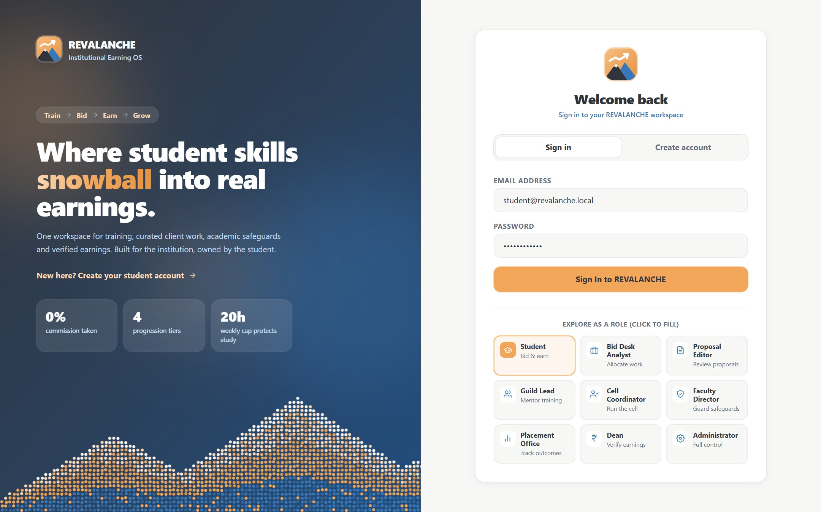
REVALANCHE
EduRev: a college workspace where students train, bid on curated client work and record verified earnings, with academic safeguards built in
Train
Bid
Deliver
Verify
Sign-in page: one click fills any of the nine demo roles
MVP showcase · November 2026
Notes:
REVALANCHE (EduRev) is a college operations workspace. Students train, bid on curated client work, get allocated under academic safeguards, and record freelance earnings that staff verify. The institution sees aggregate reports only.

Slide 2






What EduRev does
One workspace for the whole path, from a student's first sign-up to verified client earnings
Sign up
Approve
Onboard
Train & tier
Bid
Allocate
Deliver
Verify earnings
■ student acts ■ staff acts
slide 6
slide 7
slide 8
Sign-up & onboarding
Dashboard & tiers
Opportunities & bidding
@lpu.in self sign-up, staff approval and a 4-step profile wizard
Personal dashboard, training progress and four official tiers
Curated client work; one bid per student, gated by tier
slide 9
slide 10
slide 11
Fair allocation
Earnings verification
Messages & analytics
One winner per project, after tier, CGPA, hours and exam checks
Students log earnings with proof; staff verify each entry
Direct messages, announcements and aggregate-only reports
Notes:
The top row is the end-to-end journey; orange steps are done by students, blue by staff. The six cards are the MVP features, each shown with real screenshots on the slide noted.

Slide 3

System architecture
An npm-workspaces monorepo: one Next.js web app, one Express API, two shared packages, MongoDB
apps/web Next.js 15 · React 19
apps/api Express 5 · Mongoose
MongoDB
18 collections
AuthProvider → AuthGate
Routes (REST, /api/*)
Browser
Students & staff
AppShell: sidebar, top bar, Ctrl+K
JSON + JWT
Middleware: auth, permission, limits
Screens (client components)
Controllers: input + student scoping
Demo data
in-memory, dev/test only
useApi(): Bearer token, 401 handling
Services: business rules
if DB is down
Shared packages
@edurev/types
Domain types · PERMISSIONS · TIER_RULES
@edurev/mock-data
Seeds MongoDB · demo fallback · offline first render
Notes:
A request goes browser → Next.js screen → useApi() (adds the login token) → Express route → authenticate and permission middleware → controller → service → Mongoose → MongoDB. If MongoDB is unreachable during development, services fall back to in-memory demo data. Role permissions and tier rules live once in @edurev/types and are shared by both apps.

Slide 4





Technology stack
TypeScript end to end, in one repository
Frontend
UI, routing, session
Next.js 15 App Router
React 19
Tailwind CSS 3
TypeScript
Backend
REST API, business rules
Node.js
Express 5
Mongoose 9
CORS
dotenv
Database
Persistence
MongoDB
In-memory demo data fallback
Uploads stored as data URLs
Security
Auth & protection
JWT (jsonwebtoken)
bcrypt password hashing
helmet headers
Rate limits
Tooling
Build, dev, tests
npm workspaces
tsx + tsup
concurrently
node:test (149 API tests)
Notes:
Frontend: Next.js 15 with the App Router, React 19 and Tailwind. Backend: Express 5 with Mongoose on MongoDB. Security: JSON Web Tokens for sessions, bcrypt for passwords, helmet for headers and per-user rate limits. npm workspaces hold the web app, the API and the shared type and data packages.

Slide 5


MongoDB database schema
Mongoose schemas in apps/api/src/models; collections link through string ids such as studentId
users
students
academicsnapshots
trainingmodules
id
unique
1:1
id
unique
1:1
studentId
→ students, 1:1
id
String
email
unique
name, email
String
cgpa
official CGPA
studentId
→ students
passwordHash
bcrypt hash
program, year
String, Number
requiredCgpa
Number
title
String
role
enum (9 roles)
tier
TIER_1…TIER_4
cgpaStatus
enum
status
enum (3)
studentId
→ students
trainingProgress
Number (%)
complianceStatus
enum
completionPercentage
Number
status
enum
registrationNumber
unique, sparse
tokenVersion
Number, hidden
claimedCgpa
a claim only
1:N
earningsentries
bids
opportunities
allocations
id
unique
id
unique
N:1
id
unique
1:1
opportunityId
unique → opp.
studentId
→ students
opportunityId
→ opportunities
title, client
String
studentId
→ students
platformName
String
studentId
→ students
budget
Number
allocatedBy
user id
originalAmount
+ currency
proposedAmount
Number
requiredTier
TIER_1…TIER_4
slaDeadline
agreed deadline
exchangeRate
kept per entry
status
enum (5)
status
enum (4)
deliveredAt, onTime
delivery record
verificationStatus
enum (3)
proposalPdfUrl
PDF data URL
deadline
client due date
reassignments
history [ ]
unique: student, platform, amount, date
unique: opportunityId + studentId
bidsCloseAt
optional date
conversations
chatmessages
tiersuggestions
Also stored
platformaccounts (identifier only), hourlogs, blackoutperiods, proposals, safeguards, settings, readstates
id
unique
1:N
id
unique
id
unique
kind
enum (2)
conversationId
→ conversations
studentId
→ students
staff
{ id, name, role }
sender
{ id, name, role }
currentTier
TIER_n
studentId
→ students
body
String
suggestedTier
TIER_n
recipientStudentIds
[ ] snapshot
createdAt
date
reasons
[String]
unique index
reference
lastMessageAt
indexed
readstates: unique per reader
status
enum (3)
Lines: relationships (1 : N)
one PENDING per student
Notes:
Main collections. Students are the hub: each has one user account and one official academic record, and many training modules, bids, earnings and messages. A bid links one student to one opportunity, unique per pair. An allocation is unique per opportunity. Unique indexes stop duplicate accounts, bids, allocations and earnings at database level.

Slide 6
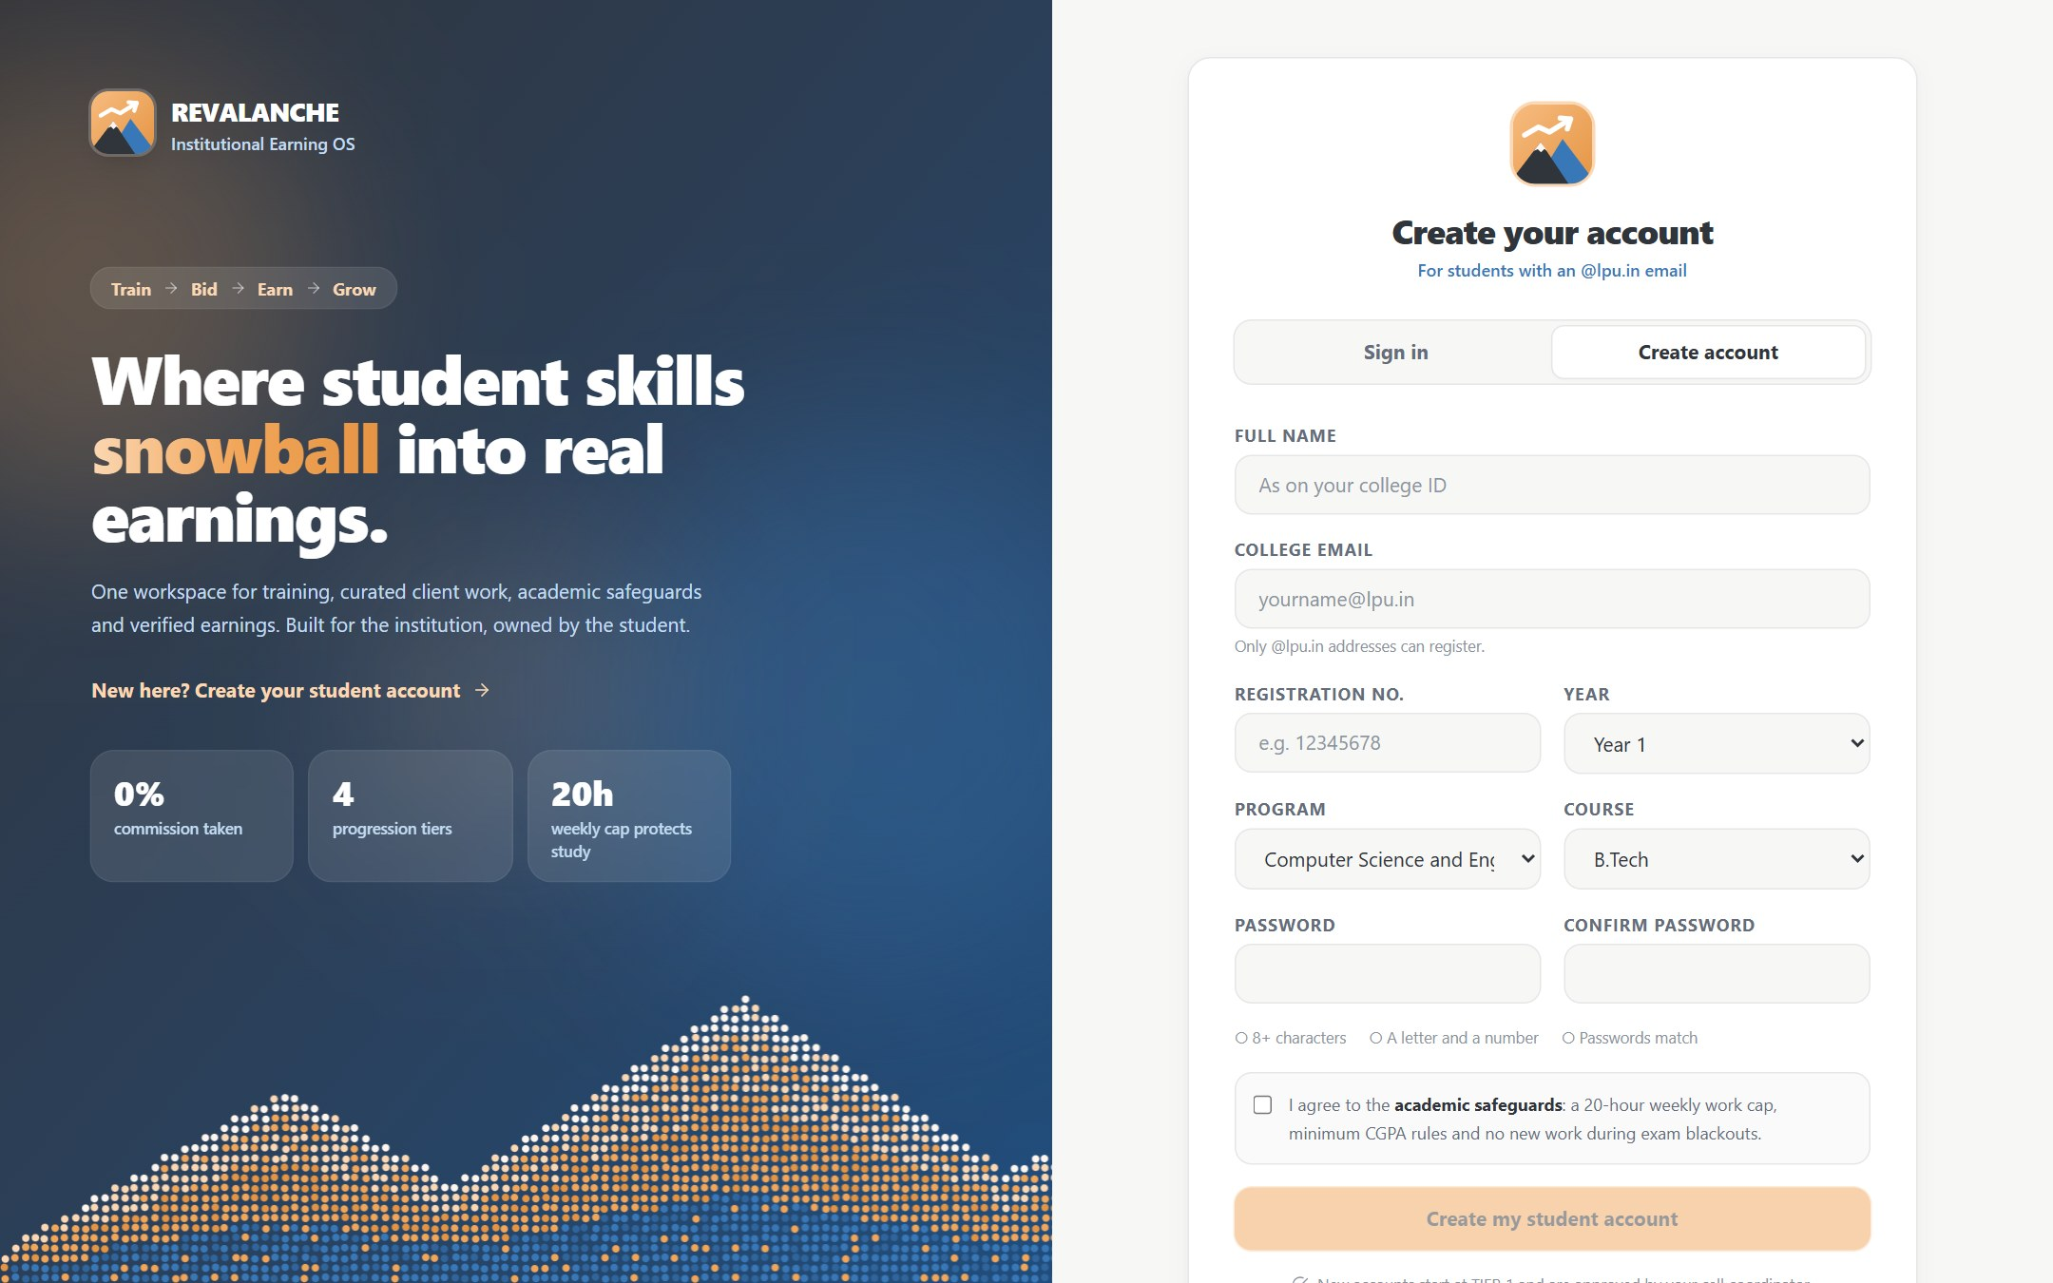
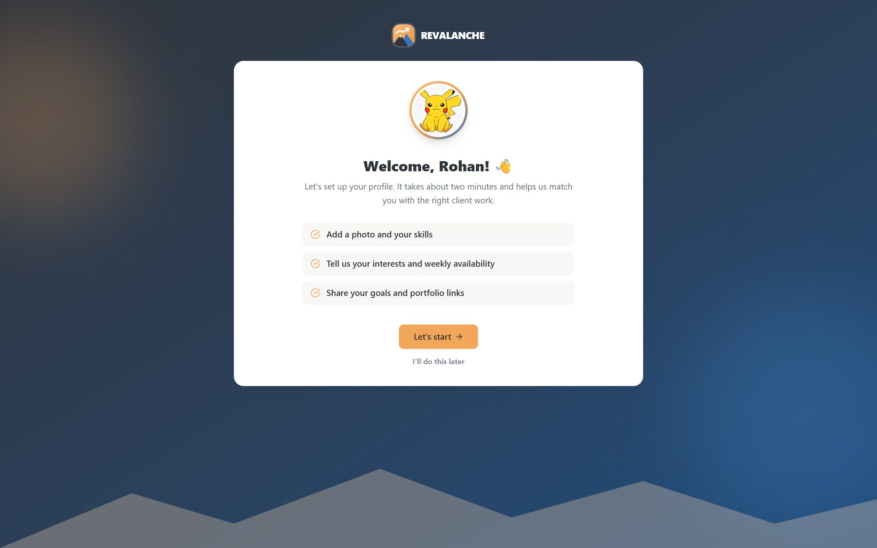
Sign-up & onboarding
Students create their own account; staff approve it; a short wizard completes the profile
Public
Create account: @lpu.in email, one account per reg. no.
Student
First login: photo, skills, availability, goals
Sign up
PENDING_APPROVAL
Staff approve
Coordinator or Admin
Student created
at TIER_1
Onboarding wizard
4 steps, skippable
Official CGPA
recorded by Faculty
Notes:
Self sign-up only accepts allowed college domains and creates a pending student account. A Cell Coordinator or Administrator approves it, which creates the student at Tier 1. On first login the student is guided through a four-step wizard. The official CGPA is recorded by a Faculty Director; what the student types is only a claim.

Slide 7
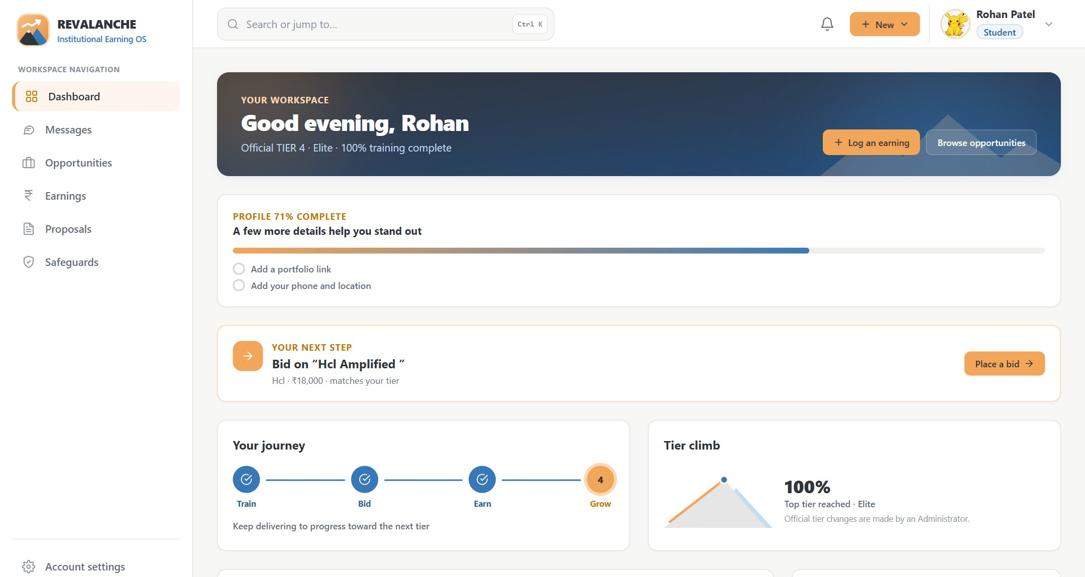
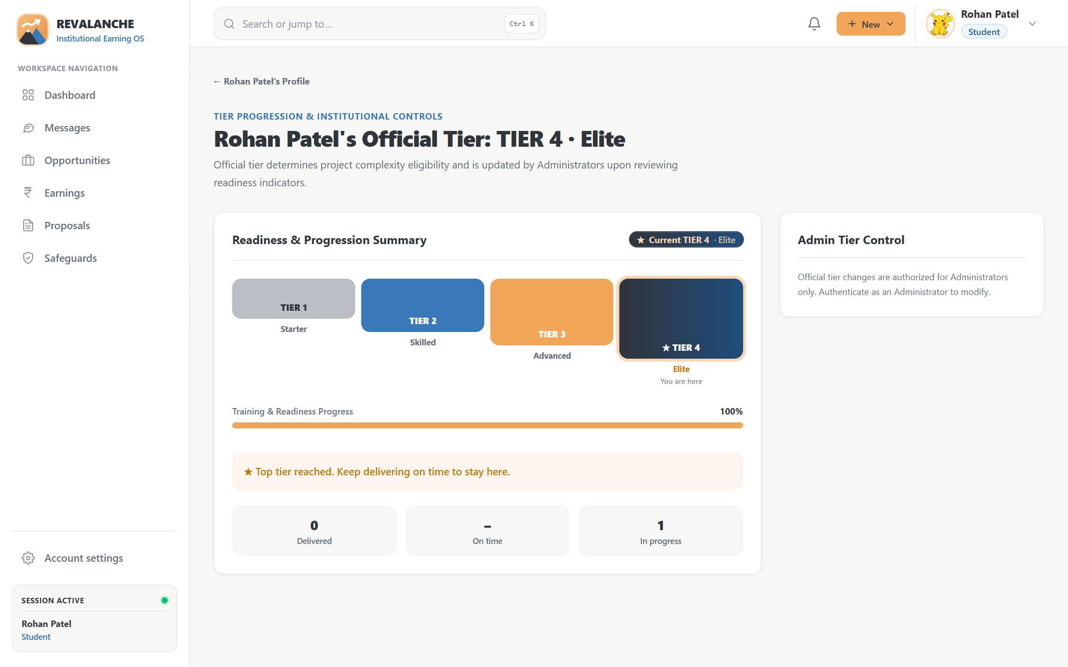
Student dashboard & tiers
Each student sees their next step, progress and official tier; only an Administrator changes the tier
Student
Dashboard: next step, journey, matching opportunities
Student
Tier page: readiness and delivery record
Tier 1 · Starter
Every approved student
Tier 2 · Skilled
CGPA ≥ 8.0 · training 40% · 2 skills
Tier 3 · Advanced
CGPA ≥ 9.0 · training 60% · 3 skills
Tier 4 · Elite
5+ deliveries · 90% on time
Notes:
The dashboard shows the student's next step, their journey and opportunities that match their tier. Tier rules use the official CGPA, training progress, skills and, for Tier 4, on-time delivery. The system may suggest a tier; only an Administrator can set it.

Slide 8
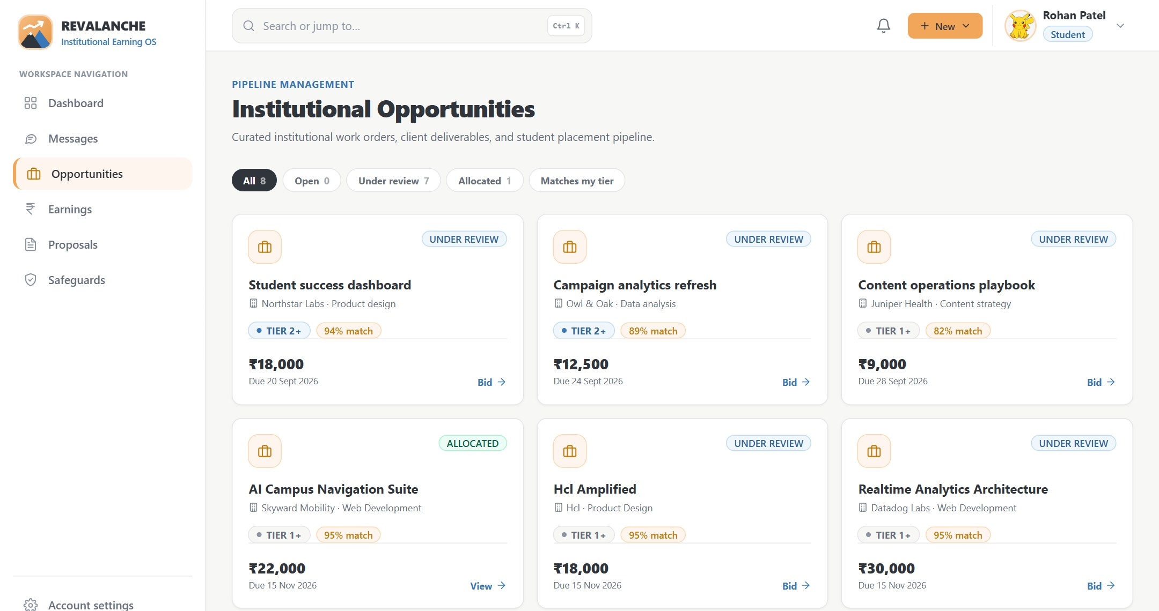
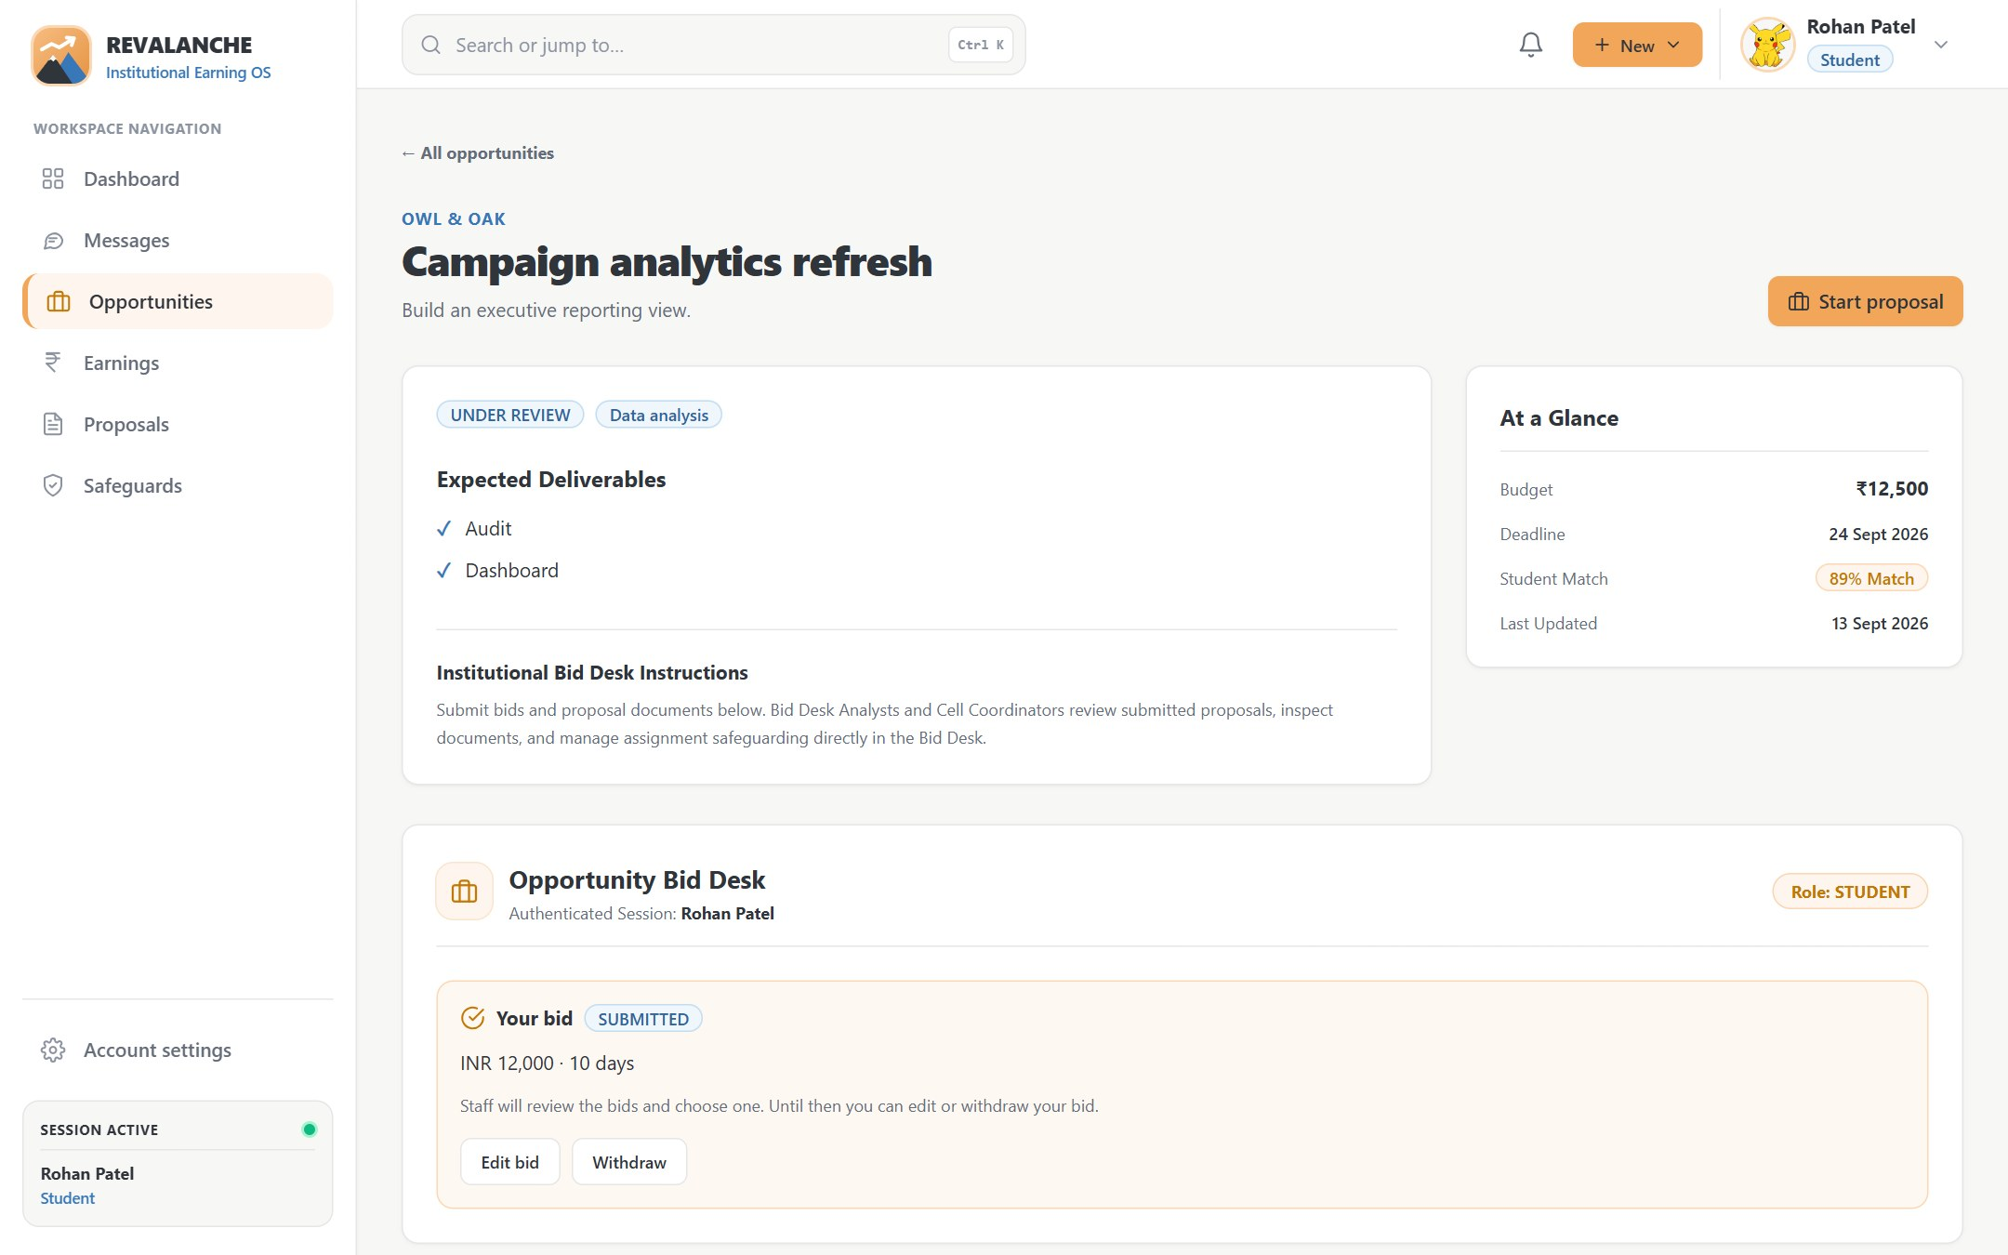
Opportunities & bidding
Students browse curated client work and place one bid per opportunity; every bid passes five checks
Student
Opportunities: budget, deadline, required tier, status
Student
Bid desk: a live bid can be edited or withdrawn
Valid input
400 if invalid
Opportunity exists
404 if missing
Bidding open
409 if closed
Tier high enough
403 if too low
One bid each
409 if repeated
Bid saved
201 Created
Notes:
Opportunities show the client, budget, deadline and the minimum tier. A student bids with an amount, timeline, message and an optional PDF proposal. The API checks the input, that the opportunity exists and is open, that the student's official tier is high enough, and that they haven't already bid; a unique database index enforces one bid per student.

Slide 9
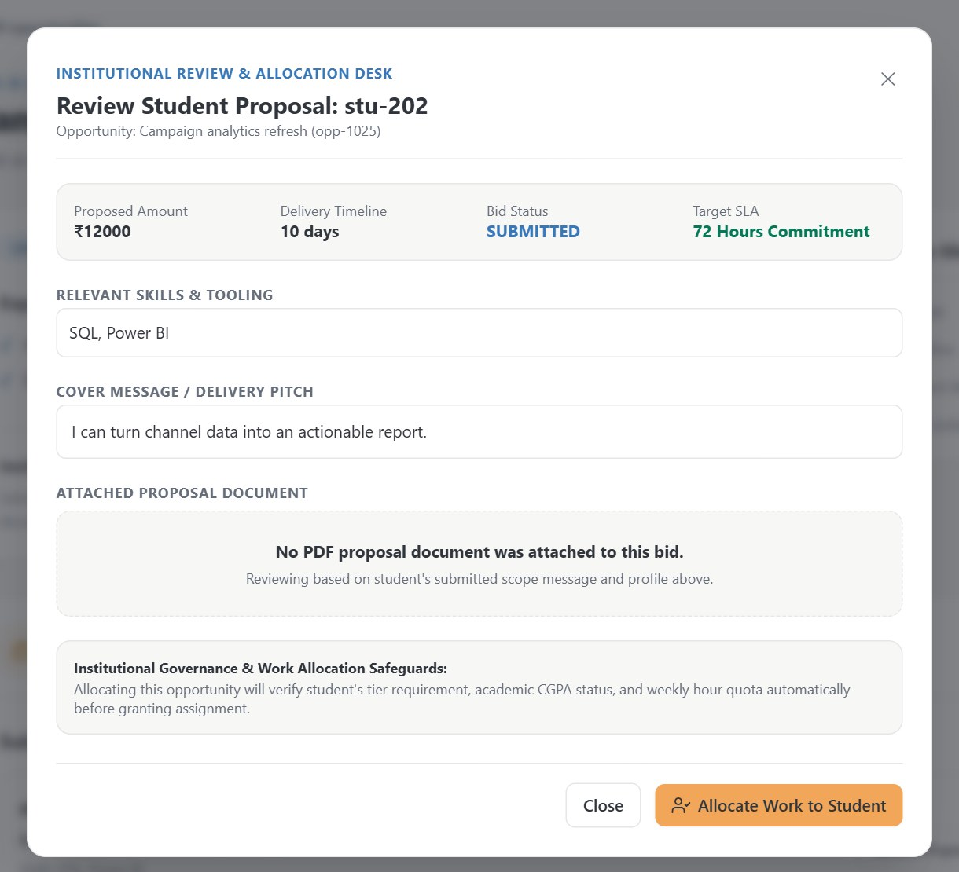



Fair allocation with safeguards
Staff review each bid; academic safeguards run first, and exactly one student wins
Checked before allocation
Official tier meets the requirement
Official CGPA is eligible
Weekly hour cap not reached (override needs a reason)
No exam blackout period
Compliance is complete
Exactly one winner
Two staff click Allocate
Atomic claim on the status
One wins; other gets 409
Staff
Analyst reviews a bid, then allocates
Other bids become REJECTED and those students get a message automatically.
Notes:
Before work is allocated the API re-checks five academic safeguards; any failure blocks the allocation with the reasons listed. The allocation itself is an atomic conditional update on the opportunity's status, so if two staff click at once exactly one succeeds. Changing the student afterwards is a separate Reassign action that needs a reason.

Slide 10
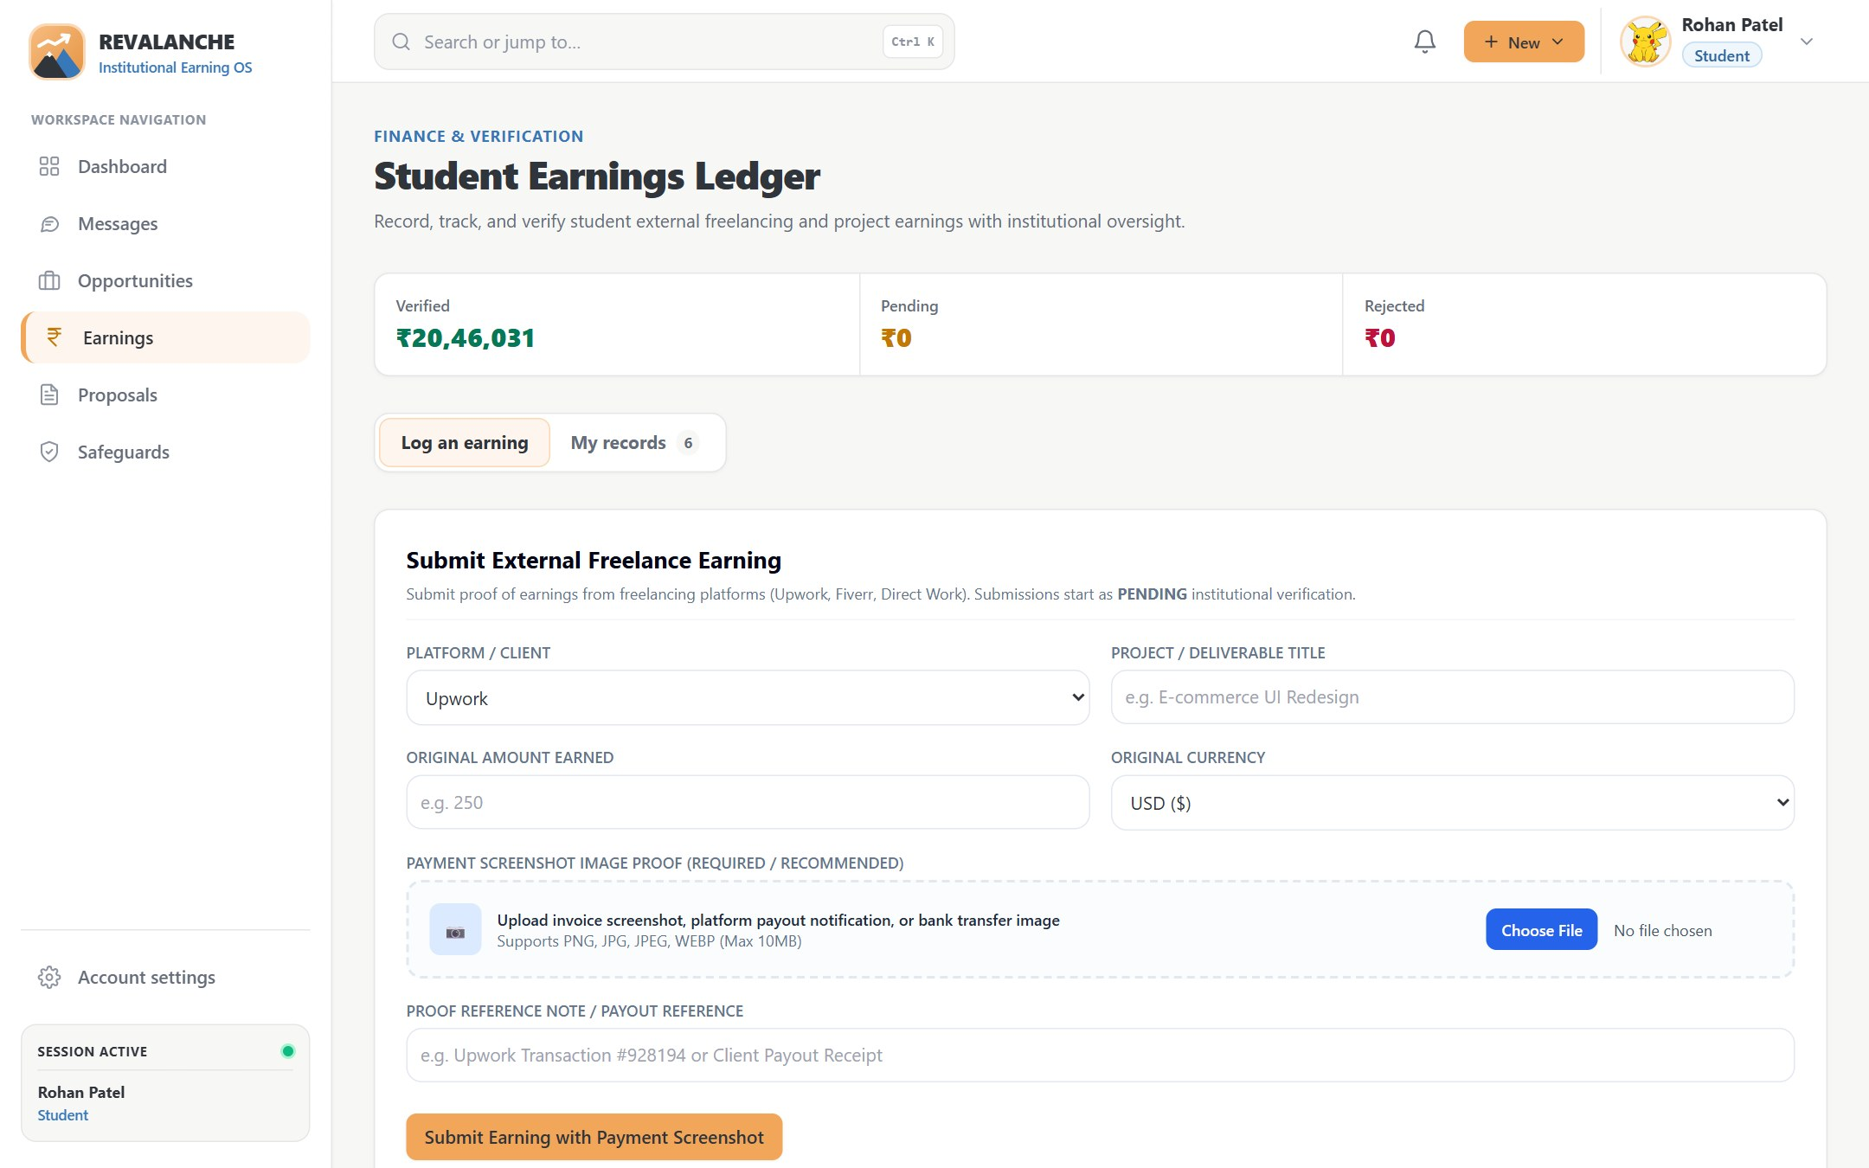
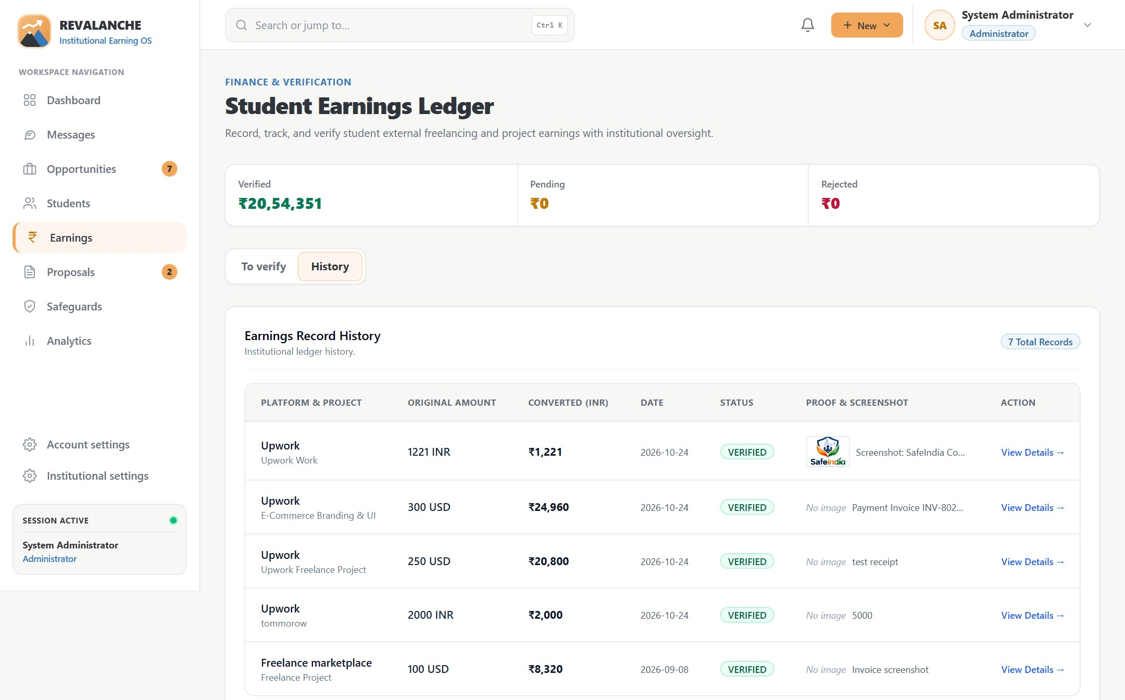
Earnings with staff verification
0% commission, no platform passwords stored, and the exchange rate is kept with each entry
Student
Log an earning: platform, amount, currency, proof
Staff
Ledger: amounts converted to INR, status per entry
Student logs earning
with a real image as proof
PENDING
waiting for staff
Staff verify
Faculty, Coordinator, Dean, Admin
VERIFIED or REJECTED
decided once (409 after)
Notes:
Students record freelance earnings with the platform, original amount and currency, and an uploaded screenshot whose bytes are checked to be a real image. Entries start as pending; verifier roles approve or reject each one exactly once. Duplicates are blocked by a unique index, and reporting stays aggregate.

Slide 11
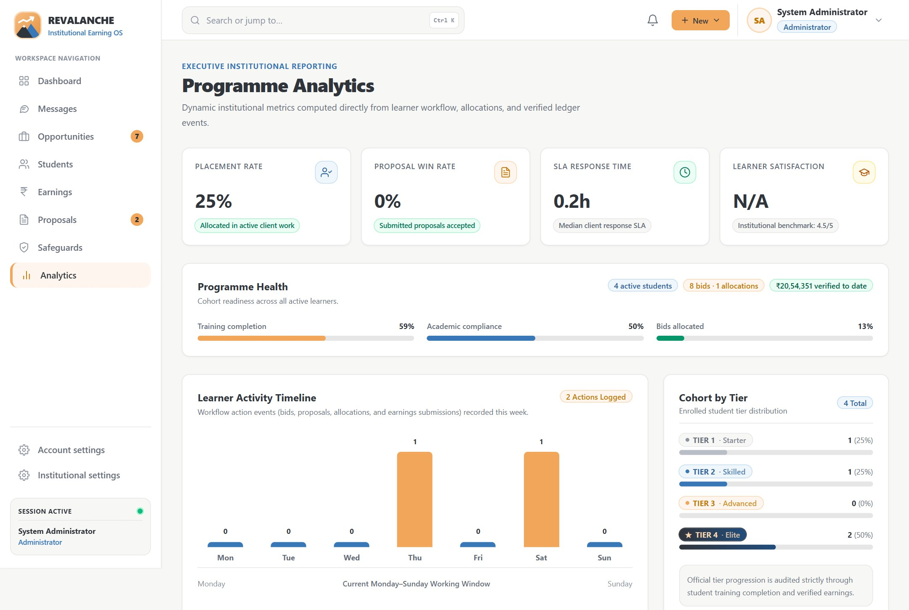
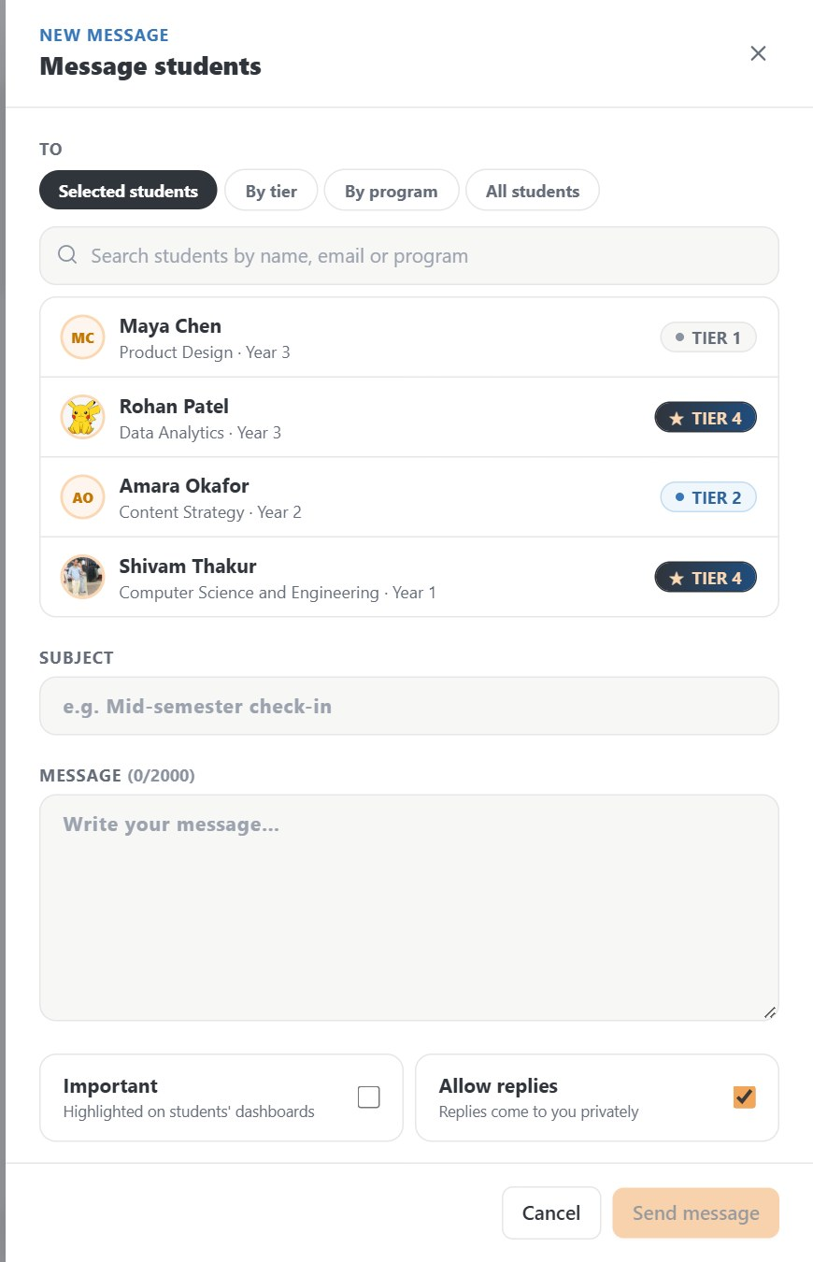



Messages & analytics
Staff reach students directly or by group; the institution sees aggregate numbers only
Direct or group
Selected students get private threads; a tier, program or everyone gets one announcement
Students reply
Students can only reply, privately to the sender; unread badges update every 30 s
Aggregate only
No individual earnings leaderboard; analytics are hidden from students
Staff
Programme analytics: aggregate metrics
Staff
Message composer
Notes:
Staff with messaging permission can write to selected students, which creates a private thread each, or to a tier, a program or everyone, which creates one announcement. Students can only reply. Analytics show programme-level numbers such as placement rate and students per tier, never an individual earnings ranking.

Slide 12
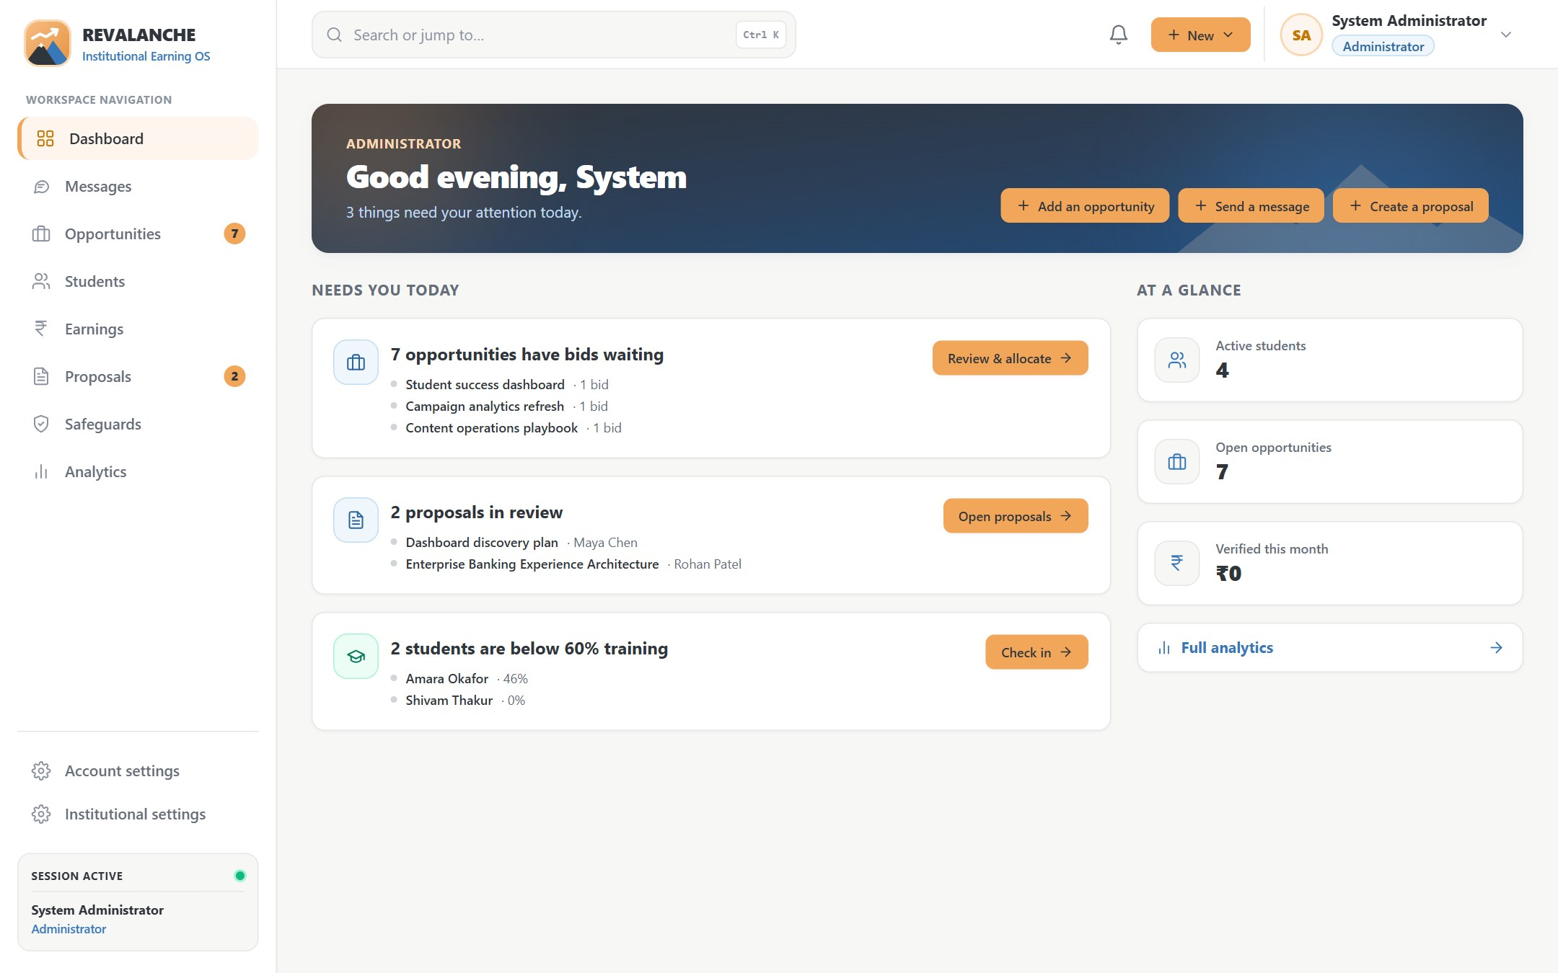



Built for staff control and safety
Each role sees its own work queue; rules are enforced by the API, not just hidden in the UI
Role-based access
9 roles, 21 permissions defined once; the API checks every request
Secure by default
1-day JWT sessions, bcrypt passwords, helmet headers, rate limits, real-file checks
Fair by design
0% commission, no platform passwords, aggregate-only reports, only admins change tiers
Thank you
Questions & live demo
Admin
Dashboard: what needs attention today
Notes:
Close by showing that every role has a focused dashboard and that the rules are enforced on the server. Then switch to the live demo: sign in as student@ and as a staff role such as analyst@ or admin@ (password Password123!).

