Slide 1
MKT 591 PROJECT Rossmann’s sales prediction
Team 11 (C-02)
Bhargava Sukkala | Siddharth Srivastava | Tejas Mehta | Vikram Vegesna

Slide 2
Objective
Perspective:
To analyze competition and its impact on Total Sales.
To analyze competition and its impact on Customers.
To analyze Sales with respect to Promotional Offers.
To analyze Customers with respect to Promotional offers.
To analyze the impact of Holidays on Customers for different Stores.
To analyze the impact of Holidays on Sales for different Stores.

Slide 3
Data
Train Dataset:
Store - a unique Id for each store, 1115 stores.
Date – the date of Sales in yyyy-mm-dd format.
Sales - the turnover for any given day
Customers - the number of customers on a given day
StateHoliday - indicates a state holiday. Normally all stores, with few exceptions, are closed on state holidays. Note that all schools are closed on public holidays and weekends. a = public holiday, b = Easter holiday, c = Christmas, 0 = None
SchoolHoliday - indicates if the (Store, Date) was affected by the closure of public schools
Promo - indicates whether a store is running a promo on that day
Store Dataset:
StoreType - differentiates between 4 different store models: a, b, c, d
Assortment - describes an assortment level: a = basic, b = extra, c = extended
CompetitionDistance - distance in meters to the nearest competitor store
CompetitionOpenSince[Month/Year] - gives the approximate year and month of the time the nearest competitor was opened
Promo2 - Promo2 is a continuing and consecutive promotion for some stores: 0 = store is not participating, 1 = store is participating

Slide 4
Preprocessing
Train Set:
Eliminate time related information and analyze data at aggregate level by each store.
Grouped Sales and Customers for each store.
Store Set:
Get age of competition store by subtracting Competition’s open date with the today’s date.
Eliminate Promotion’s start date and promotion’s interval.
Emphasize on Promo2 to get information about each store’s turnover participating in promotions.
Join train dataset and store dataset to link store and competition related information with sales and customer information.
Split the merged dataset into train and validation sets (75:25).

Slide 5
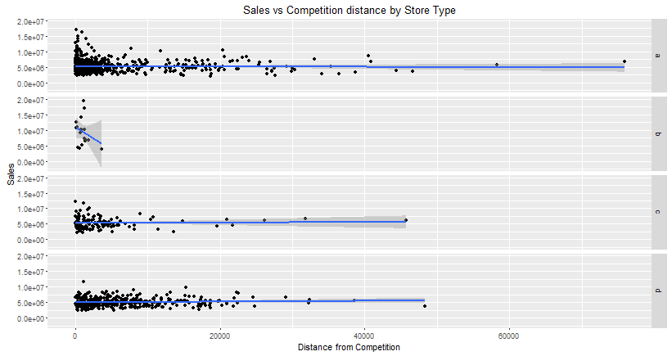
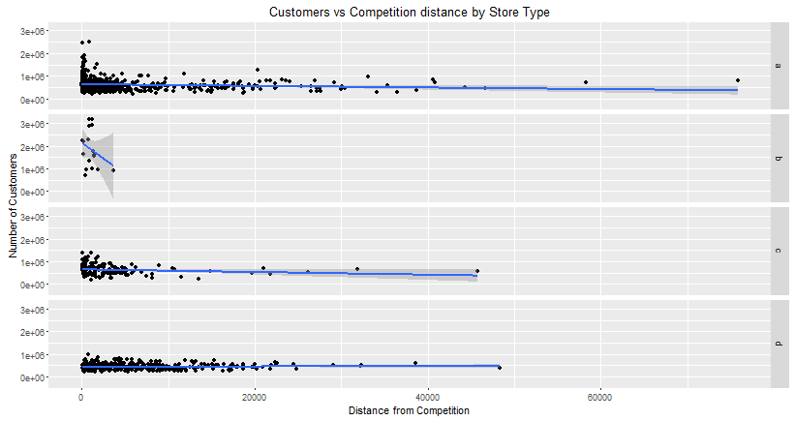
Competition’s Distance Analysis

Slide 6
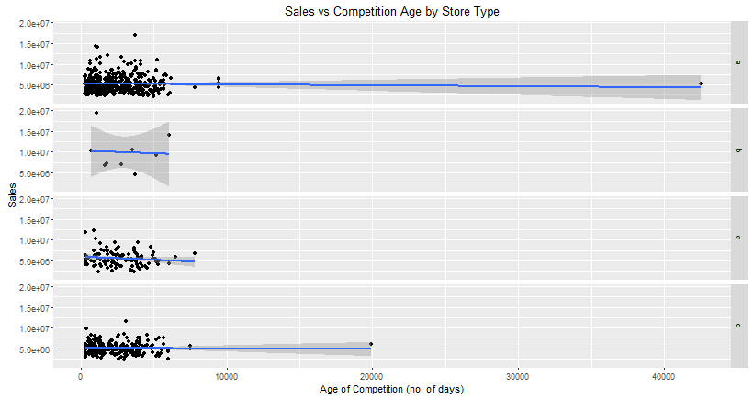
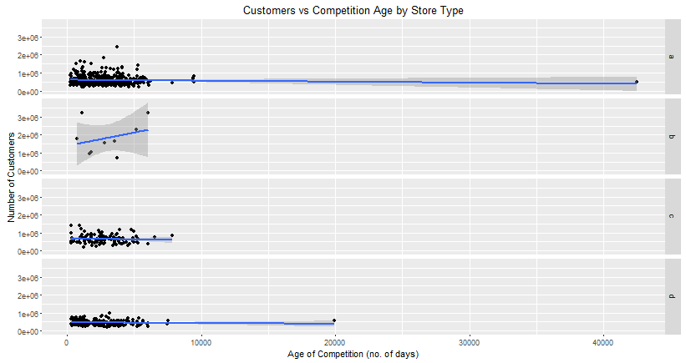
Competition’s Age Analysis

Slide 7
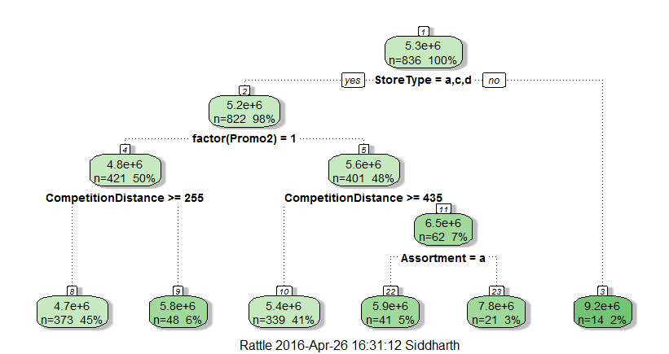
Sales vs Competition Analysis

Slide 8
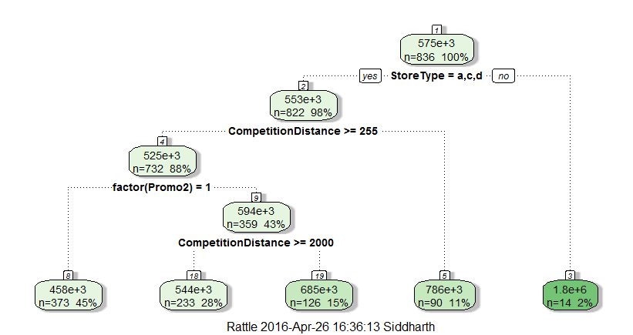
Customer vs Competition Analysis

Slide 9
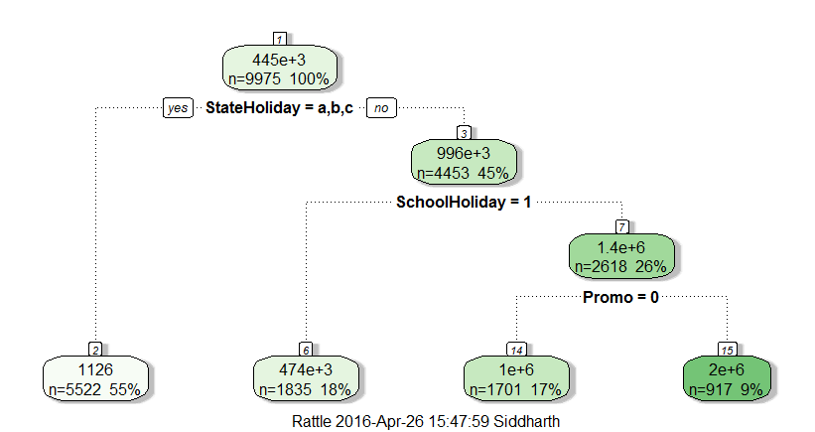
Holiday and Promotion Analysis

Slide 10
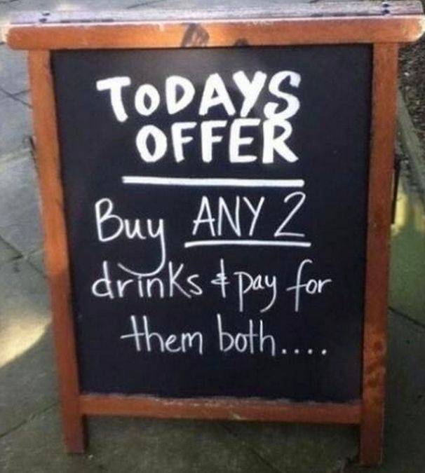
Insights and Recommendations
Competitor information better explains customer than sales.
Age of Competition is not relevant.
Competition Distance is an important factor for footfalls.
Focusing on promotions will increase sales.
Customers are less likely to go for small assortments.
Store type B has maximum footfall and conversions and minimal impact of competition.
Rossmann should include holiday specific promotions to boost sales.

Slide 11
THANK YOU!

