Slide 1
Two months.
A website
and an app.
The Neighbourhood exists to turn everyday moments into meaningful childhood memories, with as little friction as possible.
SIDDHARTH · THE NEIGHBOURHOOD · 22 JUNE TO 22 AUGUST 2026
01 / 11

Slide 2
WHAT WE'RE BUILDING
More than Home.
Home
Community
Ask
Four development activities a day, one each for motor, communication, cognitive, and social skills.
Real parents at a similar stage. Questions, answers, and moderation built in.
An AI that knows the child's age and the parent's own situation. One assistant, two audiences.
Child
You
137 milestones, a full vaccination schedule, meal planning, and a development kit.
The parent's own recovery, nutrition, and mental health. Not an afterthought. A whole side of the app.
Home is the daily habit, the reason to open the app again tomorrow. The other four are why it's worth keeping open.
02 / 11

Slide 3
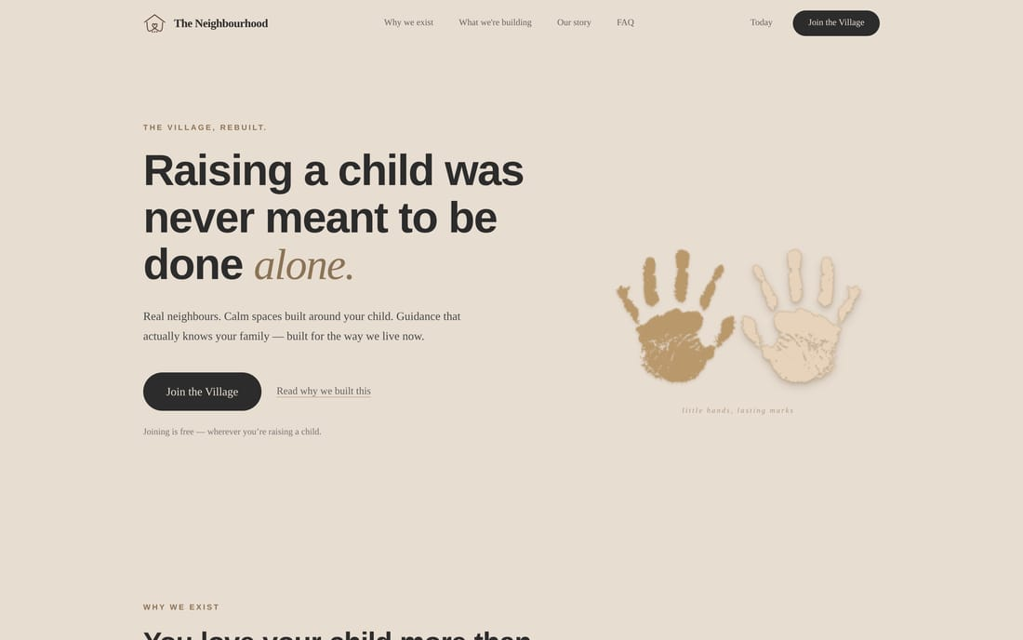
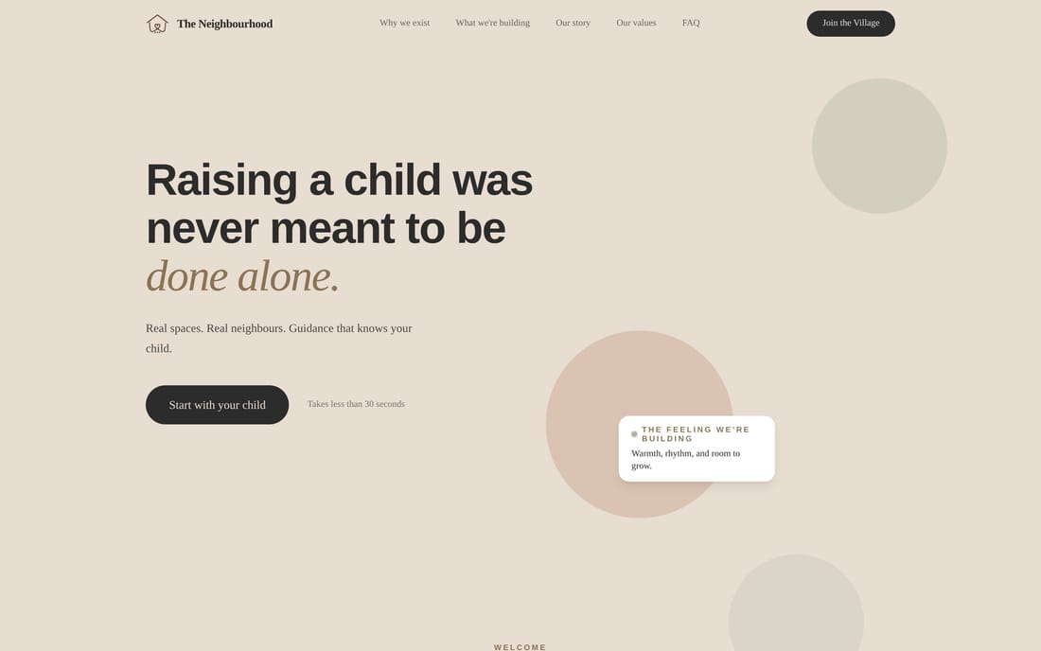
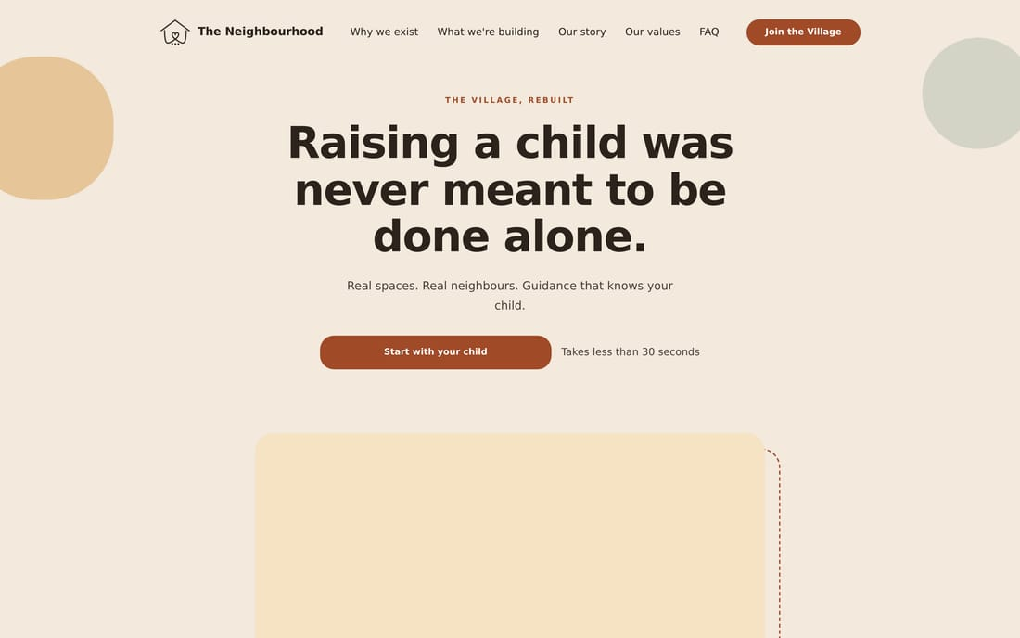
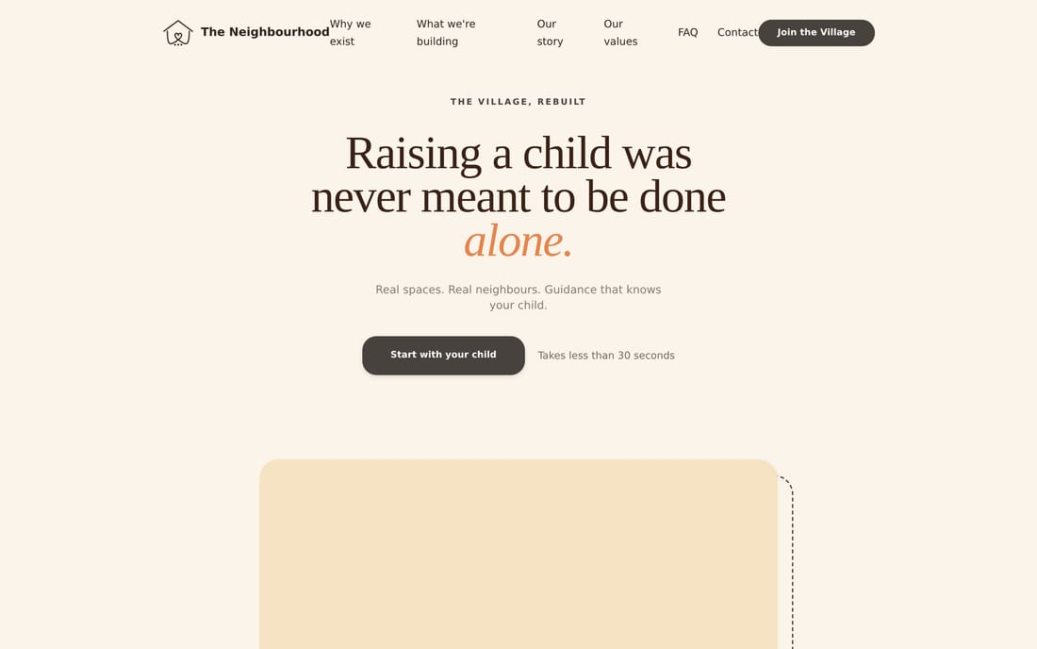
The website, week by week
12 JULY
23 JULY
2 AUGUST
21 AUGUST
First version. Grey-brown, handprints, text on the left.
Rebuilt the layout. More space, softer shapes.
New colours. Cream and terracotta. Moved to the centre.
Live now. Serif headline, one word in orange.
Same sentence the whole way through. It took four goes to find the right way to say it. At one point I had four versions running at once, so I picked one and deleted the other three.
03 / 11

Slide 4
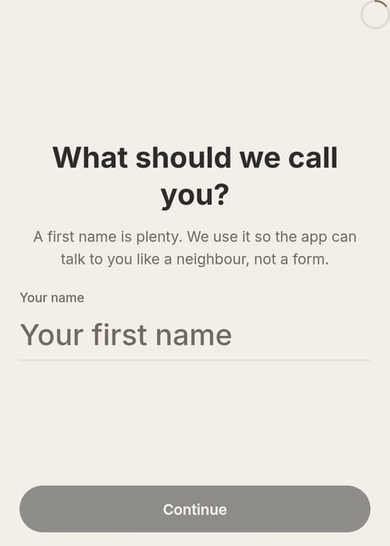
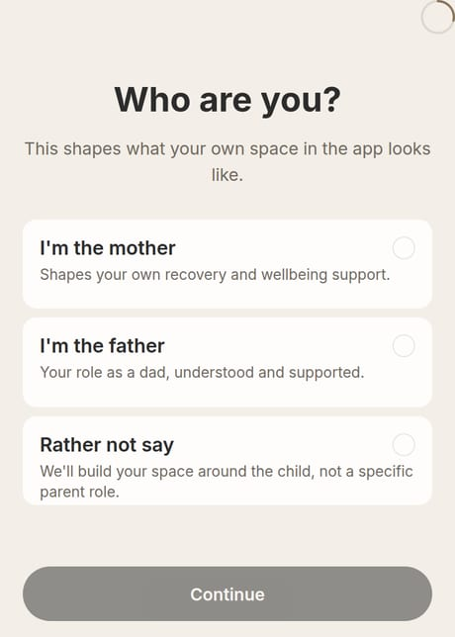
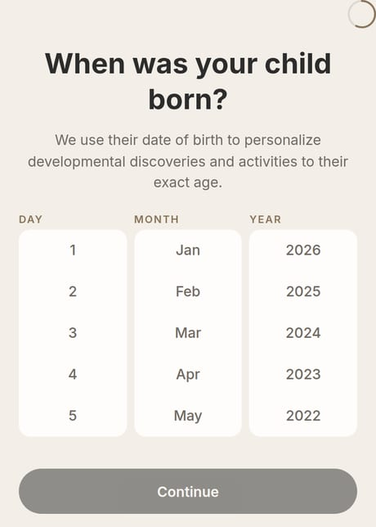
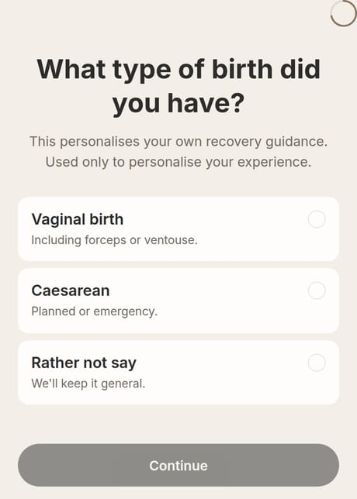
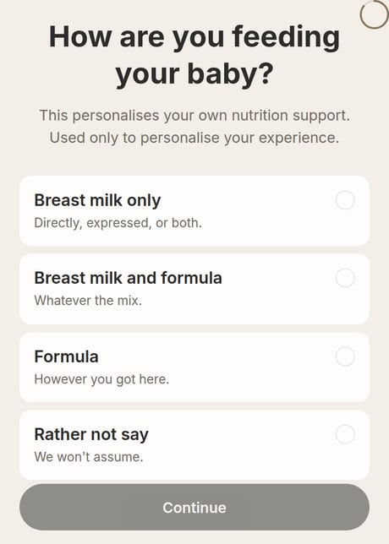
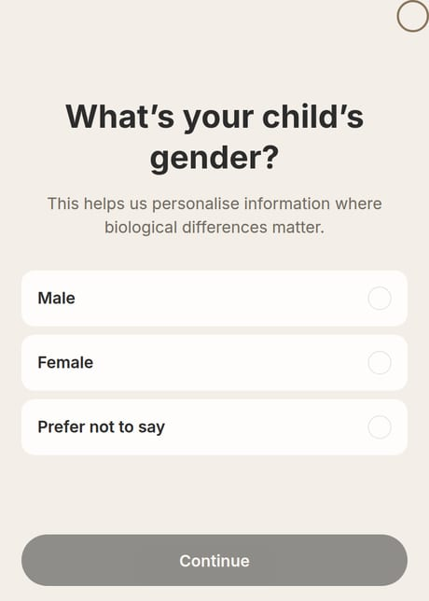
It only asks what applies to you
YOUR NAME
WHO YOU ARE
BIRTHDAY
The app talks to you by name after this.
Decides which questions you see next, and skips the ones that don't apply.
The most important one. Everything is worked out from this.
BIRTH TYPE
FEEDING
GENDER
Only for mothers. A father never sees this screen.
Only in the first year. Skipped once it stops being relevant.
Three options. One of them is prefer not to say.
04 / 11

Slide 5
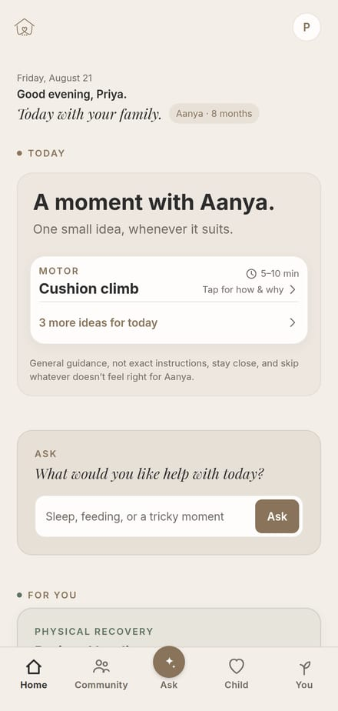
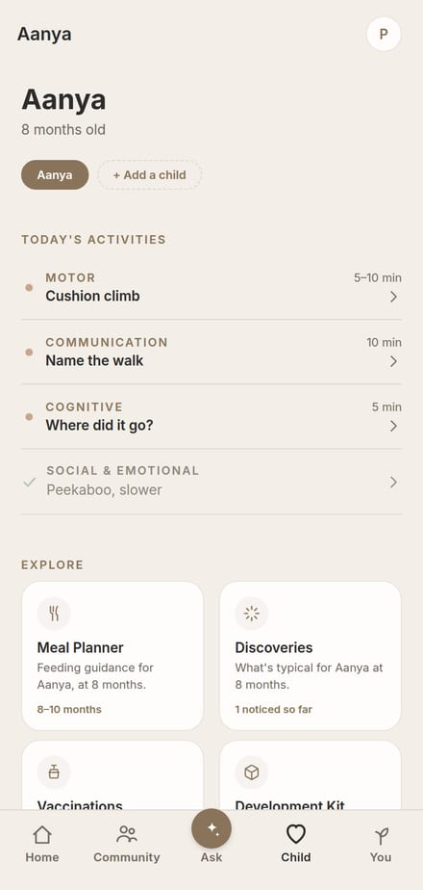
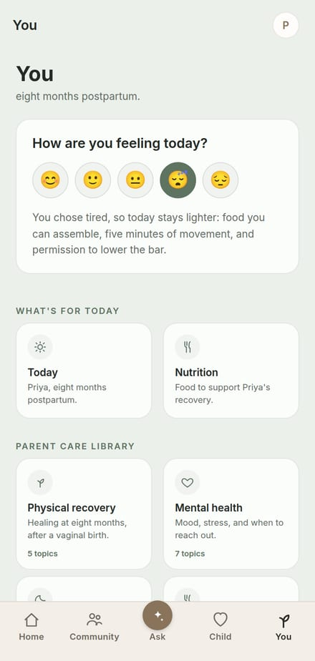
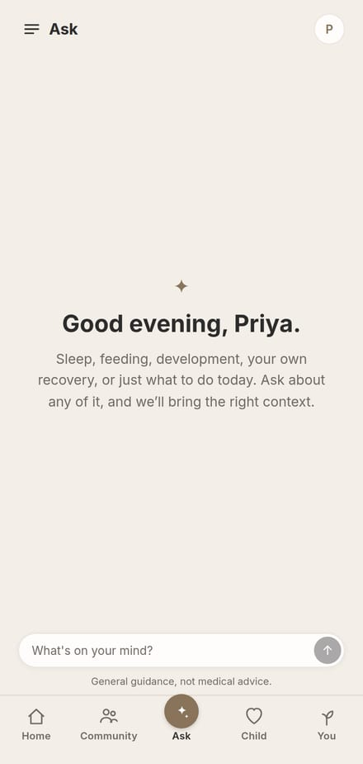
THE APP, SIGNED IN
Then it gets to work
HOME
CHILD
YOU
ASK
Today's four things, one per domain.
Today's progress, plus discoveries and vaccinations.
The parent's own side. Cooler colours, on purpose.
Questions, answered.
The bit I'm most proud of is You. Every other parenting app is about the child only. But the parent is recovering too, and nobody asks how they are. So they get their own half of the app.
05 / 11

Slide 6
HOW WE DECIDED WHAT TO BUILD
Six decisions behind it
Fewer questions
Only what gets used
Call people by name
Onboarding only asks what actually changes something later. Nothing collected just in case.
Today shows four activities, not the whole library. A daily habit needs a short list, not a browse.
The app says “Priya” and “Aanya,” not “you” and “your child.” It reads like a person, not a form.
One thumb, one hand
Cut what only made sense to us
Trust, shown not told
Every screen has to work while holding a baby. Buttons sit low, and things you'd reach for are easy to find.
We built a whole separate “Parent Mode,” switched from the top corner. Felt clever to build. Parents never found it. It's just a tab now.
Sources named, ranges instead of deadlines, “ask a doctor” where it matters. Small signals, everywhere.
06 / 11

Slide 7
What's in it, and what isn't
BUILT
WHERE IT STANDS
1,149
137
WORKING
activities, birth to seven years
things to look out for as they grow
Sign-up, the daily four, discoveries, vaccinations, the parent side, the AI, community. Real accounts and a real database.
54
17
HALF DONE
vaccinations, government and IAP
database tables
Reports, the kit guide and the product guide are built and clickable, but the content isn't written yet.
142
30+
commits on the website
on the app. Some shipped straight through Vercel.
33k
lines of code
07 / 11

Slide 8
PHOTO OF
YATI
GOES HERE
INTERN ONE
Yati
We call her aggressive. We mean it as a compliment.
All of us are a little scared of her. Also a compliment.
But if a job is hers, it's done, and it's done properly. She never needs chasing.
Best approached with your work already finished.
08 / 11

Slide 9
PHOTO OF
MUSKAN
GOES HERE
INTERN TWO
Muskan
Brutally honest about everything. You always know exactly where you stand with her.
Head down, gets on with it, never makes noise about any of it.
She gets ill sometimes. Once she sent Rachit her actual medical reports as proof. Nobody had asked for proof.
Most of us text “not well today.” Muskan submits evidence.
09 / 11

Slide 10
PHOTO OF
TEJAS
GOES HERE
INTERN THREE
Tejas
National level table tennis player. Do not agree to a friendly game.
Also the founder's nephew. Yes, we've all made the joke already.
And he still works as hard as anyone here, which he didn't have to.
The only person in the office with a national ranking.
10 / 11

Slide 11
That's it.
Everyday moments into meaningful childhood memories, with as little friction as possible.
A website that's live, and an app you can put on your phone right now. It's just a link. No app store, no invites.
THANK YOU · QUESTIONS?
11 / 11

