Slide 1

Presented by Arya Consultancy, Gujarat, India

Slide 2
About the Project
Project Title: Do It Yourself (DIY) Academic Activities for the Students and teachers
thorough the Learning Centre
Project Goal: Child centric and interest based academic activities for children’s learning
Plan:
To increase learning levels of students by building capacities of the teachers and providing grade wise, subject wise and skill specific content to students for independent learning and practice.
Objectives:
1. Increase learning levels of the students.
2.Build capacities of the teachers to improve learning levels.
3.Onsite mentoring for improved academic indicators.
4. Support for basic literacy to dropout & girl students
Project Area and Target Group: The project is proposed to be implemented in Nalsarovar block at Viramgam of Ahmedabad district covering.
Project Period: The project duration will be of 3 to 5 years

Slide 3

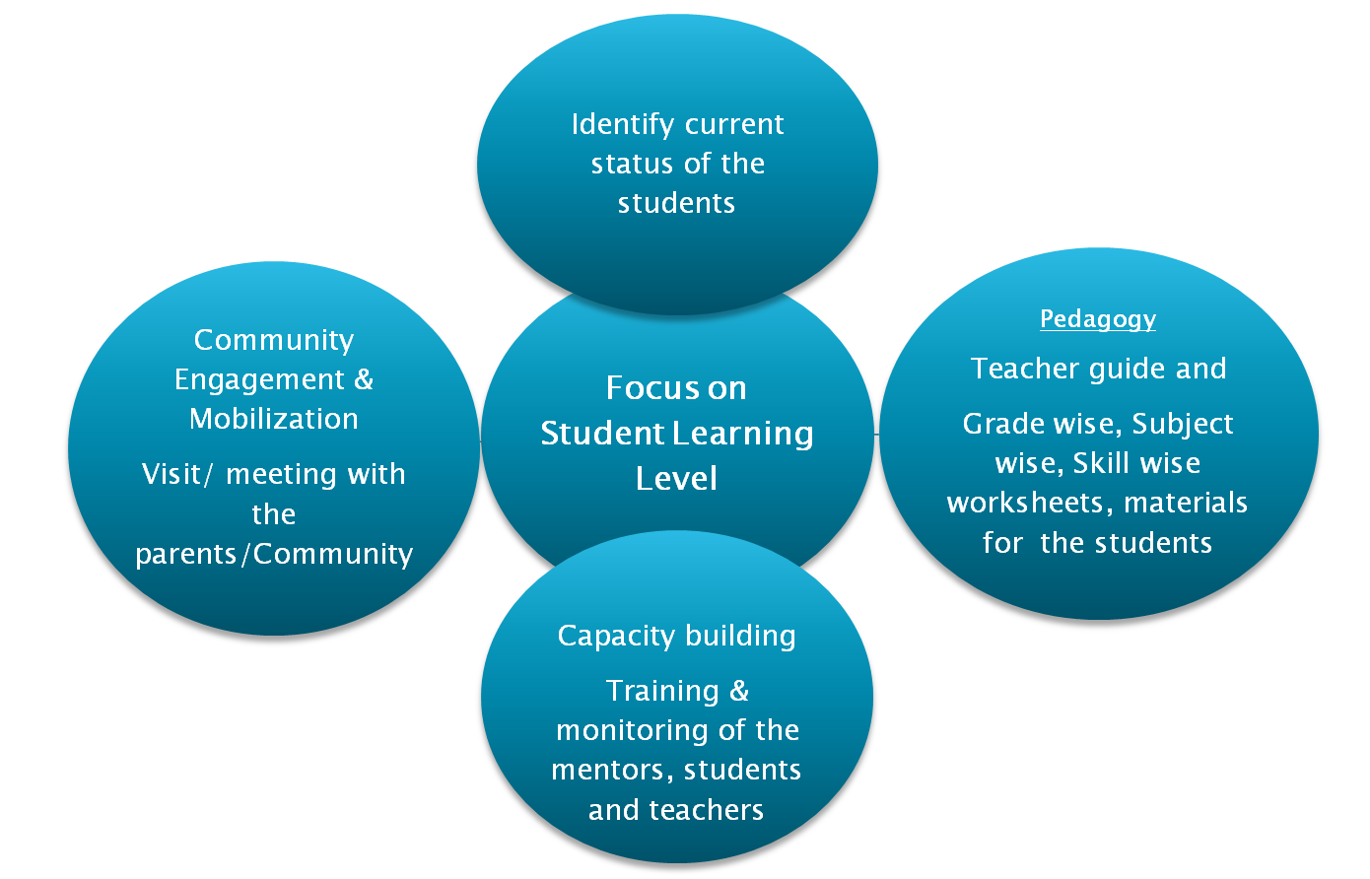

Slide 4
Strategy
1. Communicating to the community about the project and get support
2. Inaugural event in each Learning Centre
3. Registration of the children
4. Base line to map the current learning levels of the students
5. Recruitment of the local teachers
6. Provide continuous training to the selected local teachers
7. Preparation of teacher guide, worksheets, hands of materials, models etc.
8. Take session every day and follow up with the schools
9. Career orientation sessions, community engagement through out the year
10. Onsite mentoring and monitoring
11. Provide visible and measurable result in report form

Slide 5
Detailed Strategy
Communicating to the community about HGCL and the project through newspaper, one to one meetings etc.
Inaugural event: The inaugural of the project will done in Nalsarovar Block in coordination with HGCL.
Registration of the students: The students will be registered from the primary schools as well as parents for the program. Formal written consent of the parents will be taken to register their child in the project for Learning Centre.
Baseline:
To understand the current learning levels of the students, baseline will be done.
The tool will be developed grade wise, subject wise and selected skill wise.
The sample includes all the children who have registered for the project.
The subject selected includes Gujarati, Maths and Science.
Data coding, analytics and report will be developed.
Baseline report will inform the implementation framework.
Recruitment of the teachers and mentors (Women only - selection criteria will be decided mutually with HGCL - Minimum Graduate pass) :
Option 1 – Ready Resources, or
Option 2 – Identify from the community, or
Option 3 – CRCs
Cont.

Slide 6
Program Schedule for Students and Teachers :
For Students-Three and a half hours program schedule will be implemented
1. Refreshment to the children and teacher – 30 minutes
2. Prayer and Balgeet – 10 minutes
3. Story telling/ listening -10 minutes
4. Subject teaching per subject (alternatively) (Day 1 Gujarati, Day 2 Maths,
Day 3 Science and so on. – 15 minutes
5. Group Task – 60 minutes
  Group 1 - Gujarati- 15 minutes
  Group 2 - Maths- 15 minutes
  Group 3 - Science-15 minutes
  Group 4 - Activity corner-15 minutes
Each group will rotate to other group every 15 minutes. However each child will do
the task independently.
6. Self activity by children using TLMs related to above subjects. Facilitated by the
teacher.
  Group 1 and Group 2 - 25 minutes
  Group 3 and Group 4 - 25 minutes
7. Summarize – 5 minutes
Cont.
Cont.

Slide 7
For Teachers- Four hours program schedule will be implemented
Along with the above schedule, the teacher will be given 15 minutes each for pre and post activities. Local teacher will be visited student’s house, meeting with the parents and locally connected.
One day in week, the children will be exposed to Co-scholastic activities:
Week 1 - Music
Week 2 - Art and craft
Week 3 - Self defence
Week 4 - Theatre
One day in a month, parent –local teacher meeting will be held
Cont.
Cont.

Slide 8
Subject Wise, Skill Wise Details: Depending on the baseline, skills will be finally decided
Cont.
Subjects | Skills
Gujarati (Listening, Reading/Writing) | Listen and understand conversation and dialogue in unknown and known situations 2. Describe the situation and things of surroundings in simple sentences 3. Write stories, letters and composition from the given points
Maths (Numeracy) | Problem solving 2. Application of knowledge in real life 3. Critical thinking
Science | Learn to assess objects to know its characteristics/properties 2. Students are able to identify left and right directions in the map & creation of map 3. Understand the integrity in diversity
Reference:
1.Selection of all the skills from School Based Comprehensive Evaluation: Motivation for Comprehensive Education by Prof. Dr. Ravindra Dave
II. http://www.p21.org/our-work/p21-framework
Cont.

Slide 9
Teacher guide:
Guide for teachers will be prepared to help the teacher transit the academic content to the students. The teacher guide will include day wise key components as per the program schedule.
Capacity building of the local teachers:
Capacity building of the teachers will be done. Two days training will be given based on the program schedule. Maximum of 15 teachers in one batch will be included. Total batches will be made as per the total teachers involved in the project.
Materials for students & teachers:
Subject wise, skill wise worksheets will be developed for the students
Hands on materials, models and puzzles, learning games will be developed
Maths, Gujarati and Science subjects worksheet will be made for each student.
Worksheets keep on Learning Centre for the evidence of the
Onsite mentoring : For continuous support to the teachers, onsite mentoring will be done by the mentors as decided by HGCL. Capacity building of mentors will be done.
Cont.

Slide 10
Robust Project Monitoring:
Formation of Steering and Monitoring Committee
Arya Consultancy will present the project update quarter or as required to the HGCL. Inputs will be included.
The mentors will make note of the work done on daily basis
Meeting of local teachers and Arya Consultancy will be done twice in a month
Key deliverables: The following outputs are expected at the end of the project:
Increase in students learning levels
Teachers identify learning gaps and trained to help students improve
Children engaged in learning by self
Children involved in scholastic and co-scholastic activities during school. This will help build the gap experienced by the school and the children during long academic breaks.
Community awareness for education leading to increased community engagement.
Documentation:
Baseline report
Project intervention report
Any other, as required (Media coverage/Website document/Success story/ Videos)
Cont.
Cont.

Slide 11

# | Heading |  | One Location | Two Location | Four Location
 |  | Year-1
1 | Local teacher salary | 6000*12*1 | 72000 | 72000 | 144000
2 | Local teacher’s training | 4000*30*1 | 120000 | 120000 | 120000
3 | Community Engagement session | 12000*5*1 | 60000 | 120000 | 240000
4 | Materials for local teacher and students | 4000*10 | 40000 | 80000 | 160000
5 | Printing and stationary | 1000*10 | 10000 | 20000 | 40000
6 | Administration cost | 15% | 45300 | 61800 | 105000
Total Cost(INR) |  |  | 347300 | 473800 | 809600
GST 18% |  |  | 62514 | 85284 | 145728
Grand Total(INR) |  |  | 409814 | 559084 | 955328
Per location/per year cost(INR) |  |  | 409814 | 279542 | 238832

Slide 12
# | Heading |  | One Location | Two Location | Four Location
 |  | Year-2
1 | Local teacher salary | 7000*12*1 | 84000 | 84000 | 168000
2 | Local teacher’s training | 4000*20*1 | 80000 | 80000 | 80000
3 | Community Engagement session | 12000*3*1 | 36000 | 72000 | 144000
4 | Materials for local teacher and students | 3000*10 | 30000 | 60000 | 120000
5 | Printing and stationary | 1000*10 | 10000 | 20000 | 40000
6 | Administration cost | 10% | 24000 | 31600 | 55200
Total Cost(INR) |  |  | 264000 | 347600 | 607200
GST 18% |  |  | 47520 | 62568 | 109296
Grand Total(INR) |  |  | 311520 | 410168 | 716496
Per location/per year cost(INR) |  |  | 311520 | 205084 | 179124

Slide 13

# | Heading |  | One Location | Two Location | Four Location
 |  | Year-3
1 | Local teacher salary | 8000*12*1 | 96000 | 96000 | 192000
2 | Local teacher’s training | 4000*15*1 | 60000 | 60000 | 60000
3 | Community Engagement session | 12000*2*1 | 24000 | 48000 | 96000
4 | Materials for local teacher and students | 2500*10 | 25000 | 50000 | 100000
5 | Printing and stationary | 750*10 | 7500 | 15000 | 30000
6 | Administration cost | 10% | 21250 | 26900 | 47800
Total Cost(INR) |  |  | 233700 | 295900 | 525800
GST 18% |  |  | 42075 | 53262 | 94644
Grand Total(INR) |  |  | 275775 | 349162 | 620444
Per location/per year cost(INR) |  |  | 275775 | 174581 | 155111

Slide 14
Thank You
Contact person Arya Consultancy:
Name: Hiral Adhyaru
Designation: Director
E-mail: aryaconsultancygujarat@gmail.com
Phone: (+91) 9427308943
Registration: May 2017
Udyog Ahaar No.: GJ01D0060954
Current A/C no. 36980719839
Bank : State Bank Of India
Branch: A/1, Dharnidhar Park, Mafalipur, Dholka, Ahmedbad
IFC Code: SBIN0012255

