Slide 1
AI Concierge – RAG App
This is a proof-of-concept e-commerce conversational assistant demonstrating:
Vector DB retrieval (Chroma + OpenAI embeddings)
LangChain chains and tool-based function
AutoGen like multi-agent orchestration mode
Streamlit chat UI showing agent role conversations

Slide 2

Core Concepts

Slide 3
Vectors and Embeddings
An Embedding is a Vector generated by a LLM with Semantic meaning
Nearest Neighbor Search
Cosine similarities across a collection of vectors
Calculates how close one vector is to others in multidimensional space
Ranks relatedness of vectors and semantic meaning
Embedding models
OpenAI text-embedding-3-small, text-embedding-3-large, Hugging Face

Slide 4
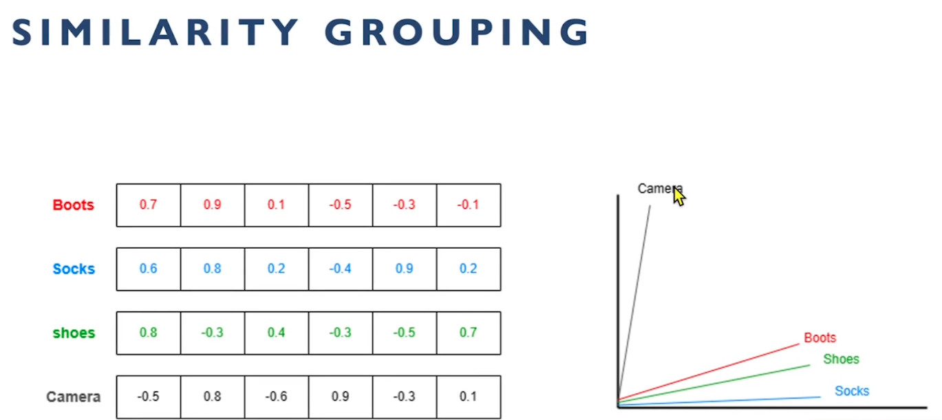
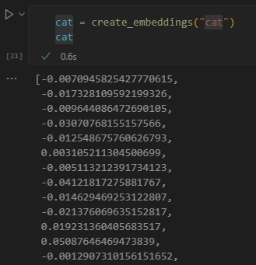

Slide 5






Data Chunking in Rag System
Embedding model
Structured Data
Chunks
Vector DB
Retrieved Chunks
Response Generation
Fixed length Chunking
Semantic Chunking
Overlapping Chunking
Sliding Window Chunking
Hierarchical Chunking
Dynamic Chunking
Sentence-based Chunking
Paragraph-based Chunking
Token based Chunking
Contextual Chunking
Unstructured Data

Slide 6
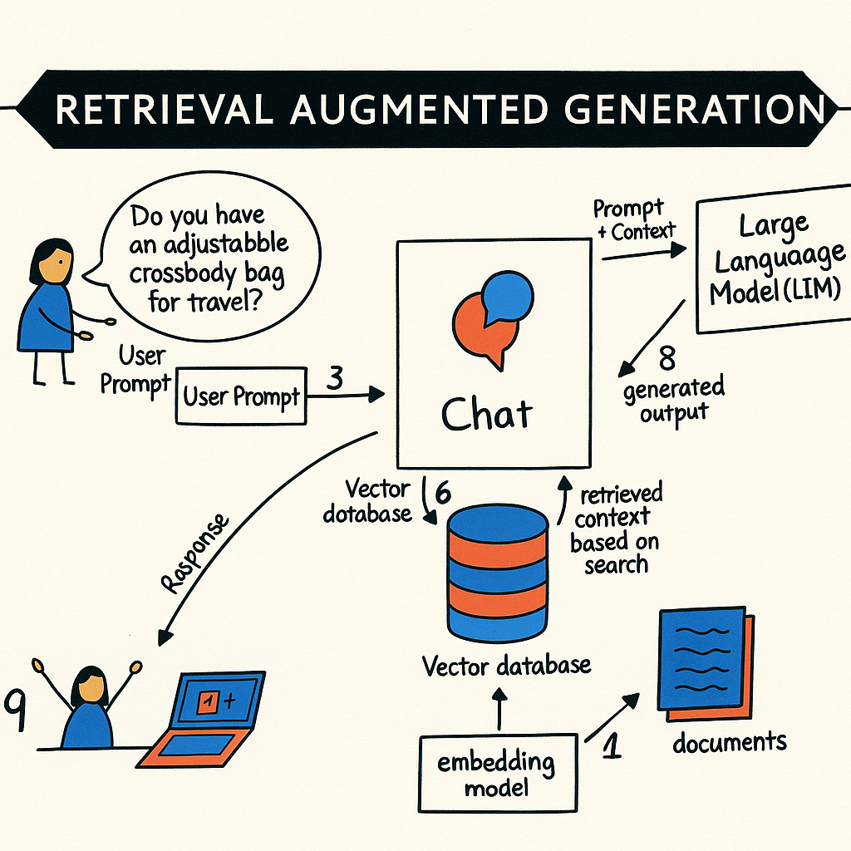

Slide 7
Langchain
Framework for building applications with Large Language Models (LLMs)
Simplifies connecting LLMs to external data, APIs, and workflows
Chains → Sequential steps combining LLM calls and logic
Agents → LLMs that can interact with tools and APIs dynamically
Memory → Stores context for multi-turn interactions
LLM orchestration for complex tasks
Integration with databases, APIs, and documents
Supports retrieval-augmented generation (RAG)

Slide 8

AutoGen
Single Agent - AI Concierge
Multiple Specialized Agents:
Customer Agent Specialist
Order Return Specialist
Policy Specialist
Order Tracker Specialist

Slide 9
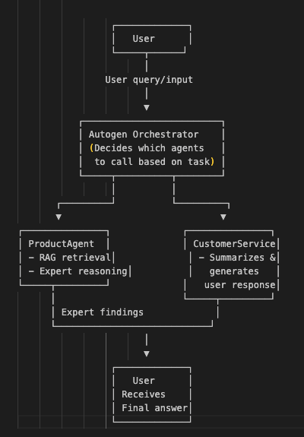


AutoGen
A2
A1
User
A3
A1 manages customer interfacing
A2 manages return policies
A3 manages order return

Slide 10
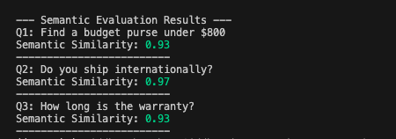
AI Evaluations

Slide 11
Hugging face
Open-Source foundry of AI models
Hosts pre-trained models, datasets, and ML tools for research and production
Libraries for quick integration and orchestration

Slide 12
Thank-you

