Slide 1



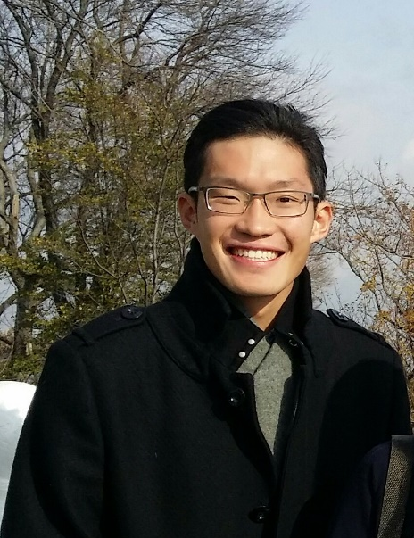

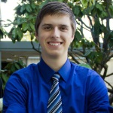

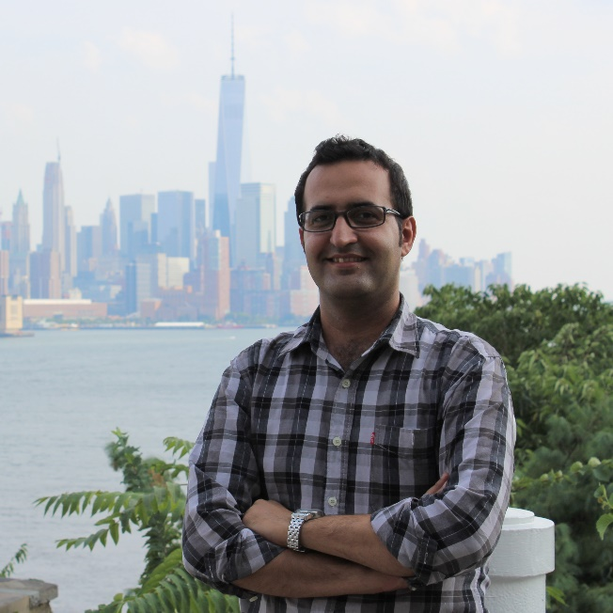
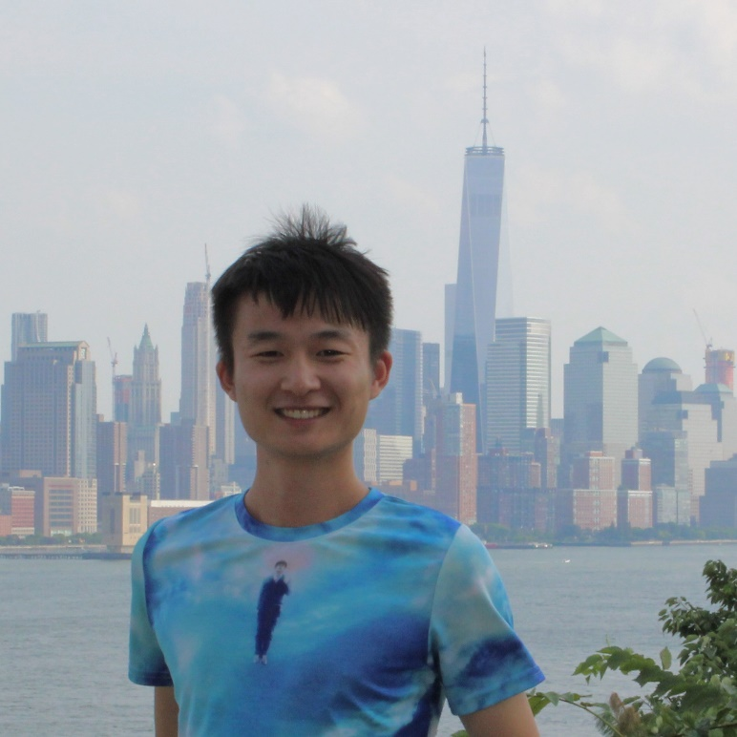
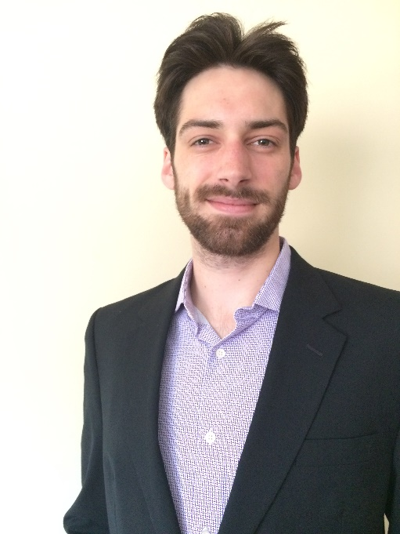
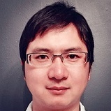
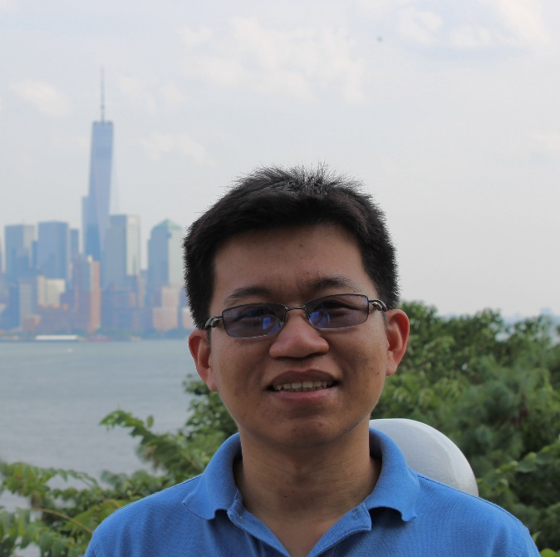
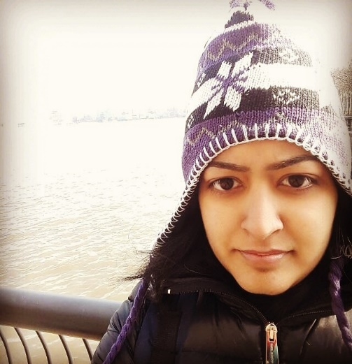
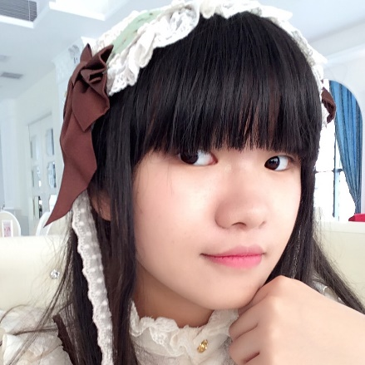
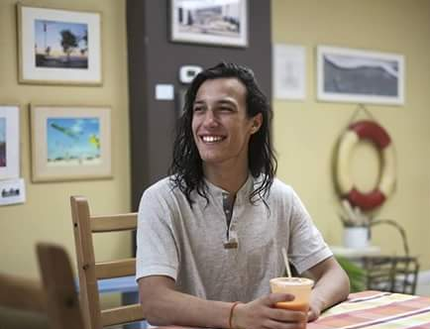

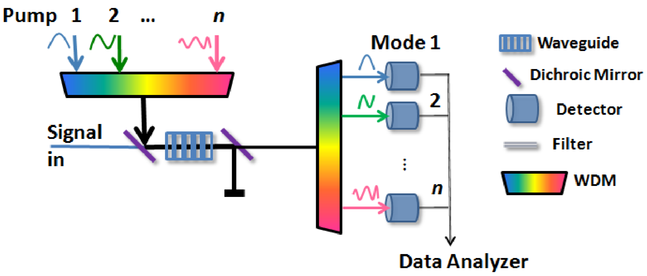
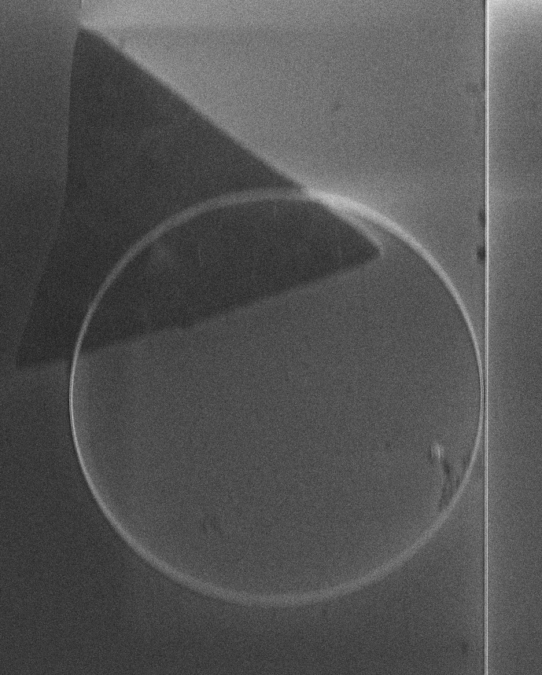
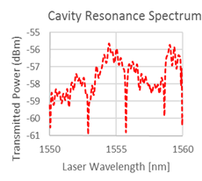
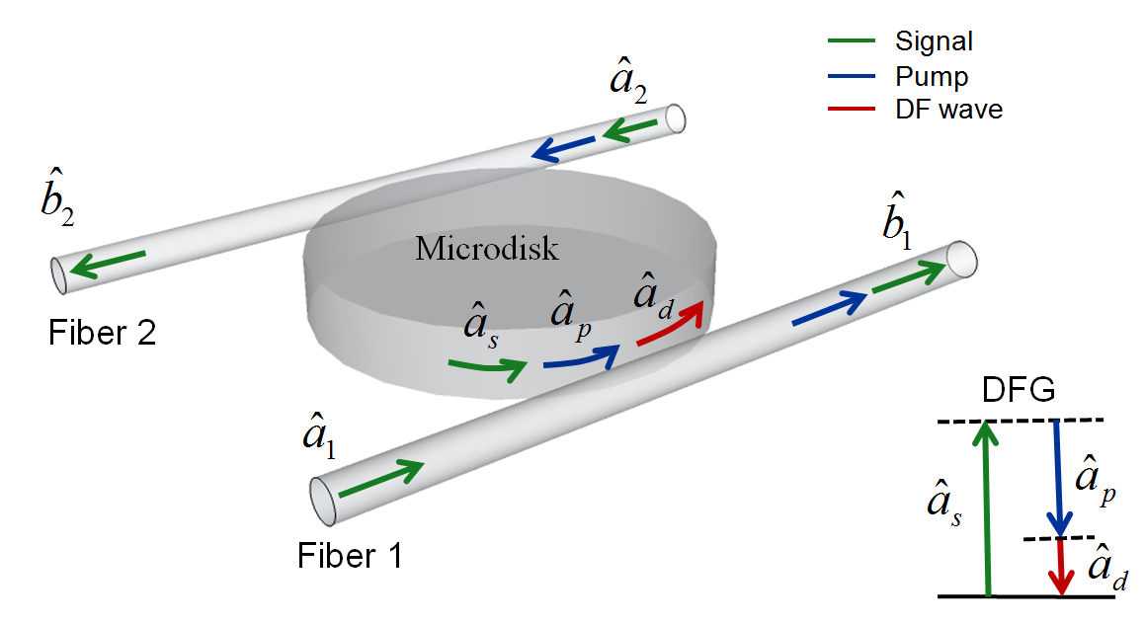
Objective: Employ quantum mechanics and exotic photonic technology to better understand the nature and society, thereby improving our lives on a green and blue planet. The current focus is on developing mass-producible, chip-integrated, turn-key, and room-temperature photonic devices powered by new physics.
Nano Engineering
Quantum Microprocessors
Environment & Defense
Photonic Remote Sensing
Information Processing
Quantum Photonics
Biomedical
Deep-tissue Imaging & Treatment
Hybrid Quantum Internet
You?
If you also believe in what we do and that, by working hard together, we will make it happen one day, the door to your left is open (please knock if not). Also feel free to email Yuping: yuping.huang@stevens.edu about graduate, undergraduate, and pre-college research opportunities.
LAB I
x
All-weather Quantum Communications and Sensing
z
Remote 3-D Sensing via Photonic Backscattering
Quantum Airy Beams for Persistent Communications
Lens-free Biomedical Imaging beyond Diffraction Limit
y
LAB II
Ultrafast Photonics
Photonic Arbitrary Waveform Generation and Measurement
Exotic Photonic Nonlinear Processing via Engineered Phase Matching
High-Dimensional, Mode-Resolving Photon Counting
LAB III
Chip-integrated Photonic Computing
THz-speed All-Photonic Information Processing
Quantum Logic Gates via “Interaction-Free”

