Slide 1

Vaccination

Slide 2
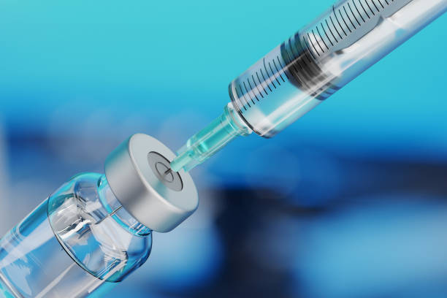
What is Vaccination?
Vaccination is the process of introducing a vaccine into the body to protect against a specific disease. It's a safe, simple, and effective way to protect people from harmful diseases before they come into contact with them.

Slide 3
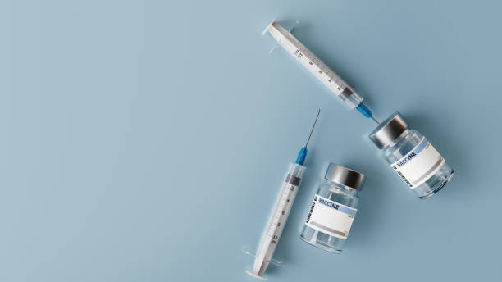
Why is it important?
Immunization also helps to reduce the spread of infectious diseases among kids by stimulating the immune system that protects against any subsequent infection attack. Vaccination is one of the most cost-effective health investments for young minds that does not require any radical lifestyle change.

Slide 4
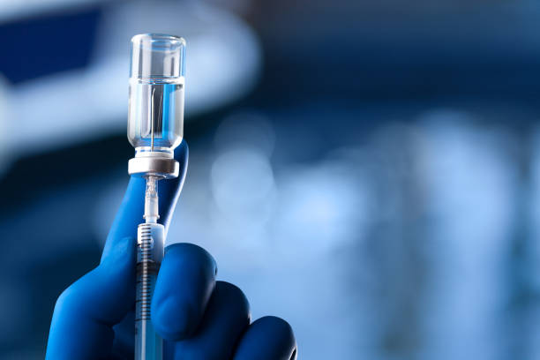
How does Vaccine prepare the human body?
They do this by introducing something called an antigen into the body, which imitates an infection and primes the immune system to respond. That way, if you encounter certain disease-carrying organisms, known as pathogens, in the future, your body already has a plan of attack.

Slide 5
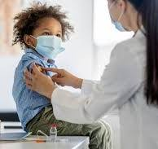
As a toddler what are the basic vaccines that are mandatory?
As a toddler the vaccines that are mandatory are:
Coronavirus Disease 2019
Hepatitis A
Hepatitis B
Influenza
Measles-Mumps-Rubella or Measles-Mumps-Rubella-Varicella
Meningococcal
Polio
Dengue

