Slide 1
PRESENTATION TITLE
Task 3 Standard Bank Virtual Internship
Forage (Loan Prediction Project)
Siddharth Hiraou
26 December 2022

Slide 2
TEXT LAYOUT 1
Agenda
Data Science Lifecycle​
Project Overview​
Data
Analysis
Modeling
Recommendations

Slide 3
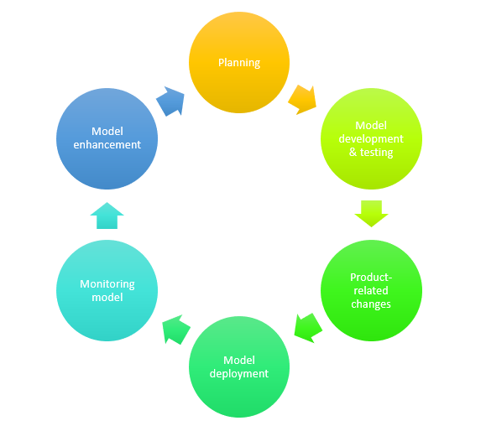
TEXT LAYOUT 1
Data Science Lifecycle
A data science lifecycle indicates the iterative steps taken to build, deliver and maintain any data science product. All data science projects are not built the same, so their life cycle varies as well. Still, we can picture a general lifecycle that includes some of the most common data science steps. A general data science lifecycle process includes the use of machine learning algorithms and statistical practices that result in better prediction models. Some of the most common data science steps involved in the entire process are data extraction, preparation, cleansing, modelling, and evaluation etc. The world of data science refers this general process as “Cross Industry Standard Process for Data Mining”.

Slide 4
TEXT LAYOUT 1
Project Overview
Business Problem:
Credit / Home Loans - AutoML vs Bespoke ML
Standard Bank is embracing the digital transformation wave and intends to use new and exciting technologies to give their customers a complete set of services from the convenience of their mobile devices. As Africa’s biggest lender by assets, the bank aims to improve the current process in which potential borrowers apply for a home loan. The current process involves loan officers having to manually process home loan applications. This process takes 2 to 3 days to process upon which the applicant will receive communication on whether or not they have been granted the loan for the requested amount. To improve the process Standard Bank wants to make use of machine learning to assess the credit worthiness of an applicant by implementing a model that will predict if the potential borrower will default on his/her loan or not, and do this such that the applicant receives a response immediately after completing their application

Slide 5
TEXT LAYOUT 1
Project Overview
Business Objective:
The Home Loans Department manager wants to know the following:
An overview of the data. (HINT: Provide the number of records, fields and their data types. Do for both).
What data quality issues exist in both train and test? (HINT: Comment any missing values and duplicates)
How do the the loan statuses compare? i.e. what is the distribution of each?
How do women and men compare when it comes to defaulting on loans in the historical dataset?
How many of the loan applicants have dependents based on the historical dataset?
How do the incomes of those who are employed compare to those who are self employed based on the historical dataset?
Are applicants with a credit history more likely to default than those who do not have one?
Is there a correlation between the applicant's income and the loan amount they applied for?

Slide 6
TEXT LAYOUT 1
Project Overview
Hypothesis:
1. Are applicants with a credit history more likely to default than those who do not have one?
Quick answer: Yes.
2. Is there a correlation between the applicant's income and the loan amount they applied for?
Quick answer: Yes.

Slide 7
TEXT LAYOUT 1
Data
Data 1 (train.csv)

Slide 8
TEXT LAYOUT 1
Data
Data 2 (test.csv)

Slide 9
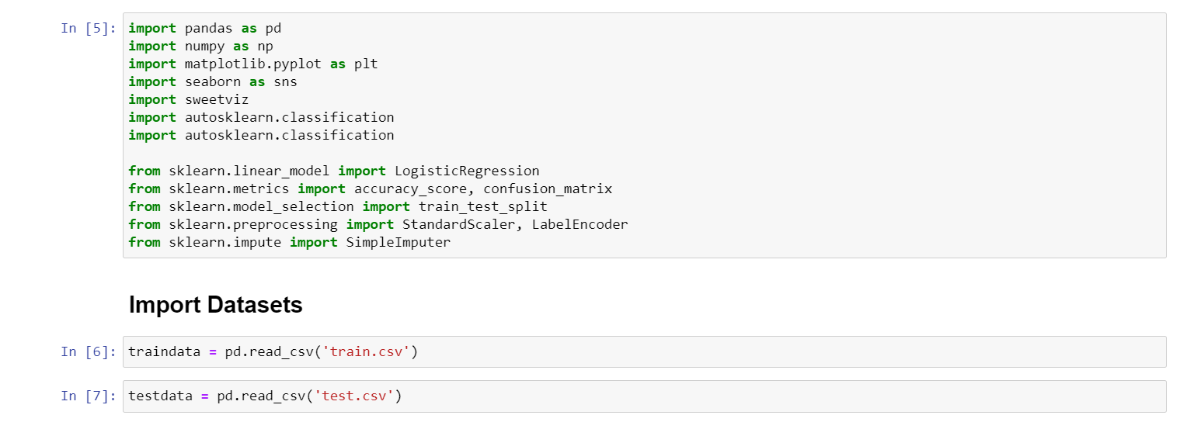
1. First we import the required libraries for our module . 1
Process Overview / Solution

Slide 10
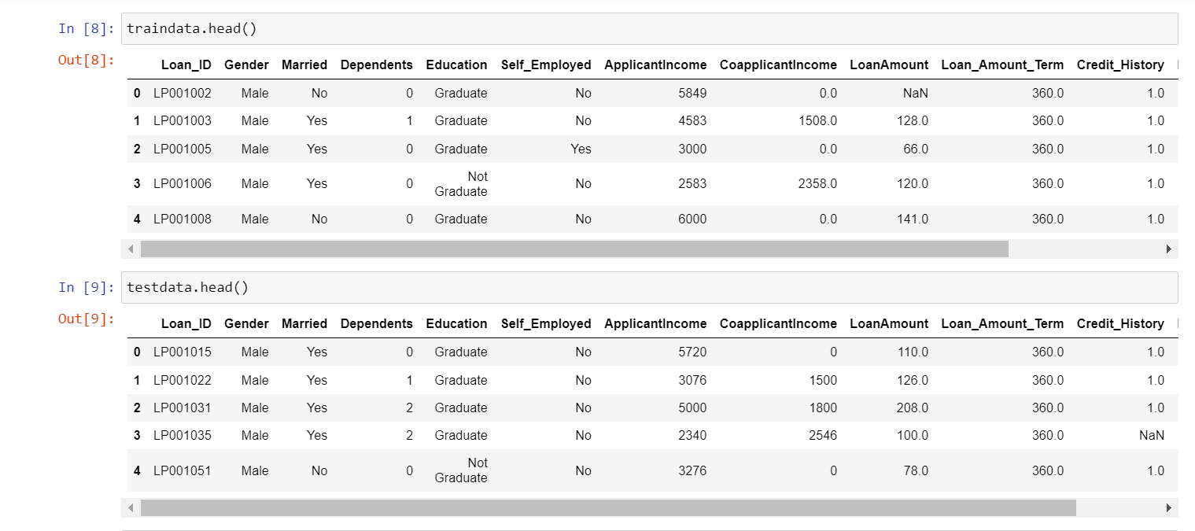
2. Then we import our datasets and name them as traindata and testdata. 1
Process Overview / Solution

Slide 11
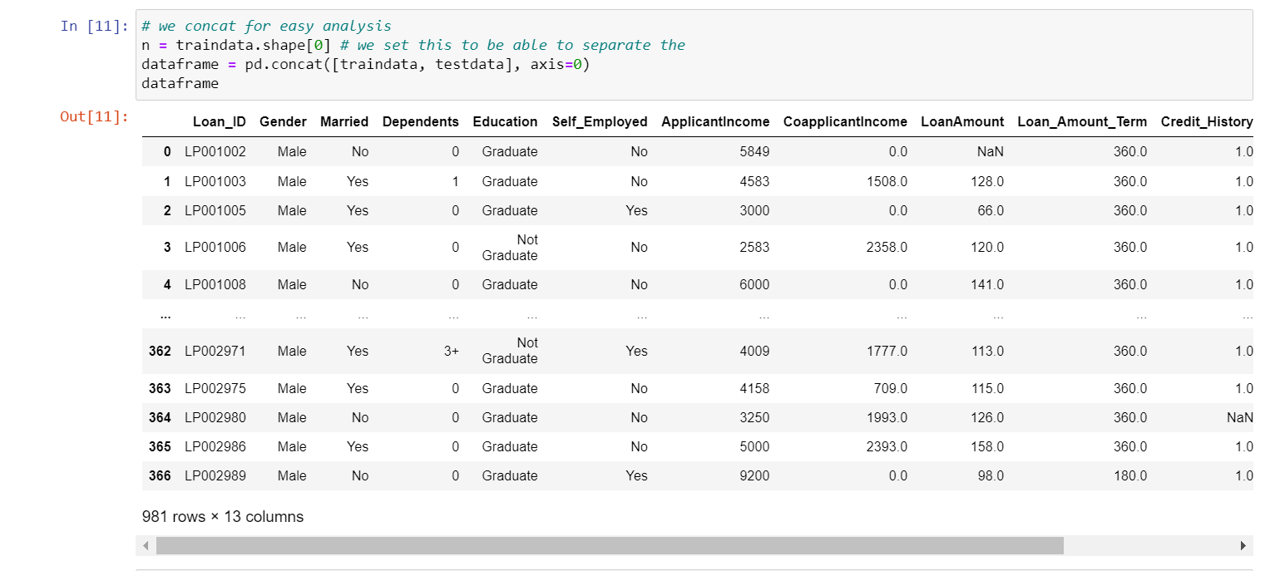
TEXT LAYOUT 1
Analysis
3.Now we create a data frame by merging 2 files train and test data

Slide 12
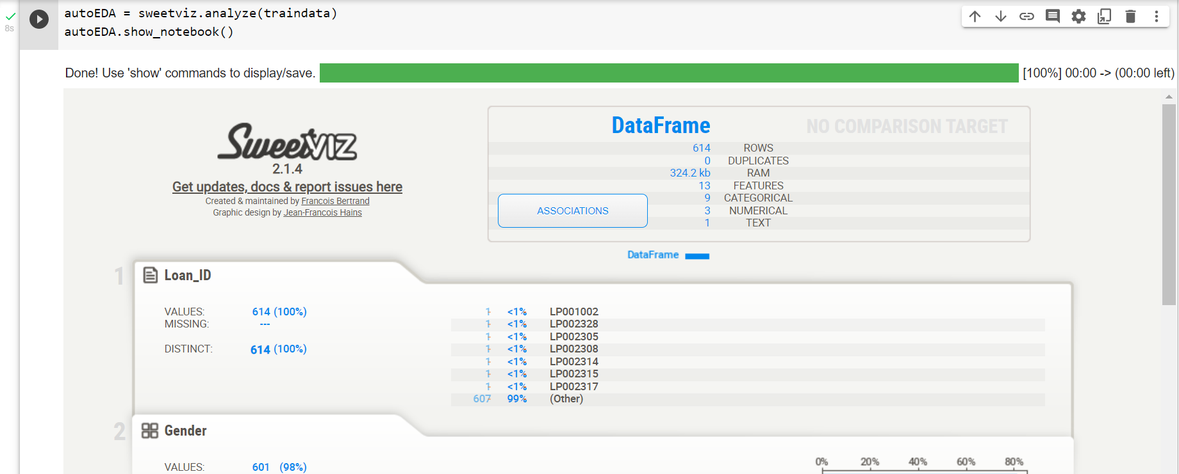
TEXT LAYOUT 1
Modeling
4.Now we auto EDA train data using sweetwiz.

Slide 13
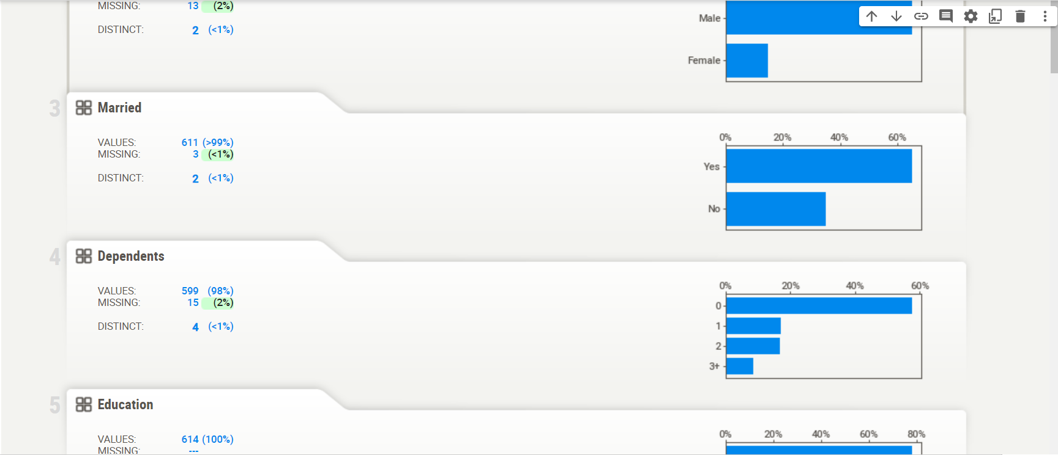
TEXT LAYOUT 1
Modeling
4.Now we auto EDA train data using sweetwiz.

Slide 14
TEXT LAYOUT 1
Recommendations
For further detailed description of model check the following link
https://colab.research.google.com/drive/1WCV3mQwM5SaFVqZLIouO_QNXoJZxuaQA?usp=sharing

