Slide 1
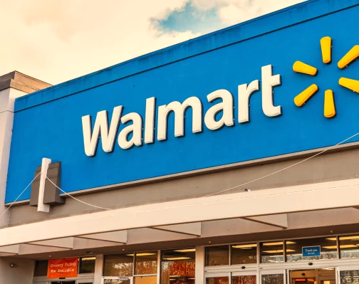
GB 730 Prescriptive Modelling and Optimization
Prof. Jordan Tong
Application Project
By
Vidaan Shankar
Siddharth Kilaru

Slide 2


Business Problem:
Walmart has 765 stores across the state of Texas. To cater their general merchandise requirements, they have established 5 Regional Distribution Centers (RDC’s) in the state.
Demand is expected to increase in the coming years and the data for the future demand is forecasted.
Probable new locations: Corpus Christi and Waco.
Key Outcomes:
Determine which RDC’s supply to which store.
Capacity for new RDC’s.
Utilization of existing RDC’s.
Relevant Organizations:
This might help large-scale businesses( Warehouses, Super-stores) with optimizing the total costs (new DC build-up cost and also the transportation costs from a DC to stores) of setting up an extensive supply chain distributions.
At a global level, this kind of model can be used for helping shipping firms to decide which ports to utilize as hubs for cargo re-distribution.

Slide 3
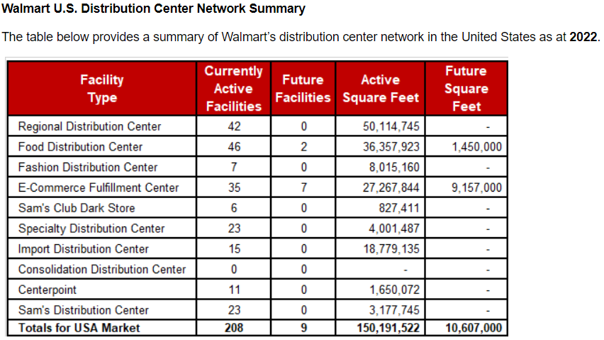

Slide 4
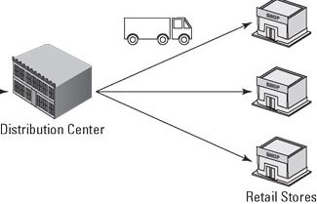
Optimization Problem:
Objective : Minimize Total Costs (Distribution/Transportation Costs + DC Building cost)
Decision Variable(s) : (i) Distribution Centre (DC) Location
(ii) Assignment of store to DC.
Constraints : (i) Capacity of the DC
(ii) Demand of the Store
Used BigM concept to determine the capacity of new DC locations. We did this by making the capacity of new locations vey large so that any excess demand is absorbed by them.
Programming Tool:
Python was used to solve the optimization problem as the number of DV’s are very high. It is not possible to solve in Excel.
GLPK Solver from the Pyomo library was used to optimize the model.
What-if analysis was used to understand the placement of new store location and its usage

Slide 5
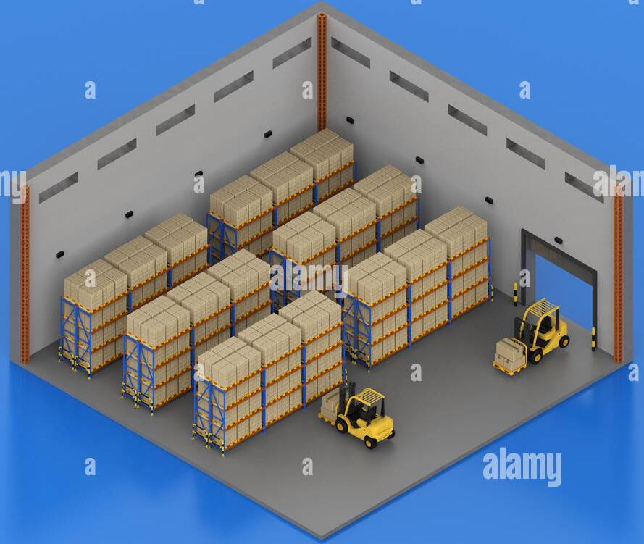
Observations or Assumptions made :
Size of a Walmart Store:
Average size of a Walmart Supercenter is 179,000 sq.ft. varying between 69,000 sq.ft. and 260,000 sqft.
Size of a store was calculated using a normal distribution and applied to all the 765 stores. This was done in Excel.
Capacity and Demand:
Used area of the RDC and store for capacity and demand calculations.
Assumed that the height of both the store and the DC is same. It is essential to directly compare demand and capacity.
Height
Spacing

Slide 6
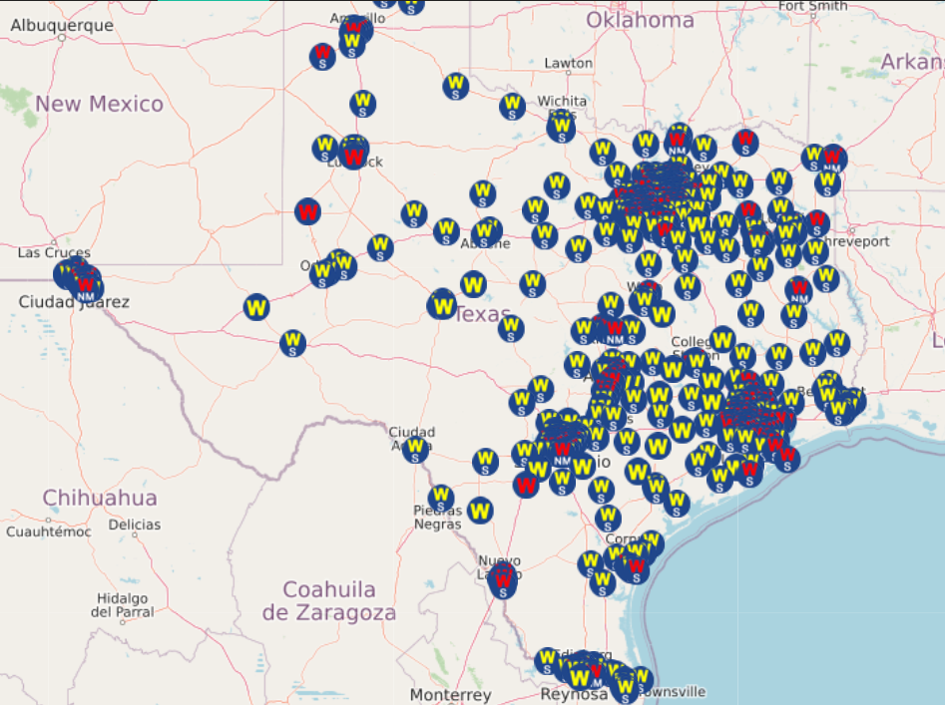
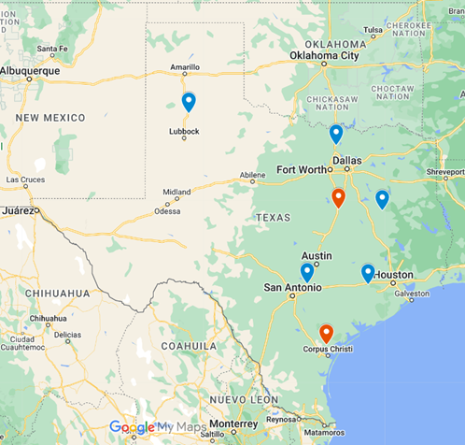
Selection of location for the new RDC’s:
New locations were chosen based on the spread of the stores across the state.
Locations were placed close to the clusters but on highways on the out-skirts of the city.
Existing store locations
RDC locations (Old in blue and New in red)

Slide 7
4. Transportation/ Distribution cost:
Cost per mile for transportation is assumed to vary between $1 and $1.2.
Cost is randomized to a level of two decimal places and multiplied with the distance from each RDC to store.
5. Cost of establishment:
Cost of building a 1.2 million sq.ft. DC is considered to be $50 million based on news reports. This converts to approx. $42/sq.ft.
This cost is applied to all the existing warehouses. For the new locations the cost is considered to be 1.2 times the cost of existing ones considering inflation over construction materials in the last year. This turns out to be $50/sq.ft.
Out of class implementation:
Problem: Our initial dataset contained only the address for the RDC’s, and the store dataset contained only the latitude-longitude coordinates. We needed the distances between each RDC to each store.
How we overcame it:
Created a custom function in Excel VBA to calculate the distances between the RDC’s and stores by making use of Bing Maps API Key.
This function enabled us to consider the actual on road distances between any two locations.
This function was used to create the Distance-matrix in Excel which was then fed into Python for optimization with Pyomo.

Slide 8
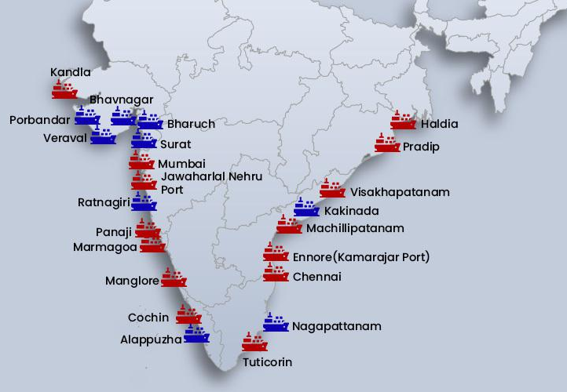
Use Case 1:
Logistics companies can decide which ports to use as port of entry for their goods that are bound for stores inland.
Every port has a different size of the hinterland.
Custom duties for ports vary.
The distance from a port to a supply location (store) can be mapped out.
It is crucial for companies to choose specific ports because they must setup local offices to deal with customs on a regular basis.

Slide 9
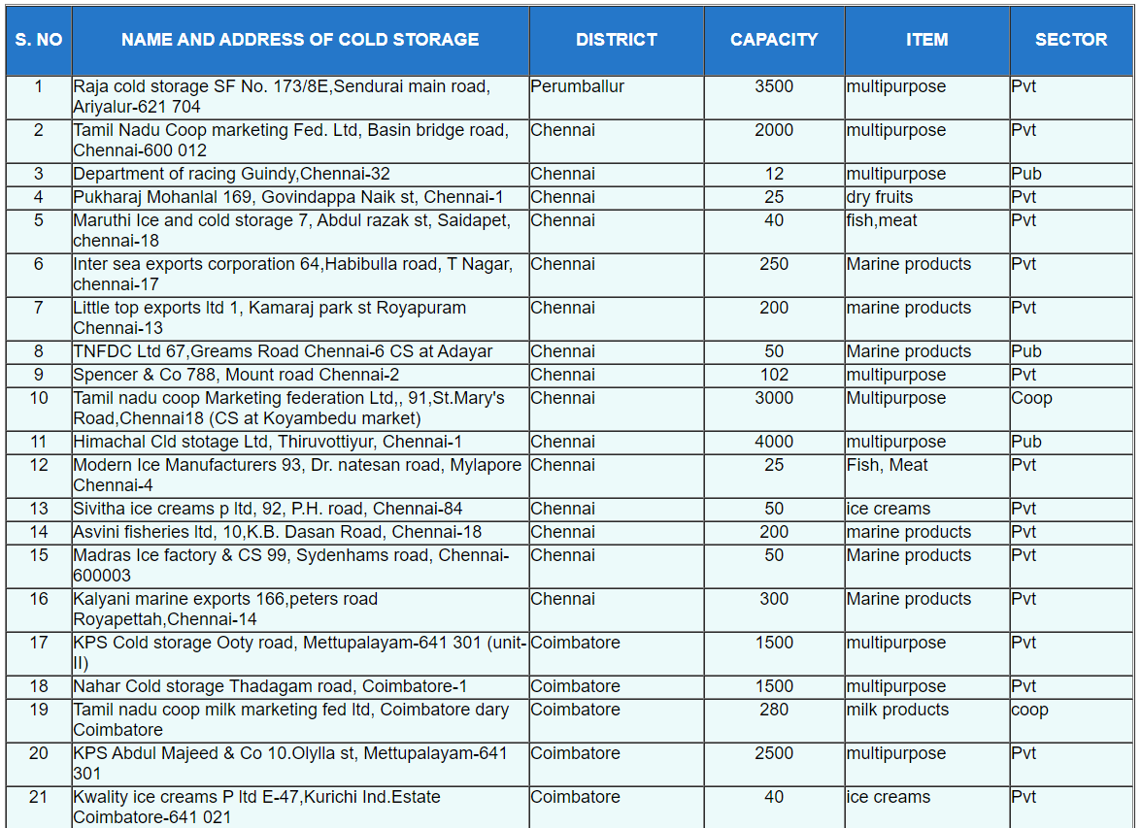
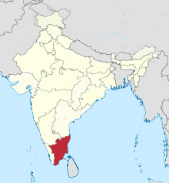
Use Case 2:
Governments can use the model to decide on the locations of cold storages within a state to minimize the loss of agricultural output.
Locating cold storages close to the farm lands helps reduce loss of produce.
Since, setting up cold storages is expensive, they must be placed strategically.
Utilization of existing cold storages and capacities for new locations can be determined using the model.
List of cold storages in the state of Tamil Nadu in India.

Slide 10
Benefits:
Mapping of DC’s to stores is possible.
Utilization of existing facilities can be estimated.
What-if scenarios can be tested.
Large number of locations can be mapped in a very short time as it is a linear problem.
Results are easily interpretable.
Possible Additions (if had extra time):
We would have tried to identify optimum location through the model by using clustering (Machine Learning) instead of manually deciding on the locations.
Number of additional locations for DC’s can be decided by setting the cap on the capacity of a DC at $1.2 million sq.ft..

Slide 11
Contents of Supporting files:
1. Excel sheets:
DC location data sheet – contains locations of DC’s, capacity, establishment cost, fixed cost and lat-long.
Store data – Store id and demand.
Dist_between_store_to_DC_in_Texas – Distance Matrix.
Transportation_cost – contains cost transporting from each DC to store. It is based on the distance matrix.
Walmart_store_status_public_data – contains source data for stores from Walmart.
2. Python:
730_Project_Vid_Sid_final – contains the program file.
Contribution :
Vidaan Shankar and Siddharth Kilaru both developed the idea and gathered the required data and and created the Optimization model.

Slide 12
Thank You

