Slide 1
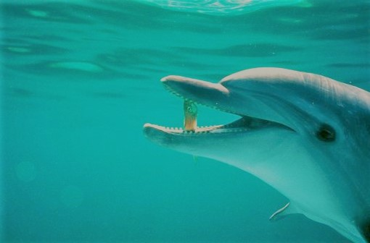
A Novel Pain Management
System with VR Game
VRInGame: Siddharth Lucky Vipasha Rana Roshini Gnanamoorthy Krishna Teja Talasila Mentors: Dr. Kewei Sha (Assistant Professor, University of Houston - Clear Lake) Dr. Sheng Li (Associate Professor, TIRR Memorial Hermann), Dr. Zhandong Liu (Associate Professor, Baylor College Of Medicine)

Slide 2
OUTLINE
Introduction
Architecture
Results
Milestone
Conclusion
Future Work

Slide 3
Introduction
Define the problem
Existing system and technical challenges
Applications
Technologies used

Slide 4
Define the project ?
In today’s world, most of the technologies make use of electric stimulus among the patients for pain relieving and muscle relaxation therapy.
The patients are stressed and nervous to stay longer under the treatment producing minimal results of the therapy.
This project aims at eliminating this stress and encourage the patients to stay longer under the treatment by immersing them into a world of virtual reality.

Slide 5
Existing system and Technical Challenges
1. In the existing system, patients are not relaxed when they are under treatment. 2. In the VR Game when a patient is calm , the breathing signals are to be matched more frequently and catches more number of fishes.
3. It encourages the patient to provide better results of the therapy.
Technical Challenges: 1. Existing System uses Labview which will not interact with Unity, so we had to move entire project to Matlab. 2. In this Project we had to learn unity to develop a VR game from ground up. 3. We had to integrate all the devices to ensure the project works asynchronously.

Slide 6
Applications
Stress management
Detecting brain activity, track lobe activation.
Can help in increasing the stamina of the patients who have breathing impairments as the pattern of breathing controls the speed.
Several other clinical applications and therapies.

Slide 7
Technologies Used
MATLAB:
It is a high-level language, which makes it is easier to understand.
We also had to consider the PC requirements to ensure the smooth running of the project.
Plotting and manipulating data in graphs is comparatively easy.
Unity Game Engine:
It is now regarded as one of the most popular game engines sought out by game developers.
Unity integrates multiprocessing and high definition graphics along with C# programming.
The UI and the highly equipped asset store made unity an obvious choice.

Slide 8
Architecture
Heart of the project: Unity, Matlab

Slide 9
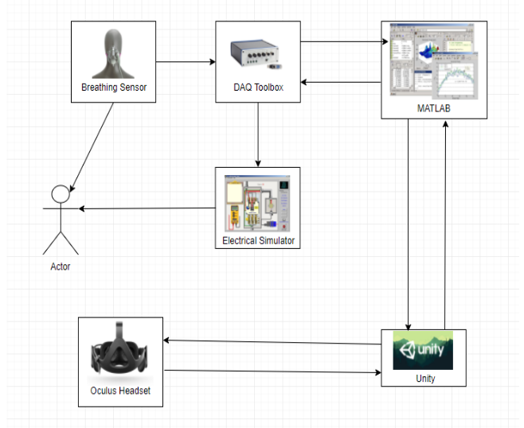
Architecture
The experience begins with collecting the data from the breathing sensor, which is then fed to control the objects in the VR game and when the breathing signal reaches a preset threshold the electric stimulus comes into the action.
Fig 1 : Architecture Diagram

Slide 10
Architecture contd….
Breathing Sensor: Collects breathing signals from the user.
Electrical Stimulus: Delivers electrical impulses as an AC charge.
DAQ: Data Acquisition Box, is used to convert Analog to Digital Signals.

Slide 11
Architecture contd….
MATLAB:
Graphs breathing sensor values, threshold detection algorithm.
Socket Communication
Interacts with DAQ
Unity Engine: Controls the Virtual Reality experience.
Terrain Generation / Object2Terrain
Prefab Brushing
NavMesh, RigidBody Movements
Randomizer class
AI Manager

Slide 12
Results

Slide 13
Results
DAQ:
DAQ is able to communicate with breathing sensor and MATLAB to collect the breathing signals efficiently.
DAQ is able to produce the desired output voltage on the electrical stimulator.
Detection algorithm:
This algorithm evaluates the trigger points after reading all the data which is sent from the DAC device.
It provides optimal performance with no delays.

Slide 14
Results contd..
Socket Communication:
A data packet is sent from MATLAB to Unity and an acknowledgement is sent from Unity to MATLAB.
The data transmitted is small, it does not produce any significant delay.
Unity:
Implemented Nav mesh and Rigid body movements using Artificial Intelligence.
When a trigger is received it takes 5.30ms to start the subprocess which instructs the dolphin to catch the fish.
The Game experience runs at 60fps, ensures a smooth gaming experience on the oculus rift headset.

Slide 15
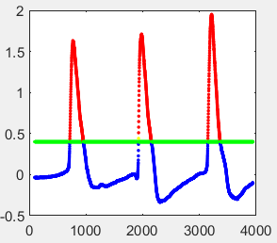
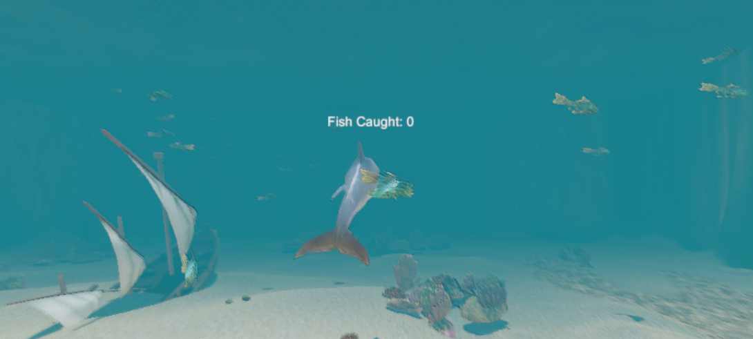
Resultant Images:
Fig 3 : Output graph from matlab Fig 4 : Output image from Unity

Slide 16
MILESTONES REACHED
Connection with DAQ we studied the NI instruments tool boxes in order to create the input/output connections with the DAQ.
We had to analyze the channel configurations of DAQ to correspond it to the channels on which MATLAB takes input or produces the output.
Establish a socket connection to send packets of data from MATLAB to Unity without delay.
Make sure the animation was quick as the next acknowledgement shouldn't have to wait to show an affect.
Design a modular code so that it can accommodate new objects on demand.
Being new to the platform we had to get ourselves up to speed on Unity.
To implement an underwater scenario which had to look appealing to the user, we had to design the scene from ground up.

Slide 17
Conclusion

Slide 18
CONCLUSION
An improvement in the patient’s therapy results is expected using this virtual reality gaming method.
The underwater scenario has been successfully implemented in Unity.
Successful communication has been implemented among MATLAB, Breathing Sensor and Electrical Stimulator using the DAQ box and Unity.
A proper integration between all the devices has been achieved thereby producing accurate results.

Slide 19
FUTURE WORK
High texture models with advanced animations can be used to make the game look even more realistic.
An improvement in the presently used Intelligent algorithms can be made to make the scheduling of movement of virtual objects in a more efficient manner.
Various other data sets can be studied upon to improve the clinical applications of this system.
A proposed ideology is where the system can be made wireless to prevent hassle to the subject. Improvements can be made in that direction.

Slide 20
DEMONSTRATION

Slide 21
References
[1] Unity3d.com, 'Unity Manual: for water, Transform, Rigidbody movement', 2018. [Online]. Available: https://unity3d.com/learn/tutorials. [Accessed: 03-Feb-2018]. [2] Rudolphkc.com, 'To know about breath sensor and DAC', 2018. [Online]. Available: http://www.rudolphkc.com/. [Accessed: 20-Mar-2018]. [3] Oculusstudios.com, 'To use oculus utilities with Unity', 2018. [Online]. Available: http://oculusstudios.com/work/. [Accessed: 25-Mar-2018]. [4] S. Attaway, Matlab: A Practical Introduction to Programming and Problem Solving. (2nd;2; ed.) 2012;2014;. [5] W. Goldstone, Unity Game Development Essentials. 2009. [6] Mathworks.com, 'To learn about Matlab', 2018. [Online]. Available: https://www.mathworks.com/academia.html?s_tid=gn_acad#learn-basics. [Accessed: 25-Feb-2018].

Slide 22
THANK YOU!!

