Slide 1
Decentralized Public Key Infrastructure on Ethereum Blockchain

Slide 2
Problems:
Certificate Authorities publishing rogue certificates for targeted attacks
Not practical to un trust certificate authorities that have issued rogue certificates - Disrupt the TLS process
for many other hosts.
Rogue certificates such as the one issued by DigiNotar CA for Google used in attempted man-in-themiddle attacks
against Google users
--------------------------------------------------------------------------------------------------------------------------------------------------------
Only CAs chosen by operating system and web browser vendors may issue universally valid certificates.
Expensive, time-consuming to convince operating system and web browser vendors to bundle a CA,
therefore entities must usually pay CAs to sign their public keys.

Slide 3
SCPKI:
PKI system based on a decentralised and transparent design using a web-of-trust model
Alternative to the centralised certificate authority identity verification model
Entity or authority in the system can verify (or vouch for) fine-grained attributes of another entity’s identity
Transparency - to quickly identify rogue certificates
Pretty Good Privacy (PGP) based on web-of turst does not use CAs to verify the authenticity of public keys.
However, PGP itself is not a PKI as it does not provide a way to retrieve public keys
PGP is implemented as centralised key servers that are used to query for public keys. Act as a central point of failure that also allow for exclusion or replacement of keys by a third party.

Slide 4
X.509
Provides scope for a wide range of identity attributes to be embedded in certificates. Such as phone number, address and name.
Adapting this system in a web-of-trust PKI solves wide range of identity related problems.
Individual needs to verify a fact about another organization or individual without trusting paper records that can easily be forged, unlike cryptographic signatures.
Current X.509 certificate standard because the standard does not allow CA to sign specific and fine-grained attributes in a certificate; certificate authorities must sign the entire certificate or nothing.
Additional concepts:
Web of Trust
IPFS- Storage layer for decentralised applications. Address large amounts of data from transactions in the blockchain using permanant and immutable IPFS links.

Slide 5
Why block chain?
Open nature of the Bitcoin block chain - central authority cannot modify the blockchain and reverse transactions
Economically unattractive for a central authority to take control of the blockchain
Helps in building a transparent PKI, as rogue certificates or identities would be universally visible.
Potential application of smart contracts discussed in the white paper is identity and reputation systems.
Smart contract can be created for mapping domain names to IP addresses to provide a decentralised domain name registration system.
Proposition: To write such a smart contract with functionality for the operation of a public key infrastructure and identity management system, where public keys and identity attributes are stored on the block chain and can be managed by the smart contract.

Slide 6
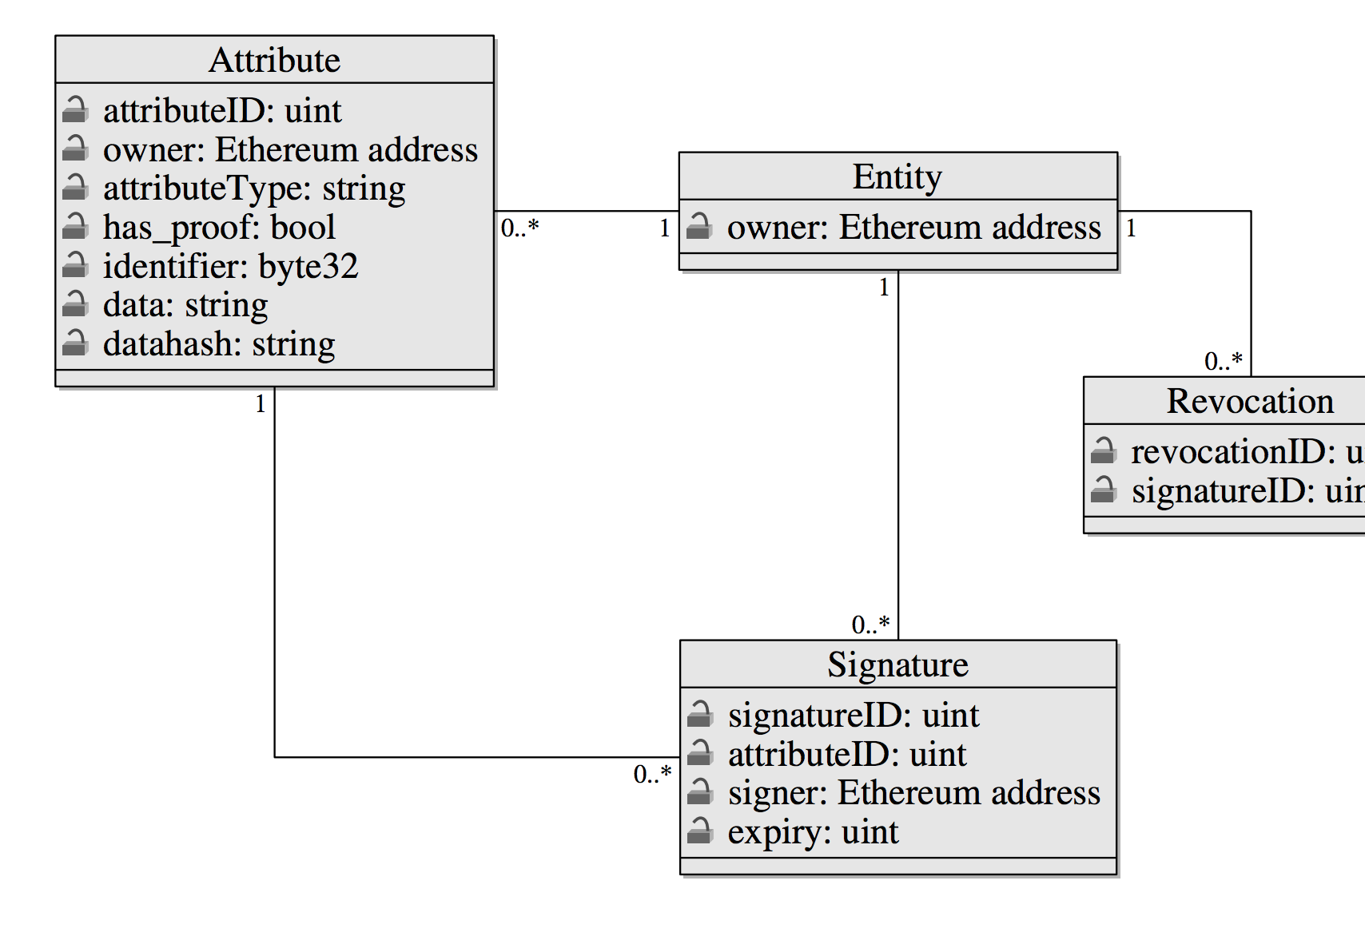
DESIGN
1) Smart Contract - Interface to the blockchain for the management of identities and attributes
2) Client - Interacts with the smart contract and other systems such as IPFS to allow users to fully utilise the system

Slide 7
Entities
Publishes a set of attributes, signatures, and revocations on the blockchain for its identity.
Entity is represented by an Ethereum address—which is controlled by a private key or smart contract that the entity has control over.
Publishing an attribute to an entity’s identity -> identity to the attribute,
Reverse-binded Attributes that represent cryptographic -> the identity, doublebinding.
Example: User A already trusts a user B’s PGP key, and user B adds their PGP key to their SCPKI identity with a binding proof, then user A can also trust user B’s SCPKI identity without asking for more information.

Slide 8
Gas Cost
Due to the expensive gas costs associated with Ethereum storage, SCPKI is designed to allow users to store large attribute data (such as PGP keys) off the block chain (such as on IPFS) to save costs.
Full version that is designed in such a way where its information (attributes, signatures and revocations) can be programmatically accessed, other one it cannot.

