Slide 1
Getting Started with Deep Learning Using TF 2.0
Usha Rengaraju

Slide 2
About me
Kaggle Grandmaster
WiMLDS(Bangalore and Mysore)
TensorFlow User Group Organizer Mysuru
GDG Mysore Organizer Mysuru
Twitter : @URengaraju
Github : https://github.com/ushareng
Ambassador : Women TechMakers Mysuru , WiDS Mysuru(Women in Data Science)

Slide 3
Communities
WiMLDS Mysore :
https://www.meetup.com/Mysore-Women-in-Machine-Learning-and-Data-Science/
GDG Mysuru :
https://www.meetup.com/Google-Developers-group-Mysuru/
TensorFlow User Group Mysuru :
https://www.meetup.com/TFUG-Mysuru/

Slide 4
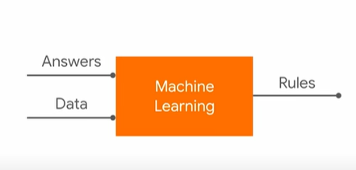
Traditional Programming
.
Notes:
Pic Credit : Laurence Moroney’s Videos in TensorFlow
https://bit.ly/Coding-TensorFlow

Slide 5
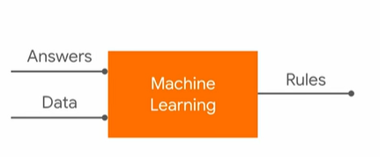
Machine Learning
.

Slide 6

Hello World of ML
.

Slide 7
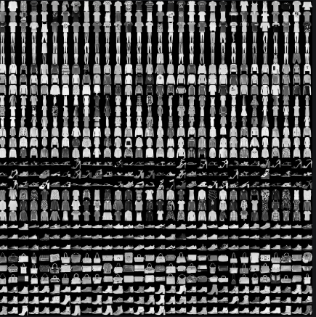
Fashion MNIST
.

Slide 8
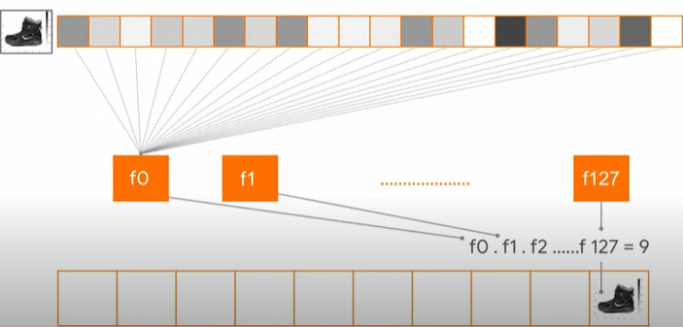
.

Slide 9
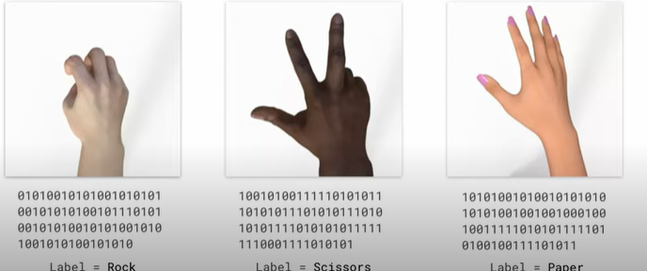
Rock , Paper and Scissors
.

Slide 10
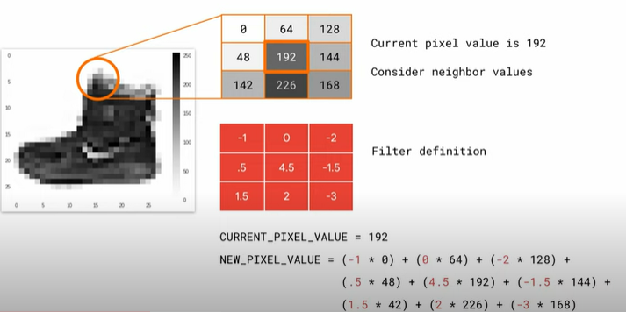
Filters
.

Slide 11
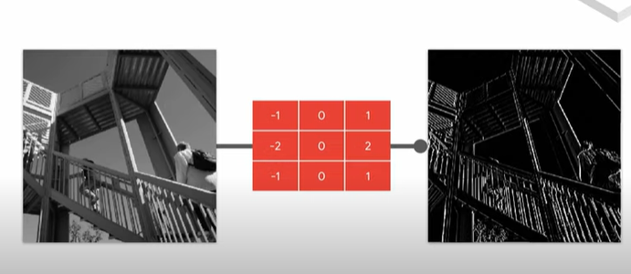
Filters
.

Slide 12
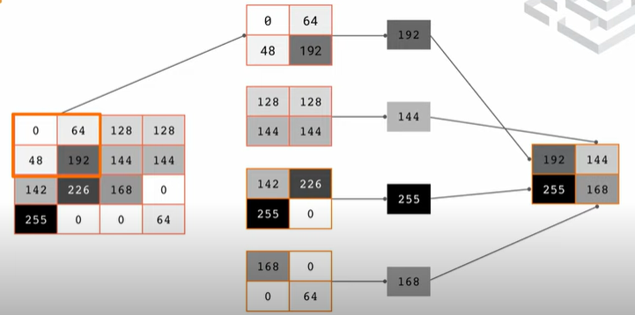
MaxPooling
.

Slide 13
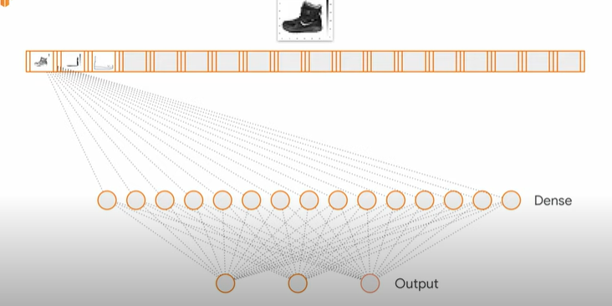
.

Slide 14
References
Github :https://github.com/ushareng/GitCommit.Show
The notebooks and slides used in the conference are from Official TensorFlow documentation and the videos from TensorFlow yotube channel
Official Documentation : https://www.tensorflow.org/tutorials
Youtube Series : https://www.youtube.com/channel/UC0rqucBdTuFTjJiefW5t-IQ

Slide 15
Thank You
Twitter : @URengaraju

