Slide 1
Email Etiquettes
Shriya Misra(1256043)
Srilipta Swati Nanda(1256576)
Divyanshu Mayank(1256027)
Naveen Kumar(1256775)
Uppula Hemalatha(1255478)
Vishnu P.R.(1255583)
Siddharth Pant(1255613)

Slide 2
CONTENTS
Email & its Importance in Professional life.
Golden Rules & basic structure
Address Line
Subject Line, Salutation & Attachment
Main Body
Signature & Conclusion
Tips To Remember
Do's & Dont's

Slide 3
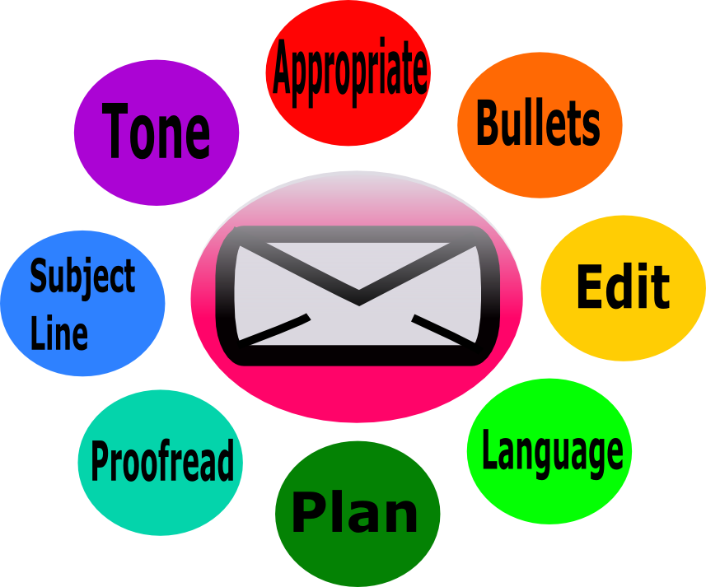
Email

Slide 4
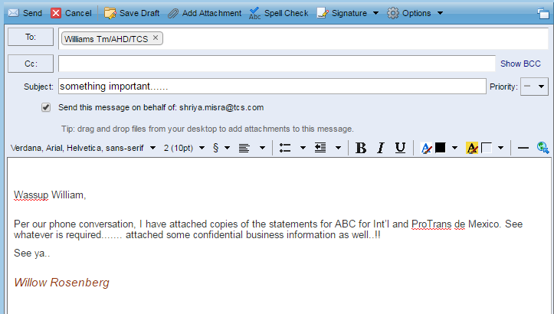
Bad e-mail

Slide 5
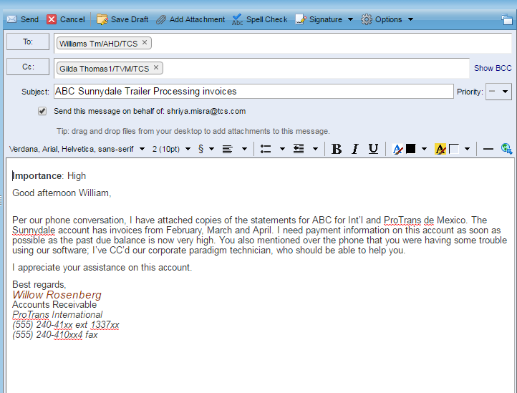
Good e-mail

Slide 6
Golden Rules For Writing Email :
Don't express emotions but state facts,figures,information and data
Always write an effective subject line
Give priority to urgent and important emails while replying

Slide 7
Do's
Always do a grammar and spell check before sending mails
Read your mail thoroughly before clicking the send button
Prioritize while replying urgent and important mails
Always write in a courteous tone while drafting emails
Remember to attach the correct documents

Slide 8
Dont's:
Don't forward and reply all mails
Never use all uppercase as it denotes shouting
Avoid using the color red while drafting emails
Avoid writing flame mails by expressing your anger
Avoid sarcasm and humor as they are very subjective and sensitive

Slide 9
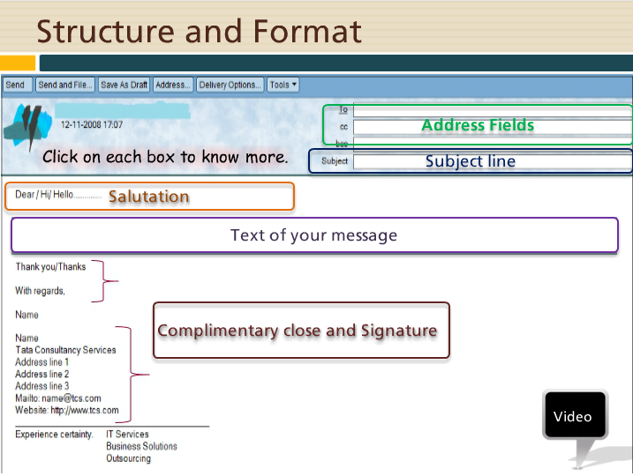
Structure And Format Of Email :
.

Slide 10
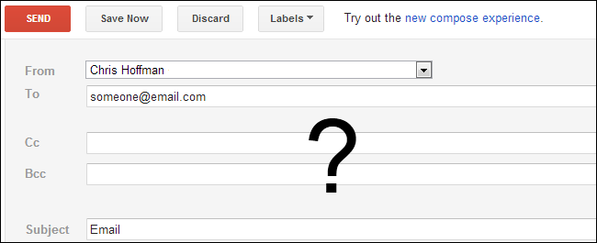
Address Field

Slide 11
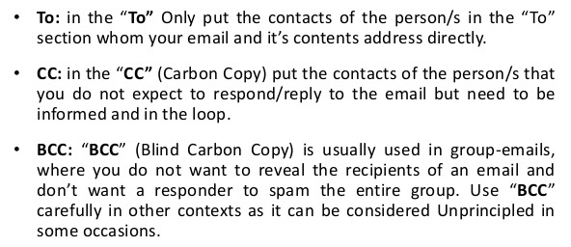
Cont...

Slide 12
Points to Ponder
Never add more people to the 'To' field.
Avoid Cc-ing recipients from whom you are expecting response.
Always use Bcc field with when the list of recipients is long and have to keep secret from others.

Slide 13
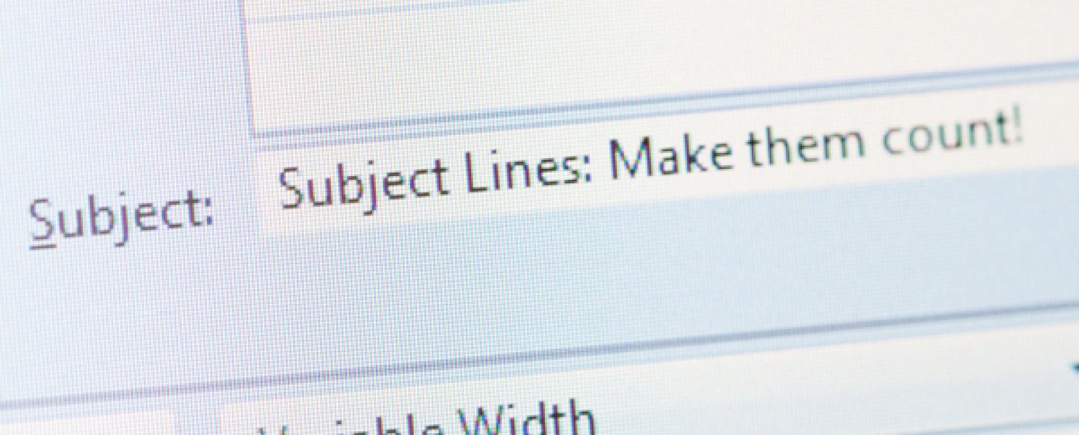
SUBJECT LINE
Not descriptive not lengthy.
Should prompt relavant information.
Should project the main idea.
Should be precise

Slide 14
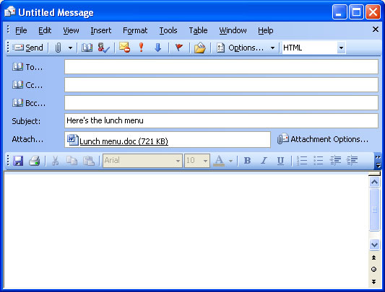
SUBJECT LINE

Slide 15

SALUTATION
The salutation is the opening line of your email where
You address the recipient directly, usually by name.
In business letters, your choices for salutations are
Limited to phrases

Slide 16
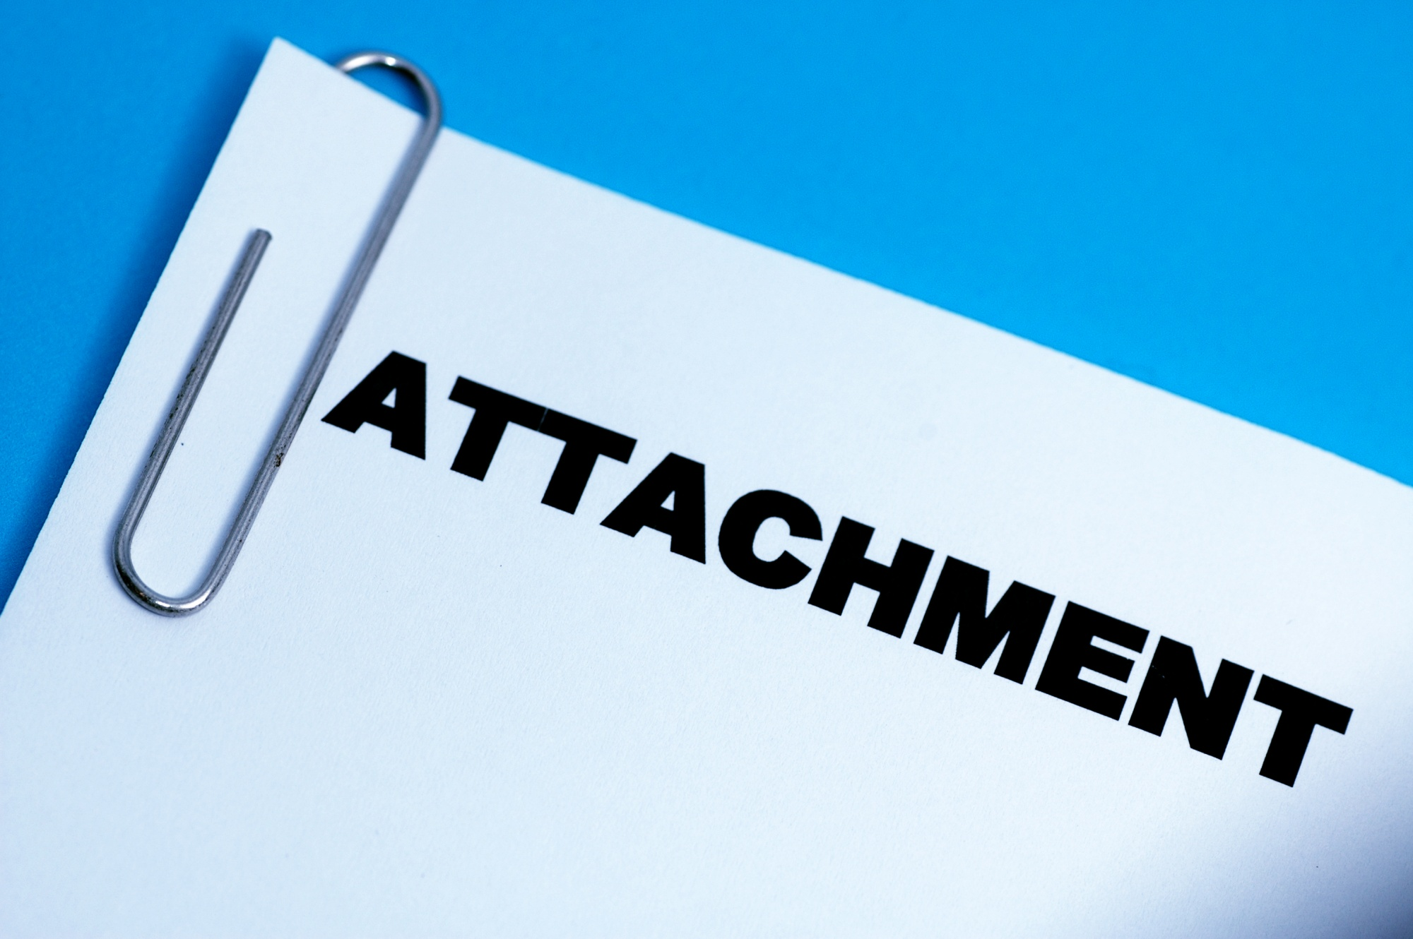
ATTACHMENT
File size consideration.
Not exposing private content.
Not tempering with authentic data and revealing/disclosing
Confidential information.

Slide 17
Main Body (IBC)
Introduction
Don't express Emotions
Don't over emphasize
Write a short introduction
Body
Don't be illogical
Don't write lengthy & complicated
Don't make stories
Check your grammar and spelling
Be efficient
Conclusion
Don't end abruptly or harshly
Conclude in a humble and thankful manner

Slide 18
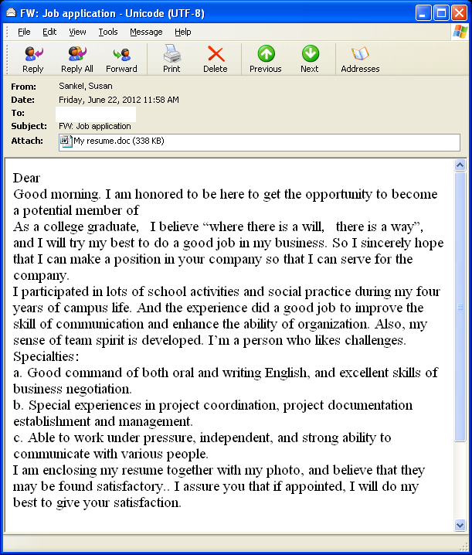
Poor Email Body

Slide 19
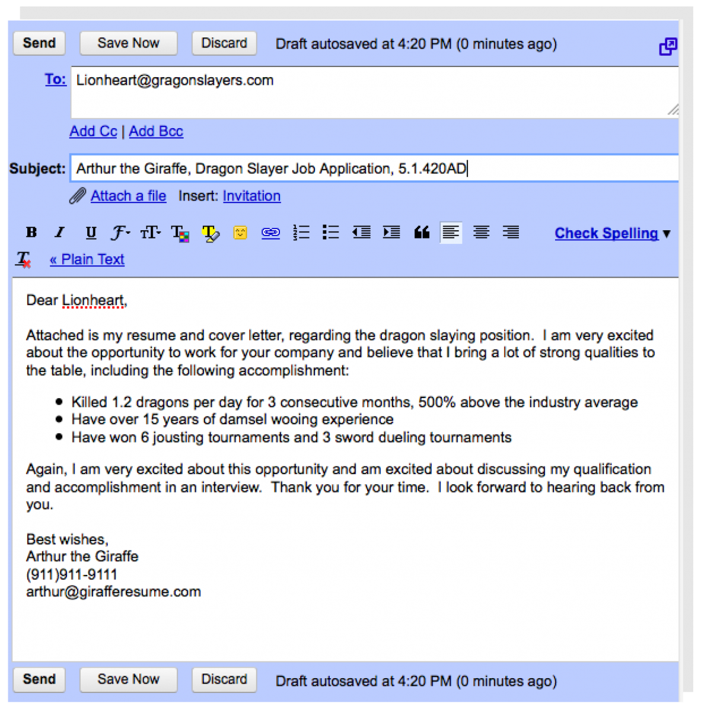
Good Body for Email

Slide 20
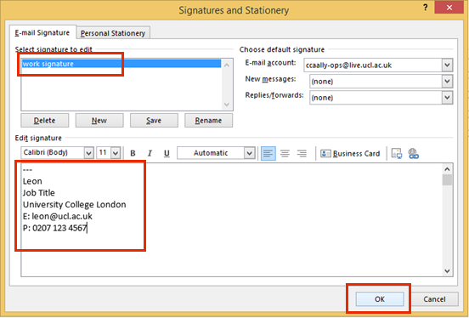
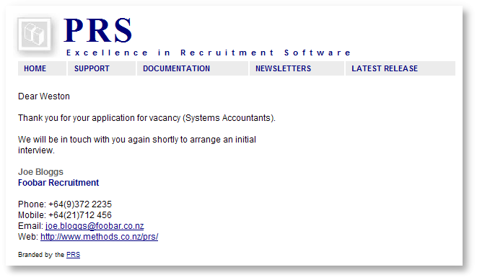
COMPLIMENTARY CLOSE AND SIGNATURE
SIGNATURE
Signature is a block of text that appended to the end of an email message you send.
We can include name,email address, telephone number and company mailing and website address.

Slide 21
COMPLIMENTARY CLOSE
Always sign off with name and a unique professional sign off line.
There are 3 types of complimentary closes
1. Formal
To someone higher in authority,senior management or someone out side the organization
Thanks. Thanks &Regards,
Regards, <name>
<name>

Slide 22
CONTINUES
2. Neutral
To team members or associates with whom you share a friendly relation.
Warm Regards, Cheers Thanks so much.
<Name> <Name> <Name>
3. Informal
Not used when writing business context
TTFN ( Tata at For Now) Adios Ciao

Slide 23

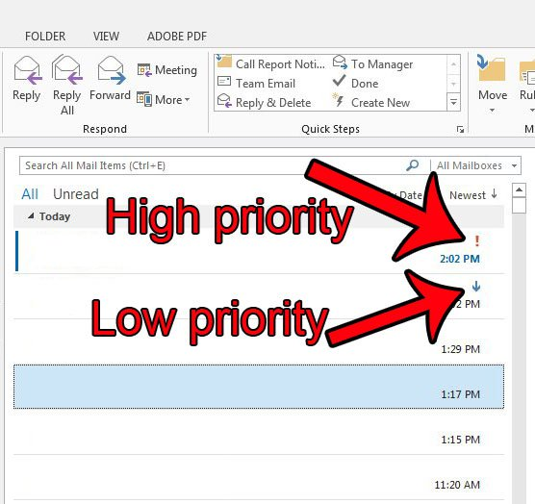
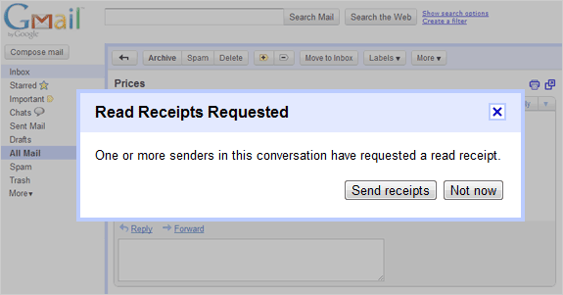
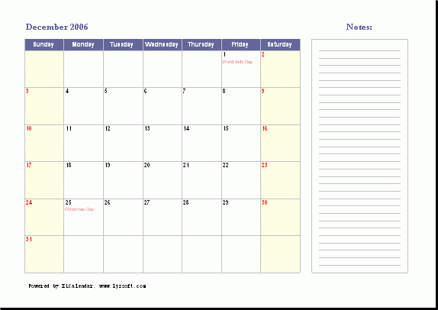
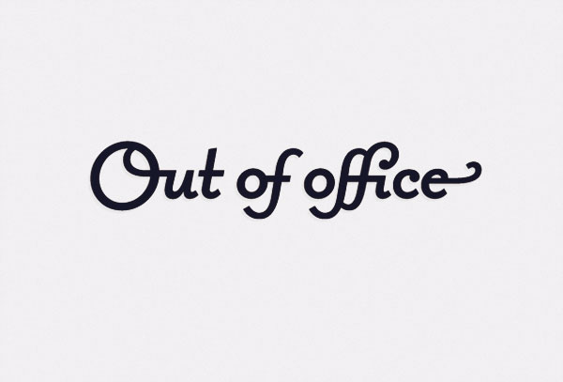
Tips To Remember

Slide 24

Do's
Always do a grammar and a spell check before sending the mails
Read your mail thoroughly before clicking the send button
Prioritize while replying important and urgent mails
Always write in a courteous tone while drafting emails
Remember to attatch the correct documents

Slide 25

Dont's
Don't forward and reply all mails
Never use all upper case as it denotes SHOUTING!
Avoid using the colour red while drafting emails
Avoid writing flame mails by expressing your anger
Avoid Sarcasm and humour as they are very subjective and sensitive

