Slide 1
The Zipf Mystery
Presented By
SIDDHARTH PANT(1255613)

Slide 2
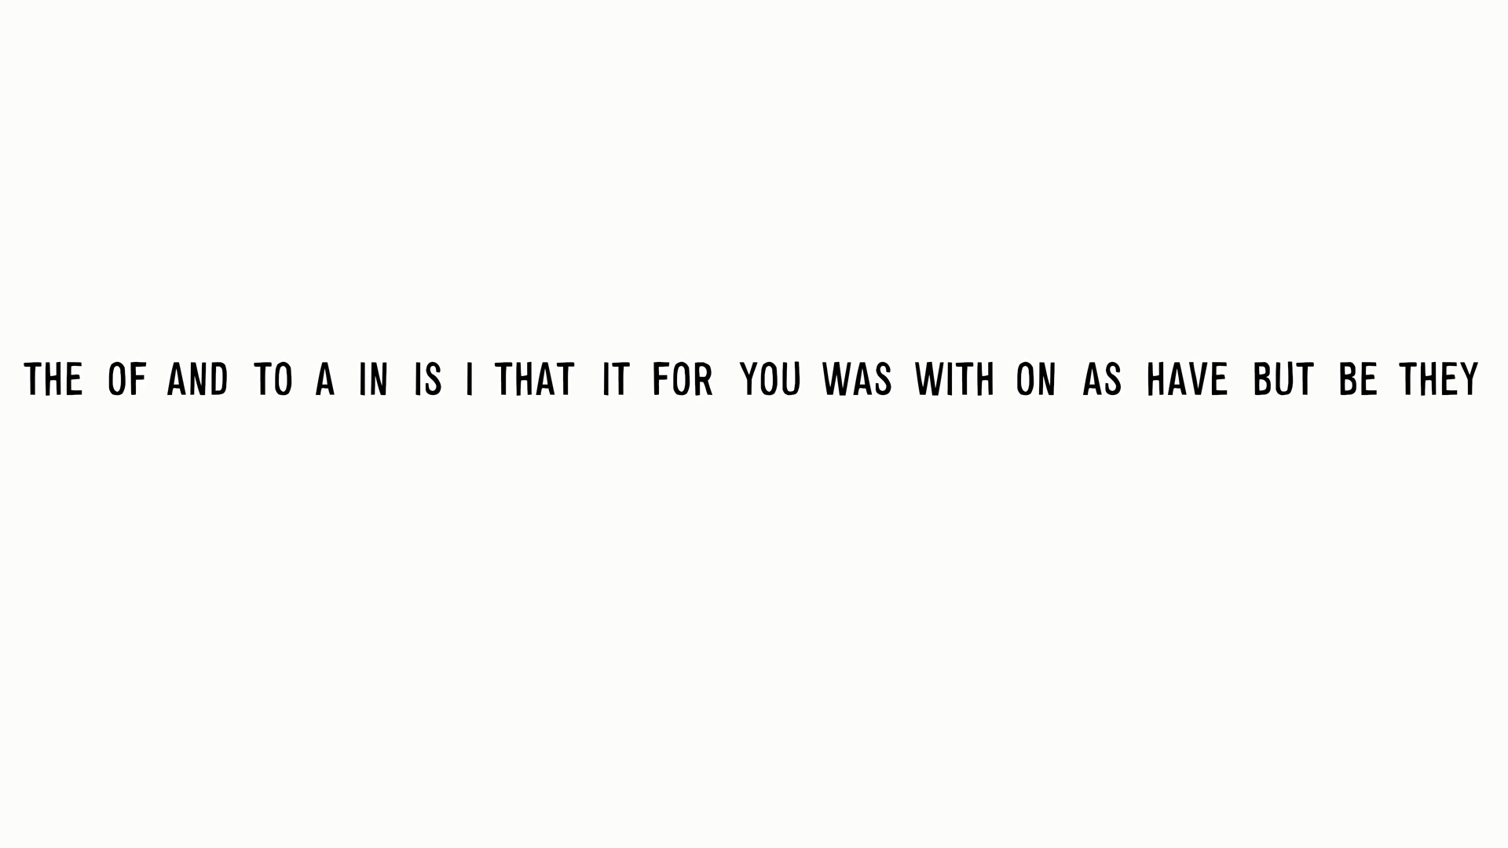
Most Frequently used words

Slide 3
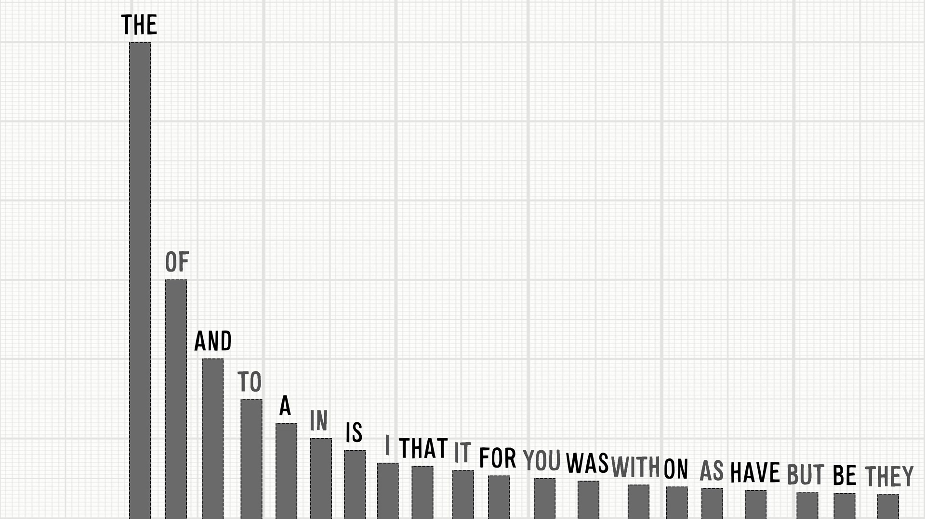
Most Frequently used words

Slide 4
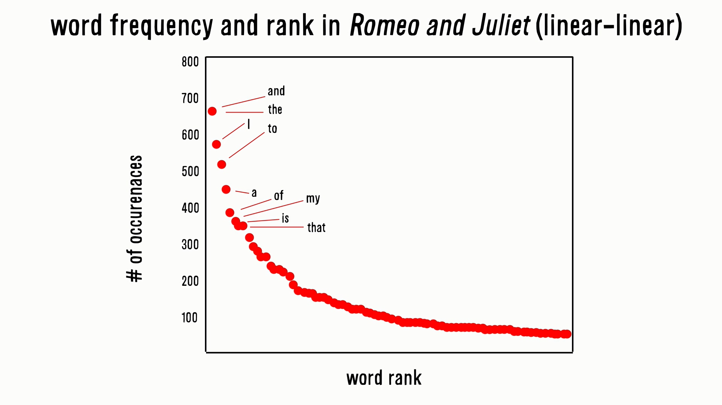
Every novel every book follows this...

Slide 5
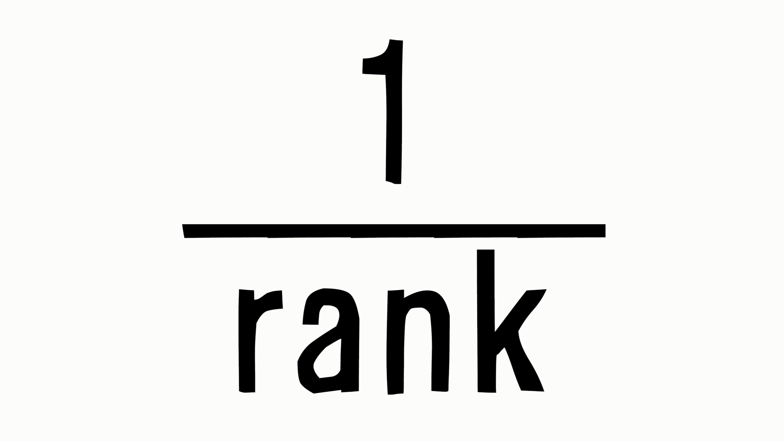
The Bizarre Rule of Thumb

Slide 6
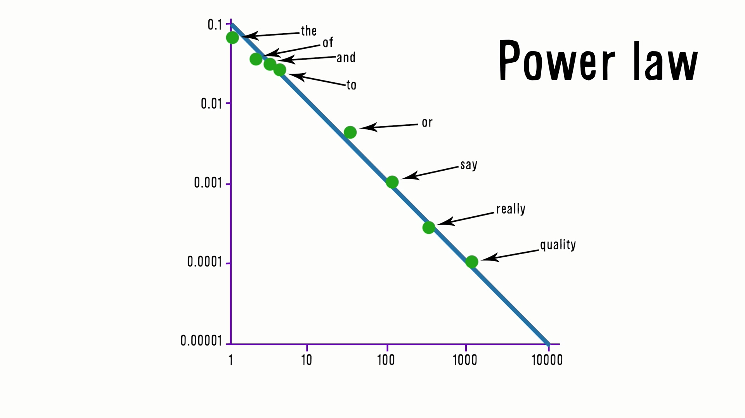
All nicely aligned on a line

Slide 7

The name of the game

Slide 8
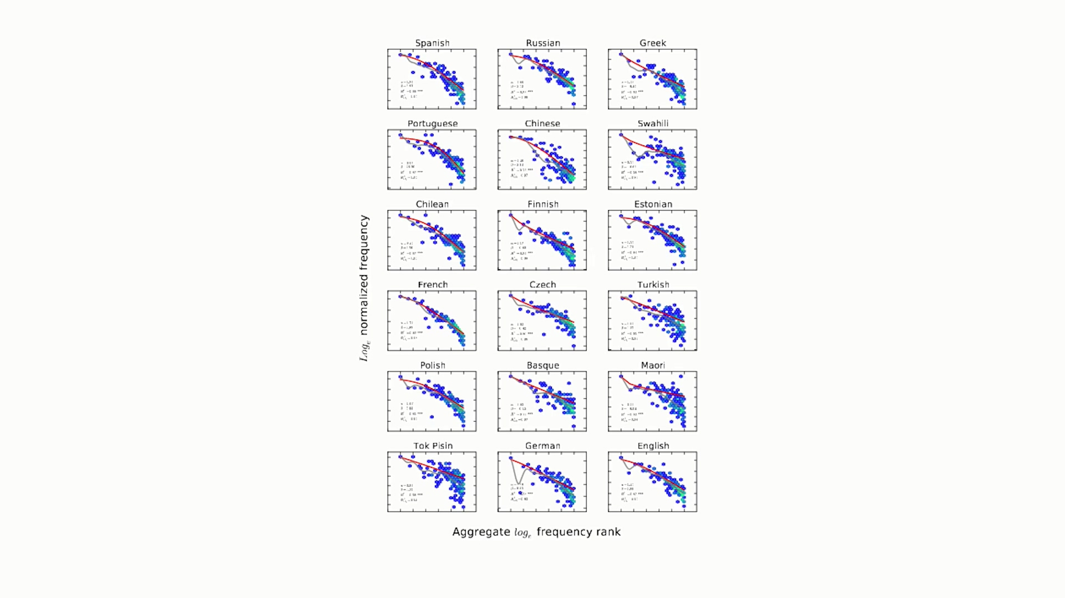
Surprise surprise…Every language has it

Slide 9
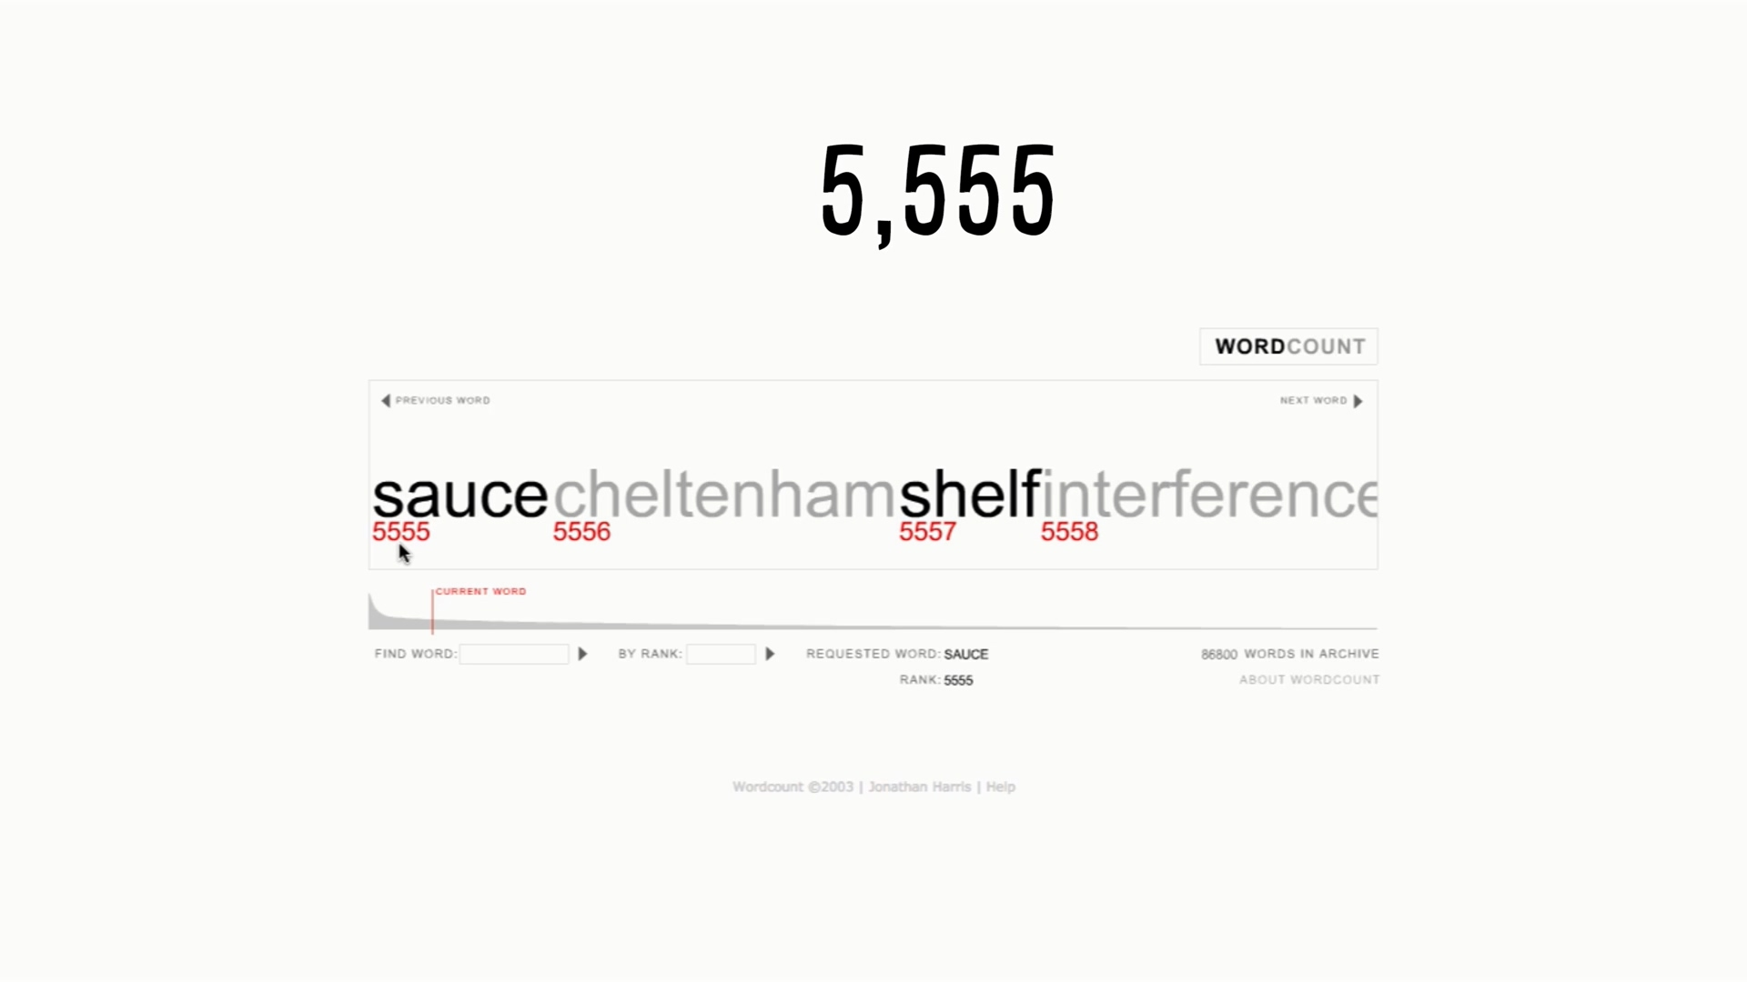
Let's do some crazy math shall we?

Slide 10
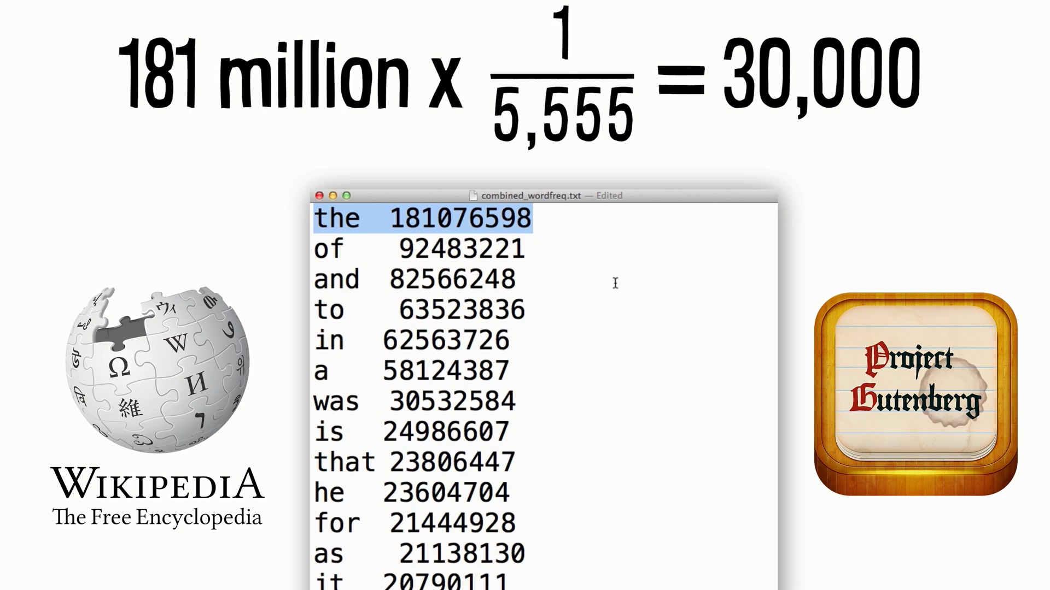
Just bear for a second more...

Slide 11
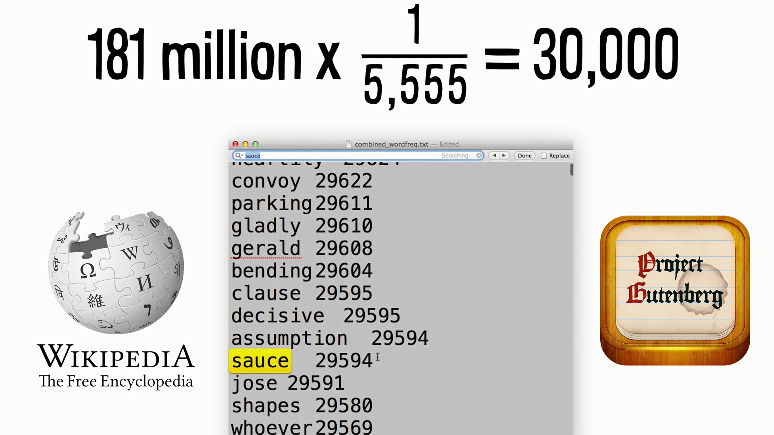
And now see the magic

Slide 12
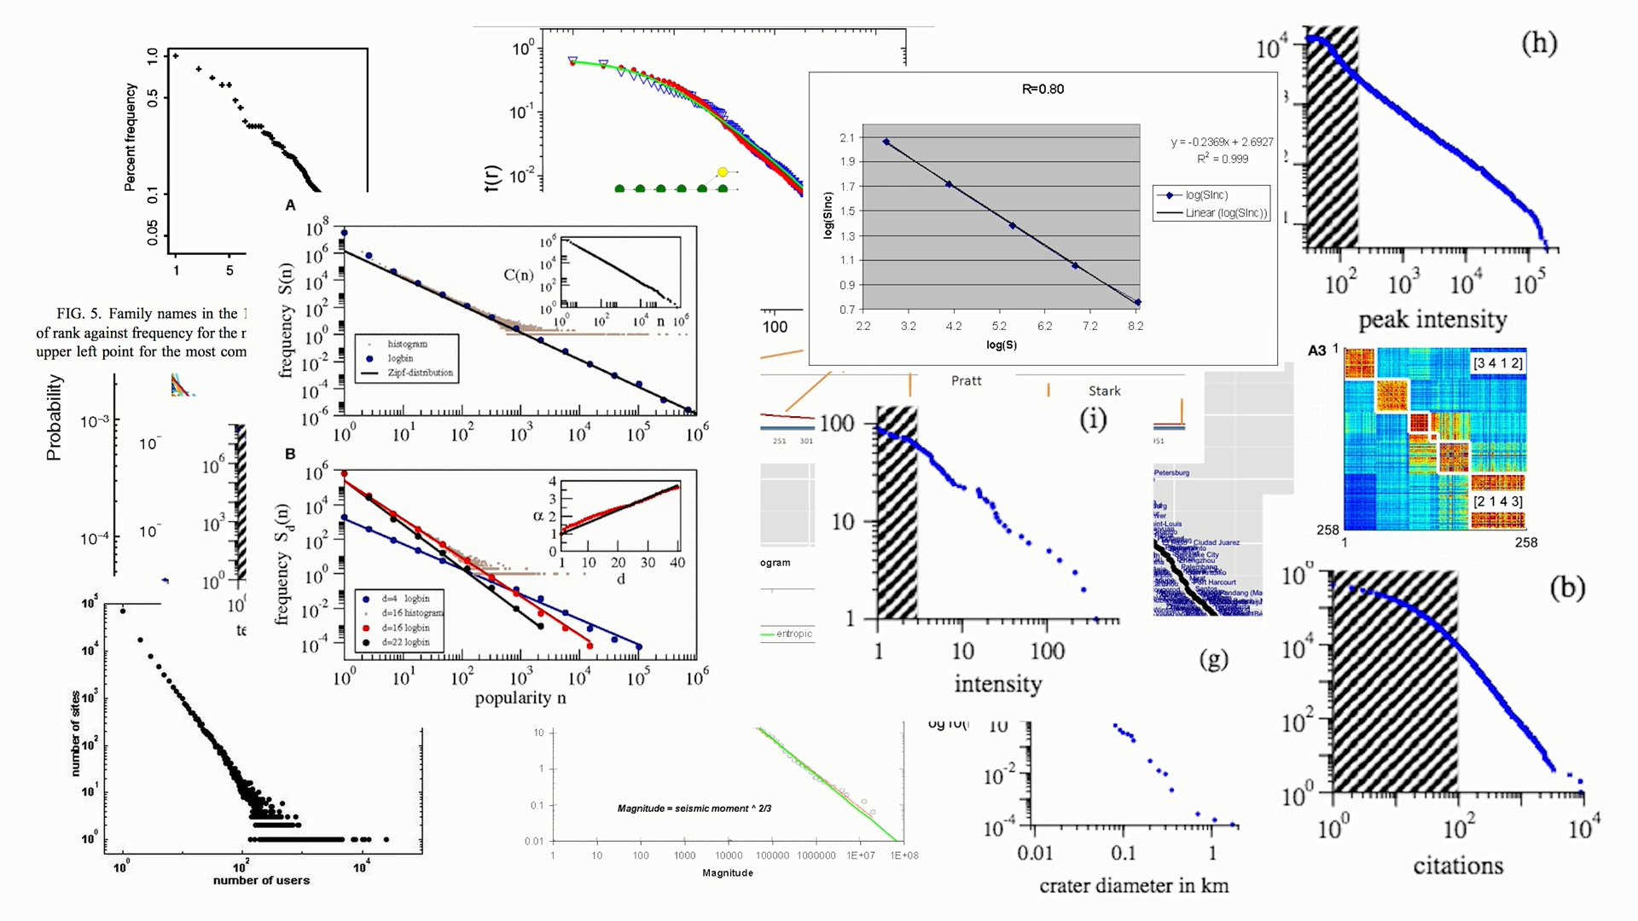
The World is “Zipfy”

Slide 13
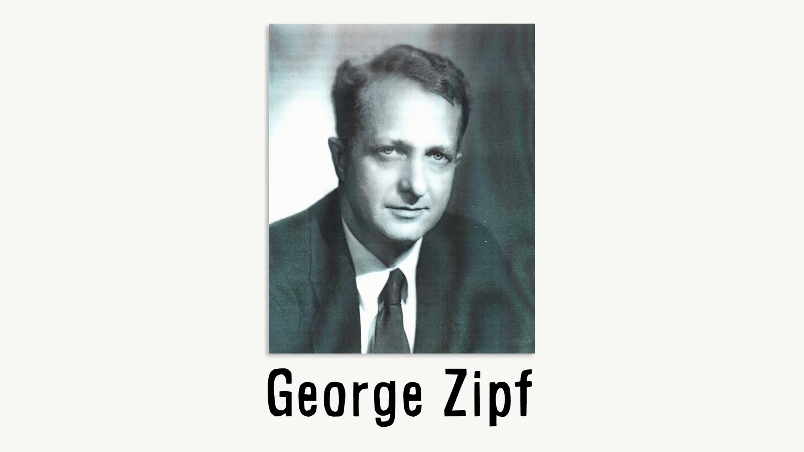
And the name comes from here

Slide 14
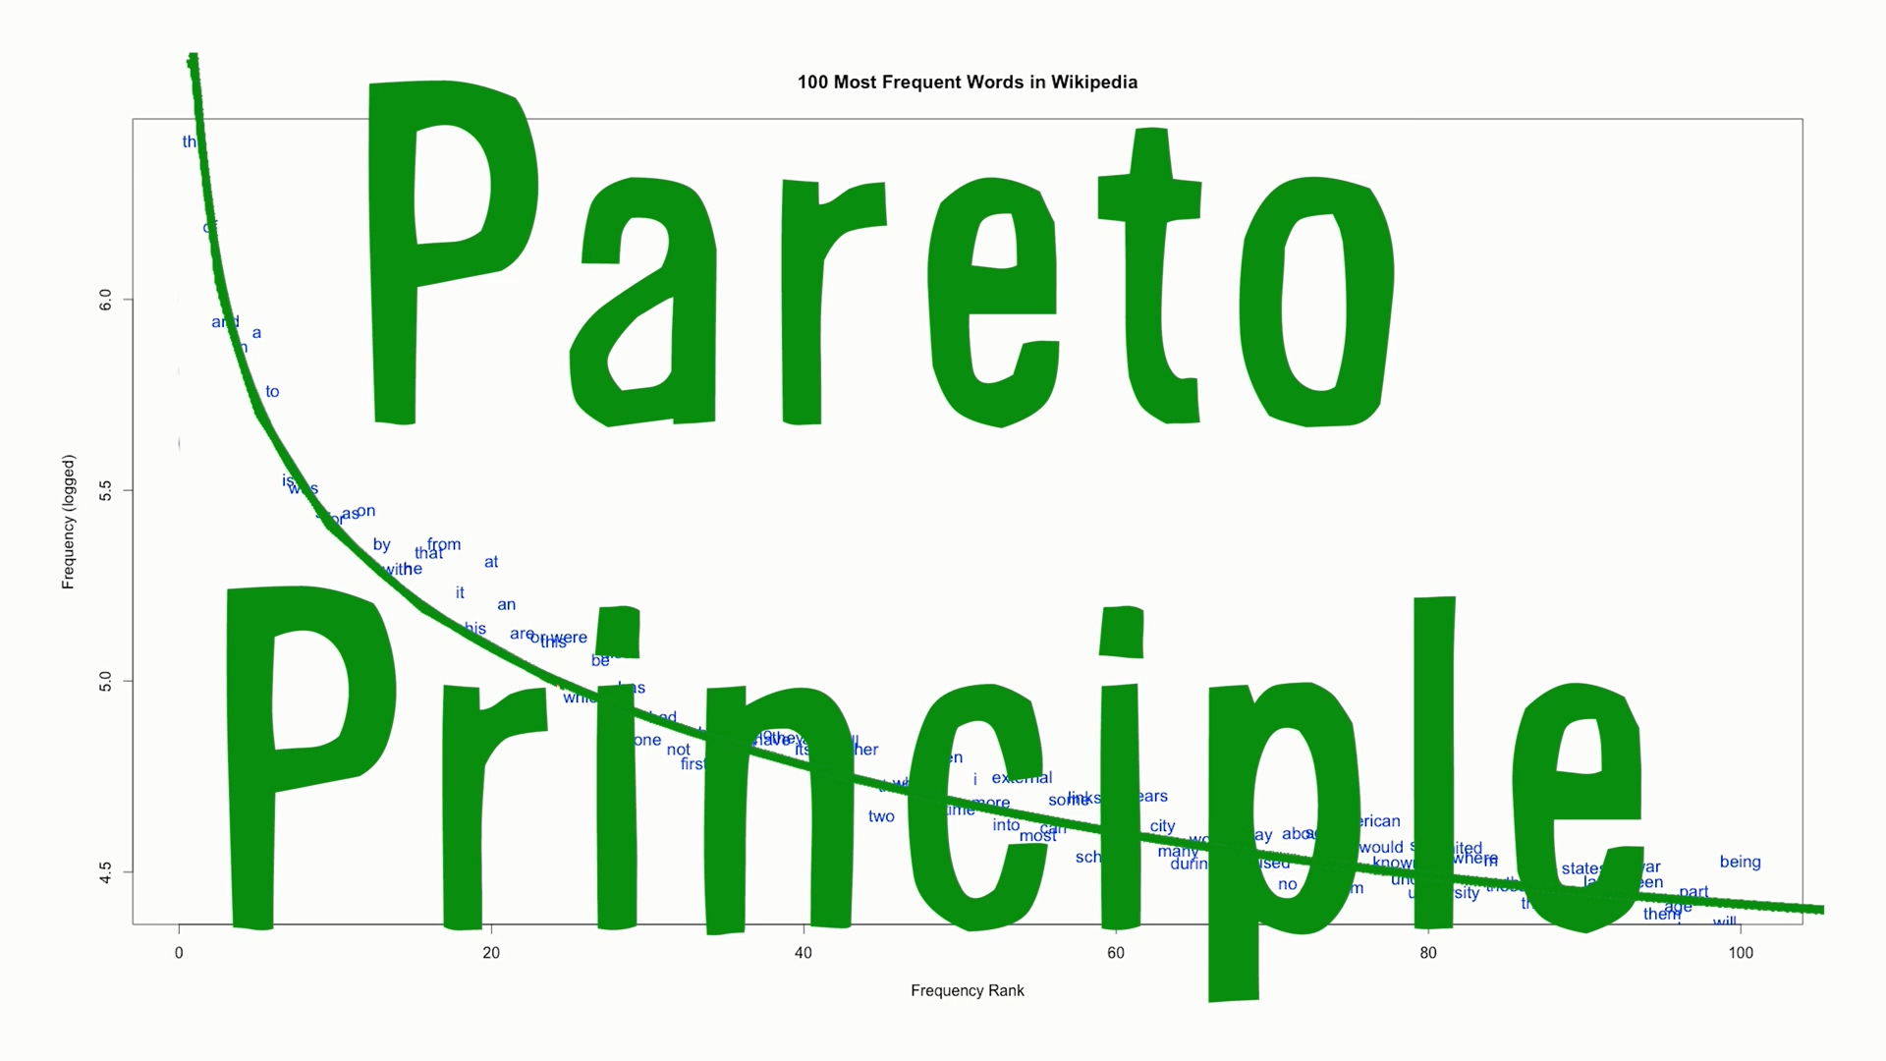
It's about to get interesting

Slide 15
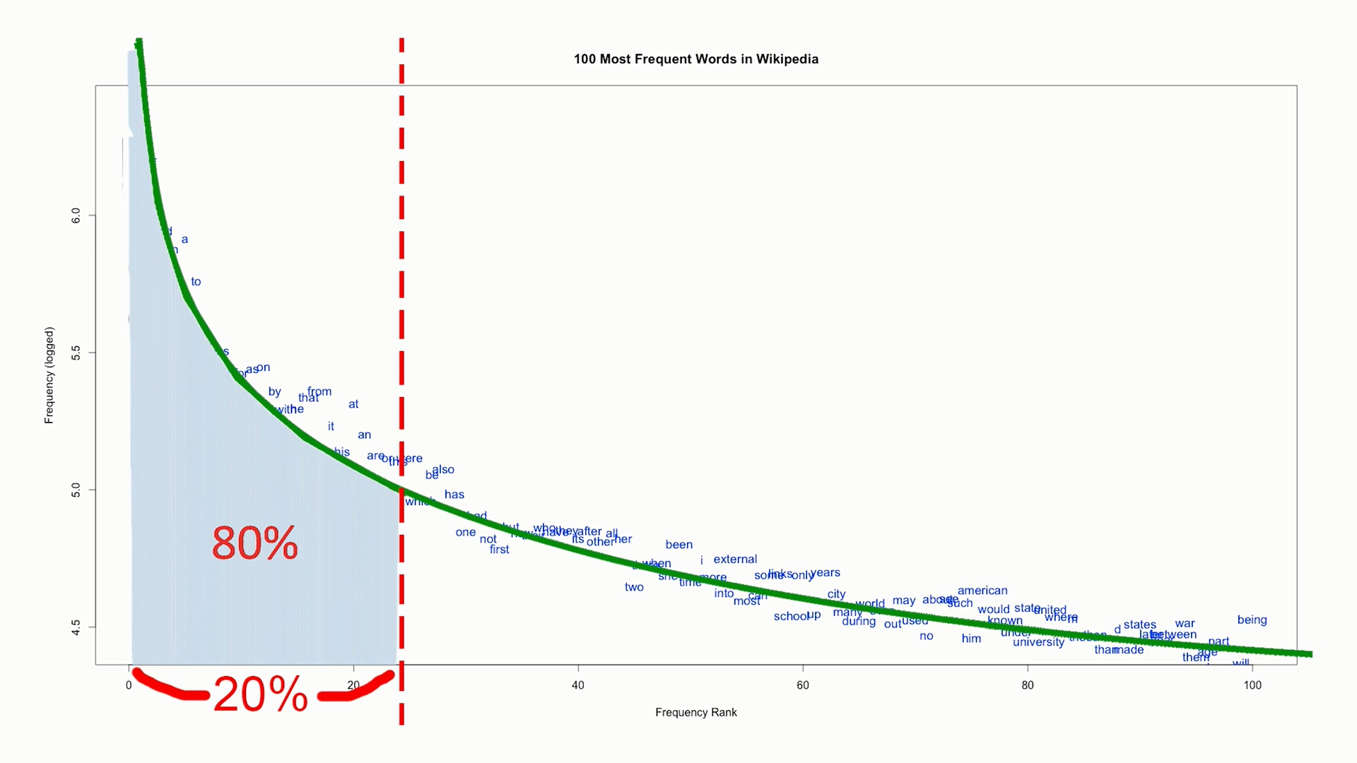
The Bizarre Rule of Thumb

Slide 16
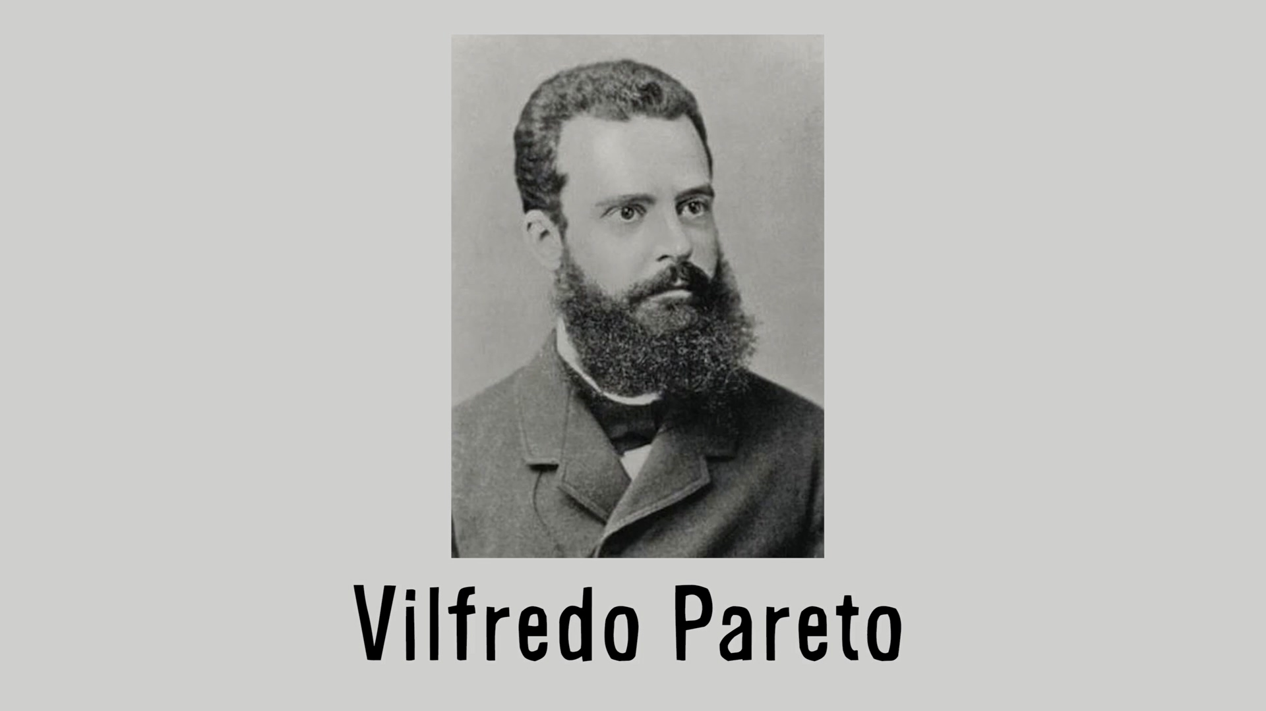
And this name comes from here

Slide 17

It affects economic ratios

Slide 18
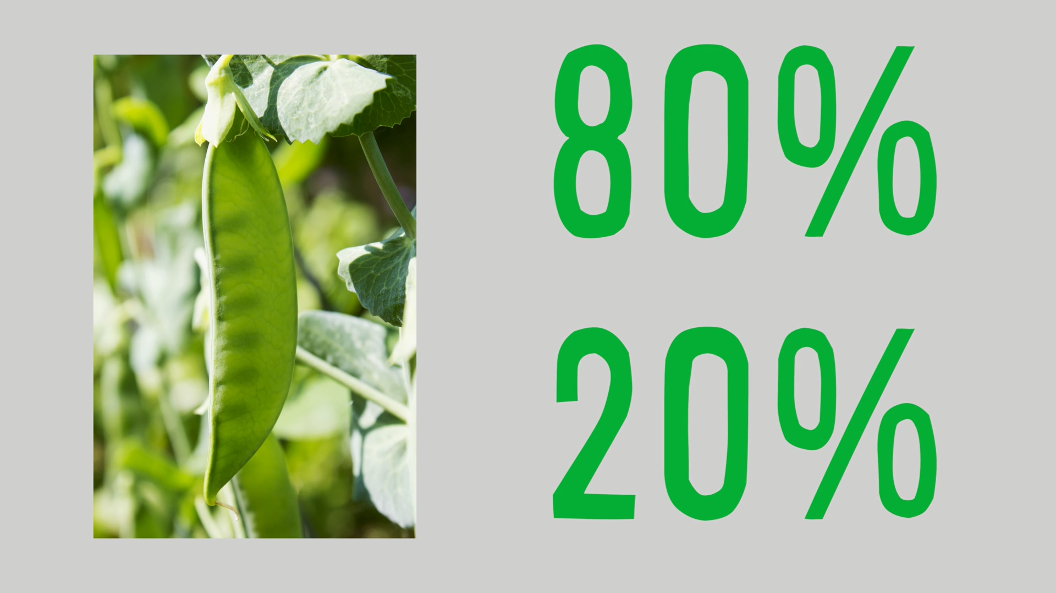
Even the growing of peas

Slide 19
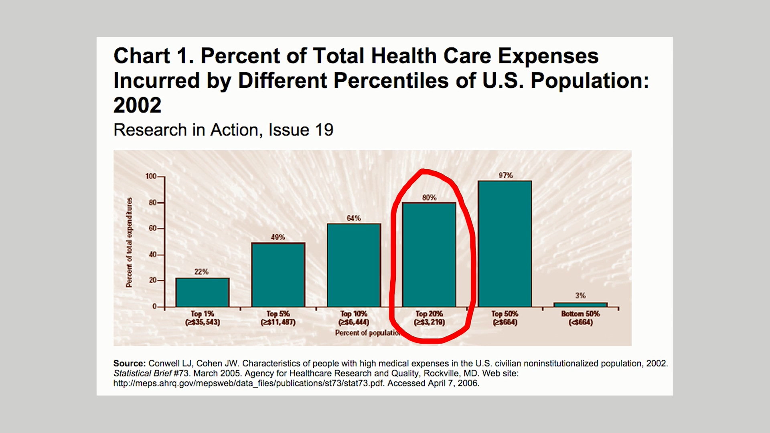
Or the health of a nation's people

Slide 20
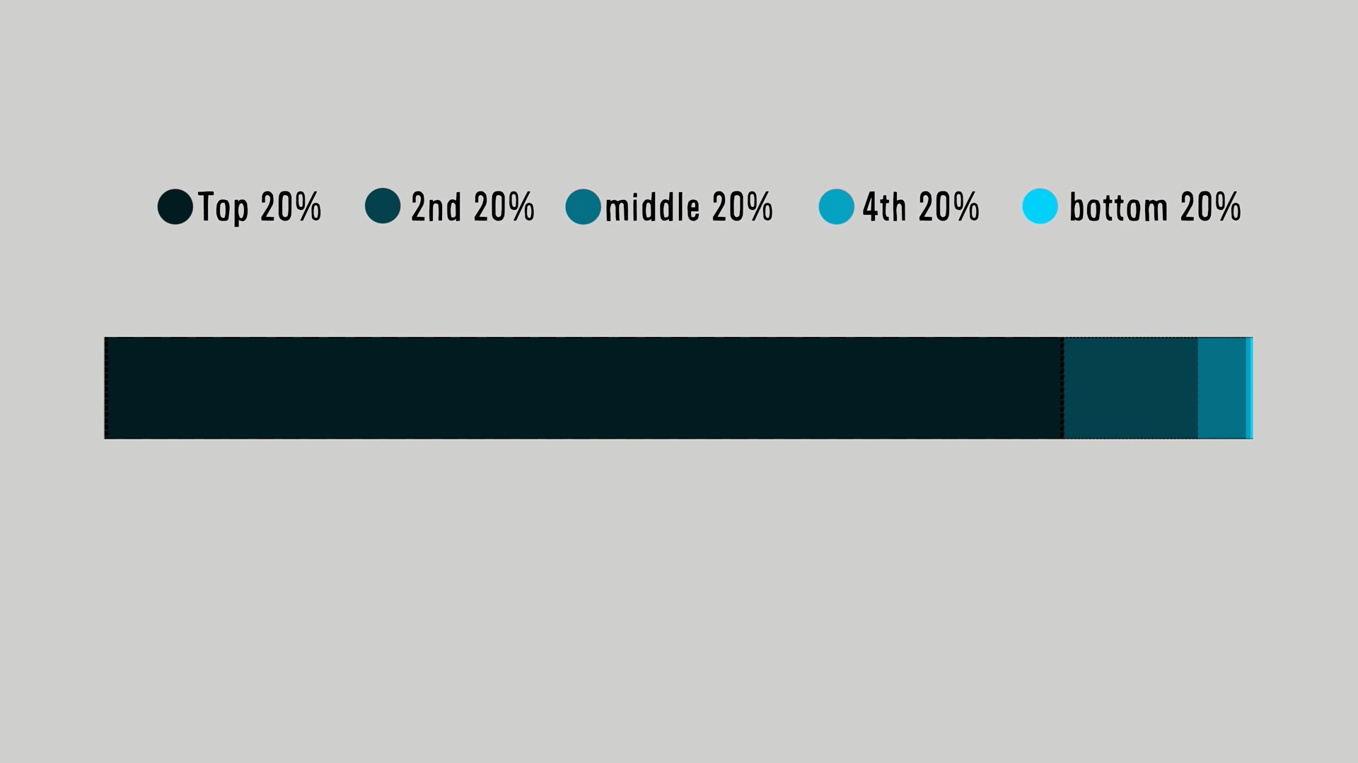
And of course their wealth

