Slide 1

Intrusion Detection System in Vehicular Ad-Hoc Networks
Architecture, Challenges, & Hybrid Solutions
Securing vehicular networks from cyber threats with IDS.
Presented by: Siddhart Singh
Reg No: 2427030548
Supervisor:

Slide 2




Introduction to VANETs
VANETs are specialized Mobile Ad-Hoc Networks (MANETs) for intelligent transport. They enable dynamic, infrastructure-independent communication for enhanced safety and traffic management.
V2V Communication
V2I Communication
V2X Communication
Direct vehicle-to-vehicle communication for cooperative awareness, collision warnings, and safety maneuvers.
Vehicle-to-infrastructure links with roadside units for extended network reach and traffic coordination.
Collective framework encompassing all communication types (V2V, V2I) for comprehensive connectivity.
On-Board Unit (OBU)
Roadside Unit (RSU)
Trusted Authority (TA)
In-vehicle computer for wireless communication, data processing, and real-time network functions.
Fixed roadside nodes providing network coverage, coordination, and vehicle connection points.
Central security entity for managing credentials, keys, and maintaining network trust.
Key VANET Applications
Safety: Collision warnings, emergency alerts, accident prevention.
Traffic Management: Congestion management, route optimization, smart traffic signals.
Infotainment: Multimedia sharing, location services, entertainment, passenger connectivity.

Slide 3


Problem Statement
Current VANET security faces critical challenges:
High mobility and dynamic topology make traditional IDS ineffective
Single-layer IDS approaches cannot handle diverse attack vectors
Existing solutions lack real-time detection capabilities for safety-critical applications
Limited research on hybrid approaches combining HIDS and NIDS for VANETs
Research Questions
How can hybrid IDS improve detection rates in dynamic VANET environments?
What is the optimal architecture for combining HIDS and NIDS in vehicular networks?
How can we achieve real-time threat detection without compromising network performance?

Slide 4

Objectives
Research Objectives
Primary Objective: Design and evaluate a hybrid intrusion detection system for VANETs that combines HIDS and NIDS for enhanced security coverage.
Specific Objectives:
Analyze existing IDS approaches and their limitations in VANET environments
Develop a hybrid IDS architecture integrating host-based and network-based detection
Design real-time detection algorithms for safety-critical vehicular applications
Evaluate performance metrics: detection rate, false positives, response time, scalability
Compare hybrid approach with traditional single-layer IDS solutions

Slide 5

Literature Review
Key Research Areas:
VANET Security Challenges
Intrusion Detection in VANETs
Machine Learning & IDS
Hasrouny et al. (2017): Comprehensive survey of VANET security challenges (862+ citations)
Nandy et al. (2024): Recent review of security attacks and IDS in vehicular networks
Manderna et al. (2023): Cascaded ML approach for vehicular network intrusion detection
Yeferny et al. (2021): Architecture, applications, and security challenges in VANETs
Rajarajan et al. (2016): Host-based intrusion detection approaches for VANETs
Hassan et al. (2023): Explainable AI models for intrusion detection in vehicular networks
Research Gaps:
Limited hybrid approaches combining HIDS and NIDS
Lack of real-time detection for safety-critical applications
Insufficient evaluation of scalability in dynamic environments

Slide 6
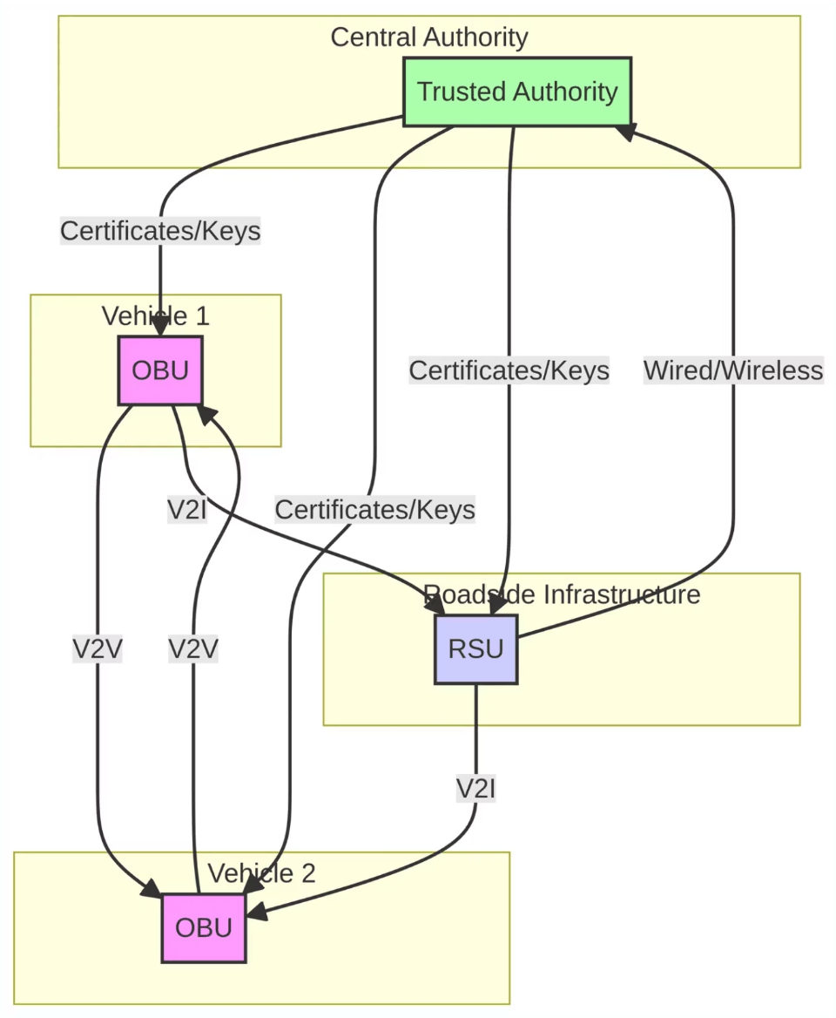

VANET Communication Architecture
VANET architecture involves vehicles (OBUs) communicating (V2V) and connecting with roadside units (RSUs) (V2I). RSUs link to the Trusted Authority (TA).
Architecture Components
Layered architecture for seamless communication. OBUs use DSRC/C-V2X protocols. RSUs aggregate traffic, relaying to TA-managed cloud.
Distributed design ensures redundancy, scalability, flexibility, and security via TA. Balances local autonomy with global coordination for optimal performance.

Slide 7

Security Challenges in VANETs
VANETs face unique security challenges due to high mobility, dynamic topology, resource constraints, and strict latency.
Network Challenges
Attack Vectors
High Mobility
Denial of Service
Rapid topology changes.
CRITICAL: Overwhelms network, blocks messages.
Dynamic Topology
Sybil Attack
Ephemeral connections, breaking trust.
HIGH: Multiple fake identities manipulate data.
Limited Bandwidth
Impersonation
Restricts security monitoring.
HIGH: Spoof identities, inject false info.
Strict Latency
Malicious Insiders
Real-time threat detection needed.
CRITICAL: Compromised nodes launch attacks.
Data Injection
CRITICAL: Inject false sensor data, cause accidents.
Collusion
HIGH: Coordinated nodes evade detection.

Slide 8

Intrusion Detection Systems (IDS) in VANETs
IDS monitor VANETs for malicious activity. Essential for rapid detection and response, ensuring integrity, availability, and confidentiality of safety communications.
IDS Classification
Category
Type
Description
Monitoring Scope
Host-Based (HIDS)
Monitors individual vehicle systems and OBU data.
Network-Based (NIDS)
Analyzes VANET traffic from RSU/central points.
Detection Technique
Signature-Based
Detects known attacks via signatures; high accuracy, limited to known threats.
Anomaly-Based
Identifies novel threats by detecting abnormal behavior.
Architecture
Centralized
Single analysis point; comprehensive but single point of failure.
Distributed
Independent IDS at each node; autonomous decision-making.
Cooperative
Multiple IDS nodes collaborate, share threat intelligence.
IDS selection depends on VANET requirements, resources, and threat models. Hybrid approaches often provide optimal security.

Slide 9





Hybrid IDS Approach
Hybrid IDS (HIDS + NIDS) offers comprehensive security for complex VANET threats, combining local precision with global awareness for enhanced resilience.
↔
HOST-BASED IDS (HIDS)
NETWORK-BASED IDS (NIDS)
Location: On-board vehicle units (OBU)
Location: RSU nodes for network-wide monitoring
Monitoring: Local system activities, sensor data
Monitoring: Network traffic, communication flows
Detection: Internal threats, compromised nodes
Detection: Coordinated attacks, network anomalies
Response: Immediate local alerts/mitigation
Response: Broader analysis, coordinated response
Advantage: Fast detection, low latency
Advantage: Detects sophisticated, distributed threats
Hybrid Integration Benefits
Improved Detection
Enhanced Resilience
Higher true positives, lower false positives via cross-validation.
Redundant layers ensure continuous threat identification.
Intelligent Data Flow
Better Classification
HIDS alerts feed NIDS for correlation and context.
Multi-layer analysis improves threat accuracy and response.

Slide 10






Proposed Hybrid IDS Solution
Solution Overview: A comprehensive hybrid intrusion detection system that integrates Host-Based IDS (HIDS) at vehicle level and Network-Based IDS (NIDS) at infrastructure level for enhanced VANET security.
Key Components:
HIDS Module
NIDS Module
Coordination Layer
Deployed on OBUs for local threat detection and immediate response
Deployed on RSUs for network-wide monitoring and correlation
Enables communication and data sharing between HIDS and NIDS
Machine Learning Engine
Real-time Response System
Adaptive learning for evolving threat patterns
Sub-second threat mitigation for safety-critical scenarios
Innovation:
First comprehensive hybrid approach specifically designed for VANET environments
Real-time coordination between local and global detection mechanisms
Adaptive ML algorithms for zero-day attack detection

Slide 11

Research Methodology
Research Approach: Mixed-method approach combining theoretical analysis, system design, simulation, and performance evaluation.
1
2
3
Analysis & Design
Implementation
Evaluation
Literature review and gap analysis
HIDS module development for OBU deployment
Simulation environment setup (NS-3/SUMO)
VANET threat modeling and attack vector identification
NIDS module development for RSU deployment
Performance metrics evaluation
Hybrid IDS architecture design
Comparative analysis with existing solutions
Algorithm development for real-time detection
Coordination layer implementation
Machine learning engine integration
Scalability and real-time performance testing
Evaluation Metrics:
Detection Rate
False Positive Rate
Response Time
Scalability
Resource Utilization

Slide 12






Hybrid IDS Detection Process
A multi-stage pipeline leveraging local and global intelligence for comprehensive threat identification. Ensures early detection and validation through coordinated analysis.
Data Collection
Continuous monitoring: network traffic, system activities from OBUs & RSUs. Includes communication patterns, sensor readings, behavioral metrics.
Local Detection (HIDS)
HIDS at OBUs analyze local activities, sensor readings, behavioral patterns. Identifies anomalies, triggers local alerts & preliminary mitigation.
Global Detection (NIDS)
RSUs aggregate anonymized data from vehicles for network-level analysis. Detects coordinated attacks, Sybil attacks, distributed anomalies.
Decision & Mitigation
HIDS/NIDS alerts aggregated at RSU/TA for final validation. Confirmed threats trigger responses: certificate revocation, node isolation, network quarantine.
Continuous Learning
Detection outcomes update threat signatures, refine anomaly models. Improves future accuracy via machine learning adaptation.

Slide 13

Comparative Analysis of IDS Approaches
Evaluating IDS architectures for vehicular networks.
Criterion
Centralized IDS
Distributed IDS
Cooperative IDS
Hybrid IDS
Detection Rate
High (global)
Moderate (local)
High (coordination)
Highest
False Positives
Moderate
Higher
Lower (validation)
Lowest
Response Time
Slower
Fast (local)
Moderate
Fast & Validated
Scalability
Limited
Excellent
Good
Excellent
Resource Usage
Low (nodes), High (center)
Distributed
Higher
Moderate
Single Point of Failure
Yes
No
No
No (redundant)
Novel Threat Detection
Limited
Limited
Better
Best (ML)
Coordinated Attack Detection
Good
Poor
Excellent
Excellent
Implementation Complexity
Low
Moderate
High
High
Hybrid IDS offers superior detection and resilience, favoring complexity for critical vehicular network safety.

Slide 14

Conclusion and Future Directions
Key Findings
Future Research Directions
Low-Latency
IDS Necessity
Real-time IDS (<10ms latency).
IDS critical for VANET security.
ML Integration
Hybrid Superiority
Advanced ML for adaptive threat/zero-day detection.
Hybrid IDS (HIDS+NIDS) offers comprehensive resilience.
Explainable AI
Develop XAI for transparent IDS decisions.
Safety Imperative
Effective IDS prevents vehicle safety compromise.
5G/6G Integration
Leverage 5G/6G for enhanced IDS.
Privacy-Preserving
IDS via federated learning/homomorphic encryption.

Slide 15

References
Nandy et al. (2024)
Rajarajan et al. (2016)
VANET security & IDS review (52+ citations)
Host-based IDS for VANETs (256+ citations)
Manderna et al. (2023)
Venkatasamy et al. (2024)
ML-cascaded IDS for VANET (53+ citations)
IDS for V2X communication (13+ citations)
Hassan et al. (2023)
Yeferny et al. (2021)
Explainable AI for VANET IDS (20+ citations)
VANETs: architecture, apps, challenges (53+ citations)
Hasrouny et al. (2017)
Springer Research Team (2020)
VANET security survey (862+ citations)
VANETs Cloud: architecture, solutions

