Slide 1
Objective
Need for Eureka server
Spring cloud config
Using spring cloud config for eureka
Basic of rabbit mq
Need for spring cloud bus
consumer
Producer
Eureka

Slide 2
GIT I have 8099 config
Cloud-config-server 8888
consumer
Producer 8090
Eureka
Eureka2 8099

Slide 3
Spring Cloud Stream
A
Producer
B

Slide 4
A
Producer
Subscribe
Publish
RabbitMQ
subscribe
B

Slide 5
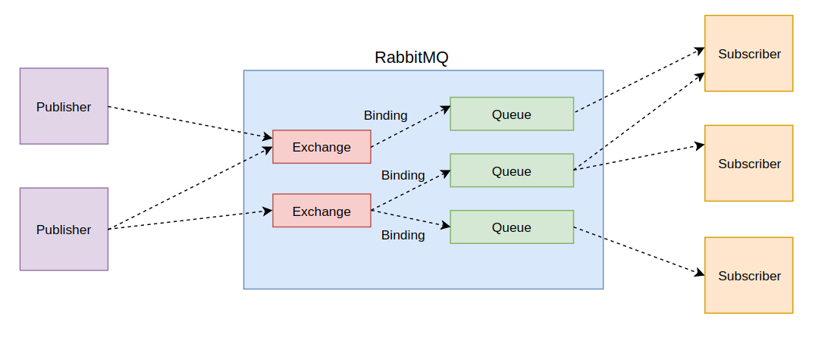

Slide 6
Producer
Rabbit mq
Channel
Consumer
Channel/queue
consumer

Slide 7
rabbitmq
GIT I have 8099 config
Cloud-config-server 8888
consumer
Eureka
Producer2
Eureka2 8099
Producer 8090

