Slide 1

A Project/Dissertation/Seminar Report
PRESENTATION
Disease Prediction With Symptoms
SUBMITTED BY SUPERVISED BY
Siddharth Singh Rawat Ms. Pooja Gupta
2020-310-215 Assistant Professor
B.Tech CSE
SUBMITTED TO
Department of Computer Science & Engineering
School of Engineering Sciences & Technology
JAMIA HAMDARD

Slide 2
OBJECTIVE
To develop a data mining application to predict disease using symptom data i.e. prognosis. By leveraging machine learning techniques, specifically Naïve Bayes and Decision Trees, to analyse symptom data and predict the likelihood of various diseases.

Slide 3
ABSTRACT
Currently, when someone experiences a specific illness, they must consult a doctor, which is both time-consuming and expensive. Moreover, if the individual is far from medical facilities, identifying the illness can be challenging. Therefore, streamlining this process with an automated program could save time and money, making it more accessible and convenient for patients
To develop this application, we use the Columbia University dataset that was available online. We start by cleaning the data, then visualizing the data before building a model using both multinomial Naïve-Bayes and decision tree algorithms to predict the disease given the symptoms faced by a person.

Slide 4
PROBLEM STATEMENT
In healthcare, early detection and accurate diagnosis of diseases play a pivotal role in improving patient outcomes and reducing healthcare costs. However, identifying diseases solely based on symptoms can be challenging due to the complexity and variability of human physiology. Therefore, there is a need for a efficient disease prediction system that can analyse symptom data and provide accurate predictions of potential diseases.

Slide 5
METHODOLOGY
DATA PRE-PROCESSING
The Dataset comprises of two columns: the first column denotes the disease, while the second column indicates the number of summaries featuring a recent mention of disease along with its associated symptoms.
The data preprocessing operations performed were:
Some spelling mistakes in the name of diseases or symptoms or their codes was rectified.
Repetitions in symptoms of a disease with the same name or slightly different name were removed.
Multiple symptoms of a disease with the same name or slightly different name were removed.
The codes which were given to diseases and symptoms were removed as they were irrelevant for our task.
A cumulative list of all symptoms was made.
Each symptom was assigned a Boolean value of 0 or 1 for each disease, according to whether the symptoms occurs with the disease or not.
The corresponding Disease i.e. Prognosis was added in the last column.

Slide 6
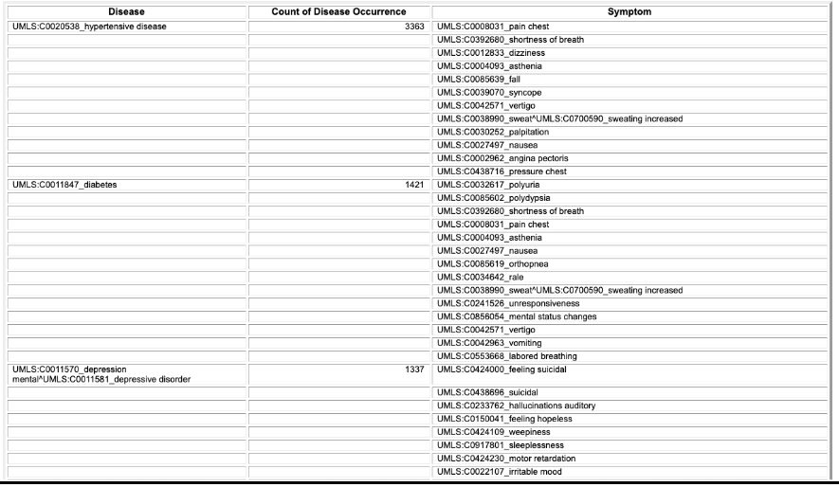
Fig.1: Original Dataset

Slide 7
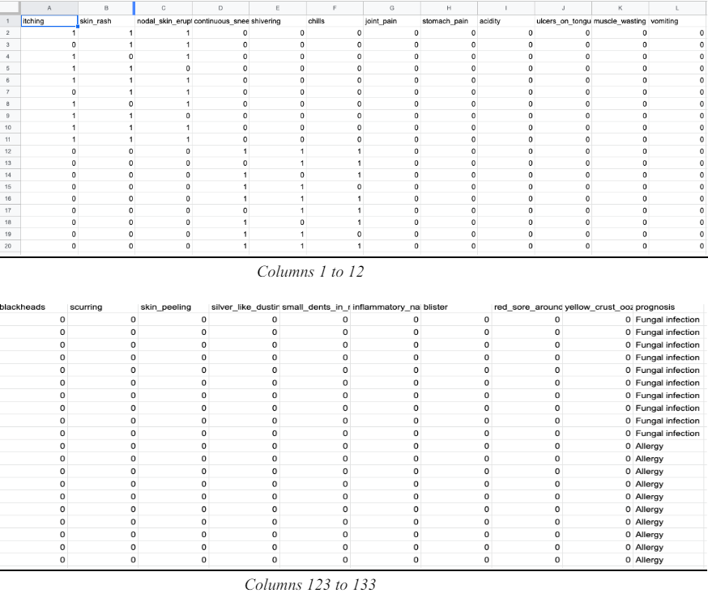
Fig.2: Final Dataset

Slide 8
Algorithms And Implementation
We have used 2 algorithms for this dataset so that we could also know which one yield better results.
Multinomial Naïve Bayes Classifier
Decision Tree
Multinomial Naïve Bayes Classifier
The Multinomial bayes classifier is a robust and widely used method for classification tasks, leveraging the power of probability theory to make predictions based on the frequency of features in the data. It assumes that features are conditionally independent given the class label. This mean it assumes that the presence or absence of a particular feature is unrelated to the presence or absence of any other feature, given the class label.
Decision Tree
Decision Tree is a popular machine learning algorithm used for both classification and regression tasks. It works by splitting the data into subsets based on the values of the input features, ultimately forming a tree-like structure where each node represents a decision based on a feature value, and each leaf node represents an outcome or class label.

Slide 9
Cross-Validation
Cross-validation is a powerful tool for model evaluation and selection, ensuring that the model generalizes well to unseen data.
It involves dividing the dataset into multiple subsets or "folds," training the model on some of these subsets, and validating it on the remaining subsets. This process is repeated several times, and the results are averaged to provide a more reliable estimate of the model's performance.
Steps involved:
1. Import required libraries
Import modules like “model_selection”, “DecisionTreeClassifier”, etc. from “scikit-learn” library in Python.
2. Create the Model Classifier
dt = DecisionTreeClassifier()
mnbc = MultinomialNB()

Slide 10
3. Perform Cross-Validation
The cross_val_score function is used to evaluate the performance of the model using cross-validation. The parameters are:
dt: The decision tree classifier
mnbc: The Multinomial Naive Bayes classifier.
X_train: The training input data.
y_train: The training target labels.
cv=3: Specifies 3-fold cross-validation.
4. Print the Cross-Validation Results:
Print the individual cross-validation scores.
Print the mean of the cross-validation scores.

Slide 11
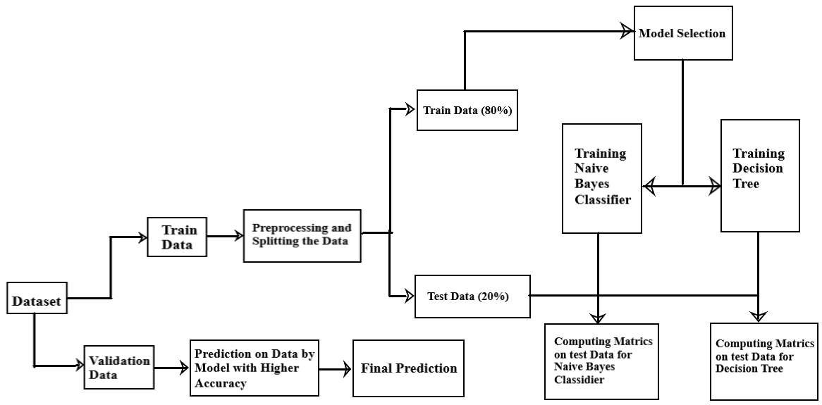
Fig.3: Entity Relationship Diagram

Slide 12
EVALUATION AND RESULT
After running the two algorithms on training and testing sets we found the accuracy scores. We now focus on interpreting how important the model thinks each symptom(input) is. This analysis uses a factor called importance which is a measure of the contribution of the input of the variable to the output predicted.
These are the top 20 symptoms with their importance in brackets:
feature 35 - loss_of_appetite (0.046433)
feature 53 - sinus_pressure (0.026973)
feature 93 - internal_itching (0.026919)
feature 79 - hip_joint_pain (0.026895)
feature 104 - increased_appetite (0.026657)
feature 126 - silver_like_dusting (0.025972)
feature 99 - red_spots_over_body (0.025887)
feature 71 - enlarged_thyroid (0.025737)
feature 118 - blood_in_sputum (0.025126)
feature 131 - yellow_crust_ooze (0.025049)
11. feature 2 - nodal_skin_eruptions (0.024985)
12. feature 86 - unsteadiness (0.024733)
13. feature 101 - abnormal_menstruation (0.024652) 14. feature 19 - weight_loss (0.024579)
15. feature 119 - prominent_veins_on_calf (0.024460) 16. feature 117 - fluid_overload.1 (0.024457)
17. feature 95 - depression (0.024430)
18. feature 109 - lack_of_concentration (0.024375)
19. feature 97 - muscle_pain (0.024292)
20. feature 41 - mild_fever (0.024262)
The same can also be seen by ordering the inputs according to the depth of the tree.

Slide 13
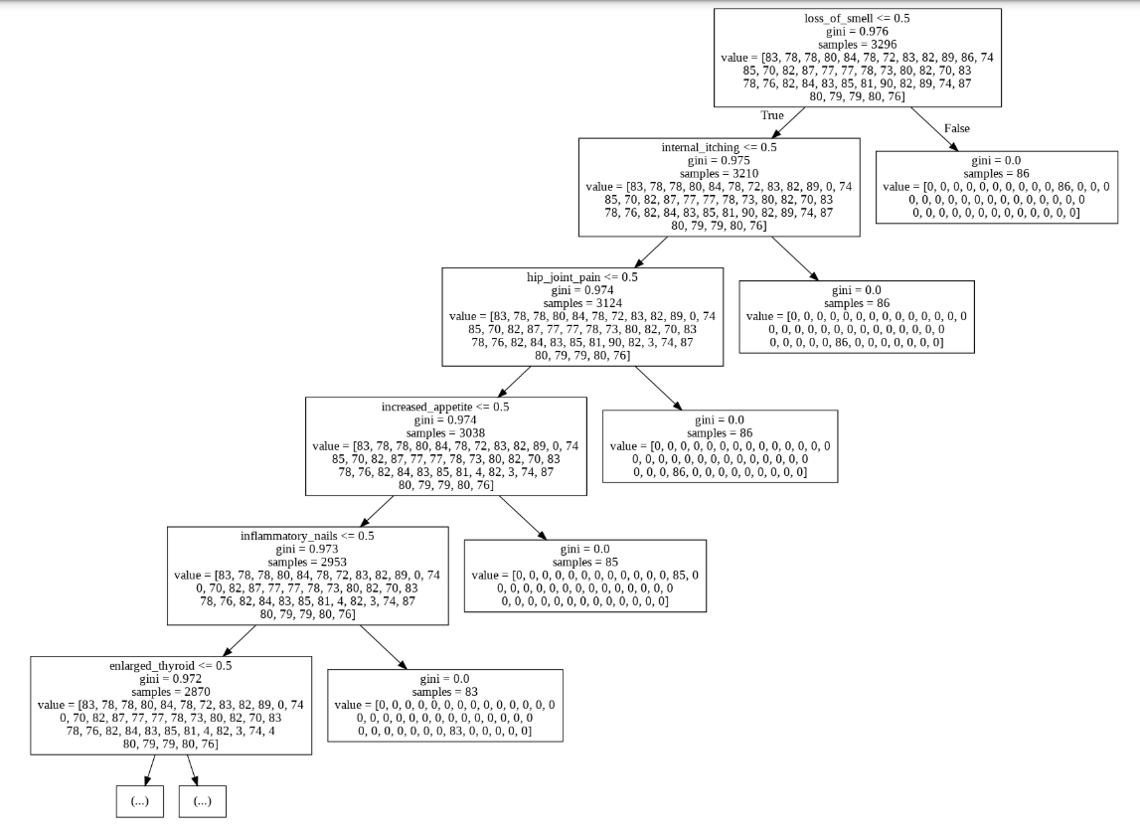
Fig.4: The top 5 nodes of the Decision Tree

Slide 14
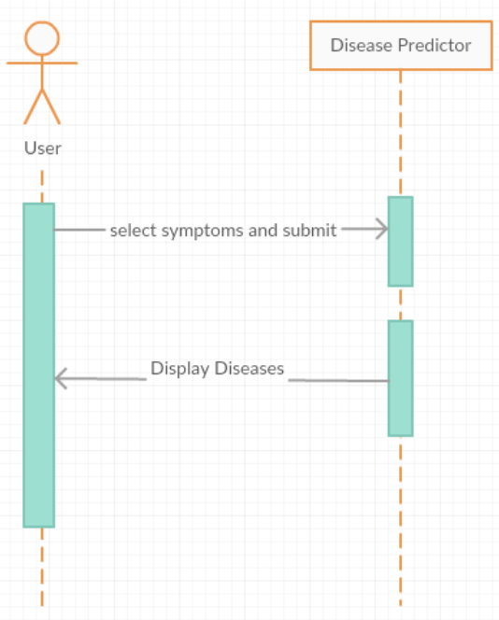
Fig.5: Sequence Diagram

Slide 15
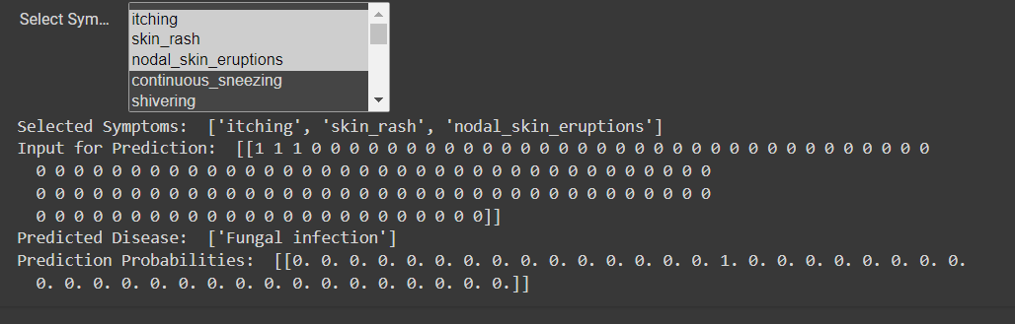
Fig.6: Predicting the Disease

Slide 16
CONCLUSION
After the data gathering and pre-processing or cleaning the data, we created a Machine Learning model using algorithms like Naive Bayes, Decision tree, that is able to correctly predict the type of disease, given the different type of symptoms experienced by the user. The decision tree approach proves to be better as naive Bayes assumes that all the features are independent of one another and gives the probability whereas in our dataset multiple symptoms together can accurately tell us about the disease

Slide 17
LIMITATION AND FUTURE SCOPE
Limitation
1. Data Quality: The dataset might have inconsistencies or inaccuracies, which can affect model performance.
2. Overfitting: The Decision Tree model, especially, is prone to overfitting, which can reduce generalizability.
3. Feature Representation: The boolean representation of symptoms may oversimplify the relationship between symptoms and diseases.
4. Limited Scope: The model is only as good as the dataset it was trained on, which may not cover all possible diseases and symptoms.
Future Scope
1. Early Detection and Intervention: Disease prediction models can help in the early detection of illnesses based on symptoms reported by individuals.
2. Personalized Healthcare: These models can contribute to personalized healthcare by providing tailored predictions based on individual symptoms and health history.
3. Resource Optimization: Disease prediction models can assist healthcare providers in optimizing resource allocation by prioritizing patients at higher risk of specific diseases.
4. Public Health Surveillance: Aggregating data from disease prediction models can contribute to public health surveillance efforts by providing insights into disease prevalence, geographic distribution, and emerging trends.

Slide 18
BIBLIOGRAPHY
"Machine Learning Algorithms for Disease Prediction: A Review"
Authors: Manogaran, G., & Lopez, D.
Journal: International Journal of Machine Learning and Computing (IJMLC)
Year: 2018 DOI: 10.18178/ijmlc.2018.8.5.751
"Applications of Machine Learning in Disease Prediction and Prevention"
Authors: Razzak, M. I., Naz, S., & Zaib, A.
Journal: Journal of King Saud University - Computer and Information Sciences
Year: 2018 DOI: 10.1016/j.jksuci.2017.07.011
"Applications of Naive Bayes and Decision Trees in Healthcare"
Authors: John, G. H., & Langley, P.
Book Title: Proceedings of the 7th ACM SIGKDD International Conference on Knowledge Discovery and Data Mining
Year: 2001 DOI: 10.1145/502512.502522
"Machine Learning for Healthcare: On the Verge of a Major Shift in Healthcare Epidemiology"
Authors: Obermeyer, Z., & Emanuel, E. J.
Journal: The New England Journal of Medicine
Year: 2016 DOI: 10.1056/nejmsr1607217
"Advances in Machine Learning for Healthcare"
Authors: Rajkomar, A., Dean, J., & Kohane, I.
Journal: Annual Review of Biomedical Data Science
Year: 2019 DOI: 10.1146/annurev-biodatasci-072018-021253

