Slide 1
ADC for a Compute-in-Memory block
Progress review: comparator, 4×4 array, analog shift-add, flash and SAR ADC
Siddhartha Agarwal · Project course under Prof. Tarun Kumar Agarwal · 29 Oct 2026
Notes:
WHAT THIS SLIDE IS: Just the title. Keep it short.
WHAT TO SAY: "Sir, since the last meeting I built every block of the readout chain at small scale in sky130: the comparator, the 4x4 array, the 2-column analog shift-add, and a 3-bit flash and a 3-bit SAR ADC. Today I'll go block by block, show hand calculation next to simulation for each, and then compare the two ADCs. I also have answers to the open questions from last time."
TIP: He has said many times "pen and paper first". So for every block, say the hand number first, then the simulated number.

Slide 2
Every block of the chain now works on its own, at 3-bit, 4-row scale
SINCE LAST MEETING
1
Built and simulated
Comparator (offset trim, delay), 4×4 SRAM array, 2-column shift-add, 3-bit flash ADC, 3-bit SAR ADC (gate-level logic)
2
Hand vs simulation
Shown for the array, the shift-add and both ADCs; the gaps are explained
3
Main finding
After 2-column shift-add the column needs 4 bits, and the array only swings 0–0.2 V, but my ADCs are 3-bit with 0.8 V full scale
4
ADC comparison
At 3 bits flash is 20× faster and uses less energy per conversion; SAR is the one that scales to the 4+ bits the chain needs
5
Open questions
TIA sign, negative weights, who generates the switch pulses: answered on one slide
Notes:
WHAT THIS SLIDE IS: The whole meeting in five lines. If he only has five minutes, this is it.
HOW TO EXPLAIN IT:
1. Built and simulated: list the blocks. Don't explain them yet.
2. Hand vs simulation: tell him that from now on every block has a hand number next to the simulated one, because he asked for that.
3. Main finding: this is your "personal insight" slide later. The array gives 5 levels per column (needs 3 bits), but after shift-add with weights 1 and 2 there are 13 levels (needs 4 bits). Also, the array's column voltage only goes up to about 0.2 V while the ADC's full scale is 0.8 V. So the blocks don't fit together yet, and you found that yourself.
4. ADC comparison: flash wins at 3 bits, SAR wins once you need more bits. Say "for my 3-bit, 4-row case" — don't make a general claim.
5. Open questions: you have answers on slide 16.
LIKELY QUESTION: "So which ADC will you use?" Answer: SAR, because the chain needs 4+ bits after shift-add and SAR scales by one comparison per bit; flash would need 15 comparators at 4 bits.

Slide 3
One column path, from input row to output code
THE CHAIN, WITH VOLTAGES
4×4 SRAM array
Column line
Shift-add (2 col)
ADC (3-bit)
Code
rows driven at 0 / 0.4 V
weights 0 / 1 in 6T cells
load RL = 250 Ω
VCL = 0 … 0.2 V
SUM = (IN0 + 2·IN1) / 3
range stays 0 … 0.2 V
VREF = 0.8 V
LSB = 100 mV
D2 D1 D0
Where the blocks do not fit yet
Range: the column only reaches 0.2 V, but the ADC spans 0.8 V, so only codes 0–2 are ever used.
Resolution: one column has 5 levels (3 bits is enough); after shift-add there are 13 levels, which needs 4 bits.
Same MAC, different voltage: MAC = 1 gives 36 mV or 32 mV depending on how many weights in that column are 1 (loading by RL).
Notes:
WHAT THIS SLIDE IS: The full signal chain with real voltage numbers at each node. Last meeting sir asked "would you be able to tell me the voltage level in each column?" This slide answers it.
HOW TO EXPLAIN IT, LEFT TO RIGHT:
- Rows are driven at 0 V (input 0) or 0.4 V (input 1). A weight of 1 turns ON the read transistor in that cell.
- Each column line has a 250-ohm load resistor to ground, so the column is a resistor divider: VCL = sum(G x Vin) / (sum G + 1/RL). With 4 cells ON and all inputs 1, VCL = 0.4 x 4/(4+4) = 0.2 V using G = 1 mS. That is the maximum.
- The shift-add takes two columns and gives SUM = (IN0 + 2 x IN1)/3. It is a weighted average, so its output range is the same as its inputs: 0 to 0.2 V.
- The ADC is 3-bit with VREF = 0.8 V, so LSB = 100 mV.
THE KEY POINT (bottom box), say it clearly:
1. Range mismatch: the ADC's full scale is 4x bigger than what the column produces. Fix: either lower VREF to about 0.2 V or add gain (a TIA). This is why the TIA matters.
2. Resolution: 5 levels per column, but 13 levels after shift-add (0 to 12 = MAC0 + 2xMAC1), so the ADC after shift-add needs 4 bits.
3. Loading: because RL is not a virtual ground, the column voltage depends on how many cells are ON, not only on the MAC. A TIA (virtual ground) removes this.
LIKELY QUESTION: "How will you fix the range?" Answer: TIA with a feedback resistor sized so the maximum column current gives close to full scale, or reduce VREF to 0.2 V — but then the LSB is 25 mV and the comparator offset (about 5.5 mV) becomes significant.

Slide 4
Bits needed come from the levels the array can produce
HOW MANY BITS?
Where the ADC sits | Possible values | Levels | Bits needed
One column (4 rows, binary in and weight) | MAC = 0 … 4 | 5 | 3
After 2-column shift-add (weights 1 : 2) | 0 … 4 + 2·(0 … 4) = 0 … 12 | 13 | 4
After 4-column shift-add (1 : 2 : 4 : 8) | 0 … 60 | 61 | 6
8-row array, 4-column shift-add | 0 … 120 | 121 | 7
Rule
bits = ⌈log₂(levels)⌉
Each extra column in shift-add doubles the range, so it adds one bit.
This is the paper's trade-off: shift-add saves ADCs, but each remaining ADC needs more bits.
My 3-bit ADCs are enough for one column, not for the shift-add output. Next step: a 4-bit SAR.
Notes:
WHAT THIS SLIDE IS: Sir asked to "justify the ADC resolution from the array". This is the pen-and-paper answer.
HOW TO EXPLAIN IT:
- With binary inputs and binary weights, a 4-row column's MAC can be 0, 1, 2, 3 or 4. That's 5 levels. 2 bits only give 4 codes, so you need 3 bits (8 codes, 3 unused).
- The 2-column shift-add weights column 1 by 2: the value is MAC0 + 2 x MAC1, so 0 to 12, which is 13 levels and needs 4 bits.
- With 4 columns weighted 1, 2, 4, 8 the range is 0 to 15 x 4 = 60, which is 61 levels and needs 6 bits.
- General rule: bits = ceil(log2(levels)). Each extra shift-add column doubles the range, so it adds one bit.
THE INSIGHT TO SAY OUT LOUD: "This is exactly the trade-off in the Jiang paper. Analog shift-add reduces the number of ADCs, but the ADC that remains needs more bits. So my 3-bit ADCs are right for one column, but after the shift-add I need a 4-bit ADC."
LIKELY QUESTION: "Why not just use the 3-bit ADC and lose the LSB?" Answer: then two different MAC results map to the same code, so the multiply-accumulate result is wrong by up to 1 unit of the LSB column. Whether that's acceptable depends on the neural network's tolerance; that's a later study.

Slide 5
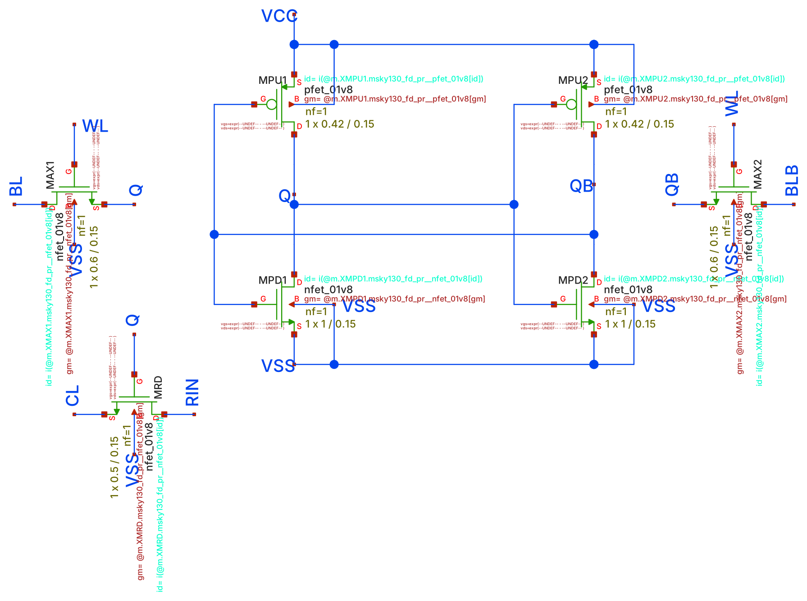
Column voltages match the hand formula with a 2.3 kΩ switch
BLOCK 1 · 4×4 SRAM ARRAY
Input x | MAC | Hand, G = 1 mS (mV) | Simulated (mV)
1 0 0 0 | 1 0 1 1 | 67 · 0 · 57 · 57 | 36 · 0 · 32 · 32
1 1 1 1 | 2 2 3 3 | 133 · 133 · 171 · 171 | 75 · 75 · 103 · 103
1 0 1 1 | 2 1 2 3 | 133 · 67 · 114 · 171 | 75 · 36 · 66 · 103
VCL = Σ G·VRIN / (Σ G + 1/RL)
Simulation is about 55 % of the hand value. Fitting the data gives a read-transistor resistance of about 2.3 kΩ, not the 1 kΩ I assumed. With 2.3 kΩ the hand formula matches the simulation within 4 %.
sram_cell6t.sch: one of the 16 cells. Q gates MRD between row RIN and column CL; each column has RL = 250 Ω to ground
Notes:
WHAT THIS SLIDE IS: The 4x4 SRAM array, with hand calculation vs simulation of the column voltages.
HOW THE ARRAY WORKS: Each cell is a 6T SRAM that stores the weight. Its Q node drives the gate of a read transistor that sits between the row input line and the column line. Weight 1 = transistor ON (a conductance G), weight 0 = OFF. The row input is 0.4 V for input 1 and 0 V for input 0. Each column has a 250-ohm resistor to ground.
THE FORMULA: Kirchhoff's current law at the column node: currents in from every ON cell = current out through RL. That gives VCL = sum(G x VRIN) / (sum G + 1/RL). Note: cells with weight 1 but input 0 still load the column (they connect it to a 0 V row), which is why the denominator has all ON cells.
HAND vs SIM: With G = 1 mS (1 kohm), the first pattern gives 67 mV for column 0 (1 cell active, 2 cells ON: 0.4 x 1/(2 + 4) = 67 mV). The simulation gives about 36 mV. Every value is about 55% of the hand value. If you solve the formula backwards from the simulated 36 mV, you get G about 0.44 mS, i.e. the read transistor is about 2.3 kohm when ON (its gate is only at VDD and its Vds is small but not zero). With 2.3 kohm, the hand values match the simulation within about 4%.
IMPORTANT, CHECK BEFORE THE MEETING: these simulated numbers are from my run with the sky130 tt models. Your TB_CIM_SRAM.sch prints v0_x1 ... v3_x3 in the ngspice window. If your numbers are different, replace the "Simulated" column with yours (it takes one minute).
LIKELY QUESTION: "How do you make the read transistor closer to 1 kohm?" Answer: make it wider (resistance goes down roughly as 1/W) or drive its gate higher. But a lower resistance also loads the row driver more. Or replace RL with a TIA so the column sits at virtual ground — then the output becomes linear in the MAC.

Slide 6
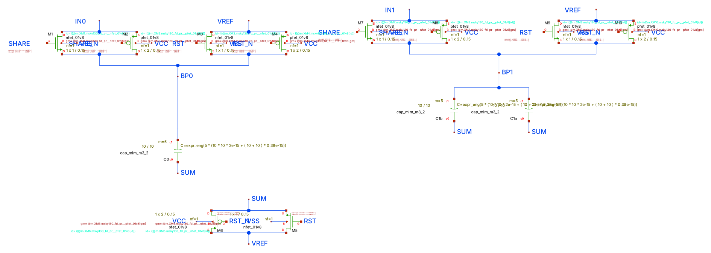
Charge sharing between C and 2C gives the 1 : 2 column weighting
BLOCK 2 · ANALOG SHIFT-ADD
shift_add_2col.sch: transmission-gate switches, C0 = 1 pF (LSB column), C1 = 2 pF (MSB column)
Two phases, never overlapping
Charge conservation on the SUM node
RST: SUM and both bottom plates tied to VREF, so both caps start with zero charge.
SHARE: bottom plates jump to IN0 and IN1; SUM floats and moves by the charge-weighted average.
C(SUM − IN0) + 2C(SUM − IN1) = 0
SUM = (IN0 + 2·IN1) / 3
(with VREF = 0; for any VREF the same steps give VREF + [C(IN0 − VREF) + 2C(IN1 − VREF)] / 3C)
Notes:
WHAT THIS SLIDE IS: The 2-column analog shift-add, and its pen-and-paper derivation.
WHY IT EXISTS: In bit-serial / bit-sliced CiM, column 1 holds a more significant weight bit than column 0, so its result must count twice. Instead of digitising both columns and shifting in digital, we combine them in analog with capacitors sized C and 2C, and use one ADC.
HOW IT WORKS:
- RST phase: the top plate (SUM) and both bottom plates are all connected to VREF. Both caps have 0 V across them, so zero charge.
- SHARE phase: RST switches open, the bottom plates are connected to IN0 and IN1. SUM is now floating, so the total charge on the SUM node must stay zero.
- Charge on C0 = C x (SUM - IN0), on C1 = 2C x (SUM - IN1). Their sum = 0 gives SUM = (IN0 + 2 x IN1)/3. Say "the bigger cap pulls SUM harder", that's the weighting.
SWITCHES: Each switch is a transmission gate (NMOS + PMOS in parallel) so it passes the full voltage range. RST and SHARE must never be on together, otherwise the inputs are shorted to VREF.
LAST TIME: SUM came out in microvolts because C3 was floating. Mention: "that was a floating capacitor node; it's fixed, and the next slide shows hand vs sim matching."
LIKELY QUESTION: "What sets the error?" Answer: charge injection and clock feedthrough from the switches when they turn off, plus the parasitic capacitance on SUM (here the 20 fF load). They're the 0.2 to 0.8% errors on the next slide.

Slide 7
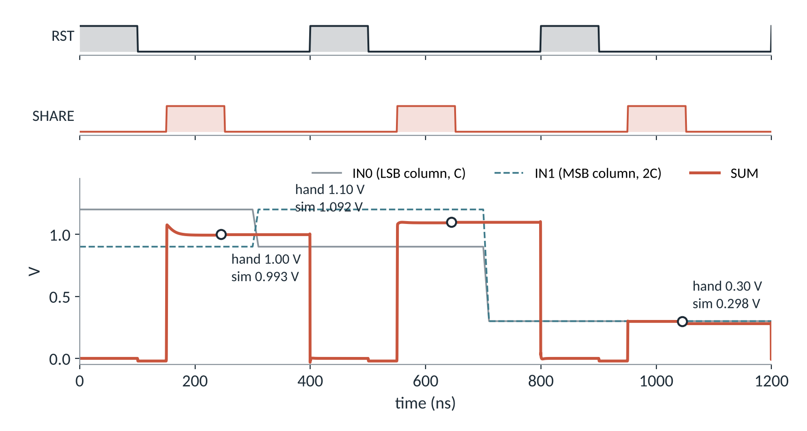
Simulation matches the hand values within 1 %
BLOCK 2 · ANALOG SHIFT-ADD
Cycle | IN0, IN1 (V) | Hand | Sim
1 | 1.2, 0.9 | 1.000 | 0.993
2 | 0.9, 1.2 | 1.100 | 1.092
3 | 0.3, 0.3 | 0.300 | 0.298
Why sim is 0.2–0.8 % low
The 20 fF load on SUM shares some charge, and the switches inject a little charge as they turn off.
Who makes RST and SHARE
Ideal pulse sources today. In the real chain they come from the same counter that sequences the SAR (slide 12).
Notes:
WHAT THIS SLIDE IS: The timing diagram he asked for, with hand vs simulation.
HOW TO READ THE PLOT:
- Top two traces are the control signals. RST goes high first (reset), then SHARE goes high (combine). They never overlap.
- Bottom: grey line = IN0 (LSB column), dashed teal = IN1 (MSB column), orange = SUM.
- During RST, SUM is pulled to VREF (0 V in this testbench). During SHARE, SUM jumps to the weighted average. The circles are the hand values.
HAND vs SIM:
- Cycle 1: (1.2 + 2 x 0.9)/3 = 1.0 V; sim 0.993 V.
- Cycle 2: (0.9 + 2 x 1.2)/3 = 1.1 V; sim 1.092 V.
- Cycle 3: both 0.3 V gives 0.3 V; sim 0.298 V.
All within 1%. The small loss is the 20 fF load on SUM (charge divides between the 3 pF of caps and the load: 3/(3+0.02) is about 0.993, which matches cycle 1 almost exactly), plus charge injection from the switches.
NOTE: these input voltages (0.3 to 1.2 V) are test values. In the real chain the inputs come from the array and are 0 to 0.2 V, as on slide 3.
WHO GENERATES THE PULSES: say honestly that they're ideal sources in the testbench now; in a real macro they come from a small digital sequencer (counter + decoder), the same one that drives the SAR phases.
LIKELY QUESTION: "Why does SUM overshoot at the start of SHARE in cycle 1?" Answer: the bottom plate switches turn on in a few ns and the input sources are ideal, so there's a short transient while charge redistributes; it settles within about 20 ns, well before the end of the 100 ns SHARE phase.

Slide 8
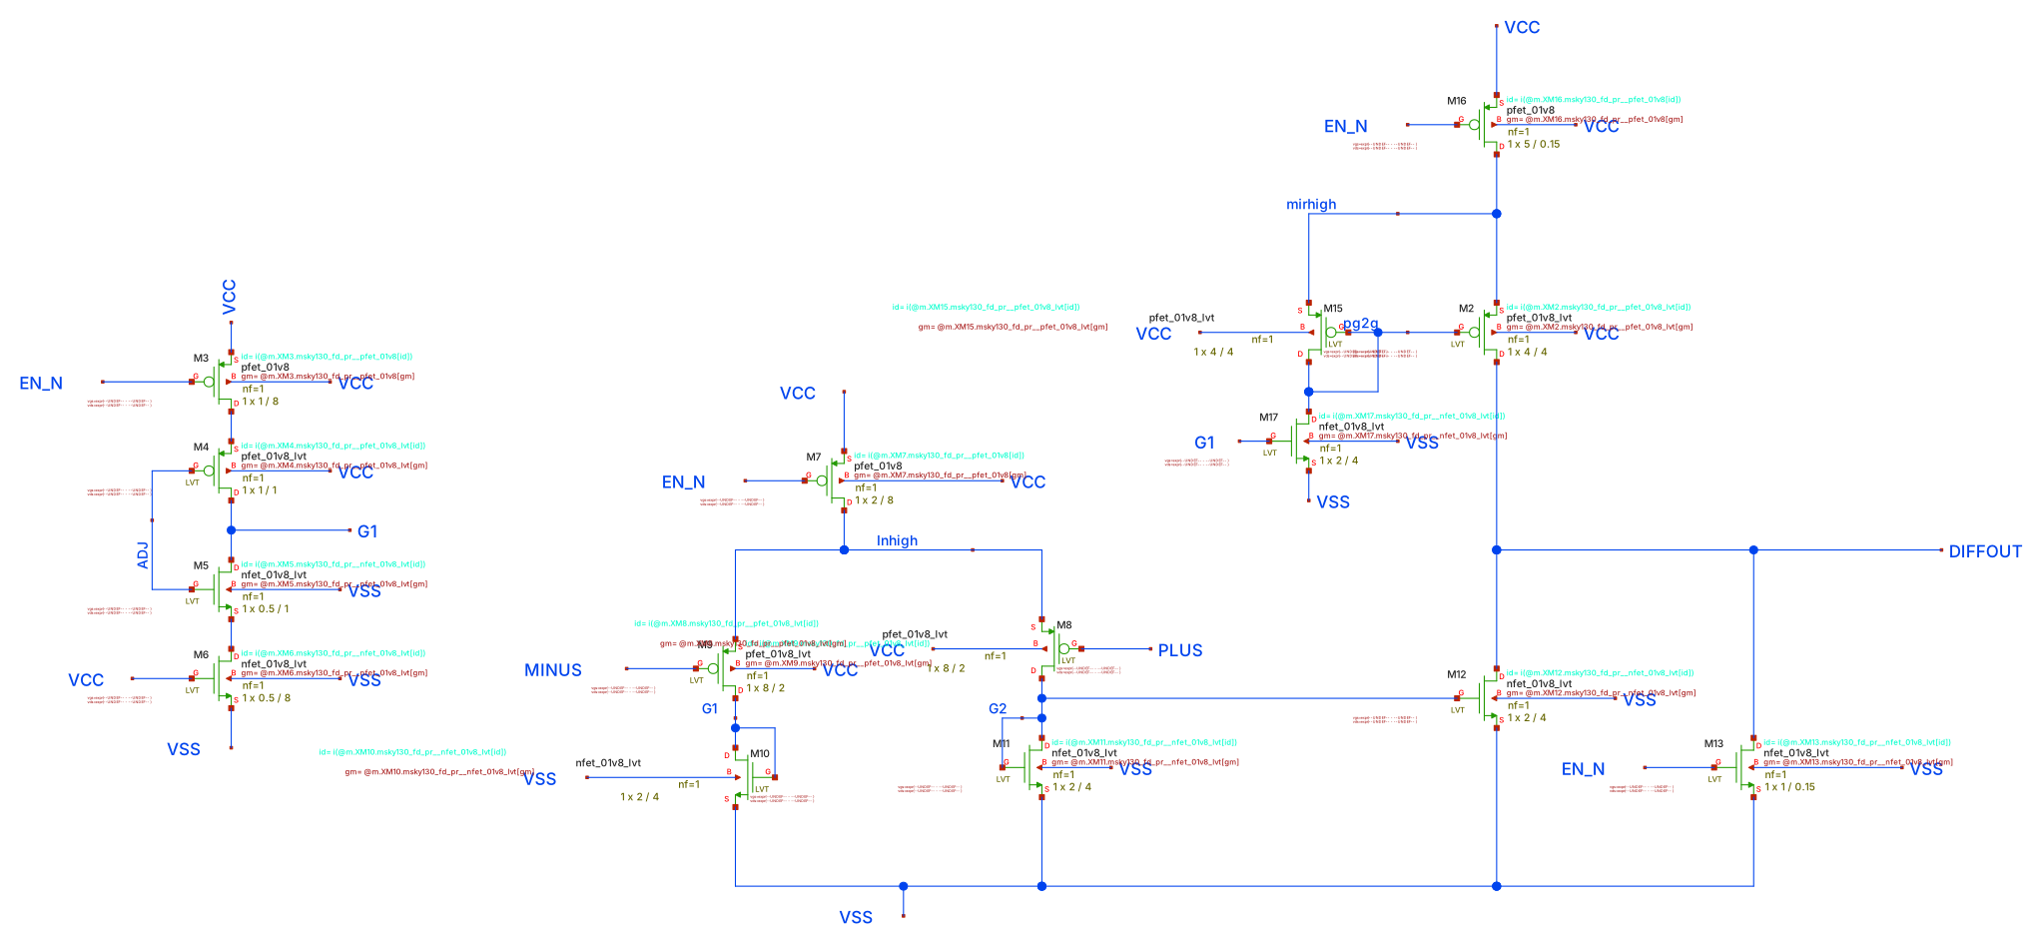
Two-stage comparator with an offset-trim input (ADJ)
BLOCK 3 · COMPARATOR
≈ 10 µA
static supply current (≈ 18 µW at 1.8 V)
−5.4 mV
offset at ADJ = 0.75 V
12–37 ns
delay for 200 mV down to 10 mV overdrive
5.5 mV
comparator.sch: PMOS LVT input pair (M8/M9, 8/2 µm), NMOS mirror load, push-pull output; ADJ injects a trim current at G1
random offset spread (1σ), see backup
Notes:
WHAT THIS SLIDE IS: The comparator that both ADCs use. Explain it in terms of currents, he always asks that.
HOW IT WORKS (left to right in the schematic):
- M7 is the tail current source (PMOS, long L = 8 um, gate tied to EN_N = 0 so it's ON). It feeds the input pair.
- M8/M9 are the PMOS input pair (low-Vt, 8 um / 2 um). PLUS goes to M8, MINUS to M9. Whichever gate is LOWER takes more of the tail current (PMOS conducts more when its gate is lower).
- M10/M11 are diode-connected NMOS loads. They turn each branch current into a gate voltage (G1, G2).
- Second stage: M12 copies the G2 current to the output pulling down; M17 and the PMOS mirror M15/M2 copy the G1 current to the output pulling up. The output goes high when PLUS > MINUS.
- ADJ (M4/M5/M6/M3 on the left): adds a small extra current into node G1. That unbalances the first stage on purpose, which shifts the trip point. That is an offset trim.
- M13 pulls the output low when the comparator is disabled (EN_N = 1).
THE NUMBERS ON THE RIGHT:
- About 10 uA flows all the time (static), so about 18 uW at 1.8 V. This matters for energy later.
- Offset: at ADJ = 0.75 V the trip point is 5.4 mV below the reference.
- Delay: 37 ns with 10 mV overdrive, 12 ns with 200 mV. A smaller overdrive means a slower comparator, because it's a linear amplifier, not a latch.
- Random offset 5.5 mV: from the Monte Carlo in the backup (don't show it today).
LIKELY QUESTION: "Why not a latch comparator?" Answer: the latch (StrongARM, like my sense_amp) has no static current and decides faster, but it needs a clock and kicks back onto the inputs. For a first working ADC I used the continuous-time one; the latch is next, especially for the SAR.

Slide 9
ADJ moves the trip point linearly; small overdrive makes it slow
BLOCK 3 · COMPARATOR
Zero offset at ADJ ≈ 0.76 V, slope ≈ 360 mV of trip shift per volt of ADJ. Both ADCs use ADJ = 0.75 V.
Notes:
WHAT THIS SLIDE IS: Two measurements of the comparator, both from DC/transient simulation.
LEFT CHART, offset vs ADJ: MINUS is held at 0.4 V and PLUS is swept; the offset is (trip point - 0.4 V). As ADJ goes from 0.6 V to 0.9 V, the offset goes from -55 mV to +54 mV, almost a straight line (about 0.36 mV per mV of ADJ). It crosses zero at about ADJ = 0.76 V. That's why all my testbenches use ADJ = 0.75 V. (My older testbenches had 0.9 V as a placeholder, which gives a +54 mV offset — half an LSB! — so the trim matters.)
RIGHT CHART, delay vs overdrive: PLUS steps from 0.3 V to (0.4 V + overdrive). Delay = time from the step to the output crossing 0.9 V. With 10 mV overdrive it takes 37 ns, with 200 mV only 12 ns. The comparator is a linear amplifier with limited slew, so a small input difference takes longer to drive the output all the way.
WHY IT MATTERS:
- Flash speed is set by this delay (worst case is a small overdrive).
- In the SAR, the comparator makes 3 decisions, and the last ones often have a small overdrive.
LIKELY QUESTION: "Is the ADJ value the same on every chip?" Answer: no. Random mismatch moves each comparator's offset by about 5.5 mV (1 sigma), so ADJ fixes the average offset, not each comparator's random part. For the SAR (one comparator) one trim fixes it; for the flash (7 comparators) one shared ADJ can't.

Slide 10
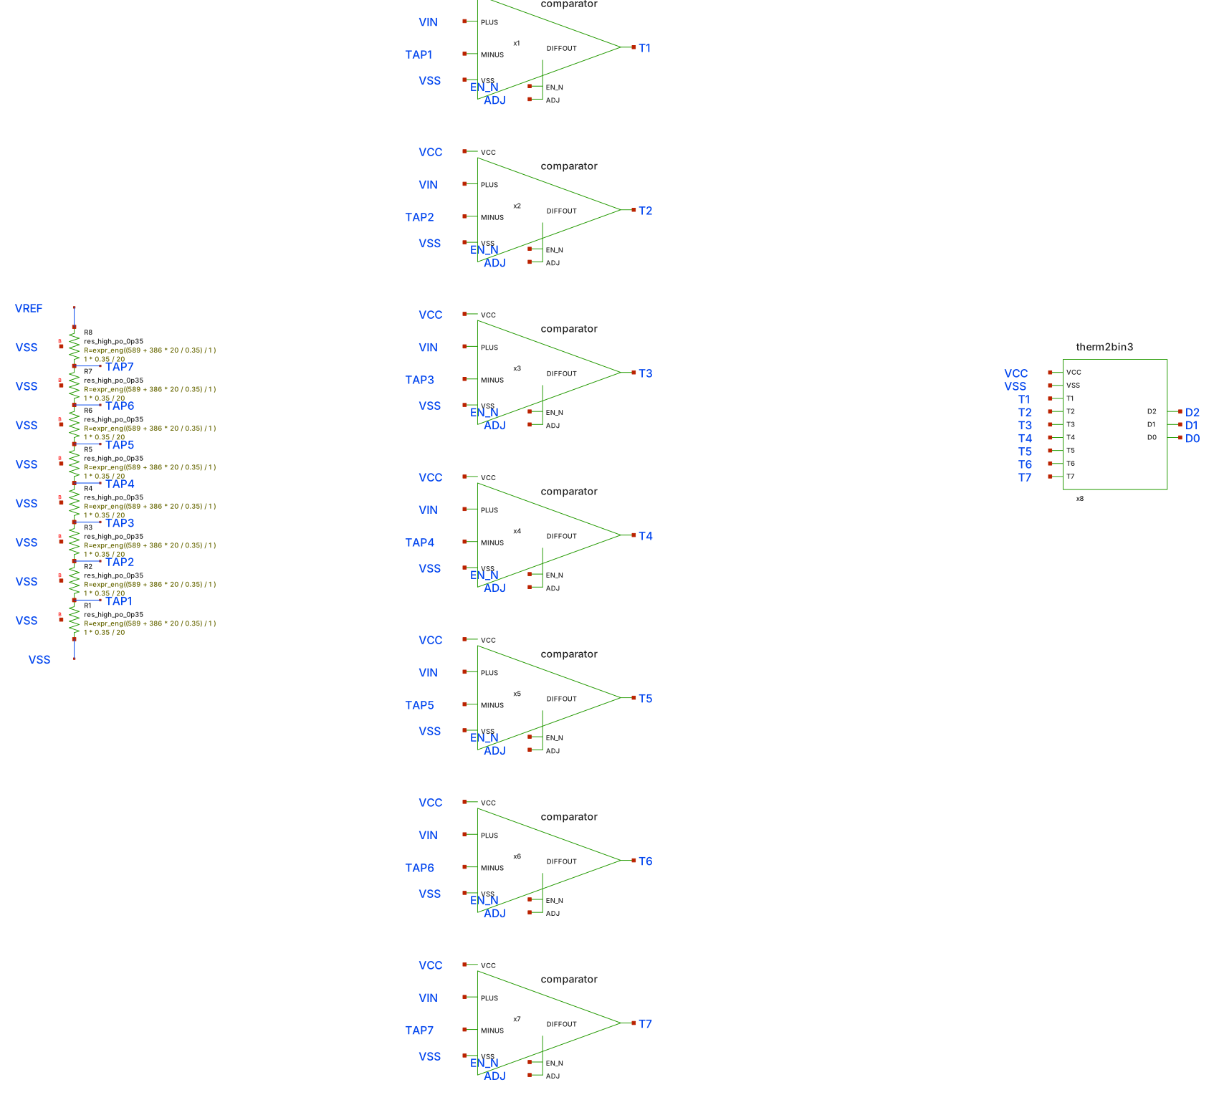
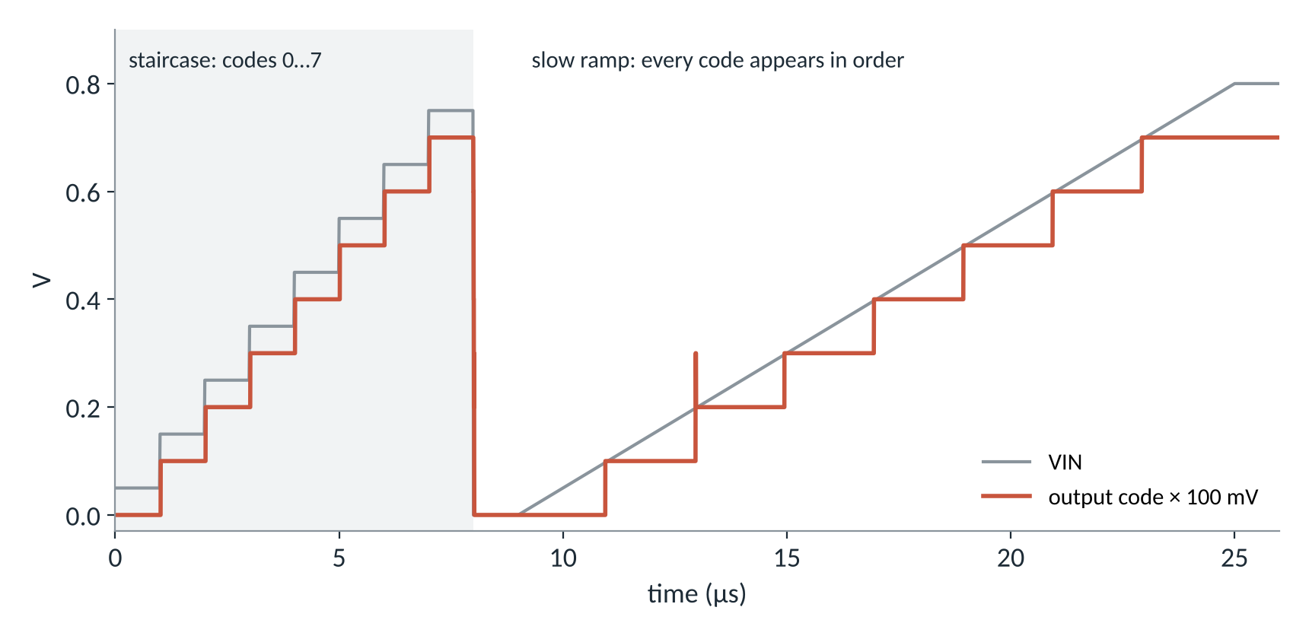
Seven comparators and a ladder: all bits in one step
ADC 1 · 3-BIT FLASH
flash_adc3.sch: 8 × 22.9 kΩ poly ladder, 7 comparators, thermometer-to-binary encoder
Threshold (V) | 0.1 | 0.2 | 0.3 | 0.4 | 0.5 | 0.6 | 0.7
Measured, ramp (V) | 0.098 | 0.199 | 0.298 | 0.397 | 0.498 | 0.597 | 0.697
All 8 codes correct; every threshold within 3.5 mV of ideal.
Notes:
WHAT THIS SLIDE IS: The 3-bit flash ADC and its transfer curve.
HOW IT WORKS:
- 8 equal resistors (22.9 kohm each, poly) between VREF = 0.8 V and ground make 7 tap voltages: 0.1, 0.2 ... 0.7 V. Each tap is a threshold.
- 7 comparators compare VIN with each tap at the same time. If VIN = 0.35 V, the comparators at 0.1, 0.2 and 0.3 V output 1 and the rest 0. That's a thermometer code (1110000...).
- The encoder (NAND-NAND logic) converts the 7-bit thermometer code into 3-bit binary.
HOW TO READ THE PLOT:
- Left part (0 to 8 us): VIN steps to the middle of each code (0.05, 0.15 ... 0.75 V). The orange line is the output code x 100 mV, so it should sit 50 mV below VIN. It does, all 8 codes are right.
- Right part: a slow ramp from 0 to 0.8 V. The code climbs 0 to 7 in order with no missing codes. The table shows where each code changes: within 3.5 mV of ideal.
THE SMALL SPIKE AT 13 us: when VIN crosses 0.2 V, the code briefly shows 3 before settling at 2. That's an encoder glitch while the thermometer bit is in transition. A real flash latches its output on a clock edge after the comparators have settled, so it would never sample that glitch. Good to mention before he spots it.
HAND vs SIM: hand thresholds are k x 0.8/8 = k x 100 mV. The measured thresholds are 1.5 to 3.5 mV low, which is the comparator offset (about -5 mV static) partly cancelled by its delay on a moving ramp.
LIKELY QUESTION: "What limits the flash?" Answer: 2^N - 1 comparators. At 3 bits it's 7; at 6 bits it would be 63, each with its own random offset.

Slide 11
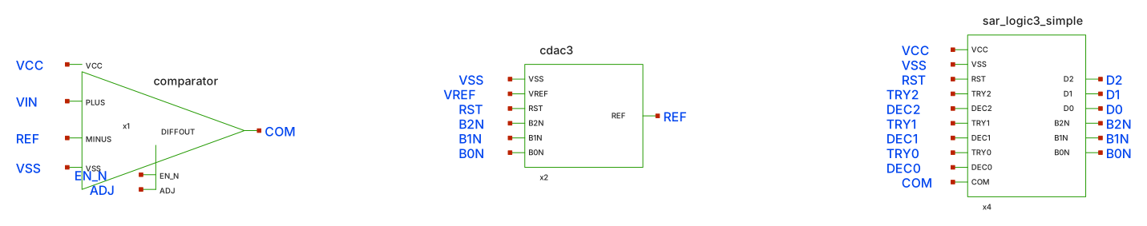
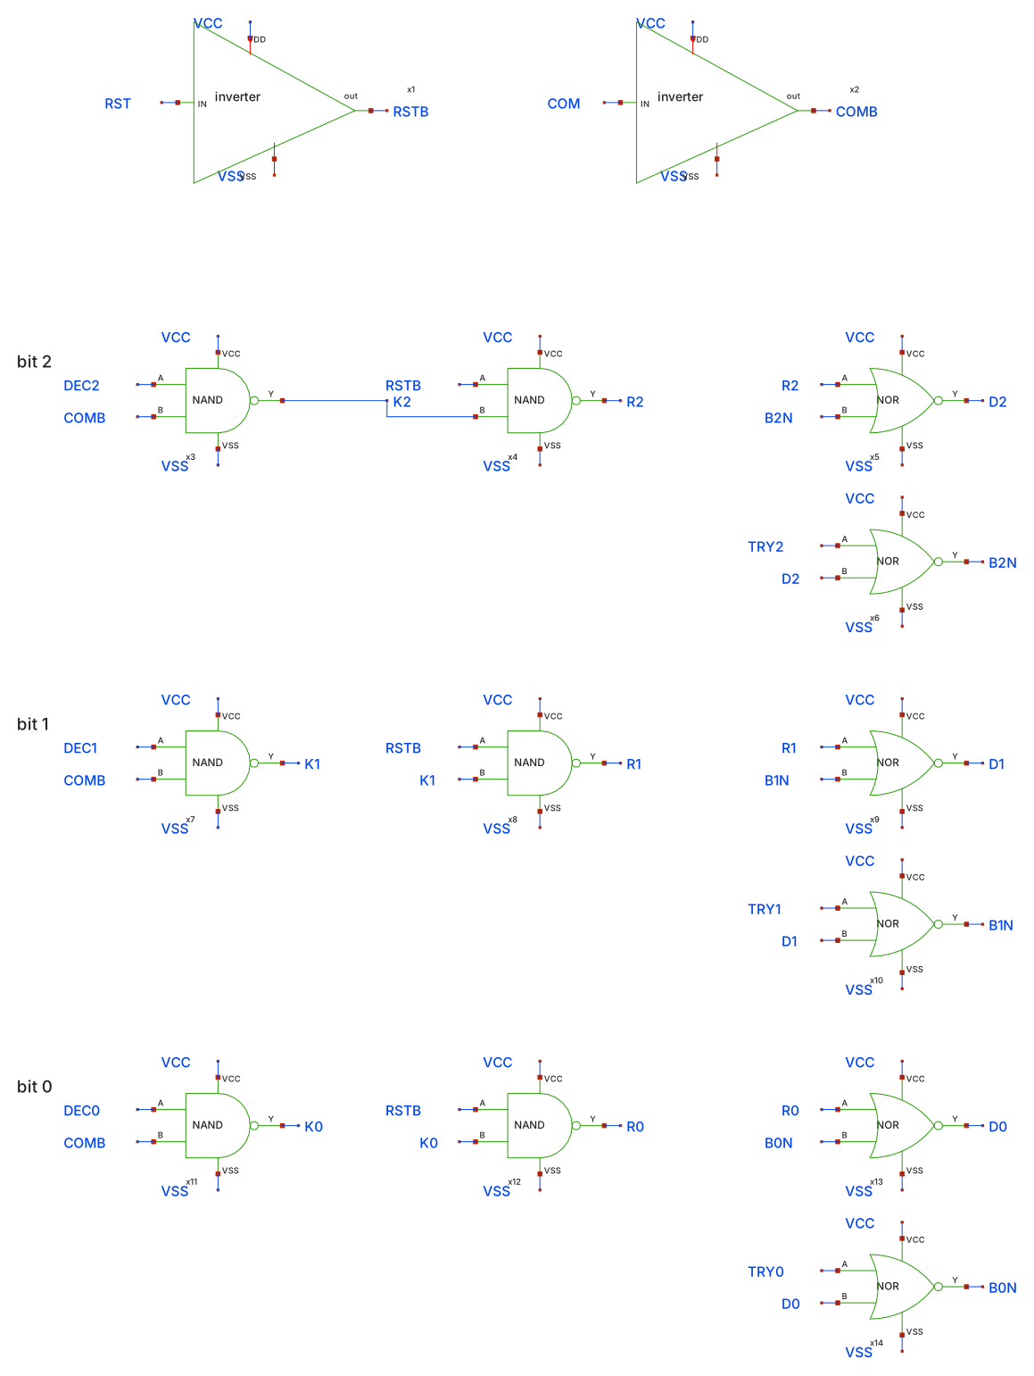
One comparator, a binary-weighted CDAC, and gate-level SAR logic
ADC 2 · 3-BIT SAR
sar_adc3.sch: comparator (VIN vs REF) → SAR logic → CDAC makes REF
Capacitive DAC (cdac3)
4C
2C
C
C
common top plate = REF, grounded during RST
D2
D1
D0
dummy
REF = VREF · (4·D2 + 2·D1 + D0) / 8
Bottom plates are driven to VREF (bit 1) or 0 (bit 0) by inverters; C = 1 pF MIM.
sar_logic3_simple.sch: 2 inverters, 6 NAND2, 6 NOR2 (52 transistors). Each bit is a NOR SR latch.
Notes:
WHAT THIS SLIDE IS: The SAR ADC structure. Three parts.
1. COMPARATOR (same as before): compares VIN with REF. COM = 1 means VIN > REF.
2. CAPACITIVE DAC (cdac3): binary-weighted caps 4C, 2C, C plus one dummy C, total 8C, all sharing one top plate called REF. During reset the top plate is grounded. Then each bottom plate is driven to VREF (bit = 1) or 0 (bit = 0) by an inverter. By charge conservation on the floating top plate: REF = VREF x (4 x D2 + 2 x D1 + D0)/8. So REF is the DAC output for the current bits. The dummy C makes the total 8C, so the weights are exactly 1/2, 1/4, 1/8 of VREF.
3. SAR LOGIC (sar_logic3_simple, the new gate-level version, 52 transistors instead of 92):
- Each bit is an SR latch made from two NOR gates. TRYi SETS the bit (trial 1). The reset input is RST OR (DECi AND NOT COM).
- So: RST clears all bits. In TRYi the bit is set to 1, REF goes up by that bit's weight. In DECi, if COM = 0 (VIN < REF), the bit is cleared; if COM = 1 it stays.
- I didn't need a separate latch for COM, because during DECi the bit is still 1, so REF still holds the trial level and COM is still valid.
HAND CALCULATION: REF levels for trials are 0.4 V (D2), then 0.2 or 0.6 V (D1), then +/-0.1 V (D0). That's binary search.
LIKELY QUESTION: "Why does VIN go directly to the comparator? Where's the sampling?" Answer: in this version VIN is held constant by the testbench (ideal sample-and-hold). In a real chain I need a sampling switch and cap, or to sample VIN onto the CDAC itself (the classic charge-redistribution SAR). That's on the next-steps list.

Slide 12
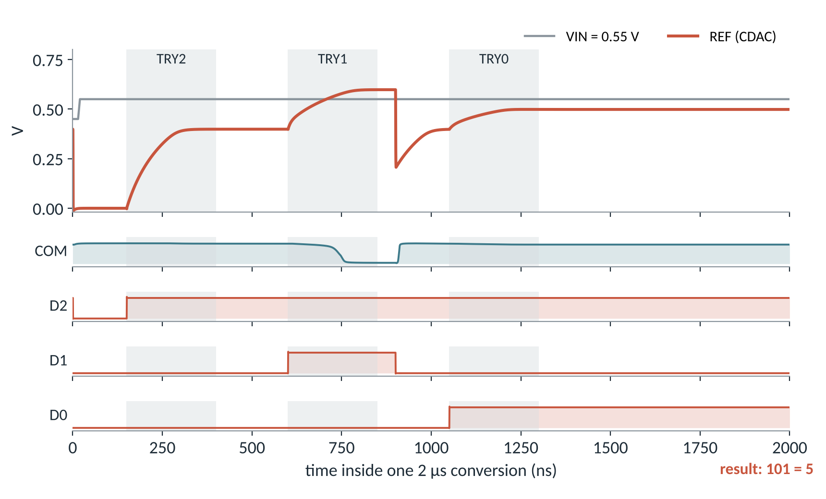
Binary search in three trials: VIN = 0.55 V gives code 101
ADC 2 · 3-BIT SAR
Phase | REF | VIN > REF? | Bit
TRY2 / DEC2 | 0.4 V | yes | D2 = 1
TRY1 / DEC1 | 0.6 V | no | D1 = 0
TRY0 / DEC0 | 0.5 V | yes | D0 = 1
Who makes the 7 phases
Ideal sources today. Every edge sits on a 50 ns grid, so a 6-bit counter clocked at 20 MHz plus a small decoder can make RST, TRY and DEC (and the shift-add RST/SHARE).
What sets the speed
REF needs about 200 ns to settle after each trial (8 pF driven from 0.8 V). Halving all phases still works; 0.3× fails.
Notes:
WHAT THIS SLIDE IS: The SAR timing diagram he asked for, from simulation, for one conversion with VIN = 0.55 V.
HOW TO READ IT:
- Top: grey = VIN (0.55 V), orange = REF from the CDAC. Grey shaded bands are the TRY phases.
- Below: COM (comparator output), and the three bits D2, D1, D0.
STEP BY STEP (point at the plot):
1. RST (0 to 100 ns): all bits 0, REF = 0.
2. TRY2: D2 = 1, REF rises to 0.4 V. VIN 0.55 > 0.4, COM stays 1, so at DEC2 D2 is kept.
3. TRY1: D1 = 1, REF rises to 0.6 V. Now VIN < REF, COM falls to 0. At DEC1 (around 900 ns) D1 is cleared and REF drops back. COM goes back to 1.
4. TRY0: D0 = 1, REF = 0.5 V. VIN > REF, so D0 is kept.
Result 101 = 5, and 5 x 100 mV = 0.5 V is the largest level below 0.55 V. Correct.
HAND vs SIM: the REF levels in the table (0.4, 0.6, 0.5 V) are the hand values from REF = VREF x code/8. The simulated REF reaches them within a few mV once settled.
WHO MAKES THE PHASES (he asked last time): be honest that today they are ideal pulse sources. All the edges are on a 50 ns grid inside a 2 us conversion, so a 6-bit counter (0 to 39) clocked at 20 MHz with a decoder can generate them. That's the plan.
SPEED: REF takes about 200 ns to settle each time (you can see the slow rise), because the DAC drivers charge 8 pF from 0.8 V. I ran the same test with all phases scaled down: 0.5x (1 us per conversion) still works, 0.3x gives wrong codes because REF hasn't settled when the comparator decides.
LIKELY QUESTION: "Why so slow?" Answer: the caps are 1 pF per unit, which is much bigger than 3 bits needs. Smaller caps or stronger drivers would make REF settle faster.

Slide 13
Same comparator, 3 bits: flash is faster, SAR is smaller
FLASH vs SAR
Metric | Flash | SAR | Better
Worst-case latency (input ±25 mV from a threshold) | 50 ns | 1.45 µs (0.73 µs at the fastest working timing) | Flash
Max conversion rate | ≈ 20 MS/s | ≈ 1 MS/s | Flash
Power | 128 µW, all static | 22–24 µW | SAR
Energy per conversion | 6.4 pJ | 44 pJ (2 µs), 24 pJ (1 µs) | Flash
Comparators / transistors | 7 / 143 | 1 / 74 (+ sequencer) | SAR
Transistor gate area (Σ W·L) | 897 µm² | 147 µm² | SAR
Passives | 8 resistors, 56 µm² | 8 MIM caps, 4000 µm² (8 pF) | Flash, as drawn
Capacitance on the column | 206 fF | 36 fF | SAR
DNL spread (1σ, mismatch) | 0.078 LSB | ≈ 0.002 LSB (offset only shifts codes) | SAR
Needs in a real chain | output latch | sample-and-hold, sequencer, VREF buffer | Flash
Energy = supply energy (VCC and VREF) over one conversion. Area = devices only, not layout.
Notes:
WHAT THIS SLIDE IS: The comparison he expects, on every front, all from my own simulations. Keep the statement narrow: "for my 3-bit design with this comparator".
GO ROW BY ROW, briefly:
- Latency: flash needs one comparator delay plus the encoder, 50 ns worst case. SAR needs reset + 3 trial/decide steps: 1.45 us at my timing. I tested 16 inputs, each 25 mV (a quarter LSB) from a threshold.
- Rate: about 1/latency.
- Power: flash has 7 comparators that each draw about 18 uW all the time, so 128 uW. SAR has one comparator plus the DAC, about 22-24 uW.
- Energy per conversion = average power x conversion time. Flash: 128 uW x 50 ns = 6.4 pJ. SAR: 22 uW x 2 us = 44 pJ. So even though flash uses more power, it finishes 20x sooner, so it uses LESS energy per conversion. This surprises people; explain it.
- Comparators and transistors: 7 vs 1. Gate area is mostly the comparators (long-L transistors).
- Passives: my SAR caps are 1 pF each (8 pF total, 4000 um2), much bigger than 3 bits needs. That's why "as drawn" — shrinking them is easy.
- Column loading: flash puts 7 comparator inputs on the column (206 fF), SAR only one (36 fF).
- DNL: in flash, each comparator has its own random offset, so step widths vary. In SAR, one comparator makes all decisions, so its offset shifts all codes equally — that's an offset, not nonlinearity.
- Extra blocks: SAR needs a sample-and-hold and a sequencer, which I haven't built.
HOW I MEASURED ENERGY: average of (1.8 V x I(VCC) + 0.8 V x I(VREF)) over the conversion, times the conversion time.
LIKELY QUESTION: "Is energy per conversion a fair comparison?" Answer: yes, more fair than power, because the two run at different speeds. Power alone would say SAR is 5x better, which is misleading.

Slide 14
With an always-on comparator, a slow conversion costs more energy
FLASH vs SAR
Where the SAR's energy goes
About 75–80 % is the comparator's 18 µW bias, flowing for the whole conversion. The rest is charging the CDAC from VREF.
What would flip it
A clocked latch comparator draws no static current. Then the SAR pays only for 3 decisions plus the CDAC, and should beat flash on energy.
Notes:
WHAT THIS SLIDE IS: The energy result as a picture, because it's the least obvious one.
HOW TO EXPLAIN IT:
- Each bar is the energy for one conversion.
- Flash: 6.4 pJ. SAR: 44 pJ at my 2 us timing, 24 pJ when I run it twice as fast.
- Why SAR costs more: my comparator is continuous-time; it draws about 10 uA ALL the time. Energy = power x time. The SAR takes 20-40x longer, so its single comparator burns more energy than the flash's 7 comparators do in 50 ns.
- So in this design the SAR's energy is set by how long the conversion takes, not by how many comparisons it makes.
THE FIX TO MENTION: use a clocked latch comparator (StrongARM type, like my sense_amp). It only draws current when it decides, so the SAR would pay for 3 decisions (a few fJ to tens of fJ each) plus the CDAC switching. Then SAR should win on energy too. That's why most CiM papers use a latch comparator in the SAR.
LIKELY QUESTION: "How much is the CDAC energy?" Answer: about 6 to 9 pJ per conversion at 2 us, roughly C_total x VREF^2 order of magnitude (8 pF x 0.64 V^2 = 5 pJ, plus driver losses). Shrinking the caps reduces it proportionally.

Slide 15
Flash wins at 3 bits; the chain needs 4+, so SAR goes forward
WHICH ONE FOR THIS CiM BLOCK
Use flash when
Use SAR when
≤ 3–4 bits (a single 4-row column)
one result per clock, latency matters
thresholds should be non-uniform (just move the ladder taps)
≥ 4 bits, e.g. after shift-add
an ADC per column or a tight column pitch
one trim must fix the offset
with a latch comparator, for low energy
For my chain: one column needs 3 bits, but after 2-column shift-add it needs 4, and after 4 columns, 6. A flash at 6 bits needs 63 comparators, and my Monte Carlo predicts missing codes from 5 bits without trimming every comparator. So the next design is a 4-bit SAR, sized for the 0–0.2 V column swing.
Notes:
WHAT THIS SLIDE IS: The conclusion of the comparison, tied back to the chain. This connects your ADC work to the paper's architecture (analog shift-add + SAR), which is what sir wants you to focus on.
HOW TO SAY IT:
"At 3 bits, flash is the better ADC in my simulations: faster and even lower energy per conversion. But my chain doesn't need a 3-bit ADC after shift-add: it needs 4 bits for 2 columns and 6 for 4 columns. Flash cost doubles with every bit, 2^N - 1 comparators, and each has its own random offset. SAR adds one comparison per bit and uses one comparator. So for the shift-add chain, SAR is the right ADC, which matches the paper's choice."
LEFT BOX (flash): small bit counts, very fast, and a nice CiM trick: since the thresholds are just ladder taps, you can space them non-uniformly to match how column sums are distributed (most sums are small).
RIGHT BOX (SAR): high bit counts, small area per ADC, light loading on the column, one comparator so one trim fixes the offset.
THE MONTE CARLO REMARK: you mention "my Monte Carlo predicts missing codes from 5 bits" — it's in the backup if he asks, but you don't need to show it.
LIKELY QUESTION: "Then why did you build the flash?" Answer: as the reference point. It shows what speed is possible, and the comparison tells me exactly what the SAR must improve: settle time and comparator static power.

Slide 16
My answers, worked out on paper
OPEN QUESTIONS FROM LAST MEETING
Why is the TIA output negative?
The column current flows into the virtual-ground node (held at 0 V by the op-amp). It cannot enter the op-amp, so it flows through Rf to the output: Vout = 0 − I·Rf = −I·Rf.
What if the op-amp inputs are swapped?
The feedback then goes to the + input: positive feedback. Any error is amplified instead of corrected, so the output runs to a rail. It becomes a latch, not an amplifier.
How do negative weights work?
Use two columns per weight, W+ and W−, each with one current direction. Result = code(W+) − code(W−); or, in the shift-add, drive the W− capacitor's bottom plate below VREF so its charge subtracts.
Who generates the switch pulses?
A small digital sequencer: a 6-bit counter at 20 MHz plus a decoder gives RST/SHARE for the shift-add and RST/TRY/DEC for the SAR. Today they are ideal sources.
Notes:
WHAT THIS SLIDE IS: Answers to the questions sir left open. Say them in your own words; he cares that you understand the reason, not the sentence.
1. TIA NEGATIVE OUTPUT: In an inverting transimpedance amplifier the + input is at 0 V, and negative feedback makes the - input also sit at about 0 V (virtual ground). The column current arrives at that node. No current goes into the op-amp input, so all of it must flow through the feedback resistor Rf toward the output. Current flowing from the 0 V node toward the output through Rf means the output is BELOW 0 V: Vout = -I x Rf. If you want a positive output, use a current that flows out of the node, or add an inverting stage, or reference the + input to a mid-supply voltage.
2. SWAPPED INPUTS: With the inputs swapped, the feedback resistor connects the output to the + input. Now if the output rises a little, the + input rises, which makes the output rise more: positive feedback. The circuit has no stable linear point, the output slams to a supply rail and stays there (it behaves like a Schmitt trigger / latch).
3. NEGATIVE WEIGHTS: A transistor or ReRAM cell can only conduct current one way for a given bias, so one column can't hold a negative weight. Standard fix: two columns, one for positive weights and one for negative. Digitise both and subtract, or subtract in analog: in the shift-add, the W- column's cap is driven around VREF the opposite way, so its charge subtracts.
4. PULSES: Explain that the timing is on a 50 ns grid, so one counter + decoder is enough. The same counter can drive both the shift-add and the SAR.
IF HE PUSHES ON THE TIA: be honest that the array currently uses a 250-ohm load resistor, not a TIA, and that building the TIA is the next step (slide 3 showed why it's needed: range and linearity).

Slide 17
Weeks 1–3 mostly done; the full chain is next
MILESTONE STATUS
Milestone item | Status
4×4 array: hand formula vs simulation, voltage levels | Done (2.3 kΩ switch explains the gap)
ADC resolution from the array | Done: 3 bits per column, 4 after 2-col shift-add
TIA: sign and swapped inputs | Answered on paper; TIA not built yet
2-column shift-add: hand, timing diagram, simulation | Done (within 1 %)
Comparator: offset, delay, energy | Done (continuous-time); latch comparator next
SAR: CDAC, binary search, timing, DNL/INL, energy | Done at 3 bits
Connect array → shift-add → ADC | Next
Next two weeks
TIA so the column range fits the ADC and is linear in MAC
4-bit SAR with a latch comparator and smaller CDAC
Sample-and-hold and the counter sequencer
Full chain: array → shift-add → SAR, codes vs expected MAC
Notes:
WHAT THIS SLIDE IS: Progress against the revised milestone plan, and what comes next. He criticised last time that the plan wasn't updated after feedback, so show you're tracking it.
HOW TO EXPLAIN IT:
- Go down the table quickly. Green = done, orange = partly done, grey = not started.
- Be honest about the TIA: answered on paper, not built. And the latch comparator: the sense amp exists but isn't characterised inside the SAR yet.
NEXT STEPS, in order and why:
1. TIA first, because slide 3 showed the range and linearity problem comes from the plain load resistor.
2. 4-bit SAR, because the shift-add output needs 4 bits. Use the latch comparator (energy) and smaller caps (speed).
3. Sample-and-hold and the sequencer, so the SAR no longer depends on ideal sources.
4. Then connect everything and check that the output code equals the expected MAC for several input patterns. That end-to-end check is what he asked for.
CLOSE WITH: "If you agree, I'll focus the next two weeks on the TIA and the 4-bit SAR, and bring the full chain to the next meeting."

Slide 18
Backup: mismatch Monte Carlo
Not for today's meeting. Keep it ready in case he asks how robust the ADCs are.
Notes:
BACKUP SECTION. You said you won't show this today. Stop the presentation at the previous slide.
Only come here if he asks something like "what about mismatch?" or "how do you know the flash fails at higher resolution?".

Slide 19
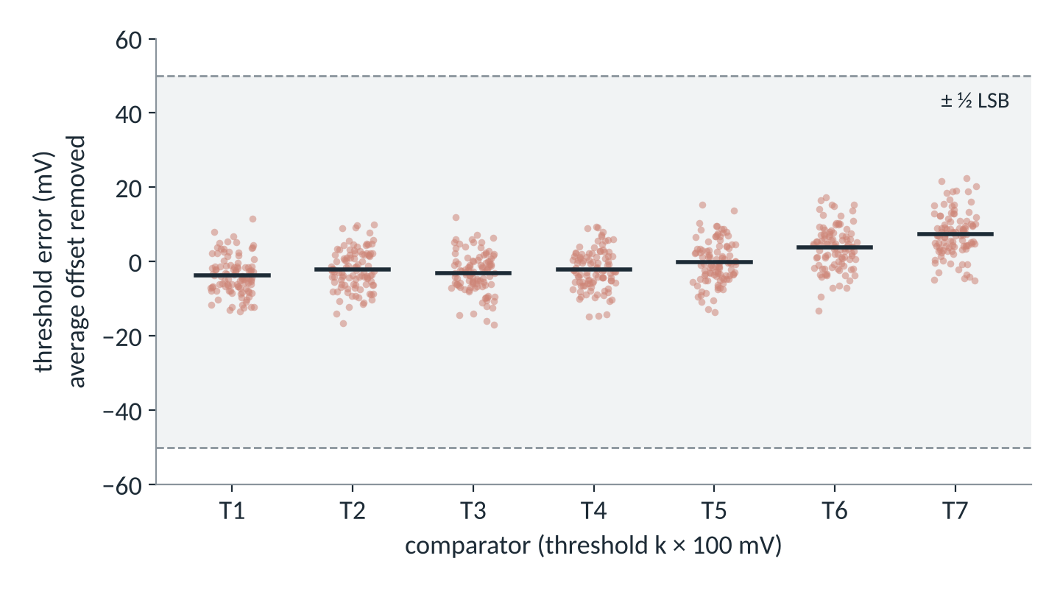
Random offset is 5.5 mV per comparator; no missing codes at 3 bits
BACKUP · FLASH MONTE CARLO (100 CHIPS)
Result | Value
Offset spread (1σ) | 5.1–6.0 mV per threshold
DNL | σ 0.078, worst 0.29 LSB
INL (offset removed) | σ 0.063, worst 0.21 LSB
Missing codes | 0 of 100 chips
Worst error after trim | 22.6 mV (< ½ LSB)
Hand estimate from transistor sizes (Pelgrom, input pair + load): 5.6 mV and DNL 0.080 LSB, within 2 % of the Monte Carlo.
sky130 tt_mm, 100 runs, DC sweep of VIN. The common offset (+51 mV, from ADJ = 0.9 V in this run) is removed.
Notes:
WHAT THIS SLIDE IS (backup): The mismatch Monte Carlo of the flash ADC you ran yourself: 100 random chips with sky130's mismatch models (tt_mm corner).
HOW TO READ THE PLOT: Each column of dots is one comparator (T1 to T7). Each dot is one chip's threshold error. The black line is the average. The grey band is +/- half an LSB (+/-50 mV). All dots are well inside it, so at 3 bits mismatch is not a problem.
THE NUMBERS:
- Each comparator's threshold varies by about 5.5 mV (1 sigma).
- DNL: step widths vary by 0.078 LSB (1 sigma), worst 0.29 LSB. No missing codes in 100 chips.
- The average threshold error in this run was +51 mV, because this testbench still had ADJ = 0.9 V. That's the trim, not mismatch; I removed it in the plot.
HAND CHECK: Pelgrom's law: sigma(Vth) = A_VT / sqrt(W x L). The input pair is 8 um x 2 um (16 um2), A_VT for the LVT PMOS is about 13.9 mV.um, so about 3.5 mV per transistor, 4.9 mV for the pair; the NMOS load adds about 2.7 mV. Combined about 5.6 mV. The Monte Carlo gave 5.5 mV. That's the "pen and paper first, simulator confirms" story.
SAR: one comparator, so its 5.5 mV offset moves all thresholds together: an offset, not DNL. I haven't run a SAR Monte Carlo yet.

Slide 20
An untrimmed flash almost always misses a code at 6 bits
BACKUP · WHAT HAPPENS AT MORE BITS
Bits | Flash comparators | Flash comparator power | SAR decisions
3 | 7 | 124 µW | 3
4 | 15 | 266 µW | 4
5 | 31 | 549 µW | 5
6 | 63 | 1.1 mW | 6
8 | 255 | 4.5 mW | 8
LSB = 800 mV / 2^bits: at 6 bits it is 12.5 mV, only about 2σ of comparator offset.
Notes:
WHAT THIS SLIDE IS (backup): Projection from the measured 5.5 mV offset to higher resolution. For each bit count I generated 50,000 random flash ADCs with independent comparator offsets and counted how many have at least one missing code.
HOW TO READ IT:
- Up to 4 bits: no missing codes.
- 5 bits (LSB 25 mV): about 2% of chips miss a code.
- 6 bits (LSB 12.5 mV): about 97% do. The LSB is now only about 2 sigma of the offset, so neighbouring thresholds often swap order.
- SAR: one comparator, its offset just shifts every code by the same amount, so no missing codes from the comparator. (CDAC mismatch would be the SAR's limit, and with 1 pF unit caps it's tiny.)
TABLE: the flash's comparator count doubles each bit (2^N - 1), and so does its static power with my comparator (18 uW each). The SAR just makes one more decision per bit.
WHY IT MATTERS FOR THE PROJECT: after 4-column shift-add the ADC needs 6 bits (slide 4). A flash there would need 63 trimmed comparators. That's the quantitative reason the chain uses a SAR.

