Slide 1
FacultyConnect AI
AI-Powered Faculty Discovery & Research Collaboration Assistant
Team Members
G.Siddhartha · P.Rajesh · Vishnu Tej · R.Mithun
Hackathon Name

Slide 2
The Problem
Students often struggle to:
Professors often struggle to:
Find faculty matching their project interests
Discover suitable project guides
Understand faculty research expertise
Identify collaboration opportunities
Keep up with emerging research trends
Discover research gaps within their department
Existing Process
Student/Professor → Manual Search → Multiple Websites → Emails → Delays
Result:
Time-consuming
Poor visibility
Missed collaboration opportunities

Slide 3
FacultyConnect AI
An AI-powered chatbot that connects students with suitable faculty members while helping professors explore research trends and collaborations.
Features
Student Mode
Find faculty by research topic
View detailed faculty profiles
Get AI-based project suggestions
Select the best project guide
Professor Mode
Discover trending research topics
Find collaboration partners
Perform research gap analysis
Explore emerging research opportunities

Slide 4
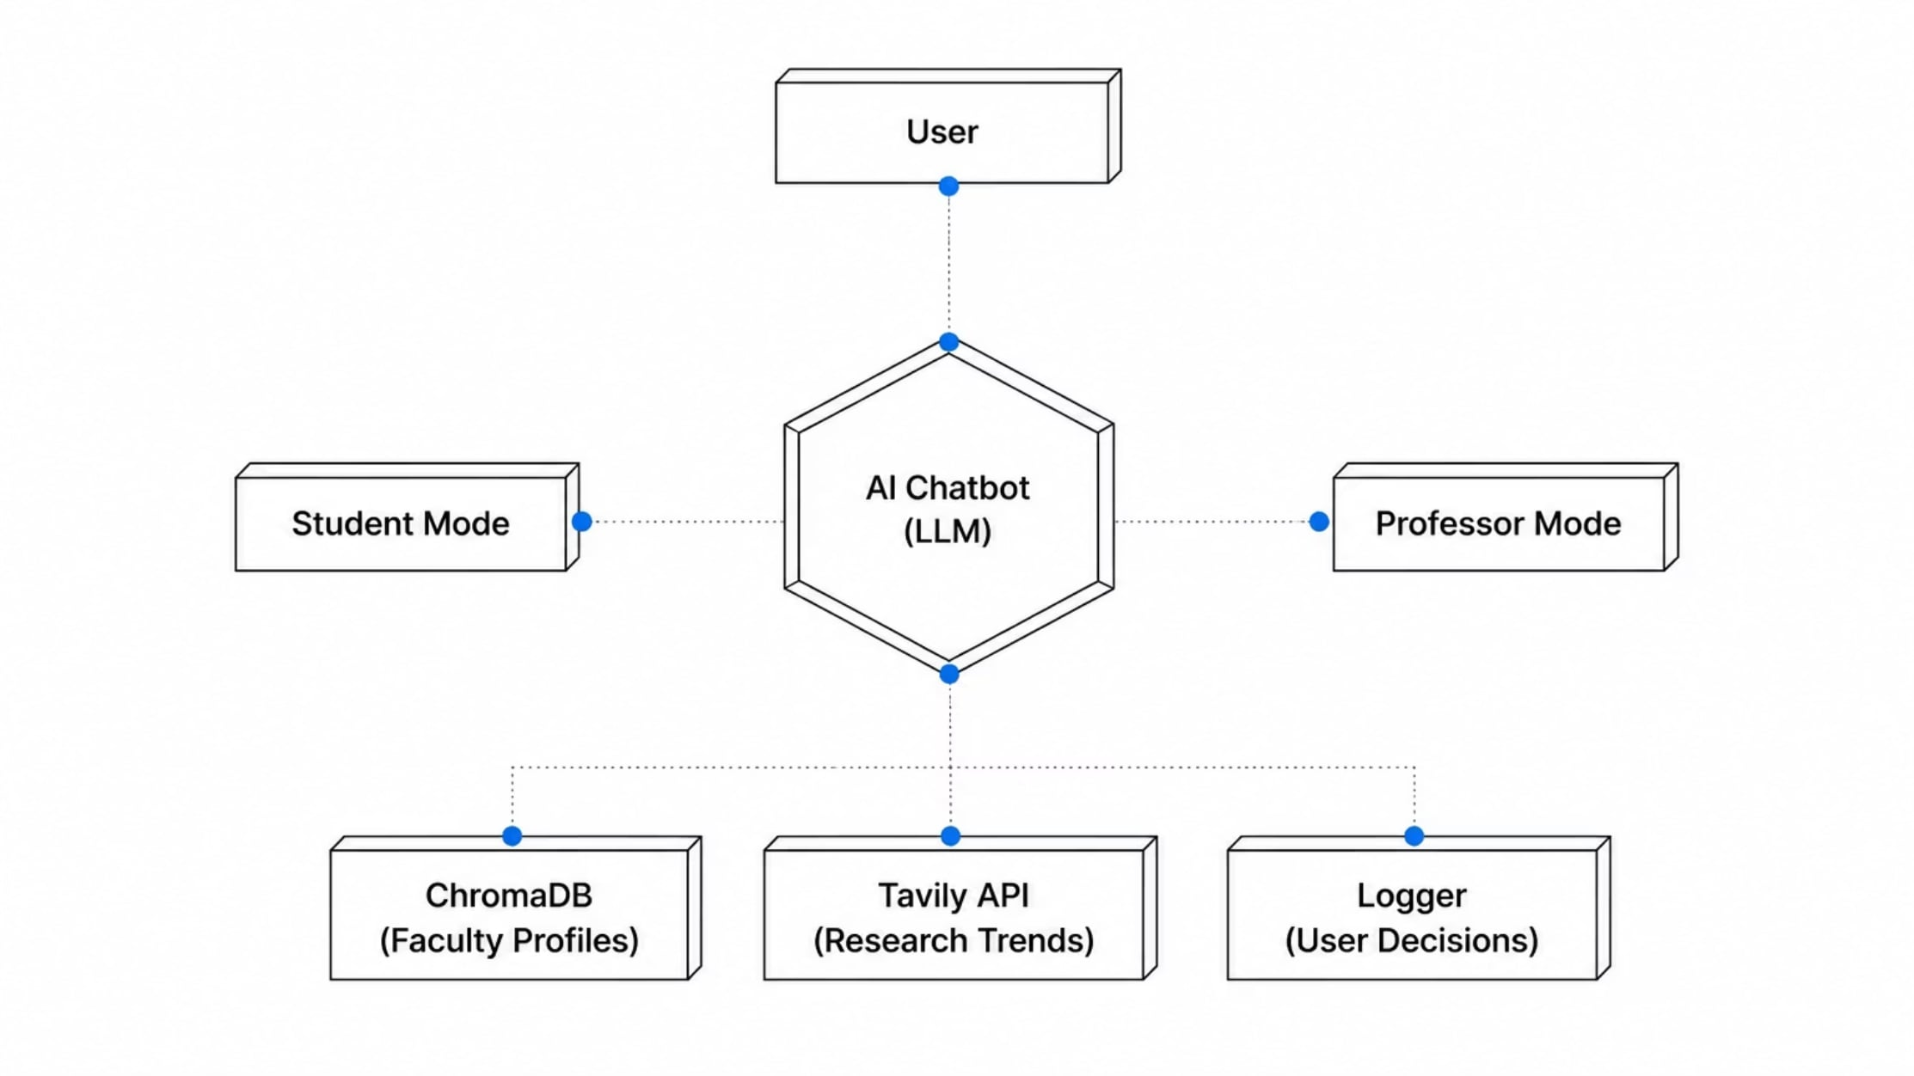
System Architecture
Technologies
Python
ChromaDB
Gemini/OpenAI
Tavily API
LangChain (optional)

Slide 5
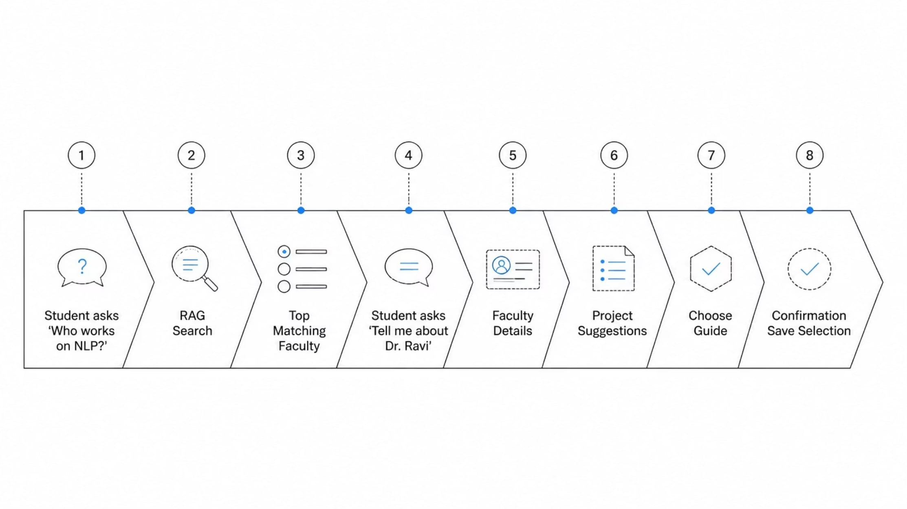
Student Workflow
Highlight:
Semantic Search
AI Recommendations
Match Scores

Slide 6
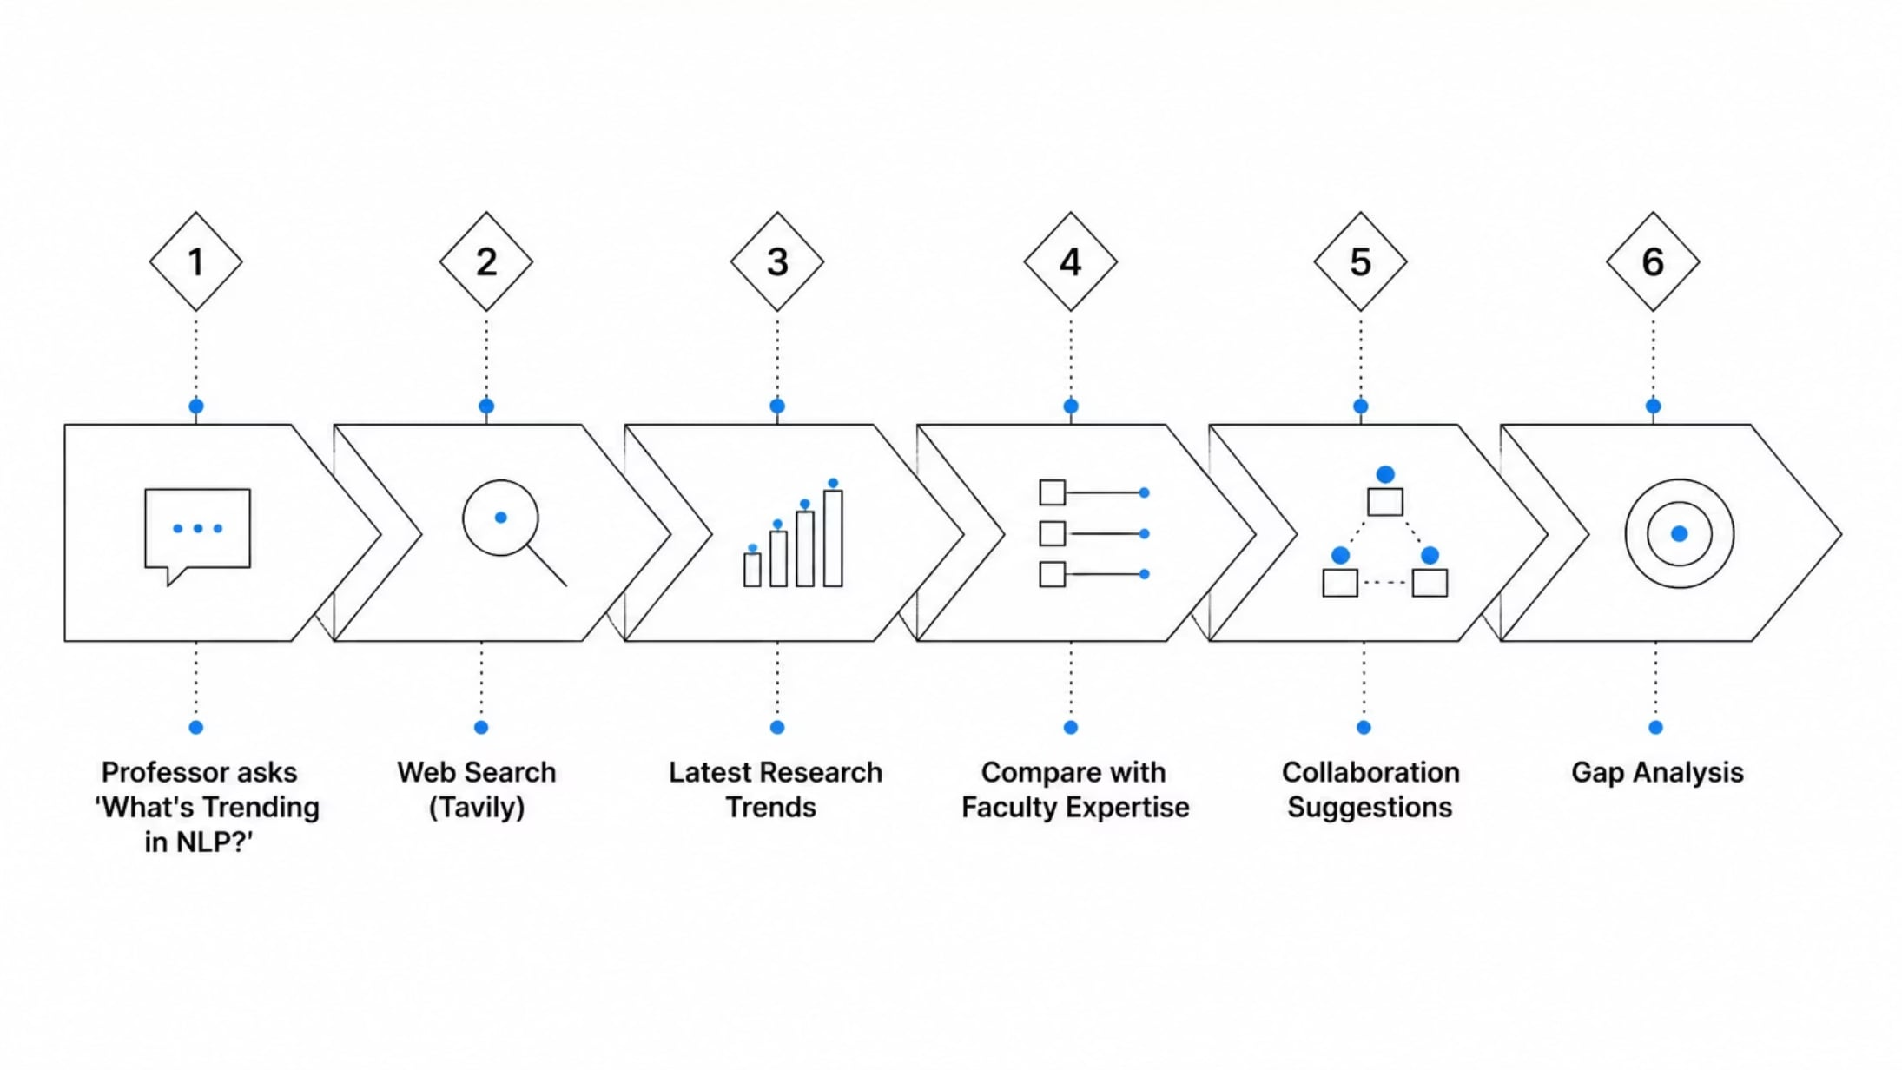
Professor Workflow
Outputs:
Current trends
Collaboration opportunities
Missing research areas

Slide 7
Key Technologies
Technology
Purpose
Python
Backend
ChromaDB
Vector Database
Embeddings
Semantic Search
Gemini/OpenAI
Natural Language Responses
Tavily API
Live Research Trends
JSON Faculty Dataset
—
Mention:
Retrieval-Augmented Generation (RAG)
Embedding-based similarity search
LLM reasoning

Slide 8
Core Features
Student Mode
Professor Mode
Faculty recommendation
Detailed faculty profiles
AI project suggestions
Confirmation before selection
Live trend analysis
Collaboration recommendations
Research gap identification
Faculty comparison

Slide 9
Innovation
Why Our Solution?
Traditional Search
FacultyConnect AI
Keyword-based
Manual browsing
Limited personalization
Semantic search
AI-powered recommendations
Live research insights
Collaboration intelligence

Slide 10
Expected Output (Screenshots)
Add screenshots of the terminal

Slide 11
Future Scope
College-wide deployment
Real faculty database integration
Streamlit/Web dashboard
Email automation
Semantic Scholar integration
Citation graph visualization
Multi-university collaboration

Slide 12
Thank You
FacultyConnect AI

