Slide 1
ANALYSIS OF RESEARCH TRENDS IN COMPUTER SCIENCE
Anirudh Nanduri (21111011)
Siddhartha (21111059)
Archi Gupta (21111014)
Nagarjun Reddy (21111031)
Akhil Ratna (180360)

Slide 2
Motivation
Analyze research trends based on the data
provided by:
Dblp
aminer citation dataset
2. Understand geographical, temporal research
trends in computer science
3. Associative rule mining of the words that occur together in
research publications
4. Correlation between co-authors of a publication
5. Analysis of phd thesis data provided by dblp
6. Prediction of Co-Authors

Slide 3
RawData
Total Research Papers
54L
Authors Per
Paper
2.82
480L
Citations
From Year
1800
To Year
2021

Slide 4
OVERVIEW (HOW?)
Data is extracted by parsing dblp.xml and DBLP-Citation-network v13 provided by aminer.
Data is preprocessed to remove stop words, converted to tokens, lemmatized.
For finding associative rules fp-tree algorithm is used
K-means clustering algorithm is used for clustering phd thesis titles and LDA algorithm is used for topic modelling.
Prediction of Co-Authors was done using link prediction techniques like Jaccard Index, Adamic/Adar Index.
All the results are plotted using wordclouds, barcharts, line charts, heatmaps etc.

Slide 5
Geographical and Temporal Trends

Slide 6
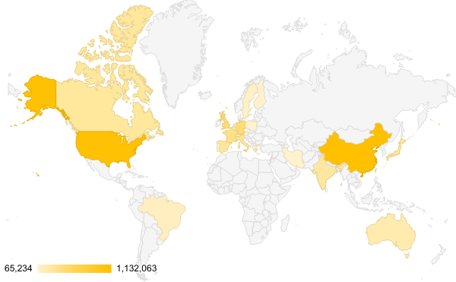
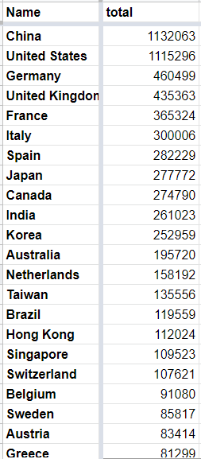
Research Activity Across the Globe
Top 25 Countries
Criteria: Paper Count

Slide 7
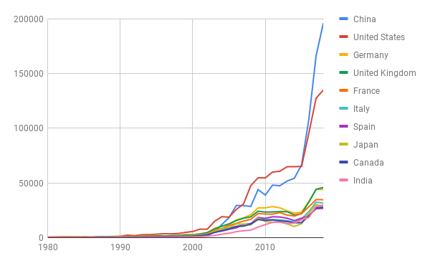
Research Activity with Years
Criteria: # Research Papers

Slide 8
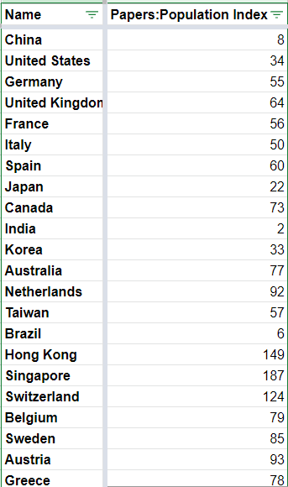
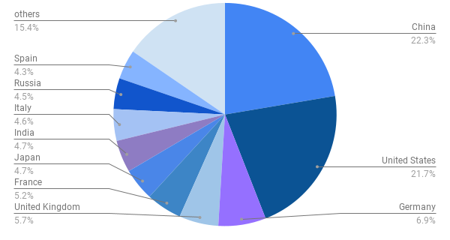
Paper : Population Index
Research activity across geography taking Population into account

Slide 9
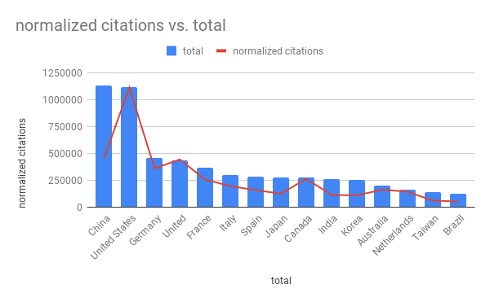
Total papers vs Citations

Slide 10
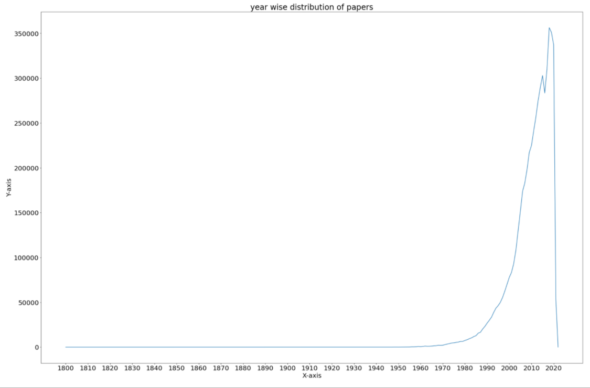
YEAR WISE DISTRIBUTION OF PAPERS
We have witnessed highest number of papers published in between years 2010 and 2020

Slide 11
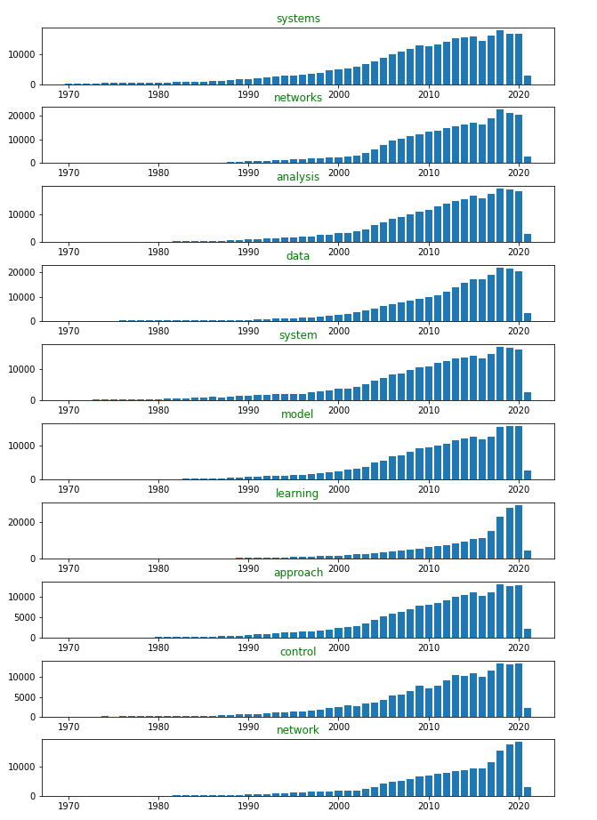
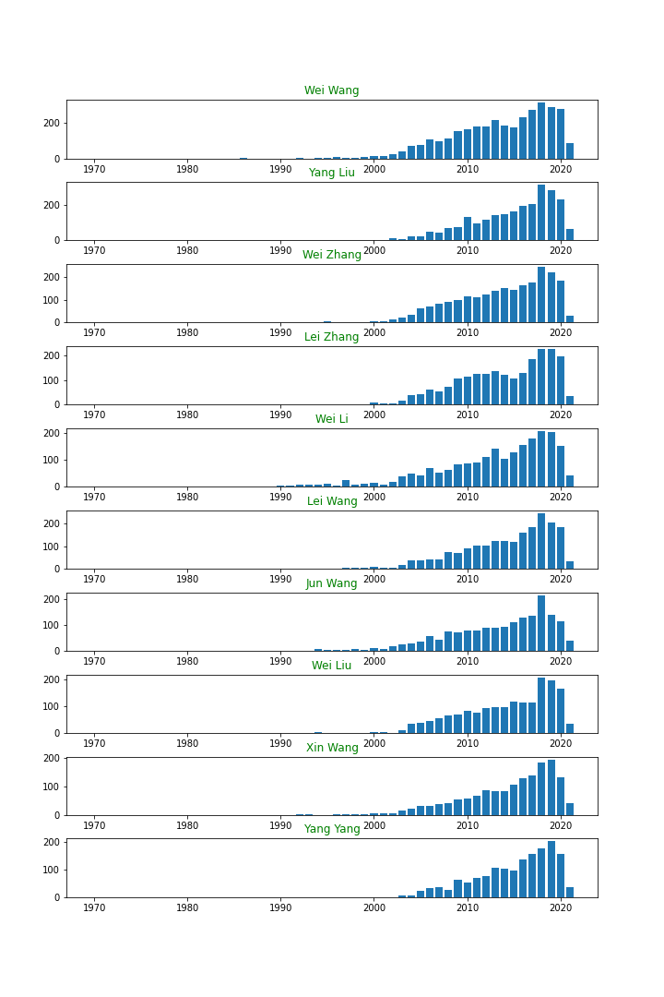
YEAR WISE DISTRIBUTION OF TITLE WORDS AND AUTHOR PUBLICATIONS
YEAR WISE DISTRIBUTION OF AUTHOR PUBLICATIONS
YEAR WISE DISTRIBUTION OF MOST FREQUENT TITLE WORDS

Slide 12
TOPIC MODELLING OF PUBLICATIONS
Publication data (title, keywords, field of study, abstract) is vectorized using tf-idf.
Topics are extracted using LDA(Latent Dirichlet Allocation) algorithm for every 20 years starting from 1961 to get the trends.

Slide 13
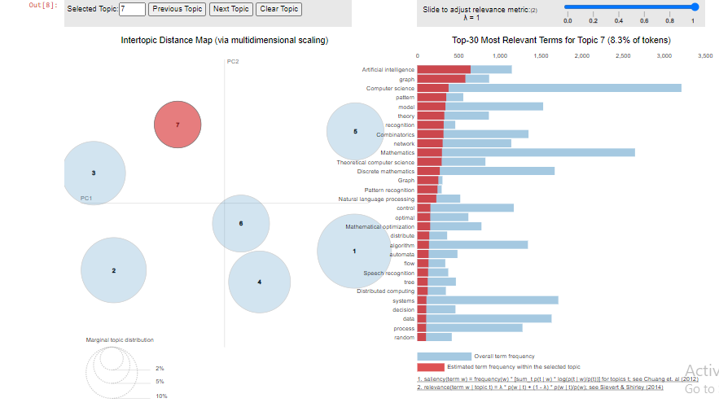

Slide 14
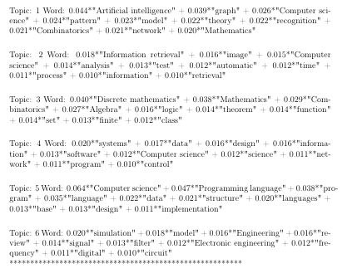

Slide 15
ANALYSIS OF PHD THESIS TITLES
Top 15 universities having maximum phd thesis titles on dblp website
Temporal count of phd thesis titles

Slide 16
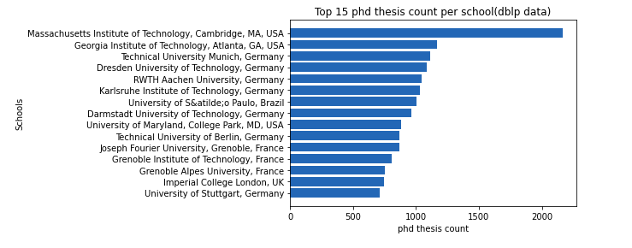
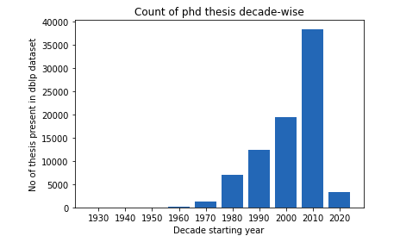

Slide 17
CLUSTERING OF PHD THESIS TITLES
K-means clustering algorithm to cluster phd thesis titles.
Thesis titles are vectorized using tf-idf.

Slide 18
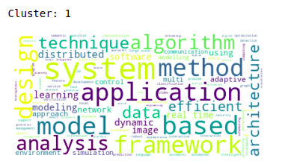
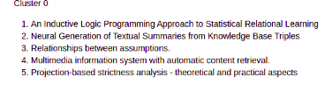
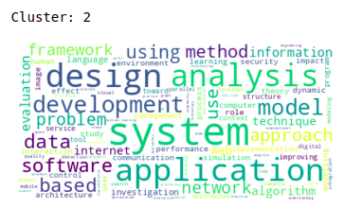
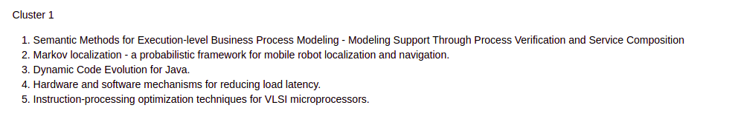

Slide 19
ASSOCIATION RULE MINING
OF TITLE WORDS!

Slide 20
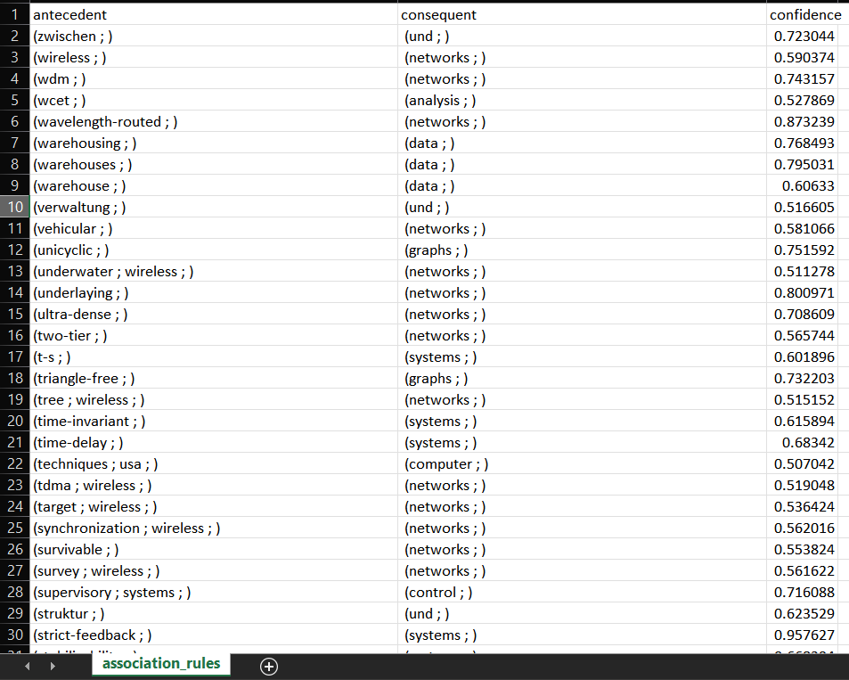
The titles of each publication were treated as transactions.
The words in each title were treated as items.
FP Growth algorithm was used for mining the frequent patterns.
A min support of 100/(number of transactions) and a min confidence of 0.55 was used to obtain the association rules.

Slide 21
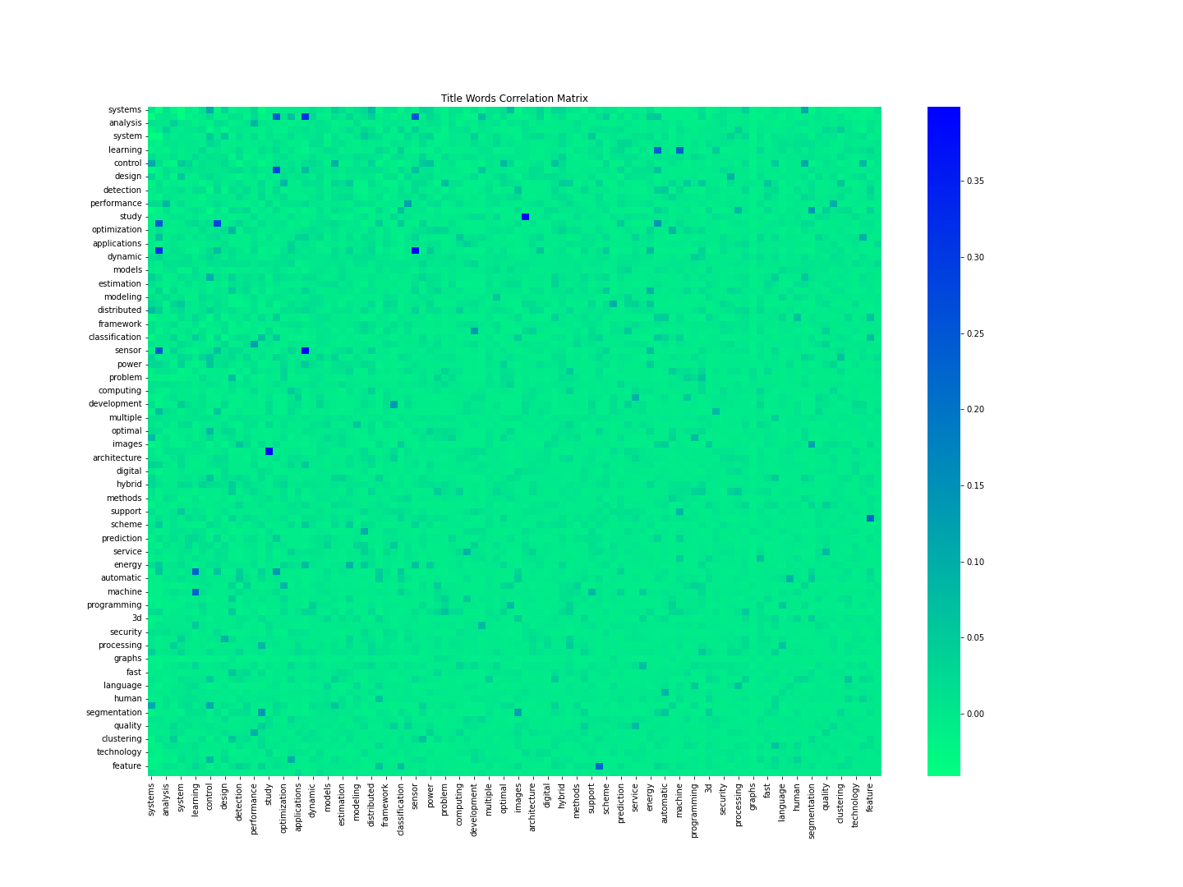
CORRELATIONS
The correlations were found out between some of the most frequent words of the publication titles.
The correlations were also found out between authors
Phi Correlation Coefficient was used to find the correlations.
The correlation matrix was plotted in the form of heatmap

Slide 22
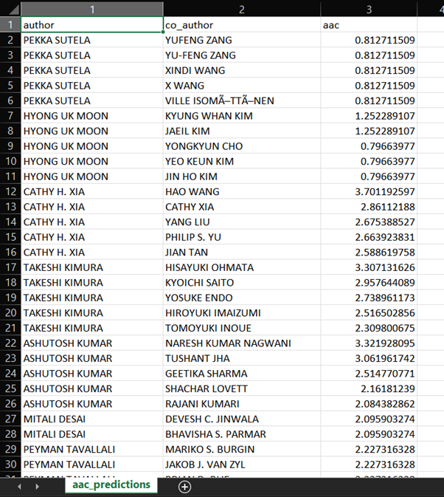
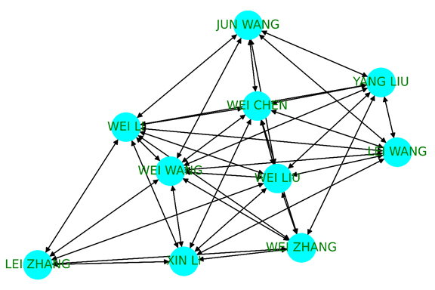
PREDICTION OF CO-AUTHORS
A network was created with authors as nodes and edges between the authors who have worked together on any publications.
Link Prediction Methods have been used to predict the possible co-authors for any author in the network.
The methods used were Jaccard Coefficient, Adamic/Adar Index.

Slide 23
THANK YOU!

