Slide 1

House Price Prediction
Department of Computer Science and Engineering

Slide 2
Objective/Motivation
The objective of this project is to develop a machine learning model capable of accurately predicting house prices based on key property features. This model will take into account various factors such as the location of the property, size, number of rooms, and additional amenities to provide a reliable price estimate.
Key Features of the Project:
Predict house prices using features like location, size (square footage), number of rooms, and other amenities.
The model is designed to improve with more data, making it adaptable to different markets and conditions.

Slide 3

PROBLEM STATEMENT
The Challenge:
Estimating the correct price of a property is often a challenging task for buyers, sellers, and real estate agents.
House prices are influenced by a variety of factors, such as:
Location: Proximity to schools, amenities, public transport, and crime rates can significantly impact a property’s value.
Size: Larger properties tend to have higher prices, but this varies based on location and demand.
Number of Rooms: The number of bedrooms, bathrooms, and additional living spaces affects the price.
Market Trends: Housing market trends, such as supply and demand, can lead to rapid price fluctuations.
Solution:
A machine learning model can provide a more objective, data-driven approach to predicting house prices, reducing human bias and improving accuracy.
With a reliable model, users can make faster, more informed decisions based on data, allowing for better pricing strategies in buying and selling properties.

Slide 4




TECHNOLOGIES USED
Python Language
Jupyter Notebook
NumPY
Pandas

Slide 5
IMPLEMENTATION TECHNOLOGIES
Processor speed - 233 MHz or above
RAM - 8 GB
Monitor - Standard color Monitor
Hard disk - 256 GB
Keyboard -108 keys keyboard
Operating System – Windows 7/10/11
Jupyter Notebook,
Numpy , Pandas , Matplotlib ,Scikit-Learn

Slide 6

“House Price Prediction”
The House Price Prediction project is a machine learning-based application designed to estimate property prices using historical data. Built with Python, the model analyzes various features such as location, area, number of rooms, and other relevant factors to predict the selling price of a house. The project utilizes key machine learning techniques and libraries like Pandas, Scikit-learn, and Matplotlib to process the data and visualize the results.

Slide 7
Data Collection
The dataset was sourced from Kaggle that contain historical house prices and property features.
Challenges in Data Collection:
Missing values for some properties (e.g., incomplete records of property features).
Variation in property sizes and room counts depending on location.
Purpose of the Data:
The data provides historical information on house prices, which is crucial for training the machine learning model. By analyzing the relationship between property features and their respective prices, the model can learn to predict prices for new, unseen properties.

Slide 8
Data Preprocessing
Data preprocessing is a critical step in preparing raw data for training the machine learning model. This ensures that the model can interpret the data correctly and make accurate predictions.
Handling Missing Data:
Some properties had missing values for certain features (e.g., number of bedrooms, year built).
Solution: Missing numerical values were filled using mean or median imputation. Categorical variables (e.g., missing location) were filled with the most frequent value in the dataset.

Slide 9
Exploratory Data Analysis (EDA)
Purpose of EDA: The goal of Exploratory Data Analysis (EDA) is to uncover insights and patterns in the data, which help guide model development. Understanding relationships between features and target variables (house prices) is key to building an effective prediction model.
Visualizations:
Scatter Plot: Displayed the relationship between property size and house price, showing a positive trend where larger properties tend to be more expensive.
Correlation Heatmap: Highlighted the strength of relationships between numerical features and house price, showing which features were the most influential.

Slide 10
Machine Learning Model
Chosen Algorithm: Linear Regression
Linear Regression is ideal for predicting continuous values, such as house prices.
It’s simple, interpretable, and performs well when the relationship between features and the target variable is linear.
Linear regression provides insights into how each feature (e.g., property size, location) contributes to the house price.

Slide 11
Testing and Validation
Model Training:
The dataset was split into:
Training set (80%): Used to train the model to learn the relationship between features and house price.
Testing set (20%): Used to evaluate how well the model generalizes to unseen data.
Performance on Test Data:
After cross-validation, the model was tested on a separate test set (20% of the data).
The results from the test set provided a good indication of how the model would perform on real-world data.

Slide 12
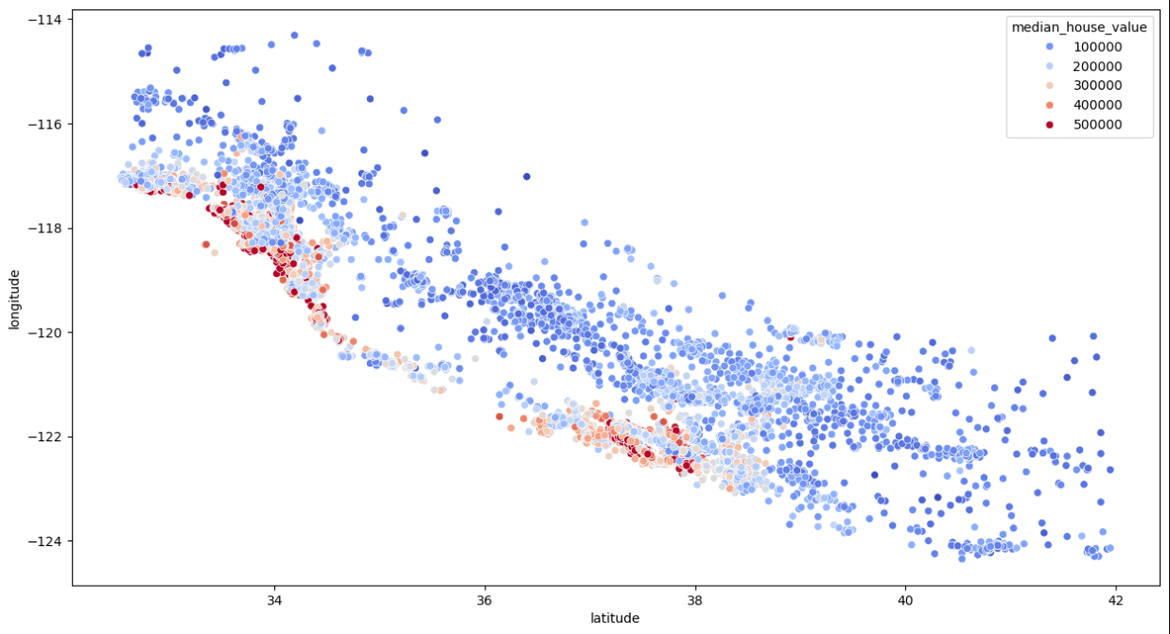
Implementation and Result

Slide 13
Conclusion
Objective Achieved: Developed a machine learning model using linear regression to predict house prices based on property features such as location, size, and number of rooms.
Key Takeaways:
Machine learning can provide a data-driven approach to predicting house prices, replacing manual or subjective appraisals.
The model is scalable and can be improved with more data and advanced algorithms.
Future Improvements:
Implementing more advanced machine learning techniques, such as Random Forest or Gradient Boosting, could improve accuracy.
Adding additional features, such as market trends, crime rates, or school quality, could further enhance the model’s predictive power.
Expanding the system to predict multi-year trends or future house prices based on economic factors.

Slide 14
THANK YOU
HOUSE PRICE PREDICTION
BY
SIDDHARTHA A501132522011

