Slide 1

DESIGN OF MACHINE ELEMENTS PROJECT
Group members:
Siddhartha Prasad -210030033
Swapnesh Sinha – 210030036
Thota Maniram – 210030041
Pranam Chandra Shibaroor - 200030043

Slide 2

AIM OF THE PROJECT
With the structure of our choice, been applied with a range of loads, we are Analyzing factor of safety and damage upon its life as well as predicting the fatigue life with the help of deep learning.

Slide 3
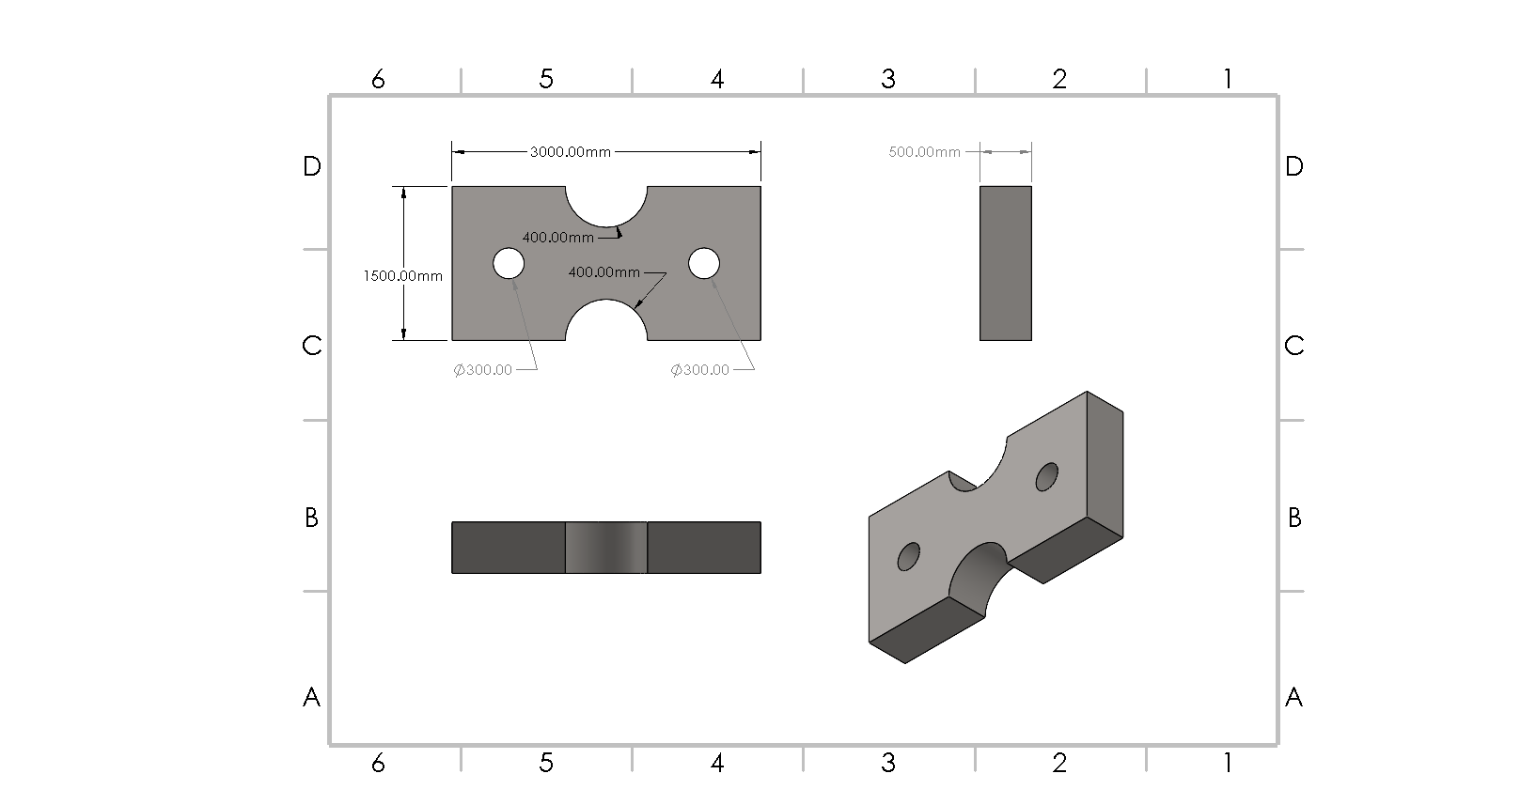
WHAT IS THE STRUCTURE?
Notes:
Structure – Solid works

Slide 4
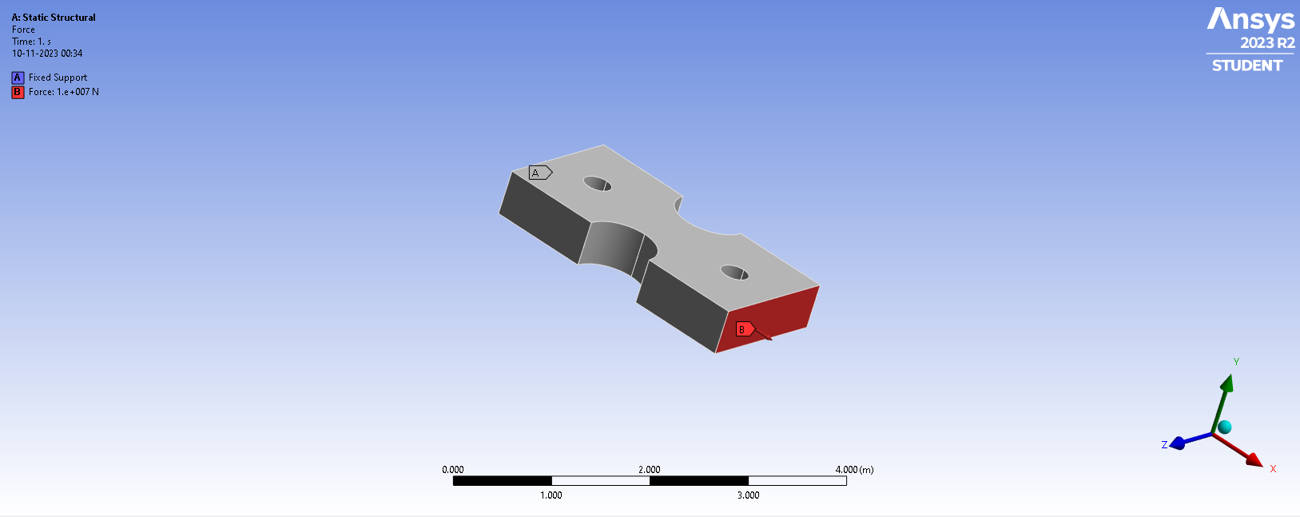
WHAT IS THE STRUCTURE?
Notes:
Structure – Solid works

Slide 5
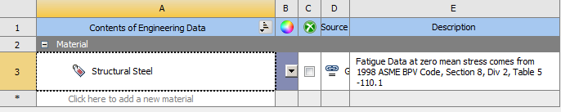
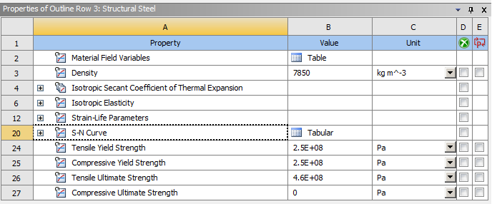
WHAT IS THE STRUCTURE?
Material – MILD STEEL
Material PROPERTIES:
Notes:
Ansys

Slide 6
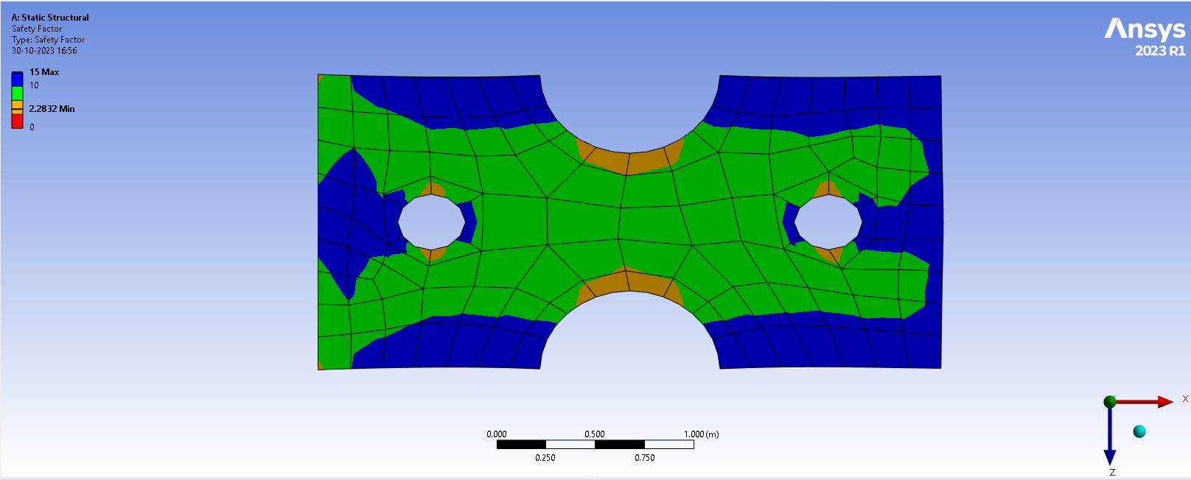
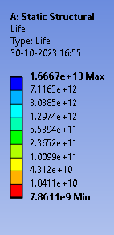
FACTOR OF SAFETY ANALYSIS

Slide 7
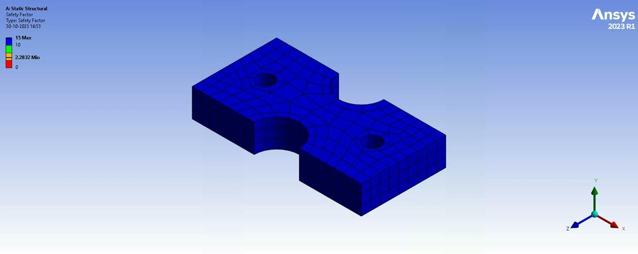
FACTOR OF SAFETY ANALYSIS

Slide 8
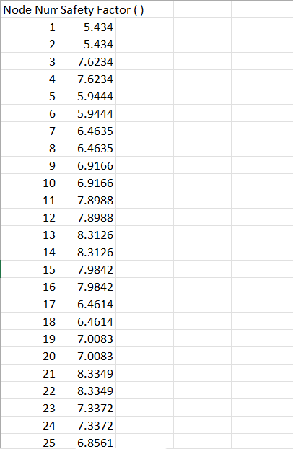
FACTOR OF SAFETY ANALYSIS

Slide 9
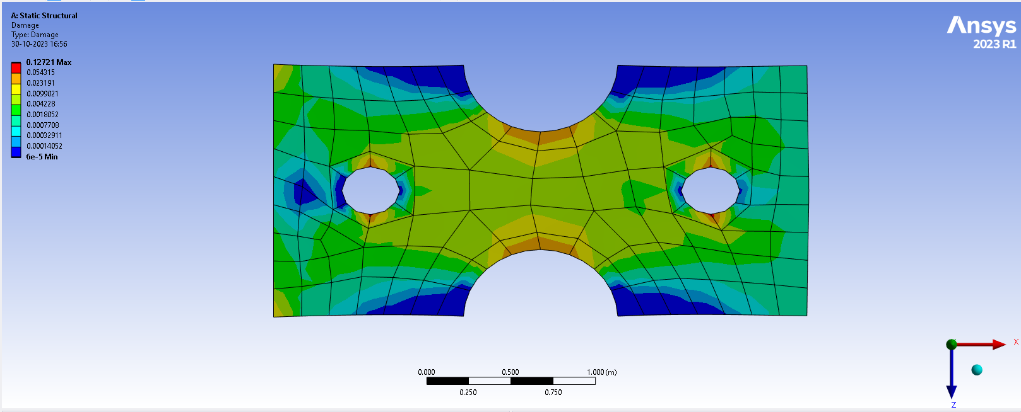
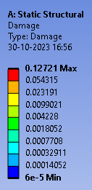
DAMAGE UPON THE STRUCTURE

Slide 10
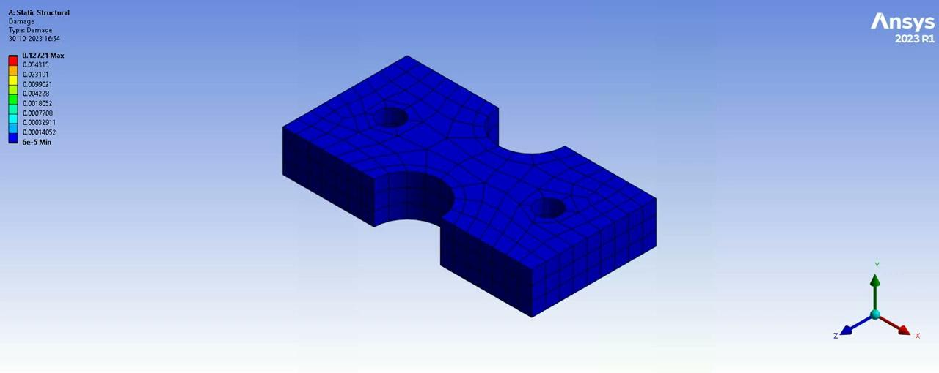
DAMAGE UPON THE STRUCTURE

Slide 11
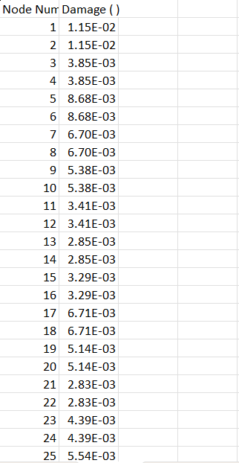
DAMAGE UPON THE STRUCTURE

Slide 12

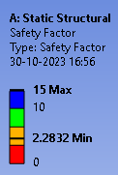
FATIGUE LIFE

Slide 13
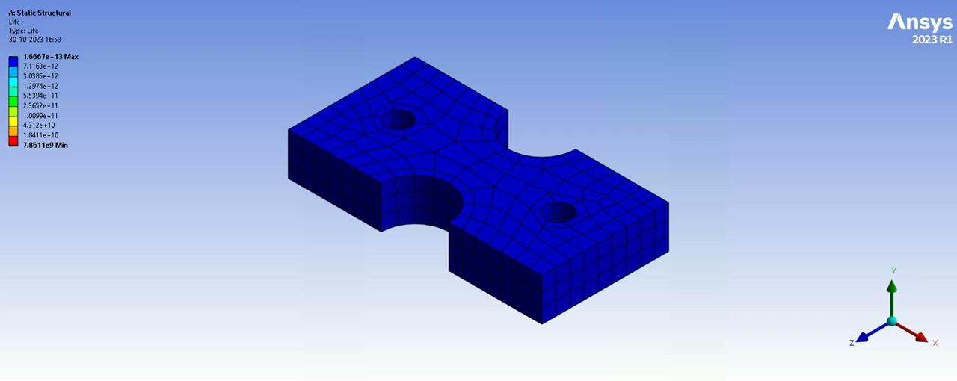
FATIGUE LIFE

Slide 14
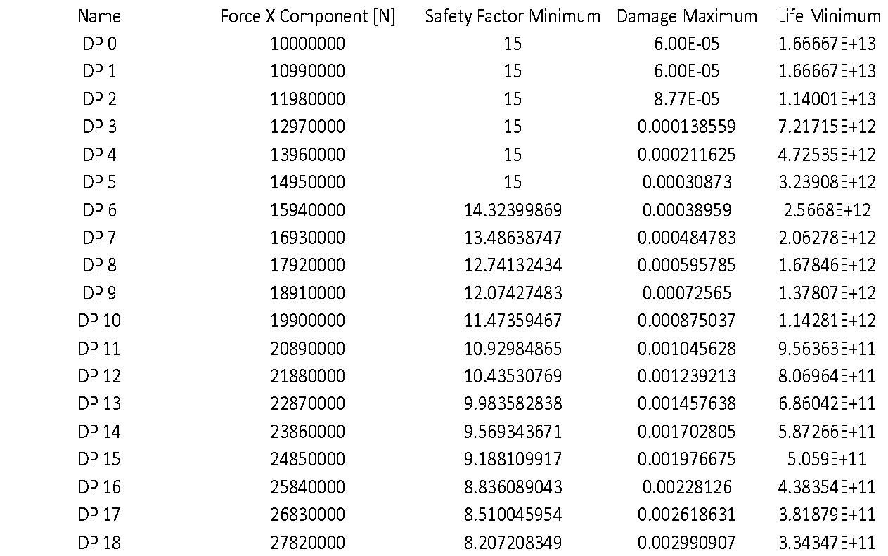
FATIGUE LIFE

Slide 15
FATIGUE LIFE PREDICTION
USING DEEP LEARNING
Training code: https://colab.research.google.com/drive/1UA4OvC56gpr016dVZQaJPqDG8BFQfKnl?usp=sharing

Slide 16
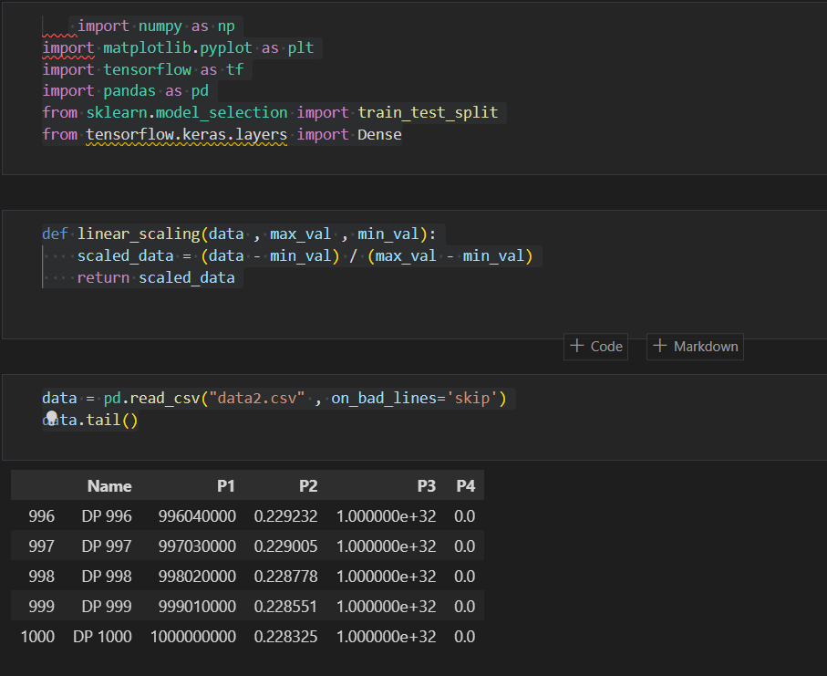
Deep Learning code

Slide 17
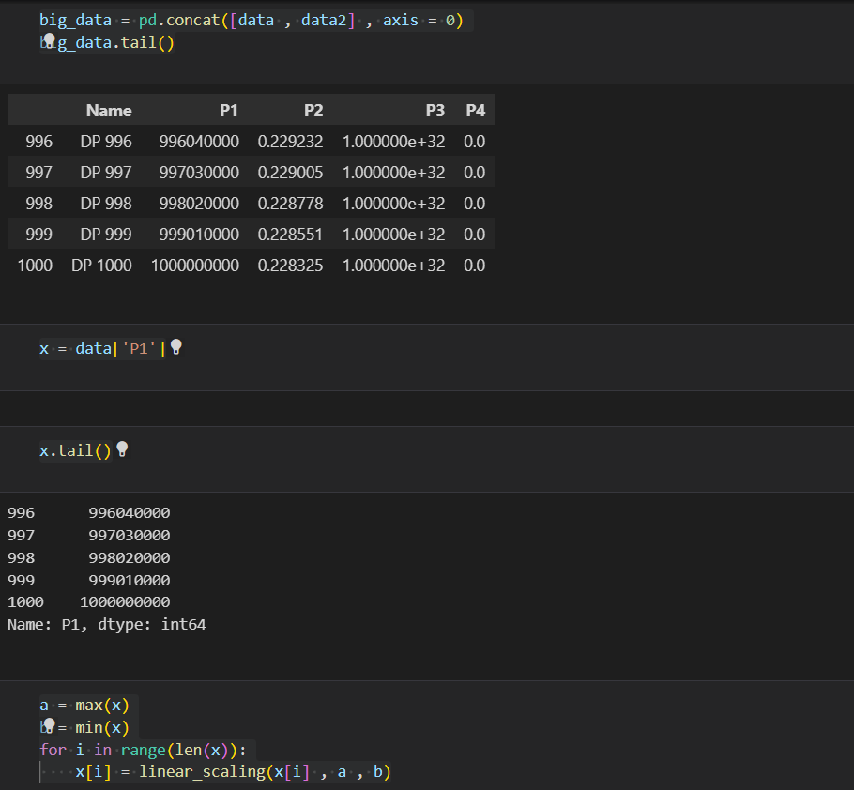
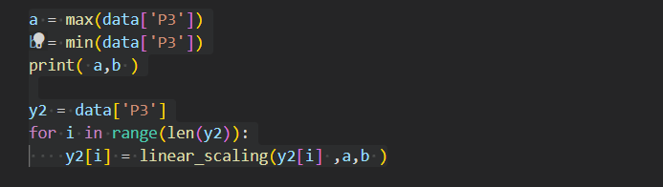

Slide 20
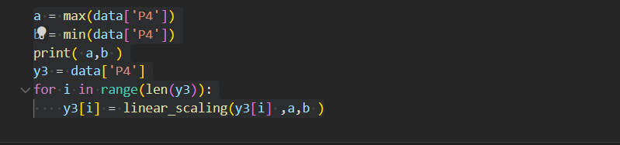
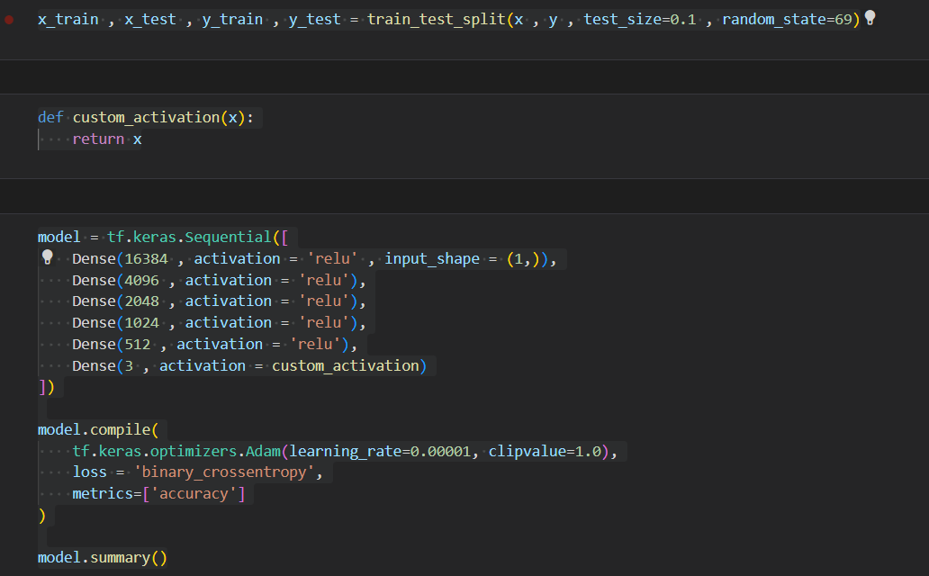

Slide 21
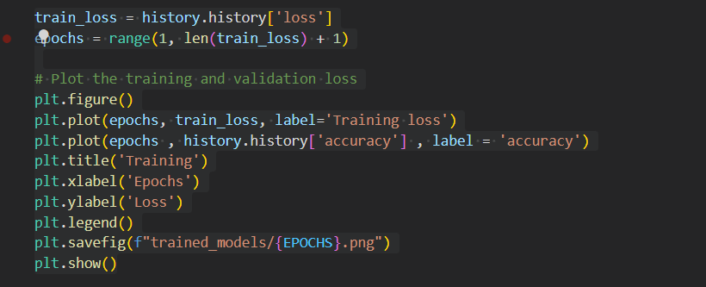
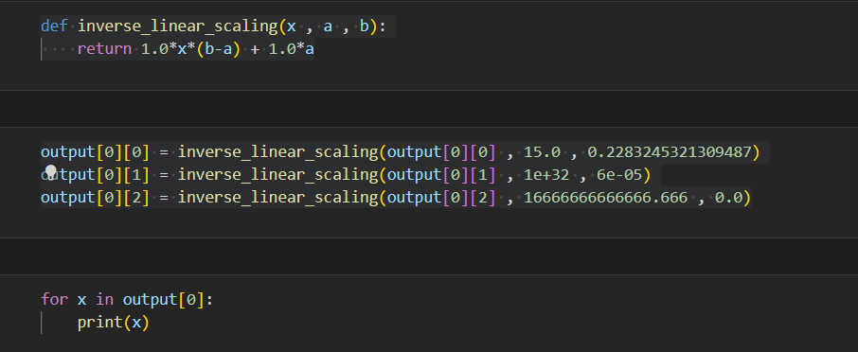

Slide 22
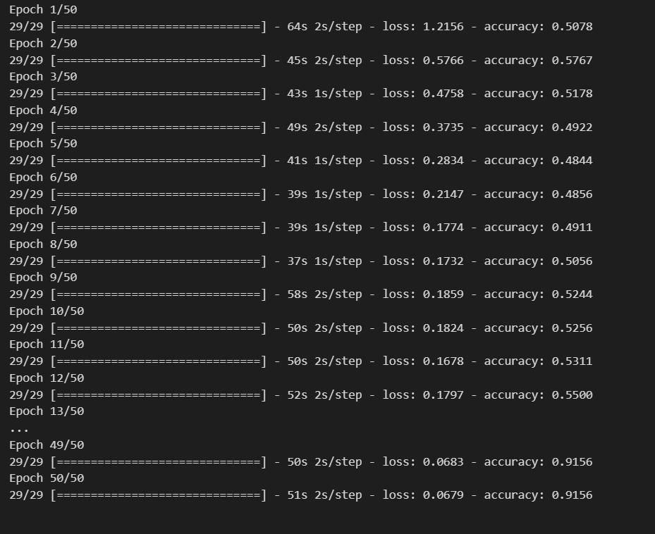
Code generated accuracy and loss
An accuracy of 91.56% is obtained by using the model

Slide 23
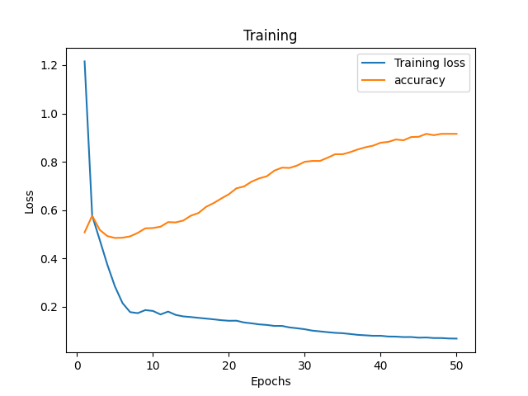
Loss and Accuracy plot

Slide 24
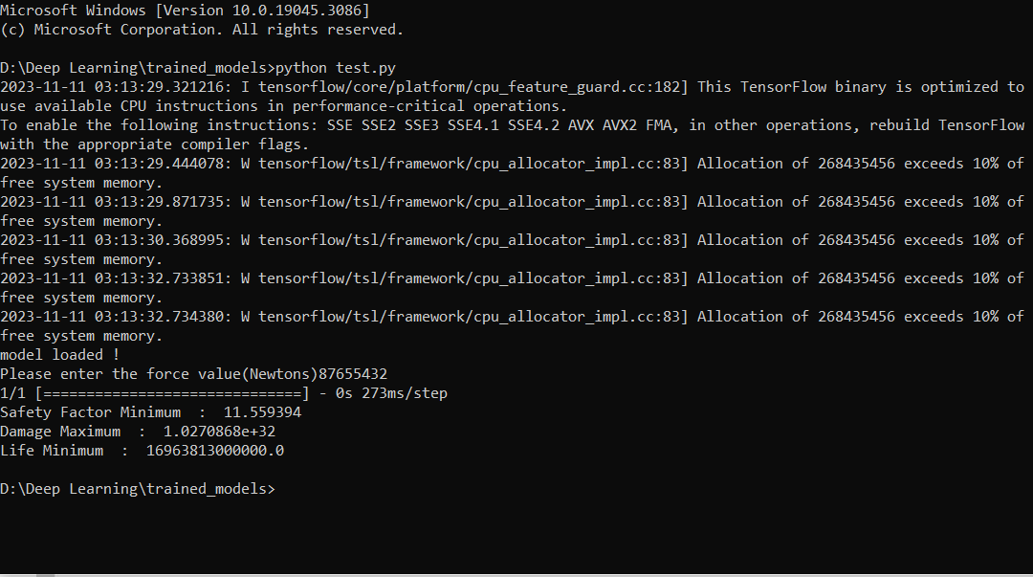
Sample Results

Slide 25
THANK YOU!!

