Slide 1
Linear Regression

Slide 2
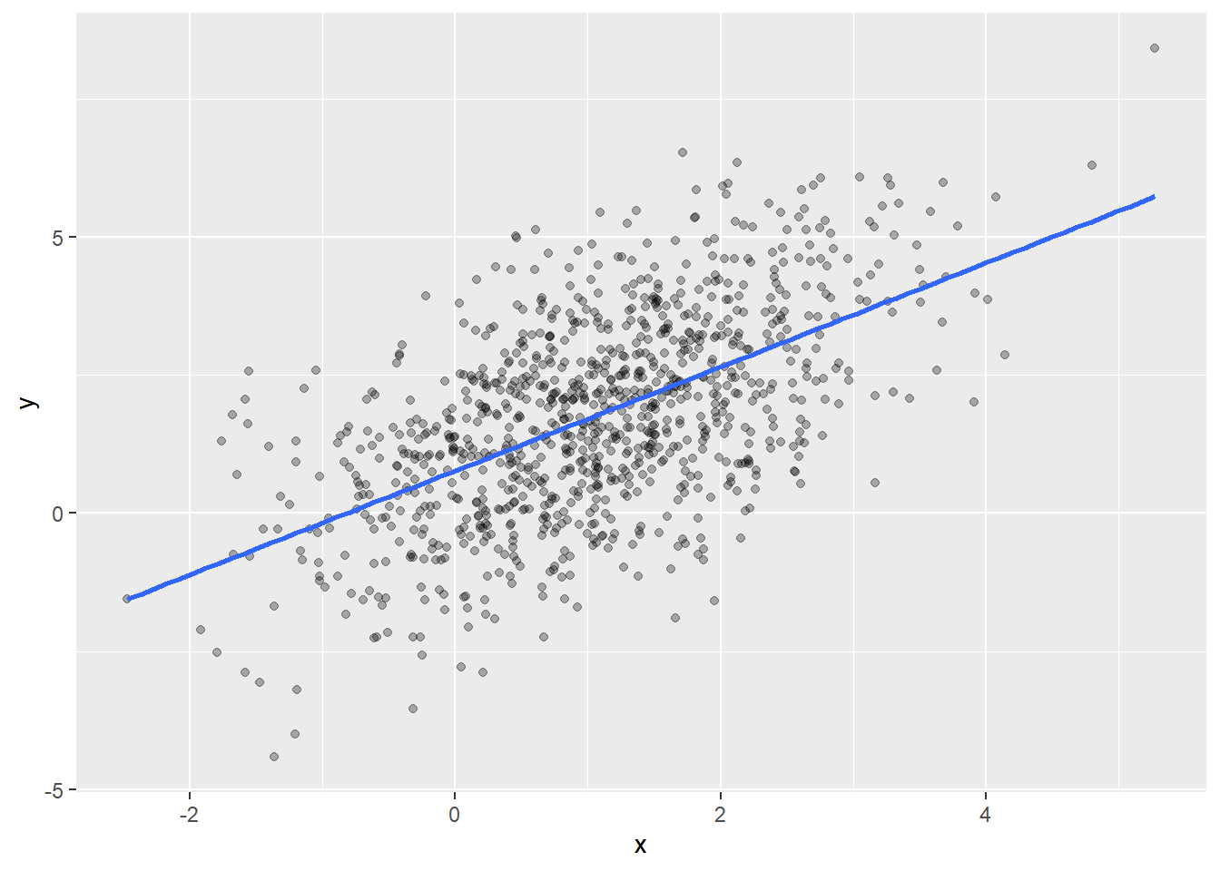
This Photo by Unknown Author is licensed under CC BY

Slide 3
Theory

Slide 4
Independent variable:
A variable whose value is not impacted by any other variable
This variable is often denoted by ‘X’
Dependent variable:
A variable whose value changes when there is a change occurred in Independent variable(s)
This variable is usually denoted by letter ‘y’

Slide 5
Linear Regression:
It is a linear model that computes the relation between independent variables and dependent variable
Takes benefit of constants : slope (m) and intercepts (c)
Relationship can be defined using the formula : y = m.x + c
During training, model considers the values of slope and intercept with an aim of minimizing the cost function

Slide 6
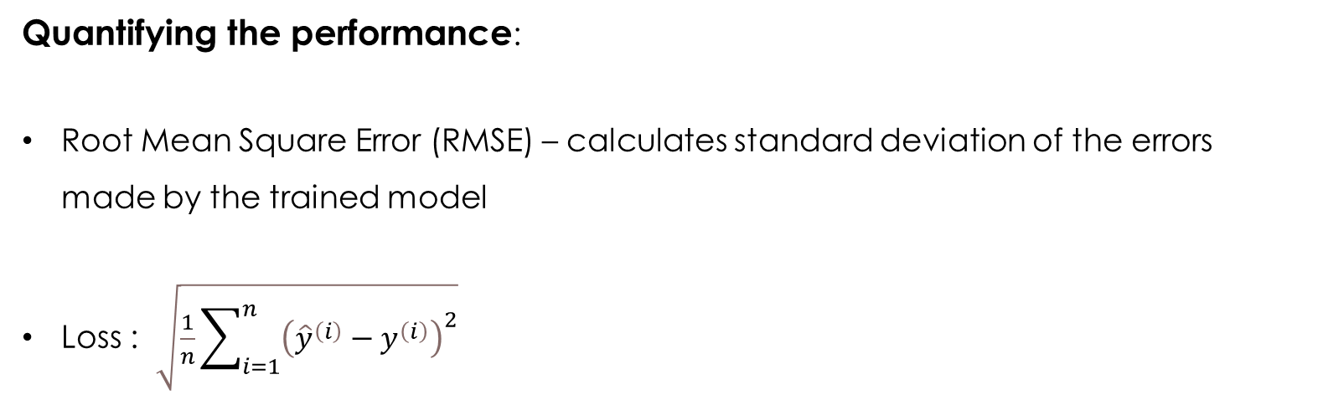
Assumptions:
Relationship between dependent and independent variables is linear in nature
Observations are independent of each other
The independent variables are not too highly correlated with each other
Quantifying the performance:
Root Mean Square Error (RMSE) – calculates standard deviation of the errors made by the trained model
Loss : $\sqrt{\frac{1}{n}\sum_{i=1}^{n}{{\left({\hat{y}}^{\left(i\right)}−y^{\left(i\right)}\right)}^{2}}}$

Slide 7
Libraries and Functions

Slide 8
Importing from package:
from sklearn.linear_model import LinearRegression
Instantiation:
regressor = LinearRegression()
regressor.fit(X_train, y_train)
Prediction and evaluation:
y_pred = regressor.predict(X_test)
from sklearn.metrics import mean_squared_error
sqrt(mean_squared_error(y_test, y_pred))

Slide 9
Applications

Slide 10
When to use:
Sales forecasting
Predicting optimum product prices
Quantifying the causal relationship between event and response
Clinical drug trails
Engineering safety tests
Marketing research
Identifying patterns to forecast future behaviour
predicting insurance claims
natural disaster damage
Election results
Crime rates

Slide 11
Weakness

Slide 12
Limitations:
Only works with numerical features
Categorical data needs to be pre-processed
Doesn’t cope up well with the missing data
It makes assumptions about the data

Slide 13
Optimization and Other formats

Slide 14
Regression tree algorithm:
Subset of Decision Tree algorithm used in the context of predicting a continuous valued output
Utilizes measures like Mean Squared Error to minimize the distance between the actual value and the predicted continuous values
Instantiation:
from sklearn.tree import DecisionTreeRegressor
regressor = DecisionTreeRegressor(max_depth = 3)
regressor.fit(X_train, y_train)
Predicition and evaluation:
y_pred = regressor.predict(X_test)
from sklearn.metrics import mean_squared_error
from math import sqrt
sqrt(mean_squared_error(y_test, y_pred))

Slide 15
Gradient boost regression algorithm:
Uses ensemble of decision trees to formulate underlying patterns within a dataset
The core idea is to operate by forming a team of decision trees, where each of the member progressively learns from the mistakes of its predecessors
In essence, each subsequent decision tree in the sequence attempts to correct the prediction errors made by the tree before it -> leading to an ‘ensemble’ that makes a final prediction based on the collective wisdom of all the individual trees
Handles wide spectrum of data while being resistant to overfitting

