Slide 1
Logistic Regression

Slide 2
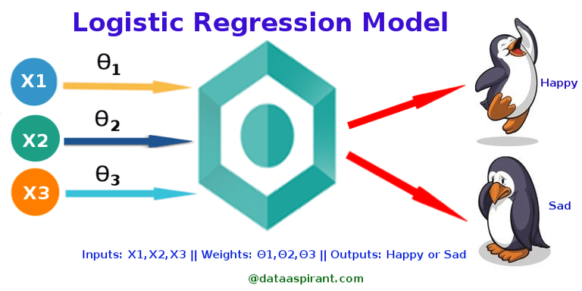
This Photo by Unknown Author is licensed under CC BY-SA

Slide 3
Theory

Slide 4
Logistic Regression:
It is a classification algorithm used for binary classifications -> 2 outputs
Uses a logistic function to formulate the interaction between the input features and the label
One of the simplest classification techniques used to model a binary dependent variable

Slide 5
Assumptions:
No missing values in training dataset
The label is binary category variable
The label is ordinal – a categorical variable with ordered values
All features or input variables are independent of each other

Slide 6

Establishing the relationship and properties:
$∅(a)=1/{(1+ e^{−a})}$
0 < $∅(a)$ < 1 : probability -> useful in binary classification
$∅\left(−a\right)=1 −∅(a)$ : Symmetry
$\frac{d ∅(a)}{dx}=∅\left(a\right) .∅\left(−a\right)$  (0, 1) -> widely used in NN

Slide 7
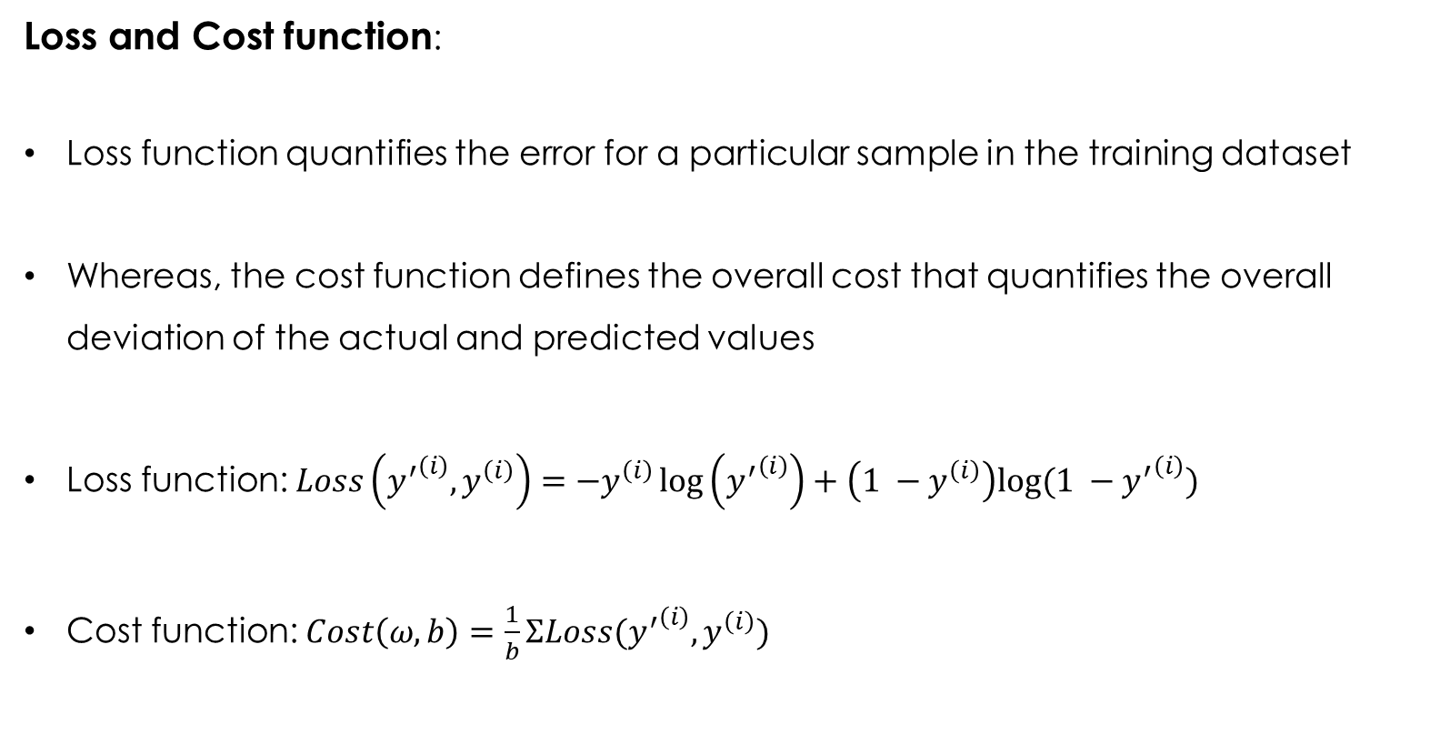
Loss and Cost function:
Loss function quantifies the error for a particular sample in the training dataset
Whereas, the cost function defines the overall cost that quantifies the overall deviation of the actual and predicted values
Loss function: $Loss\left({y^{′}}^{\left(i\right)},y^{\left(i\right)}\right)=−y^{\left(i\right)}\log\left({y^{′}}^{\left(i\right)}\right)+\left(1 −y^{\left(i\right)}\right)log⁡(1 −{y^{′}}^{\left(i\right)})$
Cost function: $Cost\left(ω,b\right)=\frac{1}{b}ΣLoss({y^{′}}^{\left(i\right)},y^{\left(i\right)})$

Slide 8
Loss and Cost function:
Loss function quantifies the error for a particular sample in the training dataset
Whereas, the cost function defines the overall cost that quantifies the overall deviation of the actual and predicted values
Loss function: $Loss\left({y^{′}}^{\left(i\right)},y^{\left(i\right)}\right)=−y^{\left(i\right)}\log\left({y^{′}}^{\left(i\right)}\right)+\left(1 −y^{\left(i\right)}\right)log⁡(1 −{y^{′}}^{\left(i\right)})$
Cost function: $Cost\left(ω,b\right)=\frac{1}{b}ΣLoss({y^{′}}^{\left(i\right)},y^{\left(i\right)})$

Slide 9
Libraries and Functions

Slide 10
Importing from package:
from sklearn.linear_model import LogisticRegression
Instantiation:
regressor = LogisticRegression(random_state = 0)
regressor.fit(X_train, y_train)
Prediction and evaluation:
y_pred = regressor.predict(X_test)
cm = metrics.confusion_matrix(y_test, y_pred)

Slide 11
Applications and Limitations

Slide 12
When to use:
Tasks with Binary classification
Limitations:
May struggle with dataset with low quality
It can fall short when dealing with non-linear relationships

Slide 13
Evaluation Metrics

Slide 14

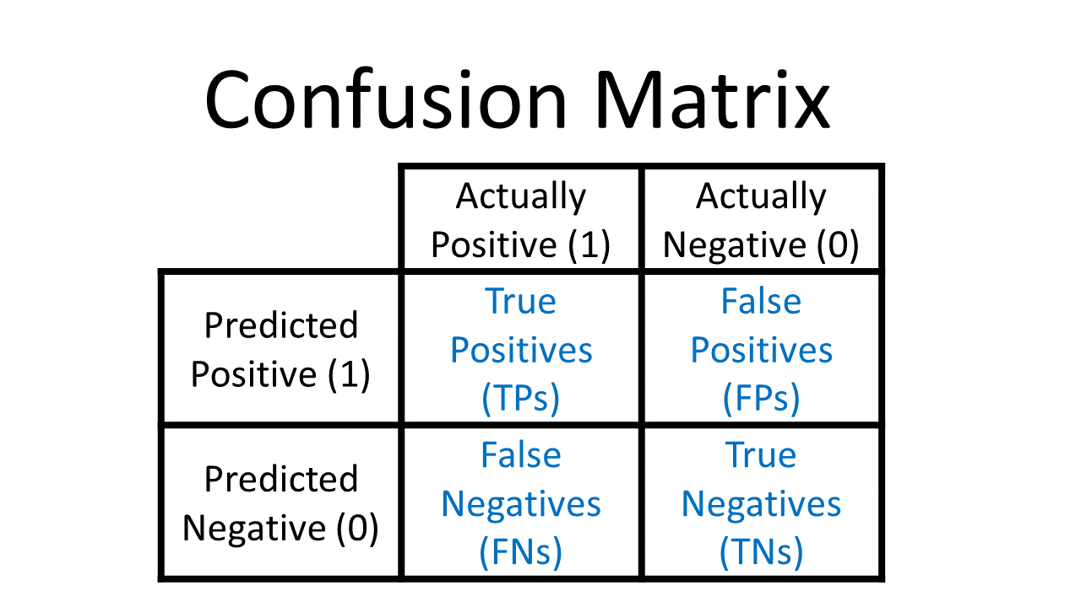
Confusion Matrix:
Confusion matrix is used to summarize the results of the evaluation of a classifier
For binary classification, confusion matrix looks like:
TP: Prediction: 1 and Actual: 1
TN: Prediction: 0 and Actual: 0
FP: Prediction: 1 but Actual: 0
FN: Prediction: 0 but Actual: 1
This Photo by Unknown Author is licensed under CC BY-SA

Slide 15

Accuracy:
The correct predictions made by the classifier to the total number of predictions
$Accuracy=\frac{Correct Classifications}{Total number of classifications}=\frac{TP+TN}{TP+FP+FN+TN}$
Recall:
A measure of quantifying the success among true actuals
$Recall=\frac{Correct Classifications}{Total number of actual positives}=\frac{TP}{TP+FN}$
Precision:
A measure of quantifying the success among true predictions
$Recall=\frac{Correct Classifications}{Total number of predicted positives}=\frac{TP}{TP+FP}$

Slide 16
Trade-off between Recall and Precision:
Classification of an object is done based on a prediction output and comparison with a threshold value
Lowering this threshold value leads to increase in True predictions
Whereas increasing the threshold value leads to increase in negative predictions
Threshold ↑ -> Precision ↑ -> Recall ↓
Threshold ↓ -> Precision ↓ -> Recall ↑
Drawing the plot between Precision and Recall, then decide upon the trade-off values
Else, proceed with Receiving – Operating - Curve (ROC) that is defined using TPR and FPR

