Slide 1
AUTOMATED “PLANTS GROWTH” INDOOR
USING ARTIFICIAL LIGHTS
INTRODUCTION(Grow Anything, Anytime, Anywhere)
1. Aim is to grow plants under various available artificial lights
2. Measuring plant growth under different
I. Temperatures (using temperature sensors and storing the data)
II. Humidity conditions (Using humidity Sensors and storing the data)
III. Various available wavelengths in different types of lights
HID Grow Lights
Led Lights
Fluorescent Grow Lights
Sulfur Plasma Lights
Light Emitting Ceramics (LEC)
Ceramic Metal Halide (CMH)
There is no ‘best light’ for growing plants indoors. Each type of plant grow light has its pros and cons.
One might fit your unique situation well, but another be unsuitable.
3. Apply different sensors and collect the data.
4. Sensors for height adjustment.

Slide 2
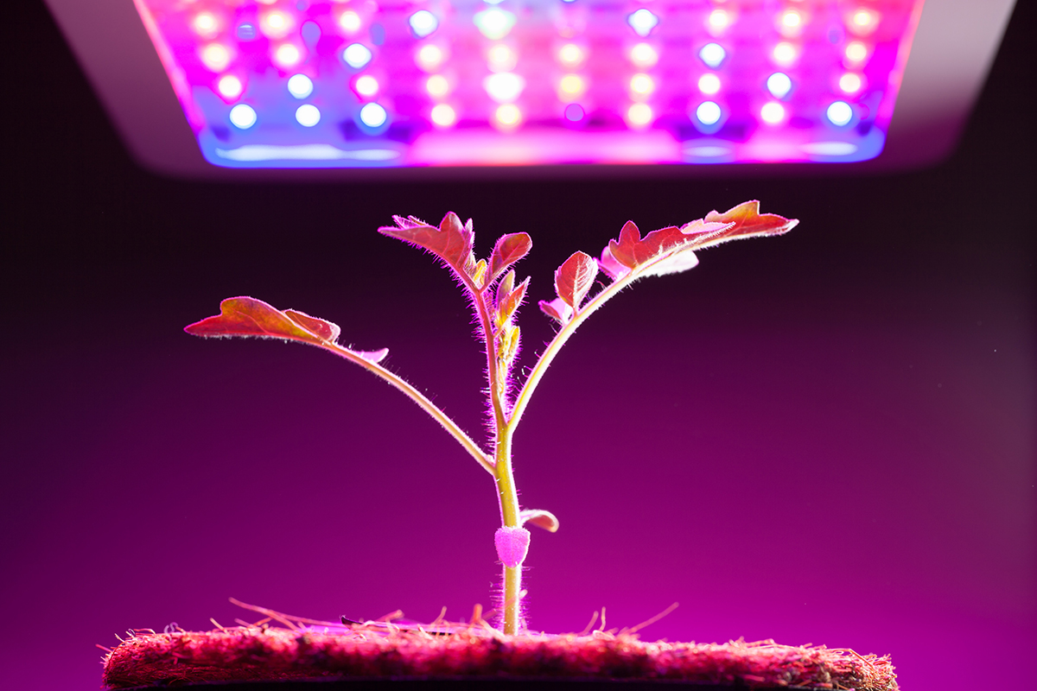
5. Collect data to understand the growth of different plants at various amount of water
>> preventing plants death due to overwatering
6.Size of room, it determines the placement of light , its intensity etc.
Source : Photography By nikkytok / Shutterstock.com

Slide 3
MODEL
Make study of plants & its requirement
Collect theoretical data.
Now keep the plant inside room and try to fulfill those requirements using
Artificial lights (try all types and according to wavelength that suits its best , chose the light)
Check performance at various temperatures and avoid overheating.
Check performance at different amount of water, prevent over watering.
Check performance at different moisture condition.
Check if performance improves by providing proper ventilation.
Keep check of height at which cutting needed for optimal growth , sensors may be used.
Keep a check of variation of intensity of light with distance , this will help in finding placement of light according to size of room.
4. Store all these data and supply to monitoring system.
5. Now use machine learning algorithms to find the optimal circumstances for every plant.
6. Categorize plants according to requirements.
7. Those having similar requirements can be placed in same basket inside the room.
8. Apply IoT now, fix the optimal temperature, moisture, water, height, light wavelength, intensity.
9. These fixes must change with the time according to requirement of plant for optimal growth.
10. Keep supplying system with this data , so that by applying machine learning, performance can be optimized further.

Slide 4
SIGNIFICANCE
Optimal Growth better than Sunlight.
No seasonal dependency.
No regional dependency.
Not affected by external weather conditions like cyclones, storms, hail etc.
Grow anything, Anytime, anywhere.
We can get sufficient amount of oxygen in room.
Pollution control to some extent.
Decorative, these trees in lights give beautiful look similar to aquarium.
Less attention is needed as everything is automated.
Can prevent overheating.
Can prevent water-logging.
Can prevent bending by proper height control.
Can use same light for normal purpose.

Slide 5
CHALLENGES
Integrating all these sensors in one device can be expensive.
No such data collection by sensors is done , so it will take time in optimization.
Everything depends upon accuracy of sensors.
All plants requirements differ.
Different plants may need different intensity , wavelength thus providing different environment for each plant is tedious and very expensive.
SOLUTIONS
For data collection : Initiate the system with the theoretical data collected , system will keep on learning and improving at every step.
Different requirements of each plants : 1. Categorize through the data obtained to those plants having similar requirements and grow them in similar basket and condition.
2. Find the average condition to all those plants in which they grow well , thus no separate basket for each but performance will decrease.

Slide 6
FUTURE SCOPE
1.Lack of Space - With the increasing urbanization and growing population, people living in metropolitan areas live in flats where they don’t even have space to feel the sunlight , there these plants are the best thing to have fresh air and enjoy natural beauty.
2. 3A’s - Its make us anything available anywhere and at anytime, thus saves the cost of exporting and time to get anything.
3.Freshness in pollution – Increasing urbanization has led to severe pollution, thus these plants provides fresh air.
4. Adds beauty as decorative thing - In future, people can use these baskets(plant with light) as decorative material like aquarium.
5.Business Purpose - In general external plantation is affected by weather condition , cyclones and hazards affect productions but this is unaffected by external environment . Hence can be used extensively in growing business plants/vegetables/fruits.
6. Fastest Growth – If proper data collection is done the this method provides faster growth than normal external growth, hence will be exploited maximum in future.
Less Attention required – In this hectic schedule, no one gets proper time to take care of plants, this is one of prime reason for no gardens even in balcony, but these mentioned basket plants is almost automated, so everything temperature, moisture, heat, water etc is maintained by itself, hence very preferable in upcoming future.

Slide 7
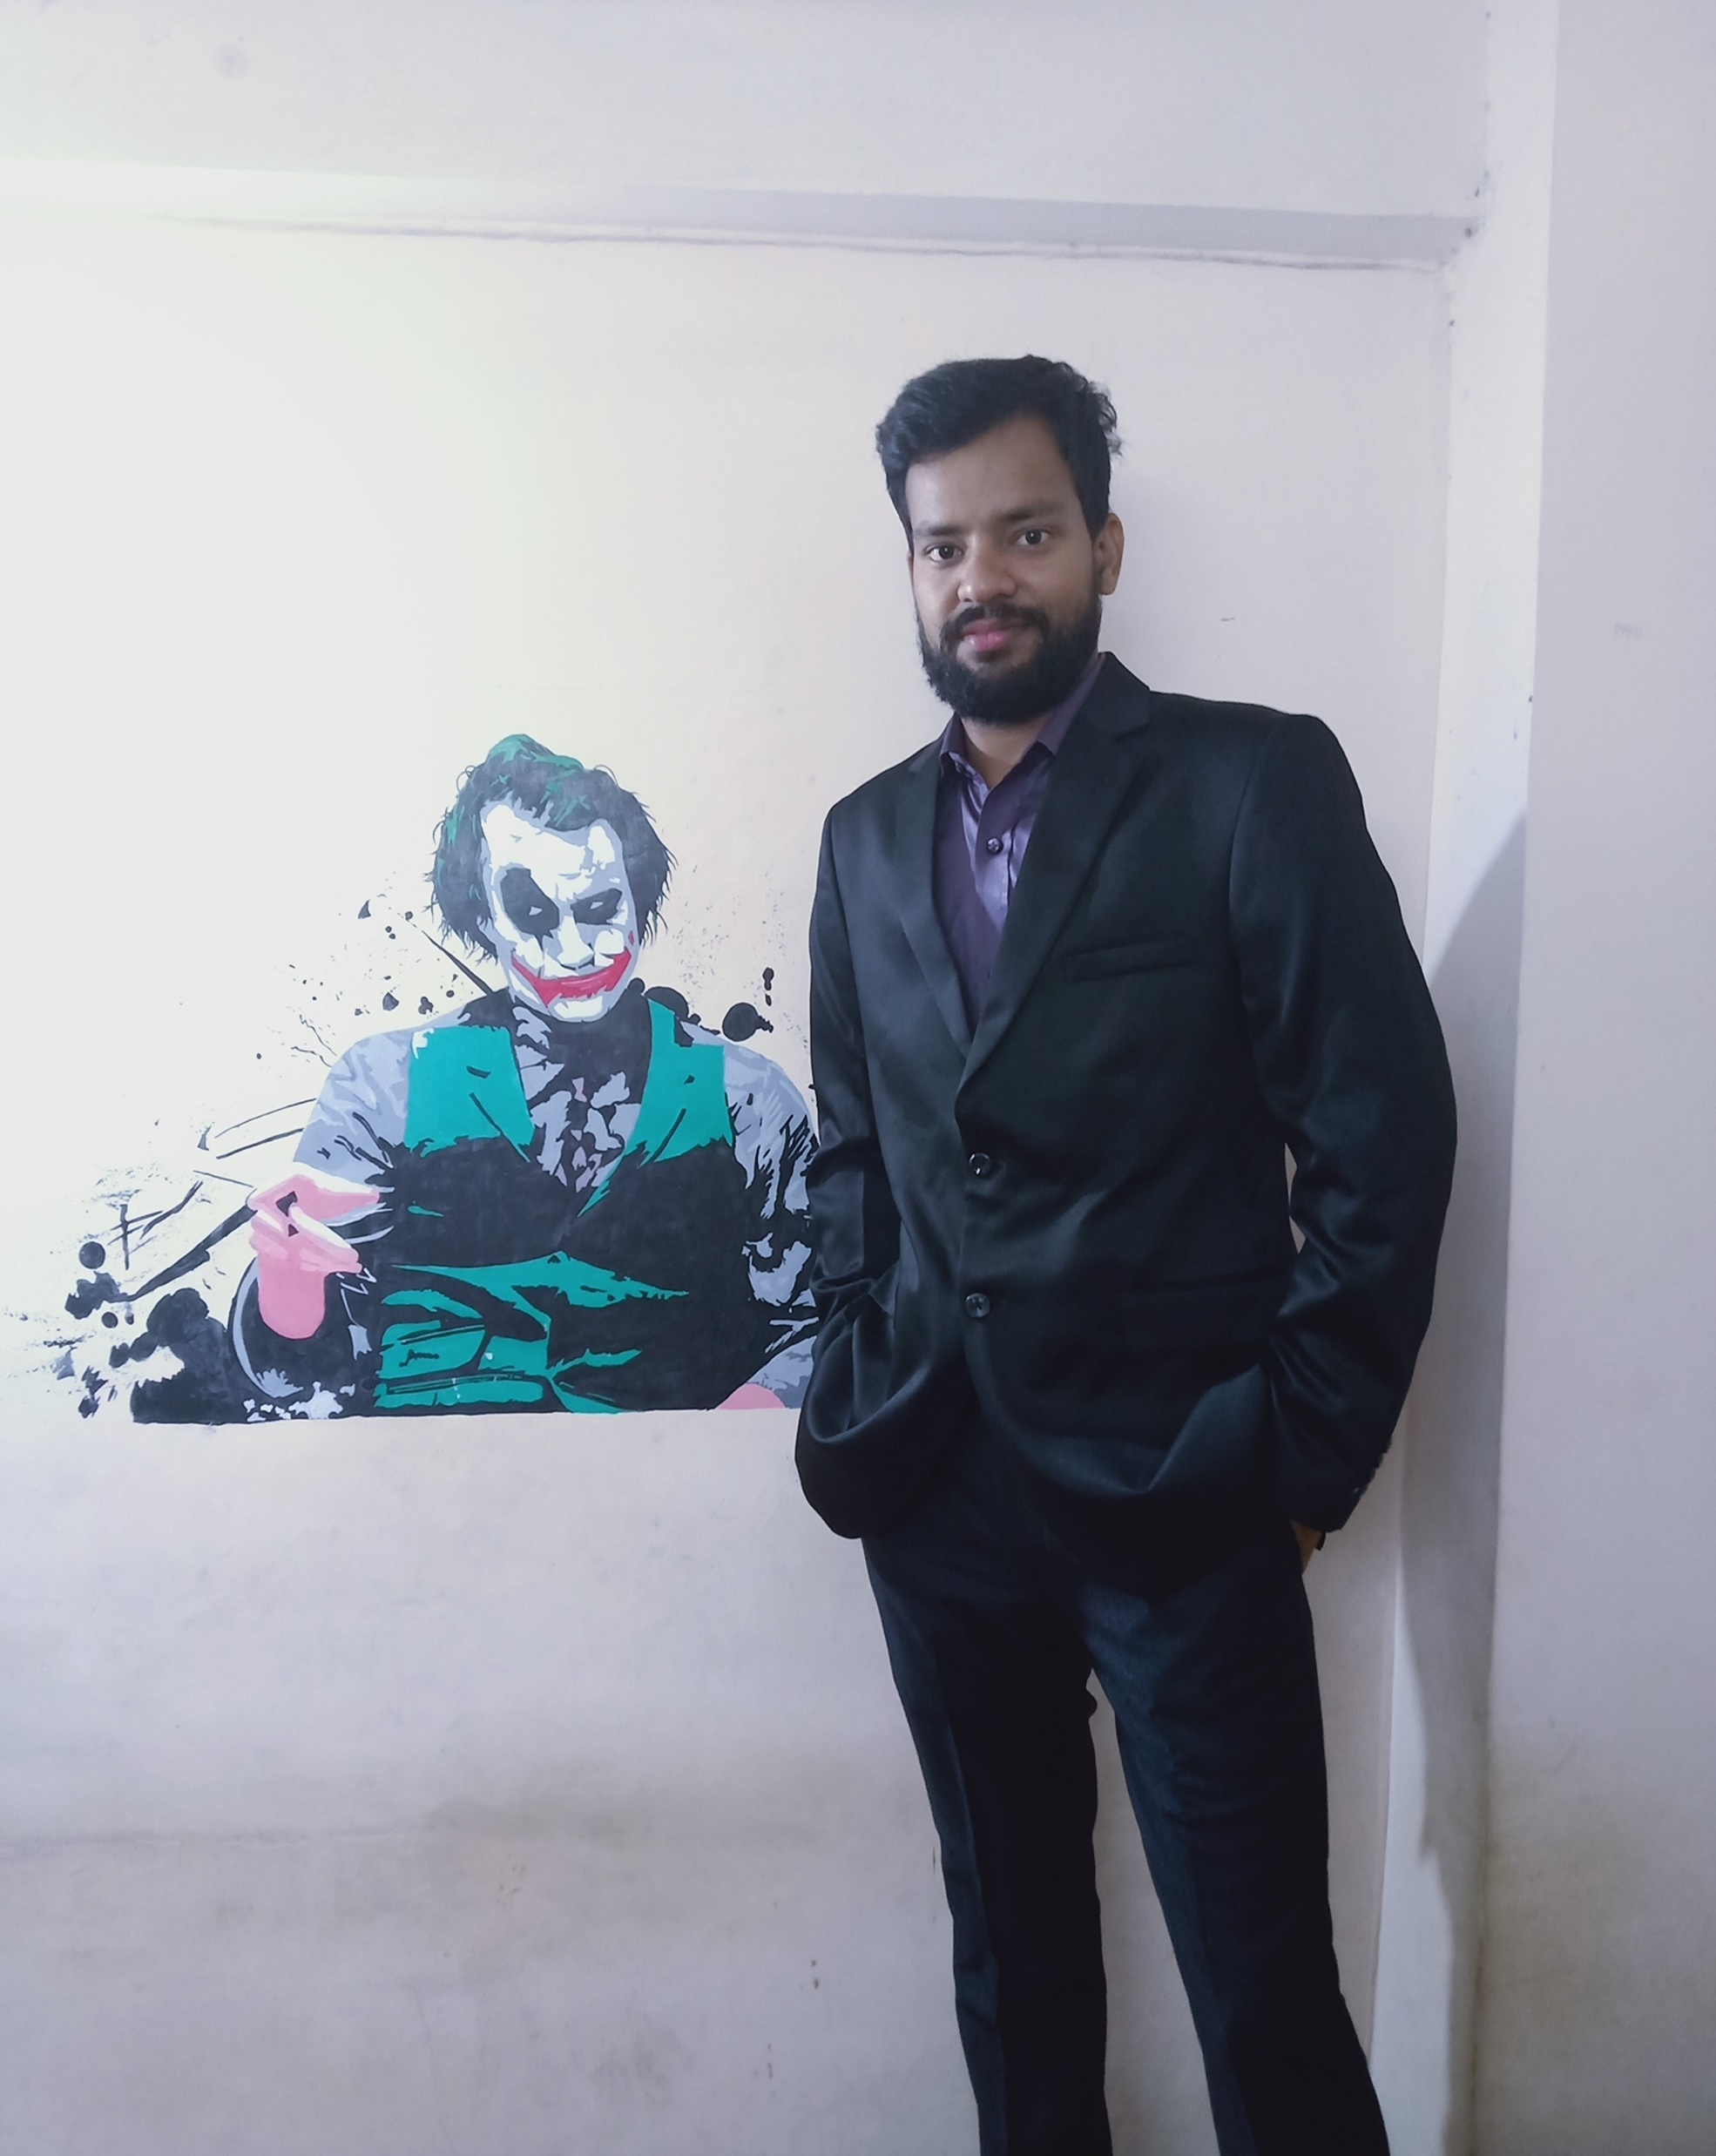
THANK YOU
SIDDHARTHA MISHRA
M.Tech Computer Science and Engineering
IIT(ISM) Dhanbad, India

