Slide 1

21BIO201
Intelligence of Biological Systems-3

Slide 2

BATCH: E4
TEAM MEMBERS:
M RAMYA SREE ( BL.EN.U4AIE21072)
METTU SIDDHARTHA (BL.EN.U4AIE21080)
POLI VAMSI VARDHAN REDDY ( BL.EN.U4AIE21101)
Under the guidance of:
Dr. Amrita Thakur and Dr. Sivakumar

Slide 3
CGR (Chaos Game Representation)

Slide 4

CONTENTS
Introduction
CGR
Leigh syndrome
hCov-19 and Beta Cov-19 ,
gene of humans and animals
Code
Implementation
Output
Reference
conclusion

Slide 5
INTRODUCTION
CGR is an iterative system method originally proposed by Jeffery.
The chaos game representation is a method used to visualize the fractal structure of a DNA sequence.
This is a graphical representation of a sequence.
It is a method of converting a long one-dimensional sequence into a graphical form.
This approach provides a visual image of a DNA sequence quite different from the traditional linear arrangement of nucleotides.

Slide 6
CGR
CGR can recognize patterns in the nucleotide sequences, obtained from databases of a class of genes using the techniques of fractal structures (repeated geometric patterns).
DNA sequence is transformed into a fractal image through a process called iterated function systems (IFS).
The process begins by choosing a starting point within the DNA sequence, called the "seed" point.

Slide 7
CGR
The process is repeated multiple times, resulting in a large number of points on the graph, forming a fractal pattern.
CGR method is unique for each DNA sequence.
Used to reveal previously unseen patterns and regularities in the DNA structure.
The fractal structure of a DNA sequence can be used to predict the 3D structure of the corresponding protein.

Slide 8
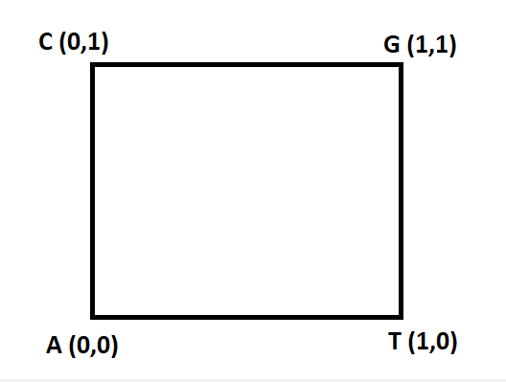
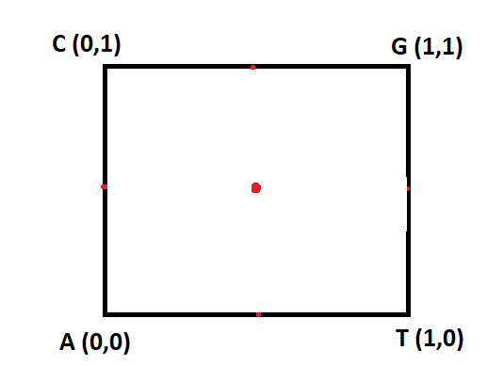
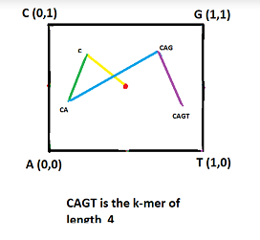

Slide 9
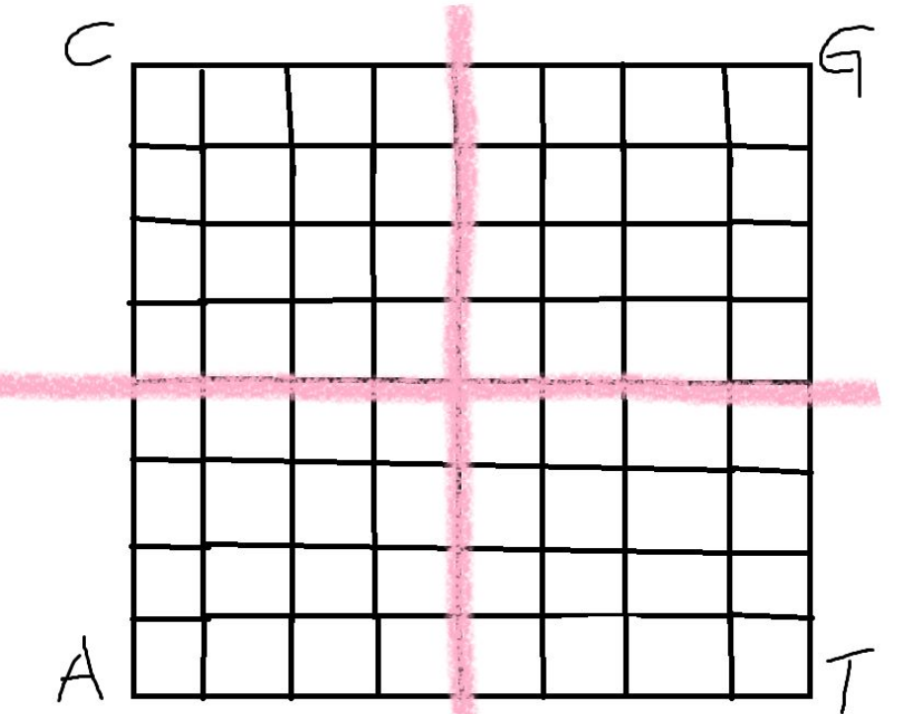
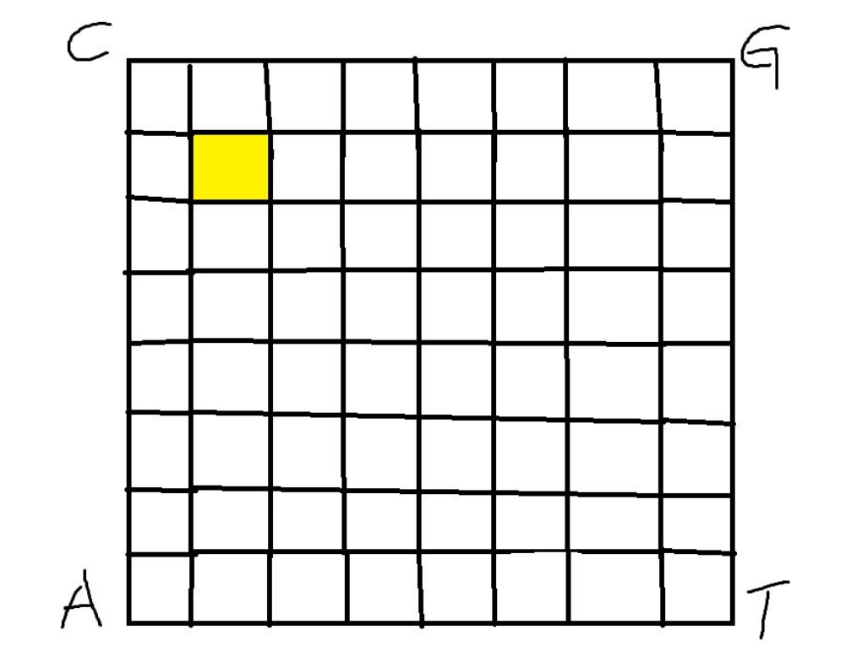
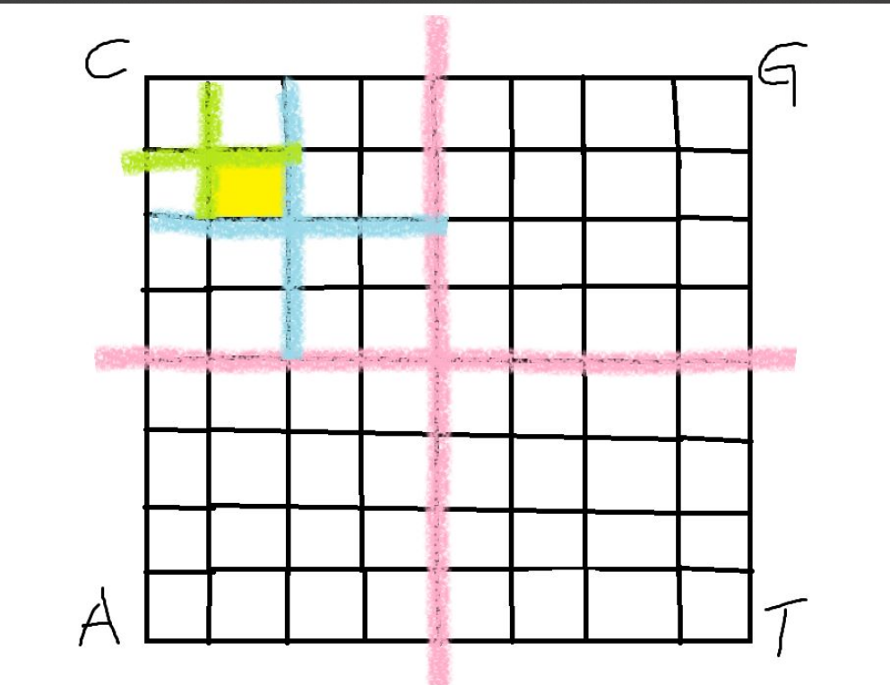
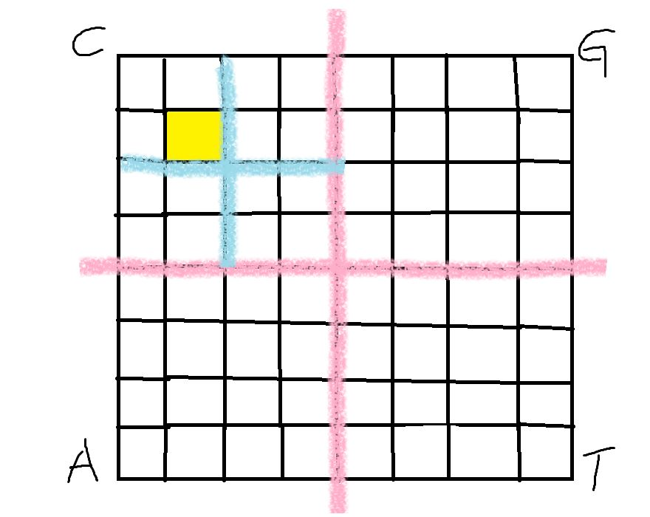
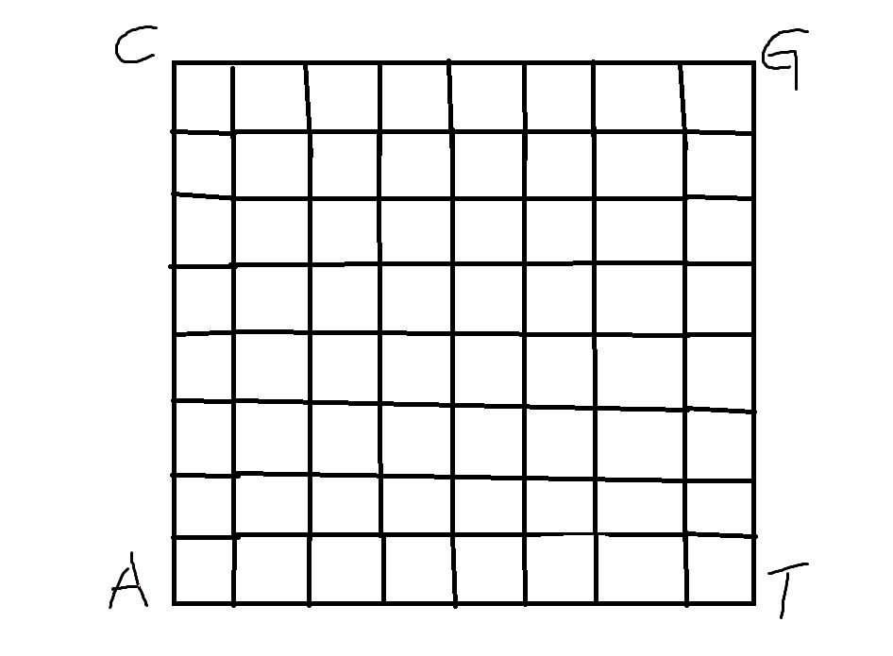
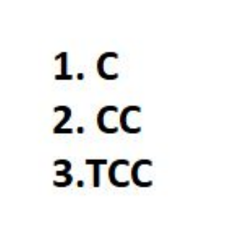

Slide 10
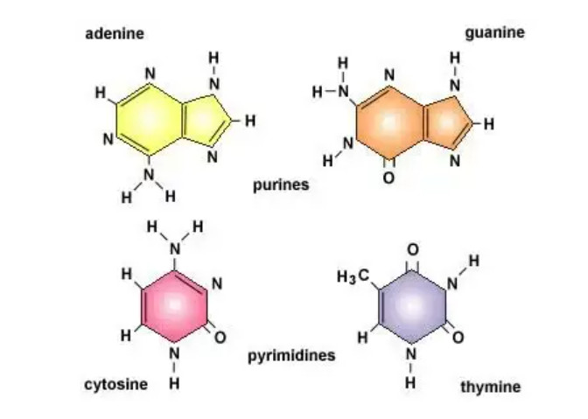

WHAT ARE NUCLEOTIDES?
Nucleotides are molecules that, when joined, make up the individual structural units of the nucleic acids RNA and DNA.

Slide 11
Protein: A macromolecular compound made up of one or more chains of amino acids.
Gene: a sequence of DNA or RNA that contains the code for the production of a specific protein
Genome: the complete set of genetic material (DNA) in an organism.
Mutations: a change in the DNA sequence of an organism's genome
Oric:(origin of replication in bacteria) is a specific DNA sequence that acts as a starting point for DNA replication in bacteria.

Slide 12
What are k-mers?
K-mers are contiguous sequences of k nucleotides taken from a DNA or RNA sequence.
K-mers that occur more than once in a genome are called repeats.
K-mers are used as building blocks for genome assembly algorithms.

Slide 13
Leigh syndrome
Leigh Syndrome is a neurological disorder that primarily affects the central nervous system.
The disorder is characterized by the degeneration of specific areas of the brain, particularly the mitochondria.
It is inherited in an autosomal recessive pattern.
This disease can cause due to genetic changes in either mitochondrial DNA or nuclear DNA.

Slide 14
SYMPTOMS
Loss of motor function and muscle weakness.
Intellectual decline and developmental delays.
Breathing difficulties and respiratory failure.
Seizures and neurological problems.
Progressive neurodegeneration leading to death.

Slide 15
We tried for two categories of data - hCov-19 and BetaCov-19 sequences and also for human and various animal genome sequences (Gallus, Goat, Gorilla, Human, Lemur, Mouse, Opossum, Rabbit, Rat).

Slide 16
CODE
CGR_SEQ_SIMILARITY.pdf - Google Drive

Slide 17
IMPLEMENTATION

Slide 18
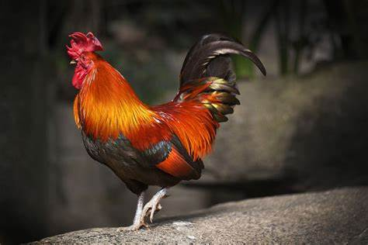
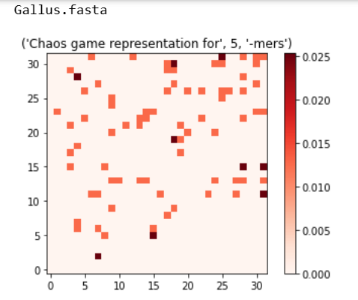
CGR of each animal:

Slide 19
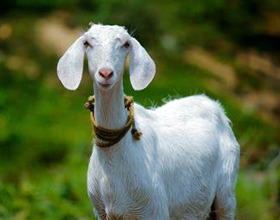
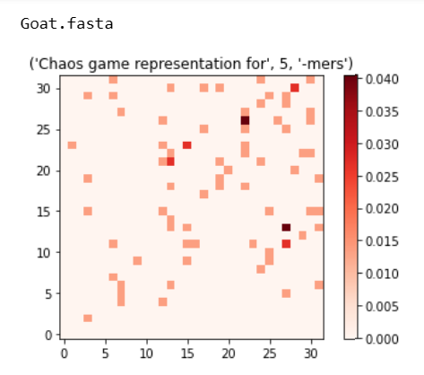
CGR of each animal:

Slide 20
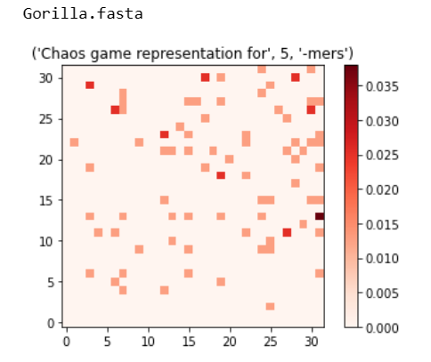
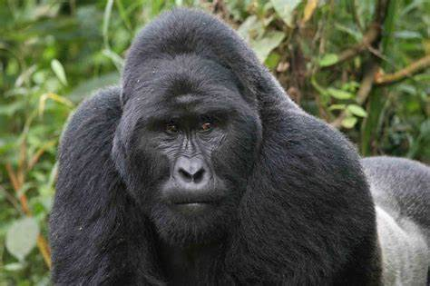
CGR of each animal:

Slide 21
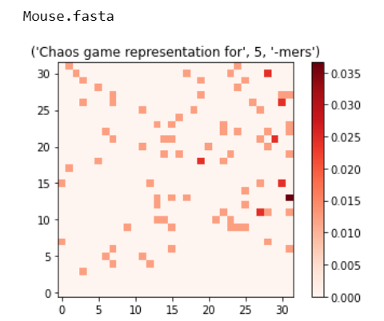
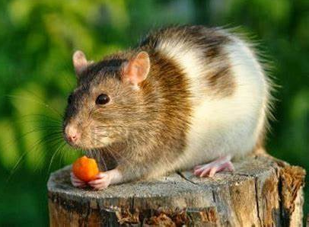
CGR of each animal:

Slide 22
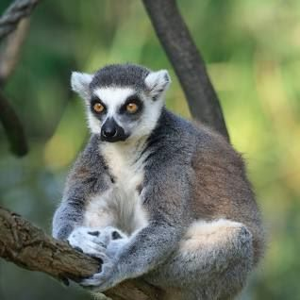
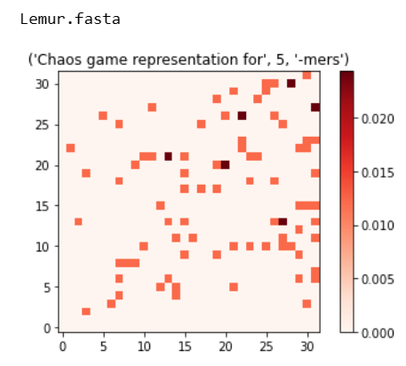
CGR of each animal:

Slide 23
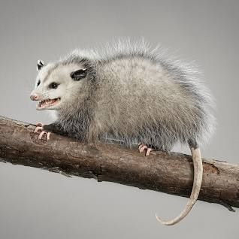
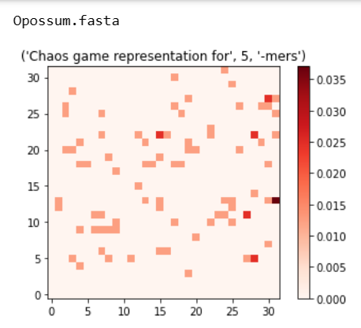
CGR of each animal:

Slide 24
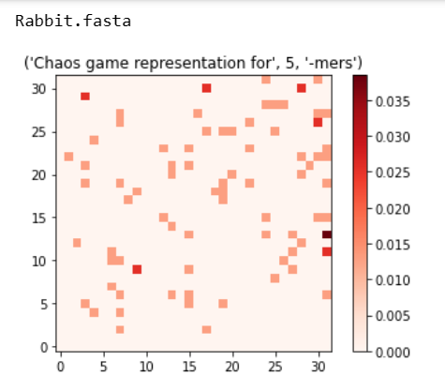
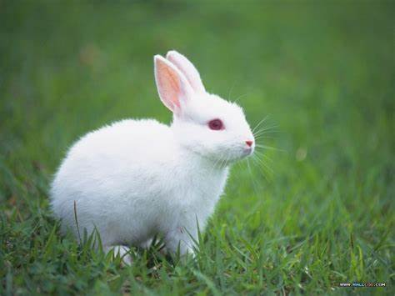
CGR of each animal:

Slide 25

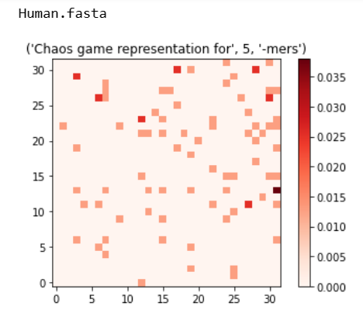
CGR of each animal:

Slide 26
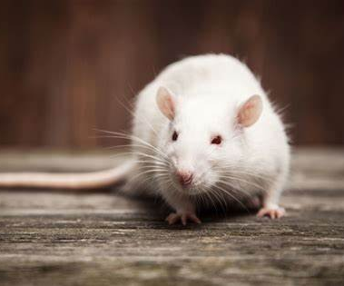
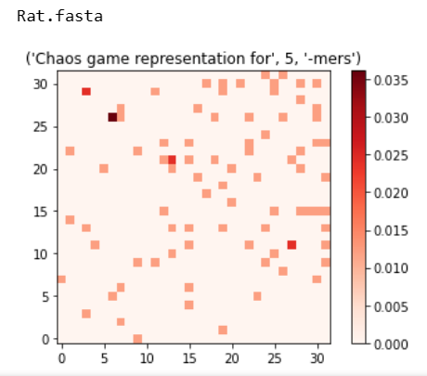
CGR of each animal:

Slide 27
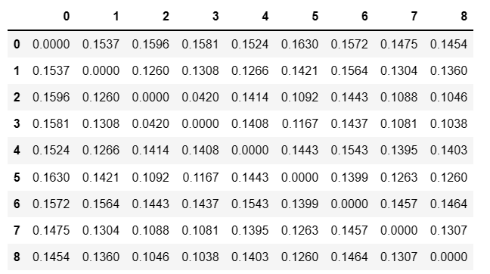
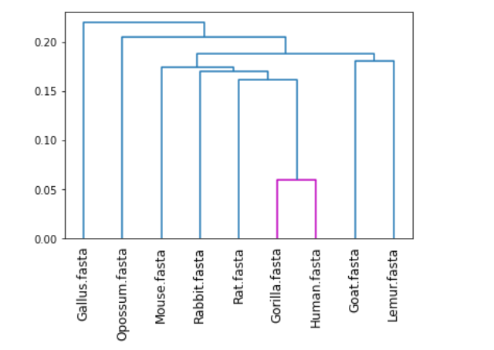
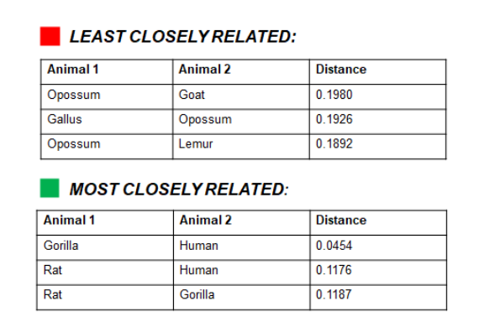
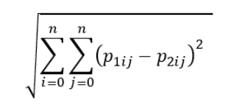
CGR probability distance of all the animals
(Gallus, Goat, Gorilla, Human, Lemur, Mouse, Opossum, Rabbit, Rat)

Slide 28
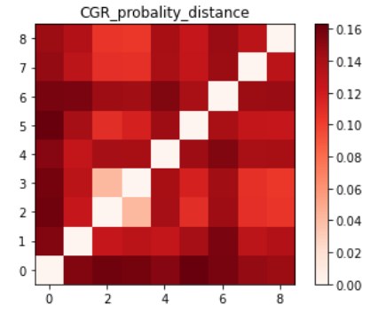
CGR probability distance of all the animals

Slide 29
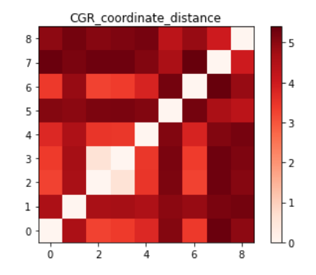
CGR coordinate distance

Slide 30
CONCLUSION
CGR is just one of the method used to study and extract meaningful information from the genetic sequences, and it may not be the most appropriate method for all types of genetic analysis.

Slide 31
REFERENCE
[1] Dipendra C. Sengupta,Matthew D. Hill, Kevin R. Benton, and Hirendra N. Banerjee.(2020). Similarity Studies of Corona Viruses through Chaos Game Representation. https://www.ncbi.nlm.nih.gov/pmc/articles/PMC7497811/
[2] Soumalee Basua, Archana Pana, Chitra Dutta ,Jyotirmoy Dasa. Chaos game representation of proteins. https://www.sciencedirect.com/science/article/pii/S109332639700106X
[3] Jijoy Joseph & Roschen Sasikumar. Chaos game representation for comparison of whole genomes. https://bmcbioinformatics.biomedcentral.com/articles/10.1186/1471-2105-7-243

Slide 32
Thank you

