Slide 1

Local AI that verifies your RTL
Integrating a skill + tool into opencode, running on on-prem Gemma
Demo: TED (Mueller-Muller CDR) iverilog RTL vs C++ golden model -> tau convergence
1 skill + 1 tool + 0 cloud
Notes:
Main message: you don't need a big model or a new app. opencode already supports skills. You drop a folder into your repo and a local model can run your verification flow.

Slide 2

The problem: co-simulation checks are manual
Every RTL change means the same 5 steps, done by hand
1
Compile + run iverilog
And a small local model can't do it alone
2
Build + run C++ model
Gemma-class models guess numbers
They mis-type long CLI flags
Mod-1 / fixed-point math is easy to get wrong
Cloud AI is not allowed for our RTL
3
Decode fixed-point tau
4
Wrap mod 1 UI, average
5
Eyeball the difference
Notes:
Two problems: the flow is repetitive, and a local model is weak at arithmetic. The design answer is to move all computation into a tool.

Slide 3




The idea: the model decides, the tool computes
Gemma never calculates tau. It picks the tool, then explains the result
You
opencode + Gemma
Skill
Tool
Simulators
plain-language prompt
on-prem vLLM
ted-verify / SKILL.md
verify_tau.py
iverilog + g++
VERDICT line + JSON + plot (every number comes from here)
Model job: understand the question, choose the variant, explain the verdict. Tool job: build, simulate, decode Q4.16, compare mod 1 UI, plot.
Notes:
This split is what makes a weak model reliable. Same idea as a hardware accelerator: the CPU (LLM) does control flow, the accelerator (tool) does the math.

Slide 4



Three building blocks in opencode
Only the skill and the tool are new; AGENTS.md is optional but recommended
AGENTS.md
SKILL.md
verify_tau.py
Project rules
Task playbook
The tool
Loaded in EVERY session
What the repo is, what not to touch
EN/JA reply rule
Like a coding standard
Loaded ON DEMAND
Trigger = its description line
When + how to call the tool
How to format the answer
Actually EXECUTES
Runs iverilog + g++
Returns VERDICT + JSON + PNG
Deterministic, testable alone
Notes:
AGENTS.md = who you are here. SKILL.md = how to do X. Tool = the thing that does X. Skills keep context small, which matters most for a small model.

Slide 5



Step 1: drop the files into your repo
opencode discovers skills by folder convention; no plugin, no install
ted-demo/
|-- AGENTS.md <- always loaded
|-- params.txt <- shared by RTL + C++
|-- data/stim.txt <- 1 sample / line
|-- rtl/ted_toy.v, tb_ted.v
|-- rtl/ted_toy_broken.v <- demo bug
|-- model/ted_toy.cpp
'-- .opencode/
'-- skills/
'-- ted-verify/ <- folder name
|-- SKILL.md <- name == folder
'-- scripts/
'-- verify_tau.py
Where it looks
.opencode/skills/<name>/SKILL.md in the repo, or ~/.config/opencode/skills/ for all repos
Name rule
lowercase-hyphen, and must equal the folder name
Also found
.claude/skills/ works too: same skill runs in Claude Code
Notes:
The whole integration is a folder. opencode walks up from the working directory to the git root looking for .opencode/skills.

Slide 6
Step 2: write the SKILL.md
The description is the trigger; the body is the recipe
---
name: ted-verify
description: Verify the TED / CDR RTL against
the C++ golden model by comparing converged
tau. Use whenever the user asks to verify,
compare, or test RTL vs C++, or mentions
iverilog, tau, TED, CDR, or convergence.
---
## The tool
python .opencode/skills/ted-verify/
scripts/verify_tau.py [--variant broken]
## Workflow
1. Run the tool
2. Read the VERDICT line + JSON
3. Reply: Verdict / Numbers / Why / Plot
## Do not
- compute tau yourself
- edit RTL to "fix" a FAIL
Frontmatter
Only thing Gemma sees before loading. Be generous with keywords: TED, tau, CDR, iverilog.
Exact command
Copy-pasteable. Small models mangle flags they have to invent.
Fixed reply format
Makes every answer look the same, easy to trust in a review.
Do-not list
Guardrails: never guess numbers, never edit sources unasked.
Notes:
Frontmatter fields opencode reads: name, description (plus optional license, compatibility, metadata). Everything else is ignored.

Slide 7



Step 3: design the tool for a small model
The first line is the answer; everything else is evidence
$ python .opencode/skills/ted-verify/scripts/verify_tau.py
VERDICT: PASS | RTL 0.2998 UI | C++ 0.2998 UI | delta +0.0000 UI (tol 0.02)
{
"verdict": "PASS",
"tau_rtl_ui": 0.29978, "tau_cpp_ui": 0.29978,
"delta_ui": 0.0, "tol_ui": 0.02,
"rtl_converged": true, "cpp_converged": true,
"ground_truth": { "tau_true_ui": 0.3, "pass": true },
"reasons": [],
"plot": "out/tau_trace.png"
}
One-line verdict
No hidden math
Fail loudly
Runs from any cwd
Model reads 1 line, not a log
Q4.16 decode, mod 1 UI, stats: all inside
Missing iverilog -> VERDICT: ERROR
Human can run it without AI
Notes:
If the tool is good, the model can't really get it wrong. Test the tool alone first, then add the AI.

Slide 8

Step 4: point opencode at the local model
opencode.json in the repo root: provider + permissions
{
"$schema": "https://opencode.ai/config.json",
"provider": {
"vllm": {
"npm": "@ai-sdk/openai-compatible",
"options": { "baseURL": "http://<server>:8000/v1" },
"models": { "gemma-4": { "name": "Gemma 4" } }
}
},
"model": "vllm/gemma-4",
"permission": {
"bash": { "python .opencode/skills/*": "allow",
"*": "ask" },
"skill": { "ted-verify": "allow" }
}
}
Checklist
vLLM runs with tool calling enabled (auto tool choice + tool-call parser)
Tool command allowed, so the demo never stalls on a prompt
Everything else still asks: safe by default
iverilog, g++, numpy, matplotlib on PATH
Notes:
Without tool-calling enabled on vLLM, the model sees the tools but never calls them. That's the number one setup trap. Adjust baseURL and model name to your server.

Slide 9
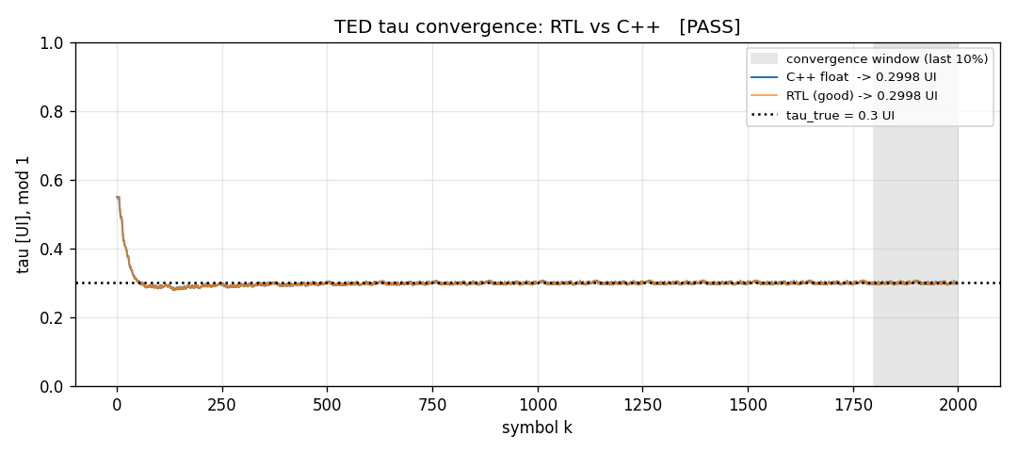
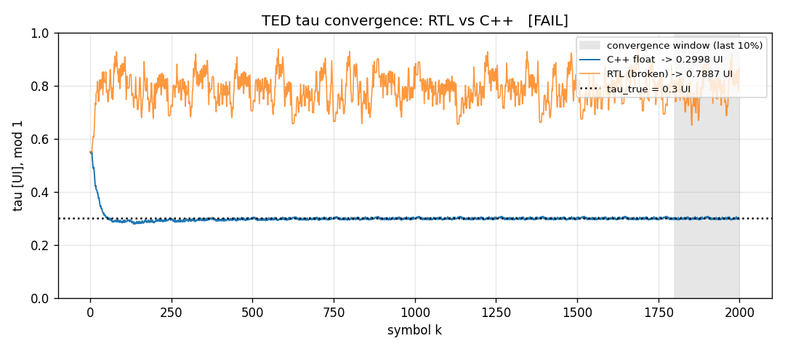

Live demo: 3 prompts
Same stimulus, same C++ model; only the RTL file changes
"Verify the TED RTL against the C++ model."
"Now check the broken RTL variant."
PASS: both 0.2998 UI, matches tau_true 0.30
FAIL: delta +0.49 UI, locked on the wrong zero crossing
3. "What is different in the broken file?" -> agent diffs the two .v files: one line, TED error sign flipped
Notes:
Prompt 1 shows PASS. Prompt 2 shows the classic MM failure: flipped sign makes the unstable zero crossing stable, so the loop parks ~0.5 UI away. Prompt 3 shows the agent localizing the bug.

Slide 10
Same pattern, next skills
Swap the tool, keep the recipe: one folder per task
lint-triage
timing-triage
Verilator lint -> one warning at a time, real bug vs noise
Vivado timing report -> worst paths mapped to RTL lines
regmap-check
sim-first-divergence
RTL address decoder vs register catalog vs driver API
RTL vs golden model per stage -> first cycle that differs
Takeaway: small model + good tool + clear skill = reliable local AI for FPGA work
Notes:
The investment is in the tool. Once a team has a few skills, anyone can run expert checks by asking in plain language, fully on-prem.

