Slide 1
PrivateGit: one home for our code
Today our code lives in many copies across servers and folders, so finding a change and understanding it takes time.
This proposal: a local, SSH-based, on-premise Git server (a private "GitHub") for sharing and tracking code.
It runs on our own server 172.20.1.126. Nothing goes to the cloud.
The next slides explain the pain points, the architecture and the daily workflow.
fpga_v2/
.126
one repository
full history
fpga_v2_final/
fpga_v2_final_NEW/
copy_of_fpga (2)/
scattered copies
Notes:
Today the same project exists as many folder copies on different servers, so we spend time finding the latest version and figuring out what changed. The proposal is PrivateGit: a private, GitHub-like Git server that runs only on our own server .126 and is reached over SSH. Everyone shares one repository with the full history. The next slides cover the pain points, the architecture and how we work with it day to day.

Slide 2
Pain points today
1
Scattered copies
2
Time lost searching
The same project sits in many folders and servers. Nobody is sure which one is the latest.
Who changed what, when and why? Finding out means asking people and comparing files by hand.
3
Overwritten work
4
No control, no safety net
Copying folders over each other silently loses someone's changes.
Anyone can read or change everything, and there is no history to roll back to.
Notes:
Four problems we see today. First, scattered copies: nobody is sure which folder is the latest. Second, time lost searching: to know who changed what and why, we ask people and compare files manually. Third, overwritten work when folders are copied over each other. Fourth, there is no access control and no history to roll back to.

Slide 3
Architecture: two simple paths into one server
Server 172.20.1.126
Users
on .126, .157, .158
Terminal: git
Browser: dashboard
HTTPS · port 443
nginx
Dashboard
Git
repositories
permissions
hidden backup of main
view code & history
HTTPS, allowlist
login, browse
SSH · port 22
OpenSSH
Gate
clone / pull / push
key login
who? allowed?
One permission list for both paths: per user, per repository, Read or Read & write.
Git data always travels over SSH with a personal key (the key = the user). The browser is only for viewing and managing access.
Notes:
There are only two ways in. The terminal path uses Git over SSH on port 22: each person has their own SSH key, which tells the server who they are, and a small gate checks whether that person may read or write that repository before Git runs. The browser path uses HTTPS on port 443 through nginx to a dashboard where people view code, history and changes, and the admin manages access. Both paths use the same permission list. Everything is stored on .126, including a hidden backup of every main branch.

Slide 4
Workflow: .126 holds the main codebase
User on .157
e.g. Alice
User on .158
e.g. Bob
How it works
Everyone works in their own copy, on their own server
Changes are shared only through main on .126
Each user gets Read or Read & write per repository
main is protected and backed up automatically
push / pull
.126
main codebase
single source of truth
push / pull
User on .126
e.g. Carol
Notes:
The server .126 holds the main codebase: the single source of truth. Users on .157, .158 and on .126 itself each keep their own working copy, push their changes to main and pull everyone else's. Nobody copies folders between machines any more. Each person has read or read-and-write permission per repository, and main cannot be deleted or overwritten; every change to it is backed up automatically.

Slide 5
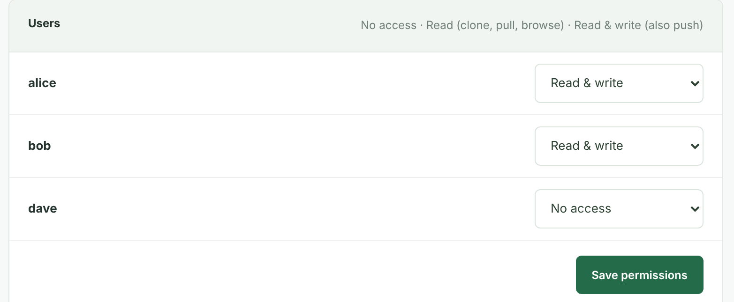
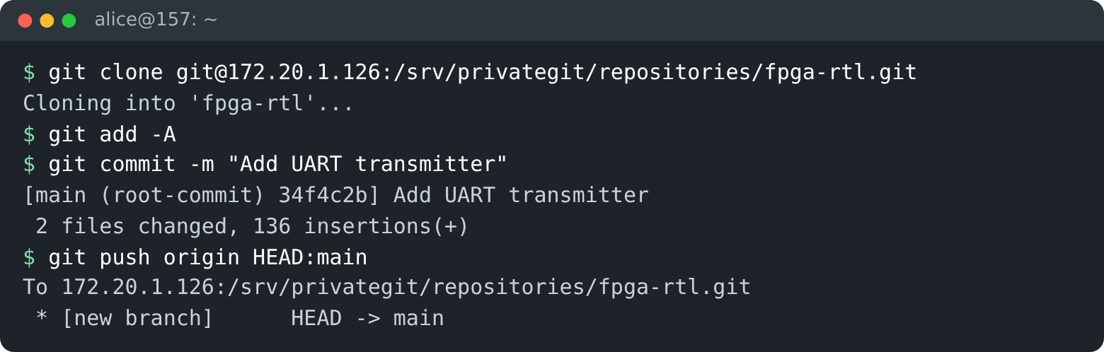
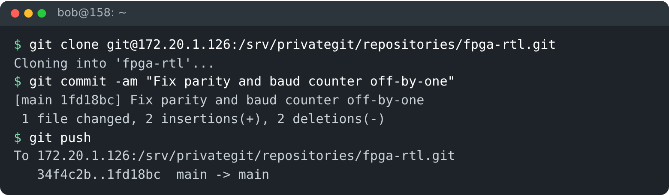
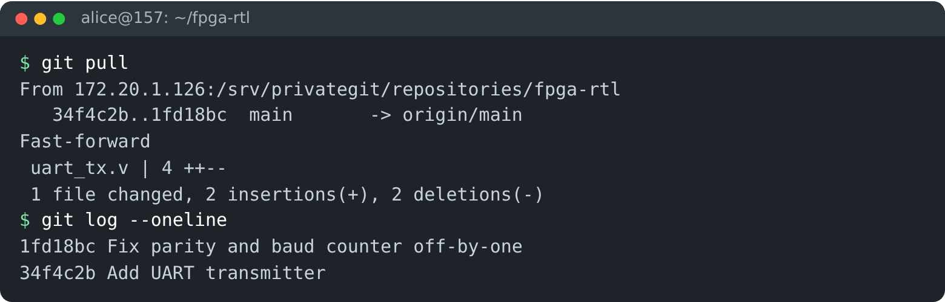
From new repository to shared work
1
Admin · dashboard on .126 creates fpga-rtl and gives A and B Read & write
2
User A · .157 clones, commits and pushes the first code
3
User B · .158 clones, fixes a bug, commits and pushes
4
User A · .157 pulls and gets B's change automatically
Notes:
This is the real application, taken from a test installation of the same software. One: the admin creates the repository in the dashboard and gives users A and B read and write access. Two: user A on .157 clones the empty repository, commits the first code and pushes it to .126. Three: user B on .158 clones it, fixes a bug and pushes. Four: user A simply runs git pull and receives B's change. Nobody copied folders; every change went through main on .126.

Slide 6
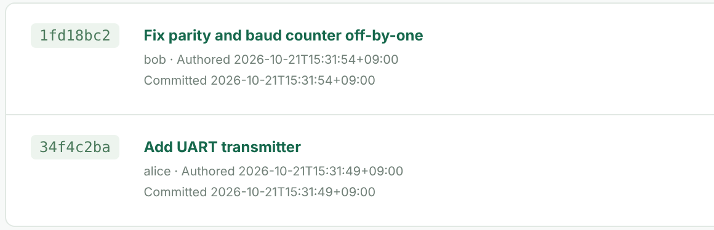
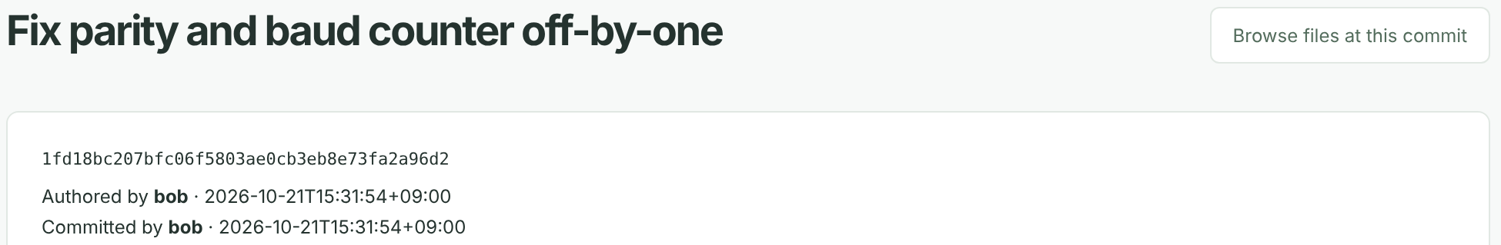
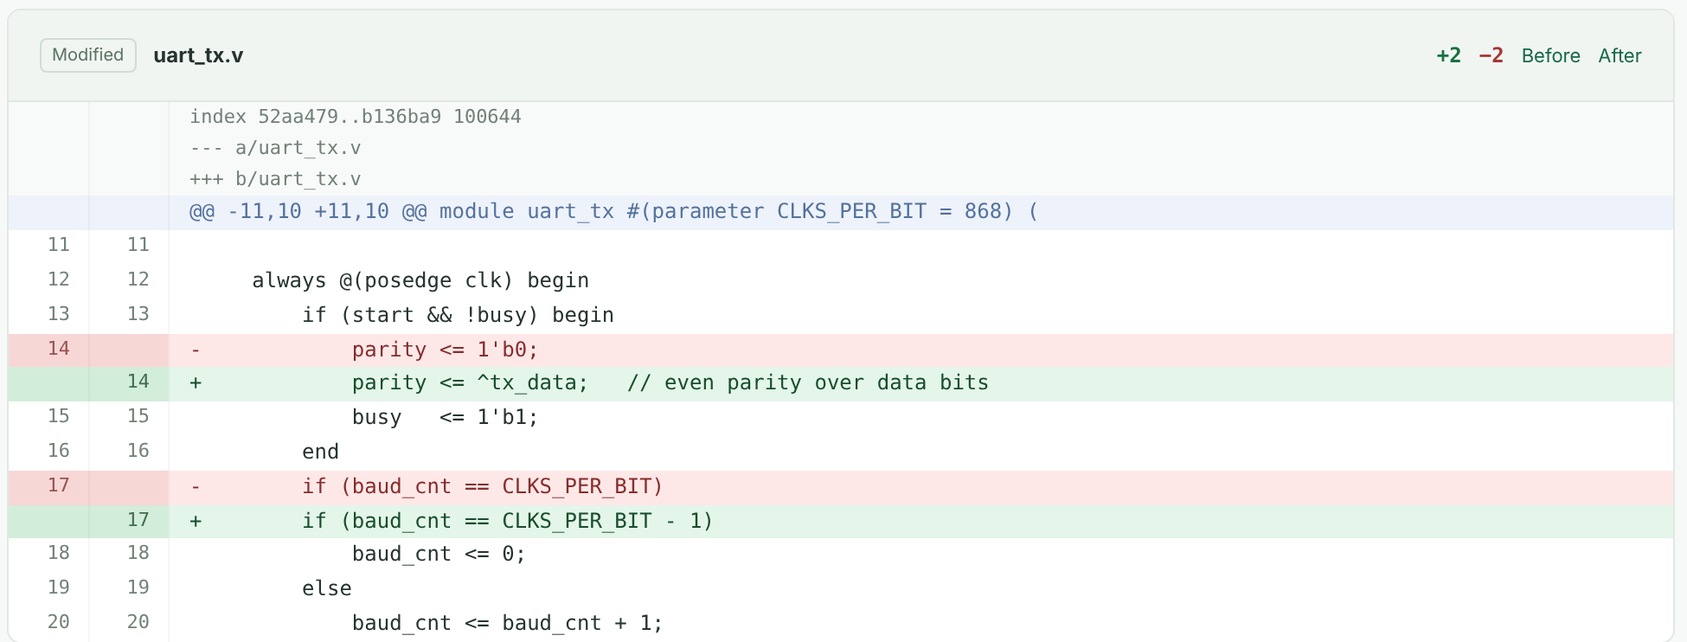
Seeing what others changed
History of main (dashboard): each commit with author and time
Bob's commit, opened with one click: exact lines changed
Who: bob
When: 15:31, Oct 21
What: 2 lines in uart_tx.v
Terminal: git log · git show 1fd18bc
Why: commit message
Notes:
Here is how we keep track of other people's work. On the left is the real history of main in the dashboard: each commit shows its message, author and time. Clicking Bob's commit opens the page on the right: the exact lines he changed, red removed and green added, with line numbers. The same information is available in the terminal with git log and git show. Who, when, what and why are answered in seconds instead of asking around.

Slide 7
Advantages and efficiency
1
One source of truth
2
Full traceability
3
Find changes fast
main on .126 is always the latest version; no more folder copies.
Every change has author, time, message and exact line diff.
History and comparisons in the browser in seconds, not hours.
4
Safe teamwork
5
Access control
6
Secure, on-premise
Git merges work instead of overwriting; main cannot be deleted or rewritten.
Per user and per repository: Read or Read & write.
SSH keys and HTTPS, no cloud; automatic hidden backup of main.
Efficiency: less time searching and reconciling copies, new members onboarded in minutes, every change recoverable.
Notes:
To sum up. We get one source of truth on .126 instead of folder copies, full traceability of every change, and fast answers to who changed what. Git merges work instead of overwriting it, main is protected, and access is controlled per user and per repository. It is secure and fully on-premise, with an automatic backup of main. Overall: less time searching and reconciling, quick onboarding, and every change recoverable.

