Slide 1
Supporting Materials

Slide 2
Note
Only SC1-SEITRS.alp model functionality is demonstrated and SC2-SEITRS also works in the same way.
In SC2-SEITRS.alp manufacturer variables are appended by “D” while in original paper, it is denoted by superscript “M”.

Slide 3
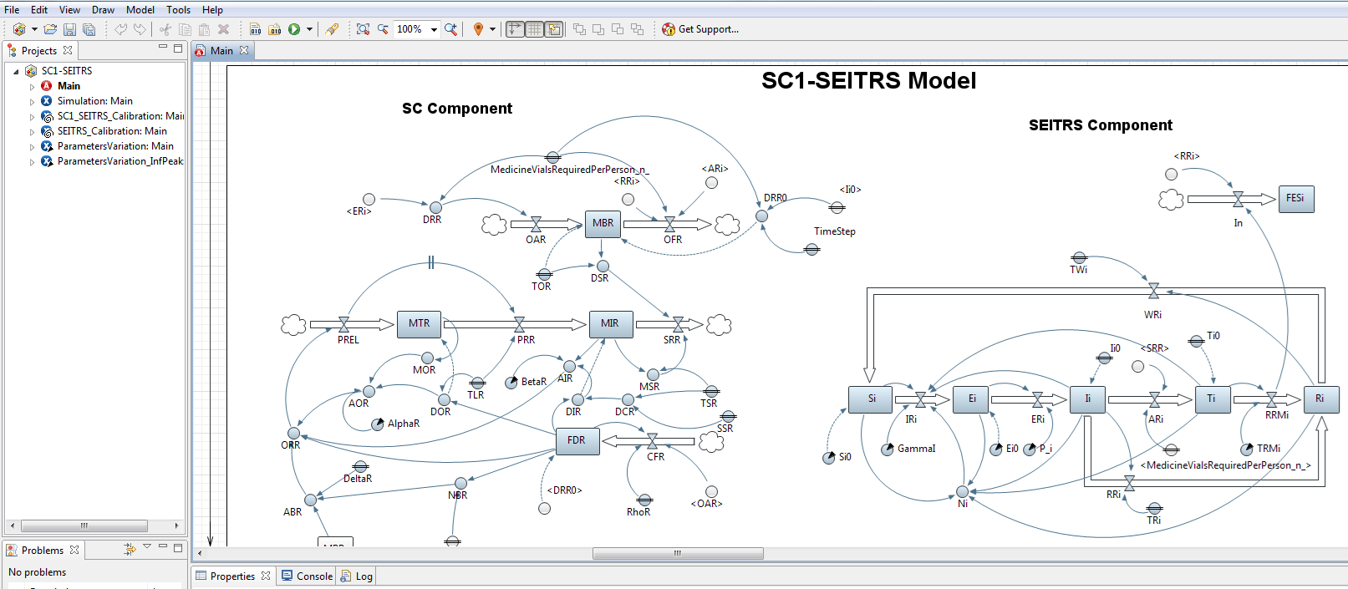
Simulation Main Window
Simulation Experiment
Button for running experiment
Sim-Opt model for calibrating SEITRS model with Raw data
Parameter variation experiment
For calculating R_inf & I_Peak at different
Alpha, Beta
Simulation Optimization Module for Calibrating SC1-SEITRS With Raw Data

Slide 4
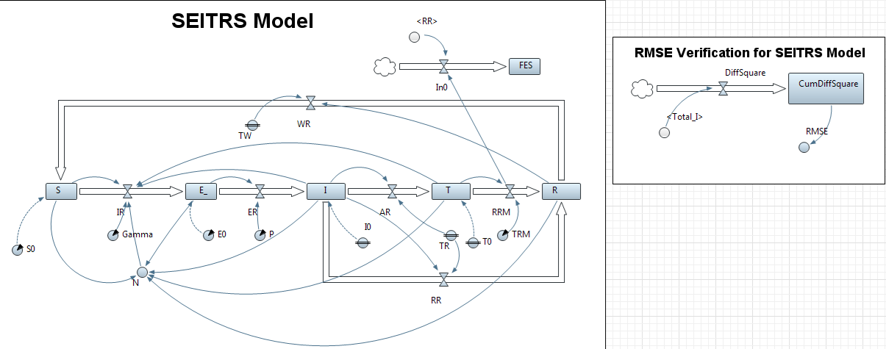
For Verification of Results of Table 2
Displays the RMSE of SEITRS
Model with Raw Data.
Substitute the estimated Parameters
values of SEITRS model

Slide 5
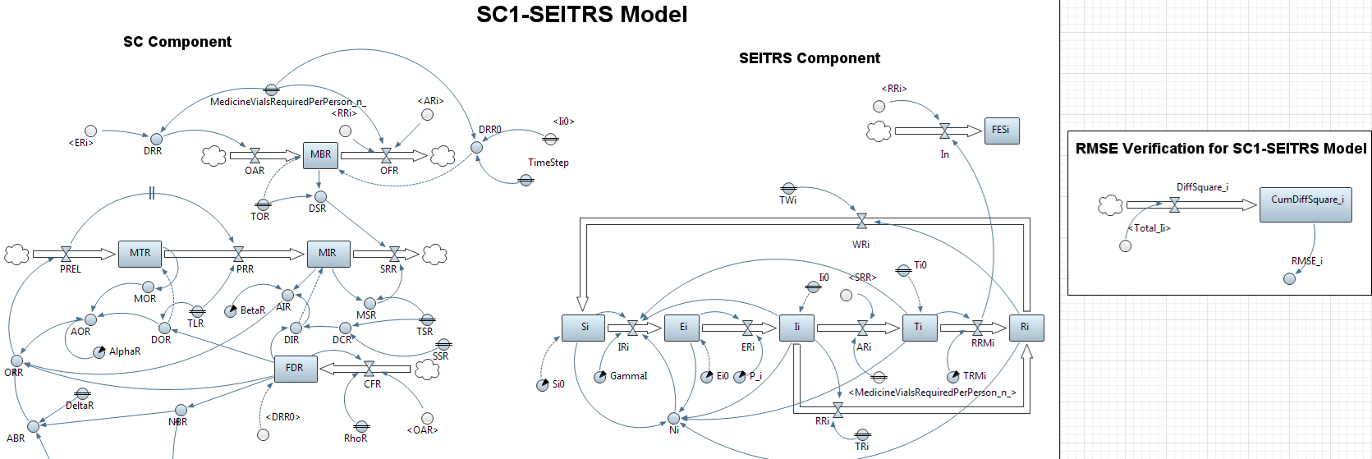
For Verification of Results of Table 3
Displays the RMSE of SC1-SEITRS
Model with Raw Data.
Substitute the estimated Parameters of SC1-SEITRS model here

