Slide 1
NETELIXIR AIGNITION 3.0 · TEAM TECHBLAZERS
Multi-Channel Ad Revenue Forecasting
Probabilistic revenue forecasts, budget optimization, and grounded AI narratives — a walkthrough of every screen in the app, what it shows, and why it's built that way.
Interface Walkthrough

Slide 2
What This System Does
Ingests
Forecasts
Google Ads, Meta Ads, and Bing Ads campaign data — with automatic schema mapping and mangled-file tolerance.
30/60/90-day revenue as a probability range (P10–P90), not a single fragile number.
Optimizes
Reconciles
Where today's existing budget should move, using fitted Hill saturation curves per channel/campaign type.
Campaign → campaign type → channel → total, so every rollup sums exactly, enforced by MinTrace.
Explains
Proves itself
A grounded AI narrative layer that only states numbers it can verify against the model's own output.
Backtests, calibration diagrams, and naive-baseline comparisons — the model shows its own homework.
AIGNITION 3.0 · TEAM TECHBLAZERS
Overview

Slide 3
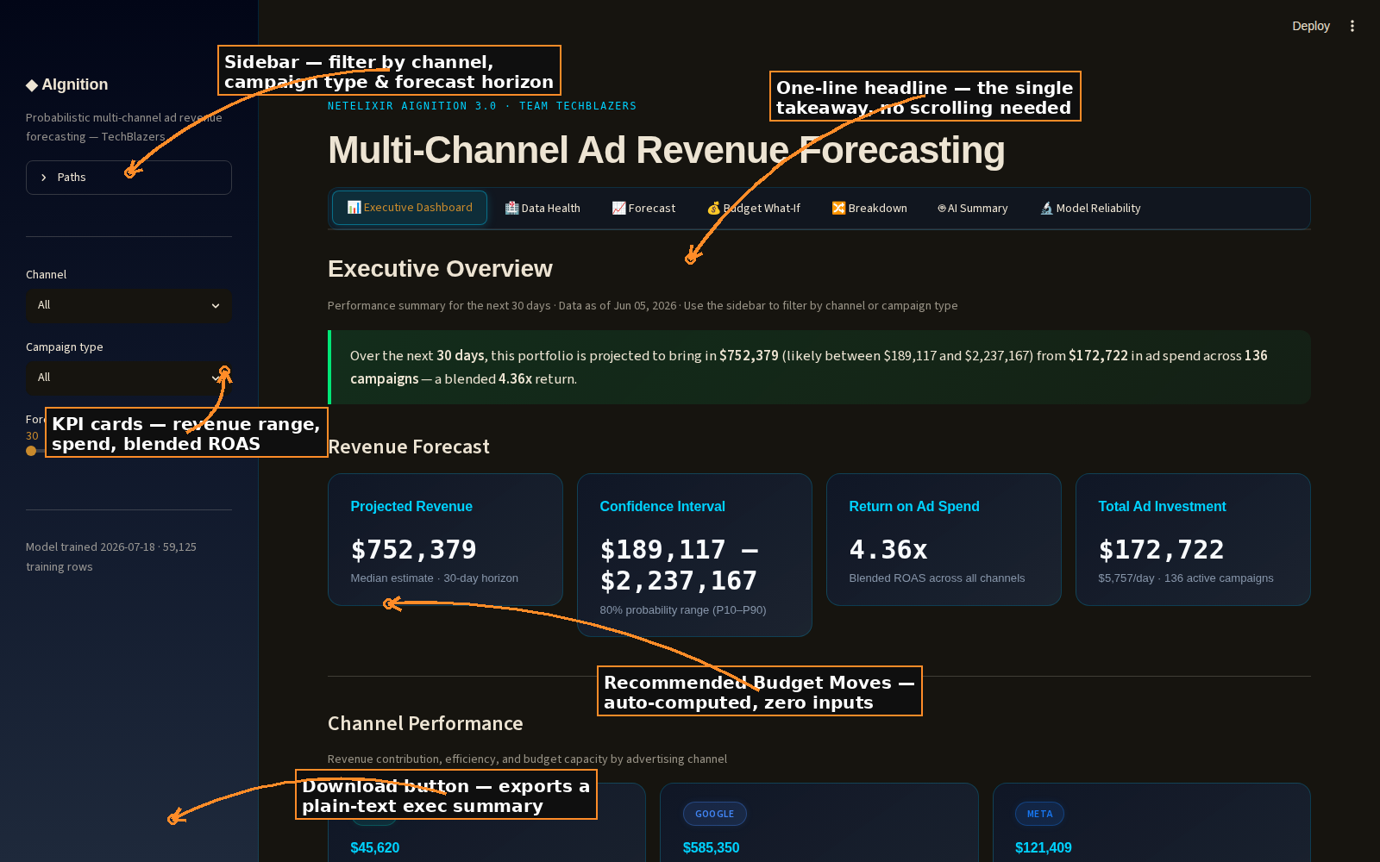
01
Executive Dashboard
WHAT IT SHOWS
The one screen a non-technical stakeholder needs: a plain-English headline, KPI cards, per-channel recommendations, auto-computed budget moves, and a downloadable summary.
WHY IT'S BUILT THIS WAY
Leads with a single sentence — projected revenue, range, spend, and ROAS — before any chart, so the takeaway never requires scrolling.
Recommended Budget Moves reuses the same Hill-curve allocator as Budget What-If, but needs zero inputs — it defaults to today's existing spend.
Every channel always gets a recommendation card, even a 'Stable — keep monitoring' one, so nothing silently drops off the page.
A 'Download summary (.txt)' button lets the reader forward or print the takeaway without screenshotting the dashboard.
AIGNITION 3.0 · TEAM TECHBLAZERS
Interface 1 of 7

Slide 4
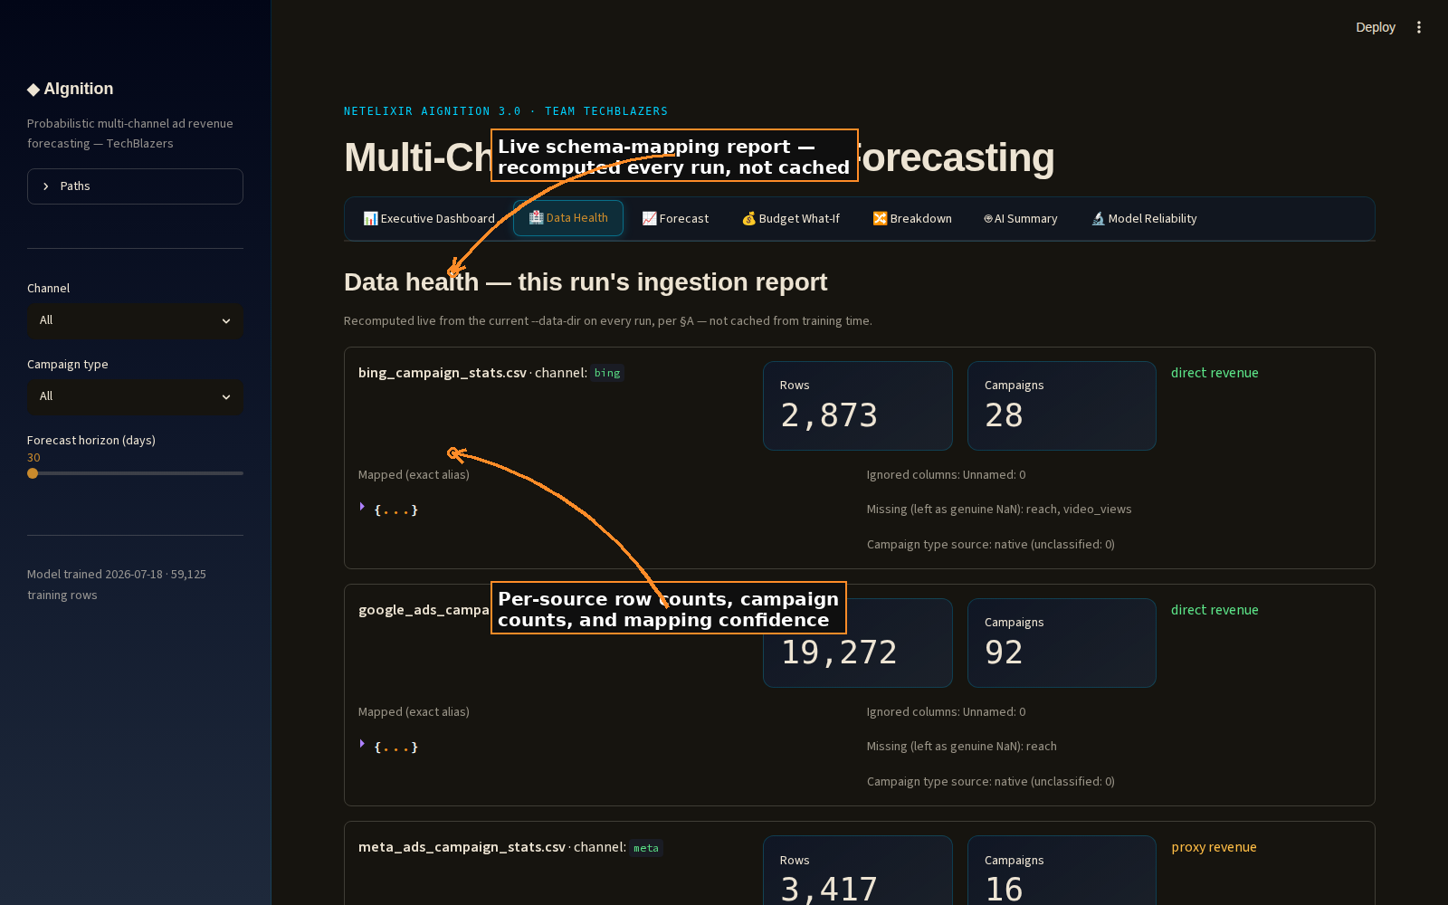
02
Data Health
WHAT IT SHOWS
A live, per-file ingestion report — recomputed on every run from whatever is in --data-dir, not cached from training time.
WHY IT'S BUILT THIS WAY
Shows exactly how each column in a raw export was mapped (exact vs. fuzzy match), what was ignored, and what was left as genuine missing data rather than fabricated.
Flags revenue confidence per channel — direct vs. proxy (conversion-value-derived) — so a viewer knows which numbers are measured vs. estimated.
Built to survive real-world messiness: mangled headers, extra columns, and missing fields don't break the pipeline, they get reported.
AIGNITION 3.0 · TEAM TECHBLAZERS
Interface 2 of 7

Slide 5
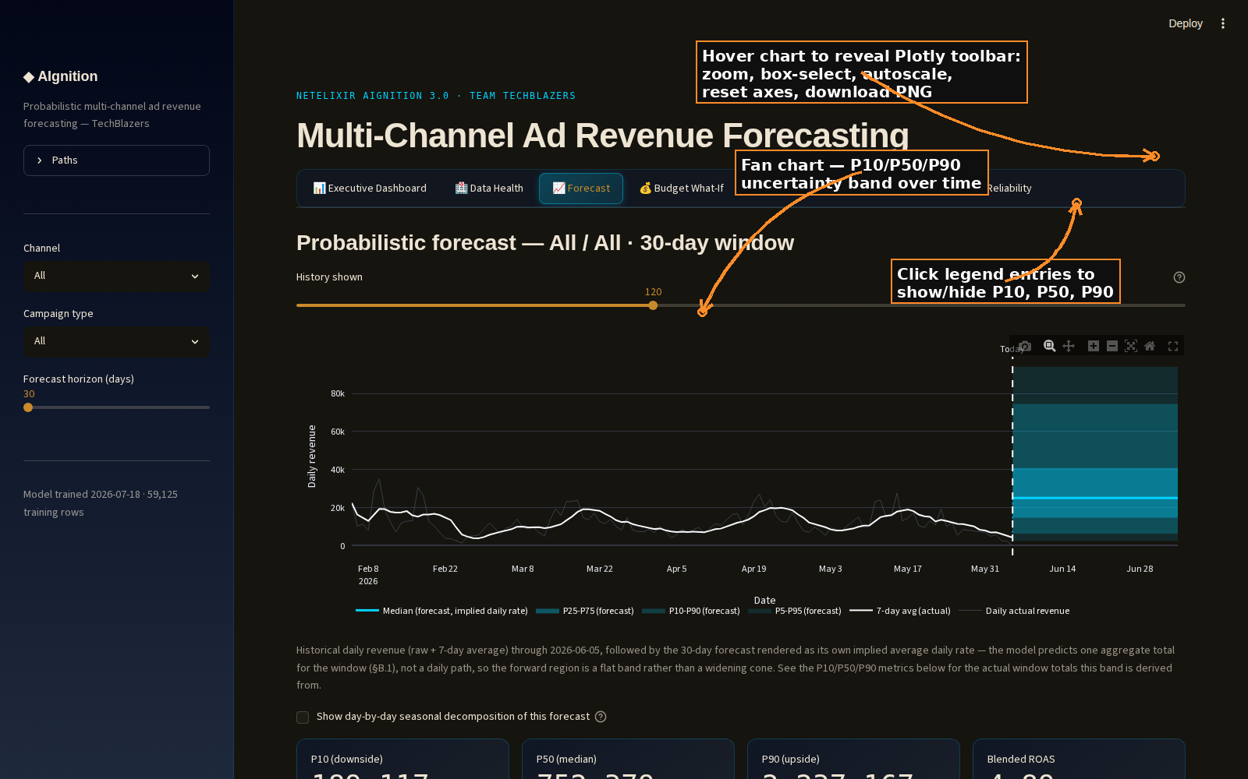
03
Forecast
WHAT IT SHOWS
The core probabilistic forecast: historical daily revenue plus a forward-looking P10–P90 fan chart for the selected horizon and scope.
WHY IT'S BUILT THIS WAY
The forecast is a range, not a point estimate — pretending to know the exact number would be dishonest for a real budget decision.
Hover any point on the chart for the exact percentile value; hover the chart itself to reveal Plotly's native toolbar — zoom, box-select, pan, autoscale, reset axes, and PNG export.
An optional day-by-day seasonal decomposition view breaks the flat forecast window into an implied daily shape, for teams that want a calendar-level view.
AIGNITION 3.0 · TEAM TECHBLAZERS
Interface 3 of 7

Slide 6
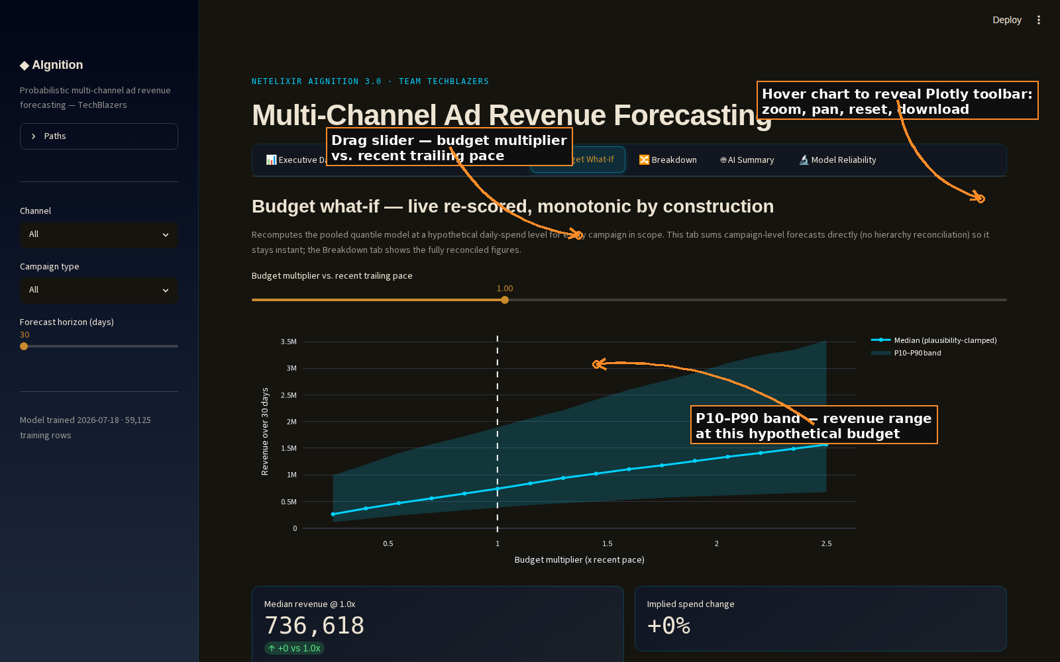
04
Budget What-If
WHAT IT SHOWS
A live, instantly-recomputed 'what if I spent 1.5x' slider — re-scores the model at any hypothetical daily-budget multiplier.
WHY IT'S BUILT THIS WAY
Monotonic by construction: dragging the slider up never produces a lower forecast than a lower multiplier — enforced numerically, not just visually.
Sums campaign-level forecasts directly (no hierarchy reconciliation) specifically to stay instant under a slider drag; the Breakdown tab has the fully reconciled version for final numbers.
The Hill-curve explorer below shows the fitted response curve per channel/campaign type, with the current operating point marked — this is what powers the Executive Dashboard's automatic recommendations.
AIGNITION 3.0 · TEAM TECHBLAZERS
Interface 4 of 7

Slide 7
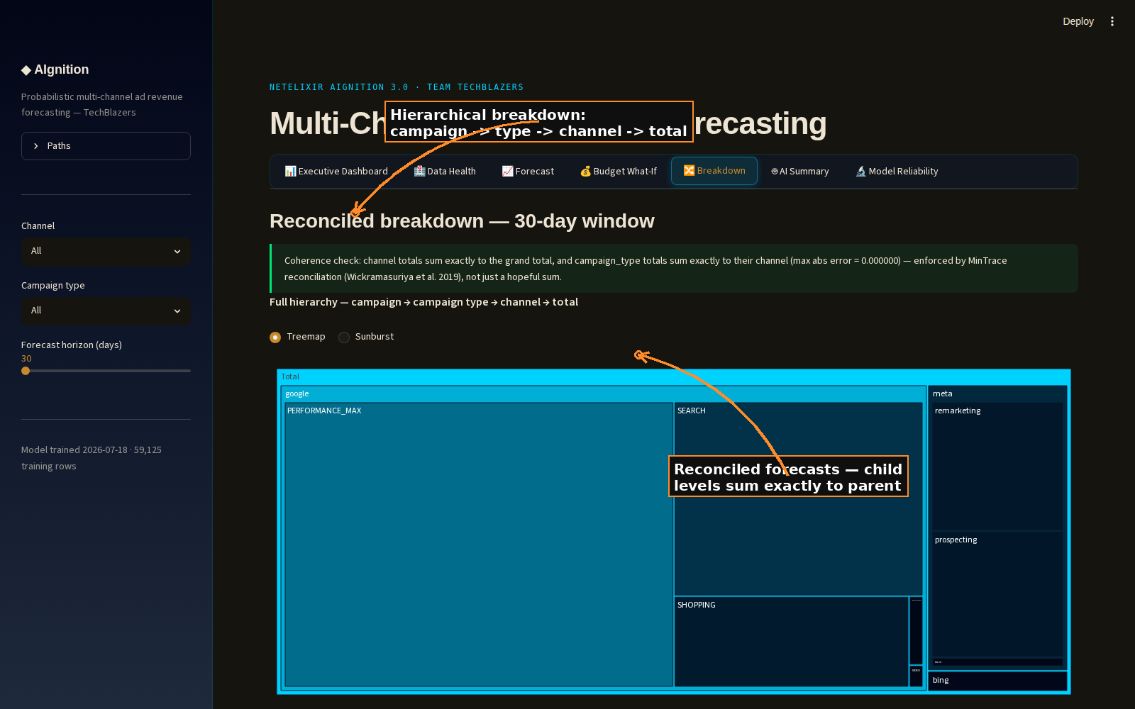
05
Breakdown
WHAT IT SHOWS
The fully reconciled hierarchy — campaign → campaign type → channel → total — as an interactive treemap/sunburst plus per-level bar charts with uncertainty bands.
WHY IT'S BUILT THIS WAY
Coherence is enforced, not hoped for: channel totals sum exactly to the grand total (MinTrace reconciliation, Wickramasuriya et al. 2019) — verified every run, max error printed on-screen.
Treemap/sunburst communicates proportions at a glance; the bar charts underneath add the P10–P90 band a treemap can't show.
Click any segment to drill in — starts collapsed at campaign-type level since 168 individual campaigns is too dense to show flat.
AIGNITION 3.0 · TEAM TECHBLAZERS
Interface 5 of 7

Slide 8
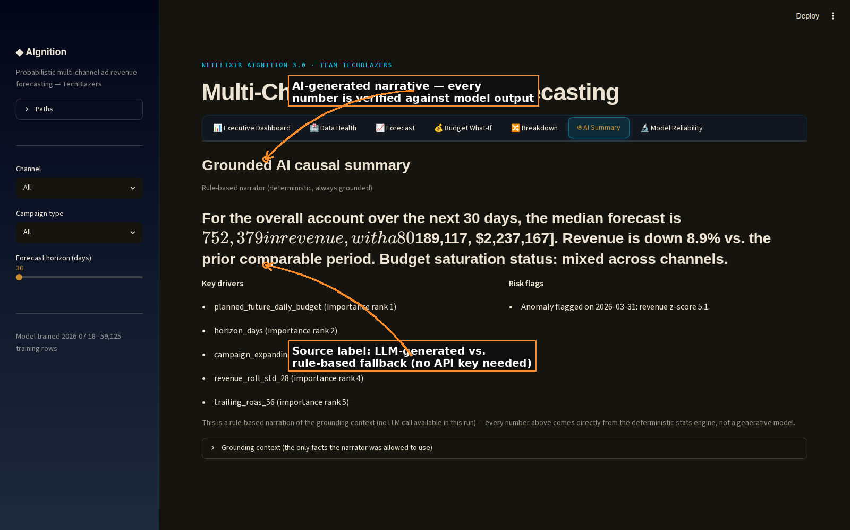
06
AI Summary
WHAT IT SHOWS
A narrative summary of the forecast, written either by an LLM or by a deterministic rule-based fallback — every number is checked against the model's own output before it's shown.
WHY IT'S BUILT THIS WAY
Grounded by construction: the narrator is only allowed to state facts from a pre-computed 'grounding context' — it cannot invent a number that isn't already verified.
Works with zero internet access or API key: falls back to a rule-based narrator using the same grounding data, so the demo never depends on a live LLM call succeeding.
Every card is labeled with its source (LLM-generated vs. rule-based) so a reader always knows which kind of summary they're reading.
AIGNITION 3.0 · TEAM TECHBLAZERS
Interface 6 of 7

Slide 9
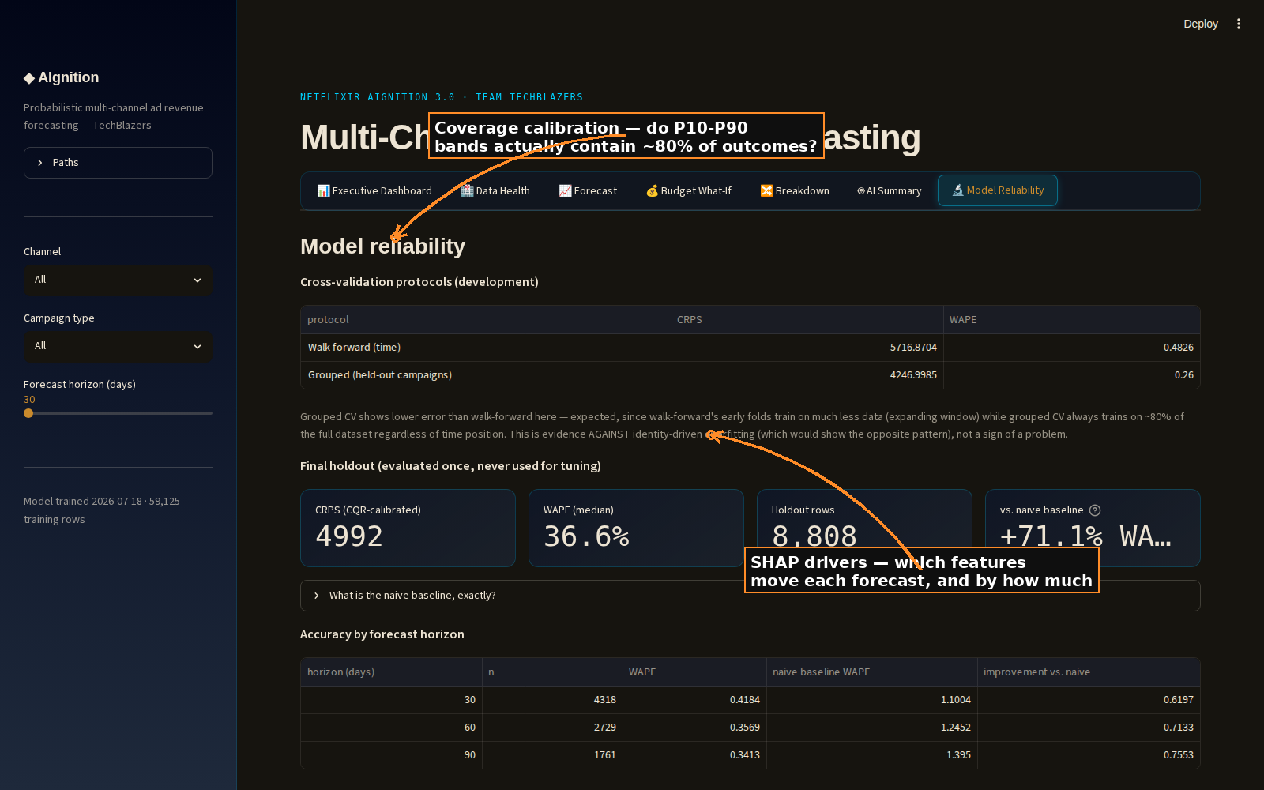
07
Model Reliability
WHAT IT SHOWS
The model's own report card: cross-validation protocols, holdout accuracy, naive-baseline comparison, and a calibration diagram checking whether the P10–P90 bands are honest.
WHY IT'S BUILT THIS WAY
Reliability diagram plots nominal vs. empirical coverage — if the 80% band doesn't actually contain ~80% of outcomes, this is where that would show up.
Compares against a naive baseline at every horizon, so 'the model works' is a relative, falsifiable claim, not an assertion.
A held-out test set, evaluated once and never used for tuning, keeps the headline accuracy numbers honest.
AIGNITION 3.0 · TEAM TECHBLAZERS
Interface 7 of 7

Slide 10
What Running the Pipeline Produces
Every file below is written fresh by ./run.sh <data_dir> <model_path> <output_csv> — nothing is pre-baked. Point --data-dir at a different CSV set (e.g. the judges' own test data) and every one of these regenerates from that data, with no code changes.
predictions.csv
The primary deliverable.
One row per campaign × forecast horizon: P05–P95 revenue quantiles, assumed spend, ROAS, plausibility flags, and saturation status. This is what the dashboard reads.
reconciled_hierarchy.csv
Hierarchy roll-up.
Campaign → campaign type → channel → total, reconciled with MinTrace so every level sums exactly to its parent — powers the Breakdown tab.
data_health.json
Per-file ingestion report.
Which columns were mapped (exact vs. fuzzy), what was ignored, row/campaign counts, and revenue confidence (direct vs. proxy) — per source file, recomputed every run.
hill_curves.json
Saturation curves.
One fitted Hill response curve per channel/campaign-type (spend → revenue), used by the budget allocator and the Budget What-If tab.
reliability.json
Model self-report card.
Cross-validation results, holdout accuracy, naive-baseline comparison, calibration data — powers the Model Reliability tab.
causal_summary.json
AI narrative output.
Grounded LLM (or rule-based fallback) summaries per scope, with the exact grounding facts the narrator was restricted to.
mpc_reallocation_backtest.json /
hindsight_regret_audit.json
Budget-strategy backtests.
How a rolling-horizon reallocation strategy would have performed vs. open-loop and vs. what actually happened.
features.parquet /
data_quality_report.txt
Intermediate artifacts.
Engineered features used for training/inference, and a plain-text data-quality log — useful for debugging a new data drop.
AIGNITION 3.0 · TEAM TECHBLAZERS
Pipeline Outputs

Slide 11
Built to Survive Scrutiny
Runs clean on a fresh git clone, fresh venv, zero manual fixes — verified end-to-end.
No internet dependency at inference time: LLM narration degrades gracefully to a grounded rule-based fallback.
Every headline number is traceable back to a specific, testable computation — 172+ passing tests.
Uncertainty is never hidden: every forecast ships as a range, every allocator decision cites the marginal ROAS behind it.
AIGNITION 3.0 · TEAM TECHBLAZERS
Thank you

