Slide 1
Demand Forecasting & Inventory Management
22nd Feb’24
- Siddhartha Paul
- Deepak Varier

Slide 2

CUSTOMER PAIN POINTS/GAPS FOR DIFFERENT BUSINESS TYPES/PERSONAS & SOLUTIONS ENVISAGED
WHY DID WE CHOOSE THE MODELS THAT WE CHOSE?
FLOW OF OUR PRESENTATION
AI/ML MODELLING
DATA INTRODUCTION
DEMO: Inputs to the model
DATA PREPARTION
MODEL EVALUATION & PREDICTION
INVENTORY REPLENISHMENT – REORDER POINT & SAFETY STOCK
DEMO: Output
BENEFITS – CUSTOMER & TBH

Slide 3
VOICE OF CUSTOMERS
Inventory is ordered using experience and intuition. Overstocking seems to be a common trait. Use time-based inventory replenishment methodology
Solutioning through:
Scientific demand forecasting
Finding optimal re-order point and safety stock
BOULTON TRADING
Trader, Mumbai
“I connect with our customers to know their orders outlook. Sometimes orders materials sufficient to fill up a 40ft container while during off season he uses a 20 ft container. I stock up materials1.5 months in advance”
SRIBAL
EPC components supplier, Bengaluru
“Sometimes I have many orders and some months it can be 0 as well. I can’t give any number”
DS ENTERPRISES
Automobile spare parts manufacturing, Gurugram
“Humko pata hai hamare customers kaun hai. Andaaza hai ki kitne orders aayenge agle mahine. Naye customers tou hum hi dhundte hai wo bhi hisaab laga lete hai kab order dega.
PAIN POINTS/GAPS
METHOD COMPARISON & DATA
DATA PREPARTION
MODEL EVALUATION & PREDICTION
INVENTORY REPLENISHMENT
BENEFITS TO EBs and TBH

Slide 4
REPLENISHMENT OF INVENTORY
TIME BASED
INVENTORY BASED
INVENTORY BASED REPLENISHMENT is better because
Better Adaptation to Demand Variability
Reduced Risk of Stockouts
Optimized Inventory Holding Costs
Improved Supply Chain Responsiveness
Customer Service Improvements
with limitations of
Requires accurate demand forecast
Requires regular monitoring of inventory
Addressed through our forecasting model
Classify inventory and keep count in their system which they currently do
PAIN POINTS/GAPS
METHOD COMPARISON & DATA
DATA PREPARTION
MODEL EVALUATION & PREDICTION
INVENTORY REPLENISHMENT
BENEFITS TO EBs and TBH

Slide 5
DEMAND FORECASTING
Can handle non-linear and complex relationships and non-stationarity of data
Can handle trend and seasonality with feature engineering
Handles both sequential and features
RANDOM FOREST
AI/ML MODELS
SELECTED
RECURENT NEURAL NETWORK
SARIMAX
Assumes data is stationary
Assumes linear relationship b/w variables
TIME SERIES
ARIMA/HOLT WINTER
Doesn’t account for external variables
DEMAND FORECASTING TECHNIQUES
REGRESSION
Only considers external variable and not trend and seasonality of data itself
CAUSAL & SCENARIO
SCENARIO ANALYSIS
Only considers strategic scenarios and not trend and seasonality of data itself
DELPHI
Done when data is not available
QUALITATIVE
MARKET RESEARCH
PAIN POINTS/GAPS
METHOD COMPARISON & DATA
DATA PREPARTION
MODEL EVALUATION & PREDICTION
INVENTORY REPLENISHMENT
BENEFITS TO EBs and TBH

Slide 6
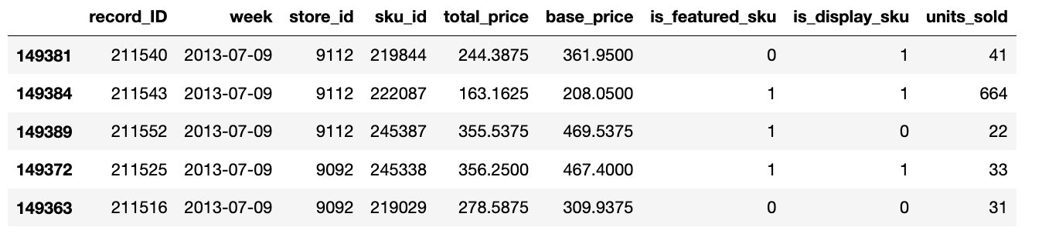
DATASET STRUCTURE
Input Variables
External/Exogenous Variables
Target Variable
Week
SKU ID
Store ID
Total Price
Base Price
Is featured SKU
Is display SKU
Units Sold
*Any external variable GDP, population can be added like mentioned in the use-case and the model will still work*
Data Source: Kaggle
PAIN POINTS/GAPS
METHOD COMPARISON & DATA
DATA PREPARTION
MODEL EVALUATION & PREDICTION
INVENTORY REPLENISHMENT
BENEFITS TO EBs and TBH

Slide 7
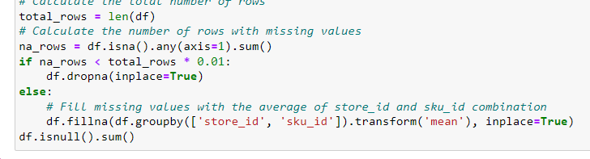
DATA PREPARATION
DATA CLEANING
DATA UNDERSTANDING
DATA PROCESSING
If missing values > 1% then removed the rows else replaced with mean
1
2
TRANSFORMED DATA TYPE
TREATED MISSING VALUES
3
4
REMOVED DUPLICATE ENTRIES
TREATED INCONSISTENT VALUES
5
SORTED DATA BASED ON DATE
PAIN POINTS/GAPS
METHOD COMPARISON & DATA
DATA PREPARTION
MODEL EVALUATION & PREDICTION
INVENTORY REPLENISHMENT
BENEFITS TO EBs and TBH

Slide 8
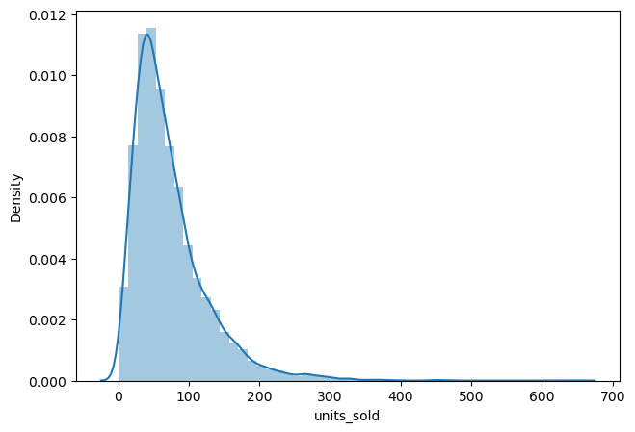
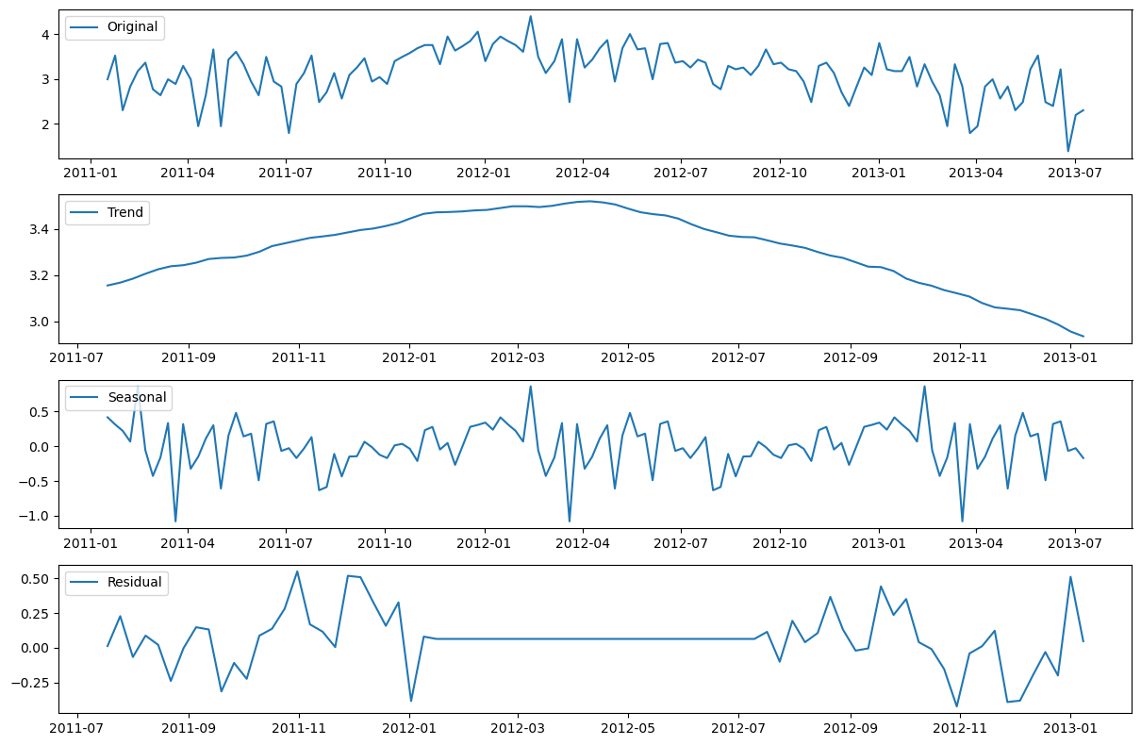
DATA PREPARATION
DATA CLEANING
DATA UNDERSTANDING
DATA PROCESSING
1
2
3
DATA SELECTION
Based on sku and store input
sku_id = 216419
store_id = 8091
2
UNDERSTANDING DISTRIBUTION
3
UNDERSTANDING COMPONENTS and DATA STATIONARITY USING DFT
SKEWNESS: 1.7979
Observation: Data is highly skewed towards right
Observation: Data has both trend and seasonality
PAIN POINTS/GAPS
METHOD COMPARISON & DATA
DATA PREPARTION
MODEL EVALUATION & PREDICTION
INVENTORY REPLENISHMENT
BENEFITS TO EBs and TBH

Slide 9
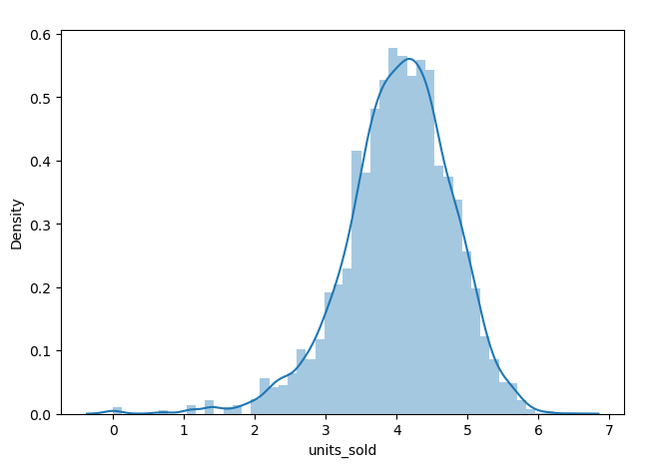
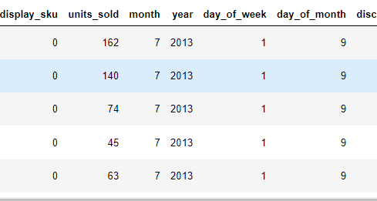
DATA PREPARATION
DATA CLEANING
DATA UNDERSTANDING
DATA PROCESSING
1
LOG TRANSFORMATION
Normalization for better predictions by treating skewness
1
3
2
REMOVED OUTLIERS
μ +/- 3σ
3
INTRODUCED FEATURES
Accounting for seasonality in data and discount as another variable
4
DIVIDED INTO TRAIN & TEST
80% - train (4680 weeks*);
20% - test (1170 weeks*)
SKEWNESS: -0.4571
*For the selected sku and store
Transformation: Normalized the curve
Features introduced: month, year, day_of_week, day_of_month, discounts
PAIN POINTS/GAPS
METHOD COMPARISON & DATA
DATA PREPARTION
MODEL EVALUATION & PREDICTION
INVENTORY REPLENISHMENT
BENEFITS TO EBs and TBH

Slide 10
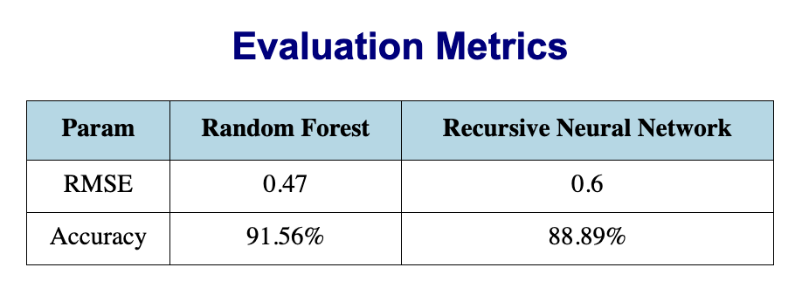
MODELLING & PREDICTIONS
SELECTION OF MODEL
PREDICTION
Evaluated the models using RMSE (root mean squared error) and MAPE (Mean absolute percentage error) and selected the model with lower RMSE
RMSE: Avg. magnitude of errors
Sensitive to large errors, therefore, useful for identifying outliers in the forecast.
Interpretation: A lower RMSE indicates that the model's predictions are closer to the actual values
Accuracy = 1 – MAPE: Percentage error
Indicates accuracy in terms of %
Asymmetry in Handling overestimation and underestimation
Insensitive to error magnitude
Interpretation: A higher Accuracy indicates that the model's predictions are closer to the actual values
SELECTED*
*For the selected sku and store
PAIN POINTS/GAPS
METHOD COMPARISON & DATA
DATA PREPARTION
MODEL EVALUATION & PREDICTION
INVENTORY REPLENISHMENT
BENEFITS TO EBs and TBH

Slide 11
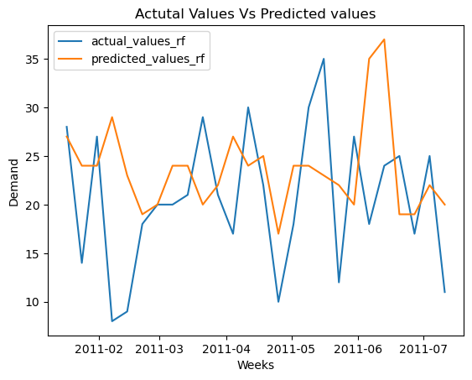
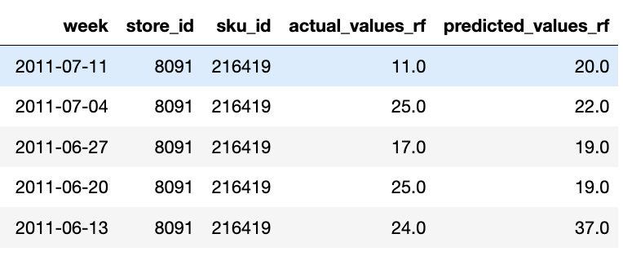
MODELLING & PREDICTIONS
SELECTION OF MODEL
PREDICTION
6 most important features important to predicting demand for the sku and store:
Selected Features: Index(['store_id', 'total_price', 'base_price', 'is_display_sku', 'month', 'day_of_month']
for the chosen sku and store
PAIN POINTS/GAPS
METHOD COMPARISON & DATA
DATA PREPARTION
MODEL EVALUATION & PREDICTION
INVENTORY REPLENISHMENT
BENEFITS TO EBs and TBH

Slide 12
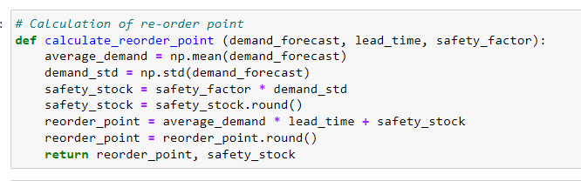
FINDING RE-ORDER POINT
Based on demand forecast
Demand curve
Inventory
Re-order point
Reorder point is the inventory level at which a new order should be placed to replenish stock before it runs out.
51 for the chosen sku and store
Safety stock
Lead Time
Safety stock acts as a buffer against variability in demand and lead time.
Assumed 2 weeks from PO to delivery of materials
4 for the chosen sku and store
Time
Sku_id - 216419
Reorder Point: 182.0
Safety Stock: 48.0
PAIN POINTS/GAPS
DATA & METHOD COMPARISON
DATA PREPARTION
MODEL EVALUATION & PREDICTION
INVENTORY REPLENISHMENT
BENEFITS TO EBs and TBH

Slide 13




BENEFITS TO CUSTOMER
Reduce stock outs
Setting optimal reorder point and maintaining safety stock ensures that businesses maintain adequate inventory levels
Identify Demand Patterns & Dependence on External Factors
Improved cash flow
Reduce inventory holding cost
Maintain optimal inventory levels based on actual demand; better inventory turnover
Reduce costs associated with storage, maintenance, and obsolescence
Better adaptation to demand variability therefore improved production planning.
01
02
03
04
PAIN POINTS/GAPS
METHOD COMPARISON & DATA
DATA PREPARTION
MODEL EVALUATION & PREDICTION
INVENTORY REPLENISHMENT
BENEFITS TO EBs and TBH

Slide 14
BENEFITS TO TBH
Value added service
Break clutter in the market by providing FORECASTING AND INVENTORY OPTIMISING SOLUTION as an additional benefit as compared to competitors
Acquisition
Data insights
By analysing trends and patterns in customer demand, TBH can get insights to the capacity, capability of the customer and provide personalised solutions to customer cohorts
BENEFITS ACROSS THE FUNNEL
Retention
Increased Revenue
PERSONALISED marketing communication to the RIGHT CUSTOMER at the RIGHT TIME or even develop AUTO-ORDERING SYSTEM based on re-order point
Monetisation
PAIN POINTS/GAPS
METHOD COMPARISON & DATA
DATA PREPARTION
MODEL EVALUATION & PREDICTION
INVENTORY REPLENISHMENT
BENEFITS TO EBs and TBH

Slide 15
Thank You!

Slide 16
Deepak
Write all texts
EXECUTIVE SUMMARY
“Forecast”
Customer Needs
XYZ
XYZ
XYZ
Understand and diagnose
Understand and diagnose
Understand and diagnose
Understand and diagnose
1
XYZ
1
XYZ
1
XYZ
1
XYZ
Our Methodology
Formulate recommendations to mitigate risks
Formulate recommendations to mitigate risks
Formulate recommendations to mitigate risks
Formulate recommendations to mitigate risks
Outcome

Slide 17



BENEFITS TO TBH
02
03
01
Value added service
Break clutter in the market by providing FORECASTING AND INVENTORY OPTIMISING SOLUTION as an additional benefit as compared to competitors
Data insights
Increased Revenue
By analysing trends and patterns in customer demand, TBH can get insights to the capacity of the customer
Subscription revenue
PERSONALISED
marketing communication to the
RIGHT CUSTOMER
at the
RIGHT TIME
or even develop
AUTO-ORDERING SYSTEM based on re-order point
PAIN POINTS
DATA & METHOD COMPARISON
DATA PREPARTION
MODEL EVALUATION & PREDICTION
INVENTORY REPLENISHMENT
BENEFITS TO EBs and TBH

Slide 18
BENEFITS TO TBH
02
03
01
Value added service
Break clutter in the market by providing FORECASTING AND INVENTORY OPTIMISING SOLUTION as an additional benefit as compared to competitors
Data insights
Increased Revenue
By analysing trends and patterns in customer demand, TBH can get insights to the capacity of the customer
Subscription revenue
PERSONALISED
marketing communication to the
RIGHT CUSTOMER
at the
RIGHT TIME
or even develop
AUTO-ORDERING SYSTEM based on re-order point
PAIN POINTS
DATA & METHOD COMPARISON
DATA PREPARTION
MODEL EVALUATION & PREDICTION
INVENTORY REPLENISHMENT
BENEFITS TO EBs and TBH

