Slide 1
Templates

Slide 2
Cassette(alternative) exon
Constitutive exon
Constitutive exon
intron
DNA
Exon 1
Exon 2
Exon 3
Transcription
(i)
5’
3’
Pre-RNA
Exon 1
Exon 2
Exon 3
Splicing
(ii)
Inclusion
Skipping
Intron
retention
Exon 1
Exon 3
ret
Incl
Skip
Exon 1
Exon 2
Exon 3
Exon 1
Exon 2
Exon 3
Degradation

Slide 3
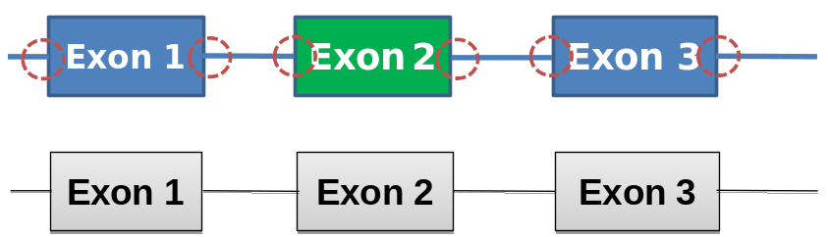
Exon 1
Exon 2
Exon 3
Exon 1
Exon 2
Exon 3

Slide 4
Species represent time progression
State
name
5’ SS
3’ SS
P0
P1
ki
P2
Incl
P3
kelong
P4
Transcription Elongation
P5
P6
Skip
P7
ks
P8

Slide 5
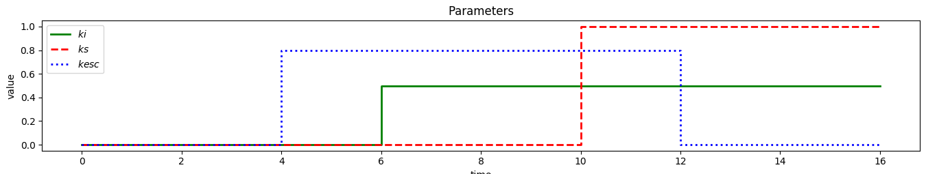
Alternative topology definition
l : whole chain length
k : first steps where inclusion is not possible
m1 : first steps where inhibition is not possible
m2 : steps where inhibition is possible
n : last steps where inclusion and skipping are possible
l
k
kelong
ki
p1
p2
p3
p4
p5
p6
p7
p8
Incl
kesc
ks
e3
kelong
e4
e5
e6
e7
e8
Skip
ks
m1
m2
n

Slide 6
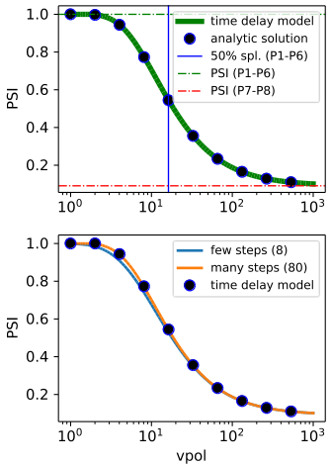
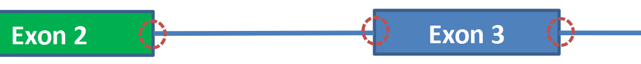
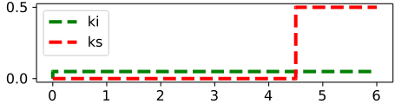
Figure 1 C
Modeling approaches
Elongation transcript
Exon 2
transcribed
Exon 3
transcribed
Commitment to inclusion only
Time delay
model
mRNA
ki
Incl
ks
Skip
time
ki
Multi- step model
P1
P2
P3
P4
P5
P6
P7
P8
Incl
kelong
ks
Skip
Exon 2
Exon 3

Slide 7
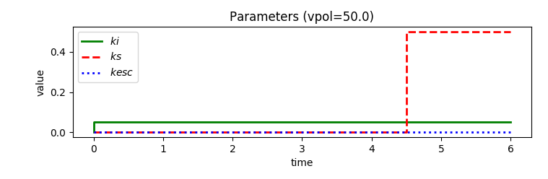
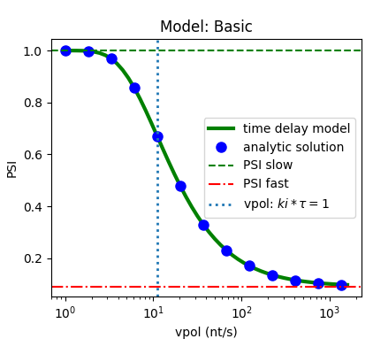

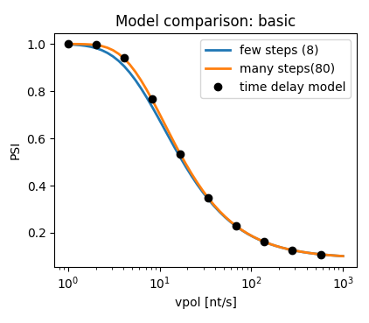
Figure 1 C
Modeling approaches
mRNA
ki
Incl
Time delay
model
ks
Skip
time
ki
Step model
p1
p2
p3
p4
p5
p6
p7
p8
Incl
kelong
ks
l₁
Skip
l
tr_{len}: simulated transcription length in nt (nucleotides)
l: whole chain length
Exon 2
Exon 3

Slide 8
Figure 1D
Commitment to skipping
Possible fluxes
Transcript elongation
Transcript elongation
Commitment
to skipping
Commitment to inclusion
Elongation of committed transcript
Commitment
to inclusion
Elongation of committed transcript
Slow elongation
Slow elongation
Main flux
Inclusion
Inclusion
Main flux
Fast elongation
Fast elongation
Main flux
Elongation
Skipping
Elongation
Skipping
Main flux
Inclusion
Inclusion

Slide 9
Figure 2B
ki
P1
P2
P3
P4
P5
P6
P7
P8
Incl
Step model
k_{elong}
ks
k_{esc}
k_{elong}
E3
E4
E5
E6
E7
E8
Skip
ks
k
m
l
n
Time delay model
ki
ks
0
k_{esc}
τ_{inh,1}
τ_{inh,2}
τ
time
ki
Incl
mRNA
k_{esc}
ks
mRNA_{inh}
Skip

Slide 11
Figure 2D
Modulation by late inhibition
Inhibited state (mRNA_{inh})
Inhibited state (mRNA_{inh})
Commitment to
skipping by inhibitor
Commitment to skipping
Transcript elongation
Transcript
elongation
Commitment to inclusion
Elongation of committed transcript
Elongation of committed transcript
Slow elongation
Skipping
Main flux
Medium elongation
Inclusion
Fast elongation
Main flux
Inclusion

Slide 12
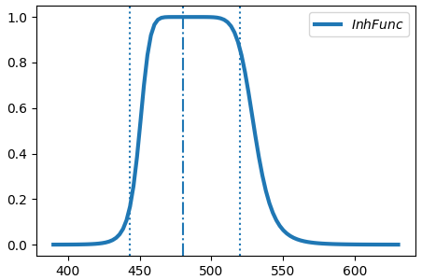
Figure 3C
Exon 2
Exon 3
5’SS
3’SS
5’SS

Slide 13
Figure 3A
Exon Definition and Inhibition Scheme
Defined Exons
+ RBP
Undefined Exons
P000
rbp_br
P000_inh
RBP Binding
k1
k3
k1_inh
k3_inh
k2
k2_inh
P100
P010
P001
rbp_br
P001_inh
k2
k3
k1
k1
k3
k2
P110
Exon def. only after 5’ SS possible
k3
k2
k1
rbp_br
Ex1
Ex2
Ex3
k_spl
P111
k_spl
P111_inh
Incl
Skip
Default reaction rates
Modulated reaction rates
Depending on RBP position (see B,C)

Slide 14
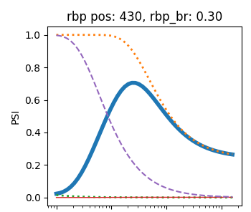
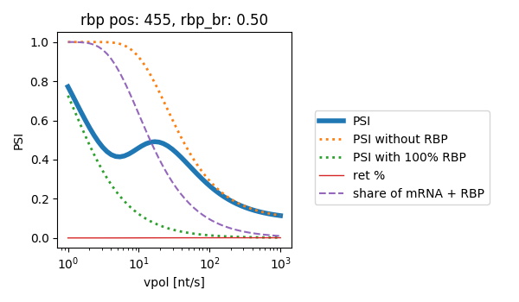
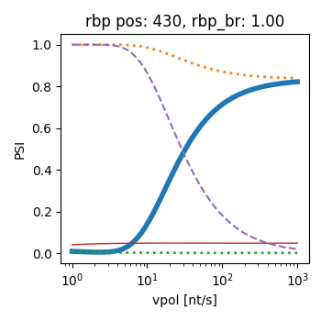
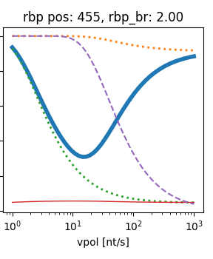
Figure 3D
Ex2
Ex3
Ex2
Ex3
k2 < k3
k2 > k3

Slide 15
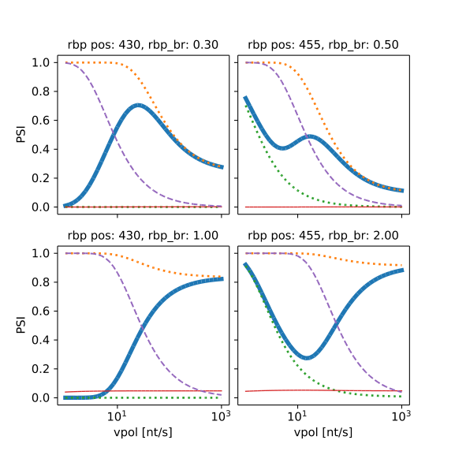
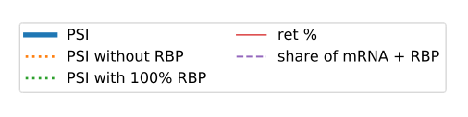
Figure 3D
Ex2
Ex3
Ex2
Ex3
k2 < k3
k2 > k3

Slide 16
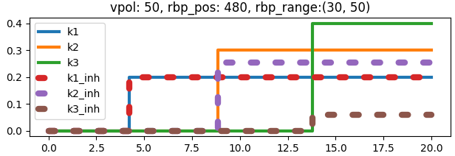
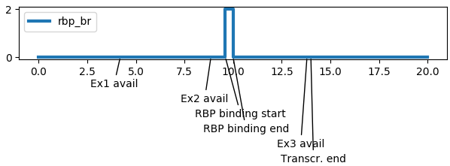
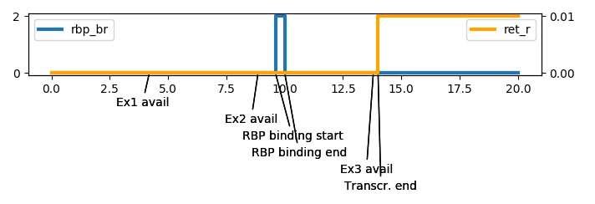
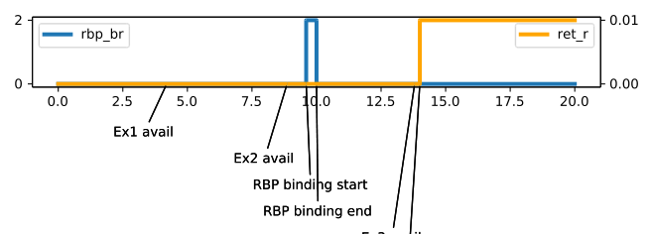
Figure 3B
k1 = 0.2
k2 = 0.3
k3 = 0.4
Ex1
Ex2
Ex3
Window of opportunity for RBP Binding

Slide 17
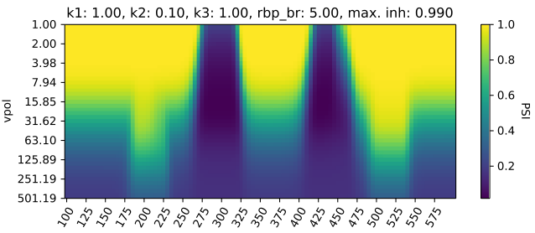
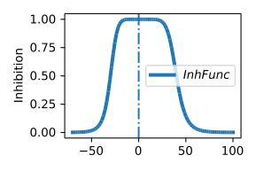
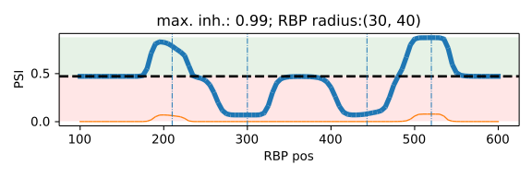
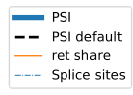
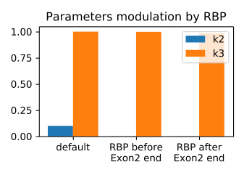
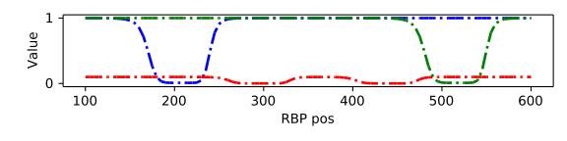
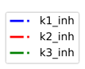
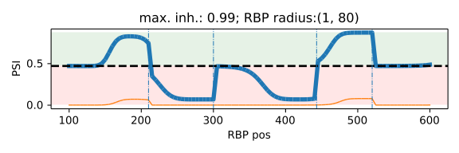
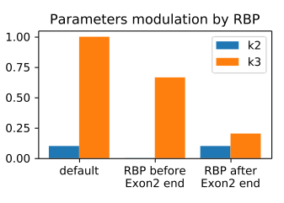
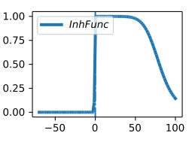
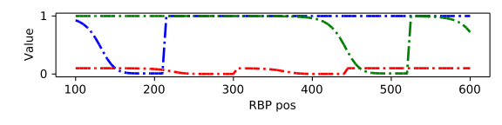
Figure 4

Slide 18
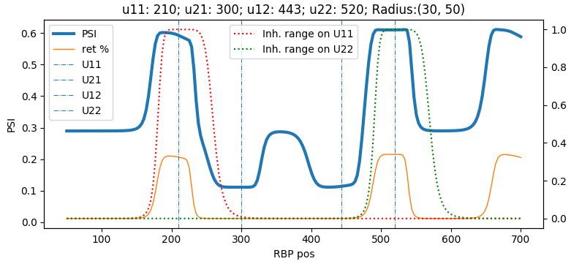
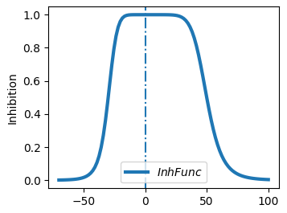
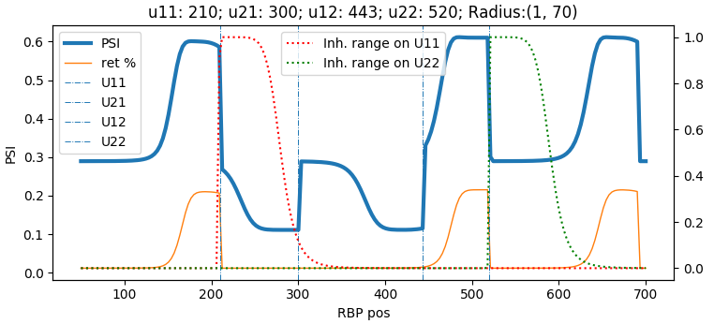
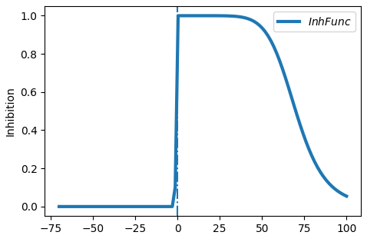
Figure 4B
Inhibition range
Ex1
Ex2
Ex3

Slide 19
Figure 4

